Slide 1

The WV Ethics Commission
2026 Ethics Act and
Open Meetings Act Training
Presented by
Kimberly Weber
Executive Director

Slide 2
WV Ethics Commission
School Board eligibility
W. Va. Code § 61-10-15 (County officials and employees)
ALJ Code of Conduct
Lobbyists Registration
Financial Disclosure Statements/other Disclosures
`

Slide 3

School Board Eligibility
BOE member may not hold (or run for) any other “public office,” unless other office is uncompensated and unrelated to public schools. W. Va. Code § 18-5-1a(a)(3).

Slide 4

Topics of Ethics Act
Office for Private Gain
Solicitation and Gifts
Name/Likeness (“Trinkets”)
Prohibited Public Contracts
Voting
Conflicts of Interest
Employment Restrictions
Disclosure statements

Slide 5
Use of Public Office for
Private Gain
W. Va. Code § 6B-2-5(b)
May not use public resources, including time, supplies, premises, subordinate staff, or prestige, for someone’s unlawful personal benefit.
Must be more than a de minimis use or gain for personal purposes.
Notes:
Motorcycle on pcard
Law enforcement vehicle
Free golf; county employee had access to a rec center

Slide 6
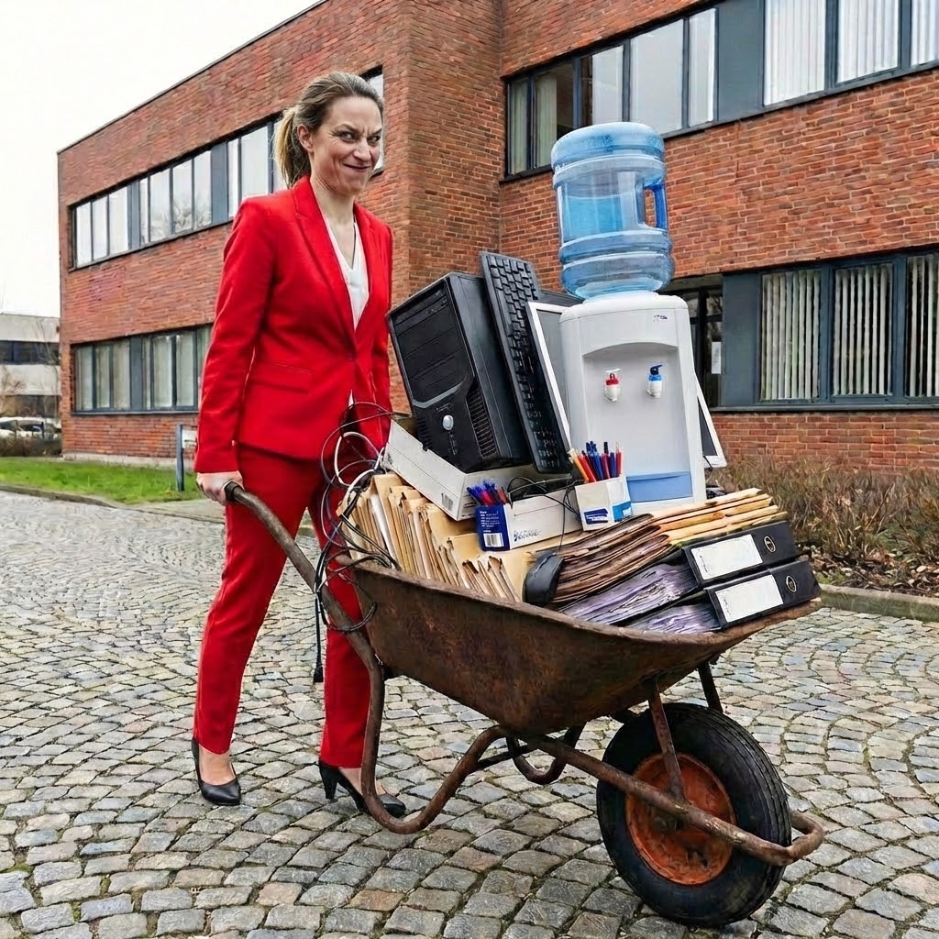
Use of Public Office for
Private Gain
W. Va. Code § 6B-2-5(b)
Notes:
Motorcycle on pcard
Law enforcement vehicle
Free golf; county employee had access to a rec center

Slide 7

De minimis?
W. Va. Code § 6B-2-5(b)
Notes:
A Public official may not use public funds to purchase funeral flowers or other expressions of sympathy,

Slide 8
Bonus Points
Private Gain
Business travel-related bonus or reward points
Airplane, hotel, gas
Non-travel related reward points
Merchandise from online catalog

Slide 9

Events Coordinator
Advisory Opinion 2025-10 - A State employee may not personally use Marriott bonus points that accumulated from her arranging hotel accommodations for the agency’s officials and employees other than herself.

Slide 10
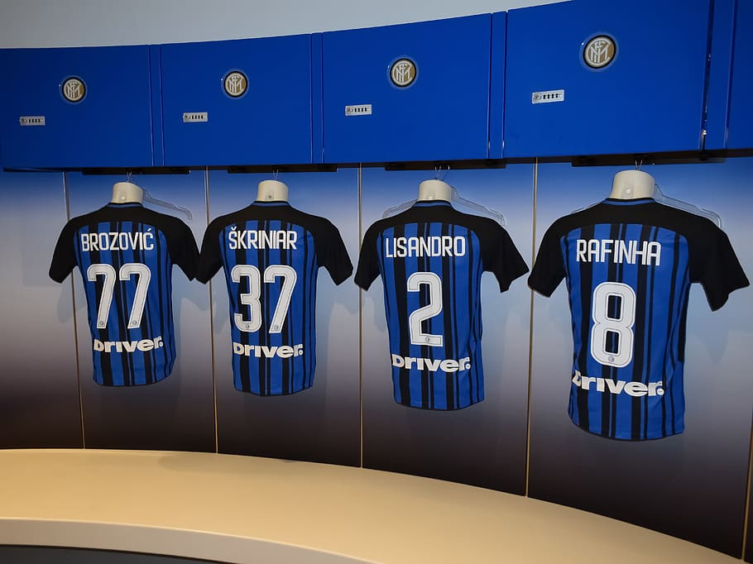
Real Life Examples
P card misuse
CIC 2017-05
An administrator at a College or University was a P card holder in the football program. He used bonus points from purchases of sportswear he made for the team to buy $540 for personal apparel for himself and his family.
He received a public reprimand,
and $1,000 fine, and restitution.

Slide 11
Real Life Examples
Private Gain
Settlements a/k/a
Conciliation Agreements
• A Mayor had town employees fix water leaks at his house. Used city asphalt for own driveway.
• A State agency director stored his personal furniture in the state’s office building.
• Public Service District employees sold PSD equipment on eBay and kept the money.

Slide 12
Recent Conciliation Agreements
Sheriff kept $4,000 from sale of photo of handsome staff to a calendar company. Fraudulent schemes criminal plea
Mayor paid his electric bill with city money, hired his father, took some petty cash from city bingo
BOE member wrote text to superintendent, “Do me a favor and get my son back home. Keep this to yourself…”

Slide 13

Real Life Examples

Slide 14

Use of Public Office for
Private Gain
Prestige of Public Office
Circuit Clerk tried to convince arresting police officer not to take him to jail.
Statements like, “You know I am the Circuit Clerk.”
Threats to retaliate against the arresting officer.
Agreed to settlement

Slide 15

Use of Public Office for
Private Gain
Agency may not allow its employees to use (more than de minimis amount of) their agency-provided cell phone as their personal cell phone unless the employees pay a reasonable fee to the agency. Even if unlimited plan.
No commercial or political campaign use.
Notes:
2021-15
A Mayor who was a candidate for the House of Delegates used a city-owned cell phone and service plan for his election campaign.

Slide 16
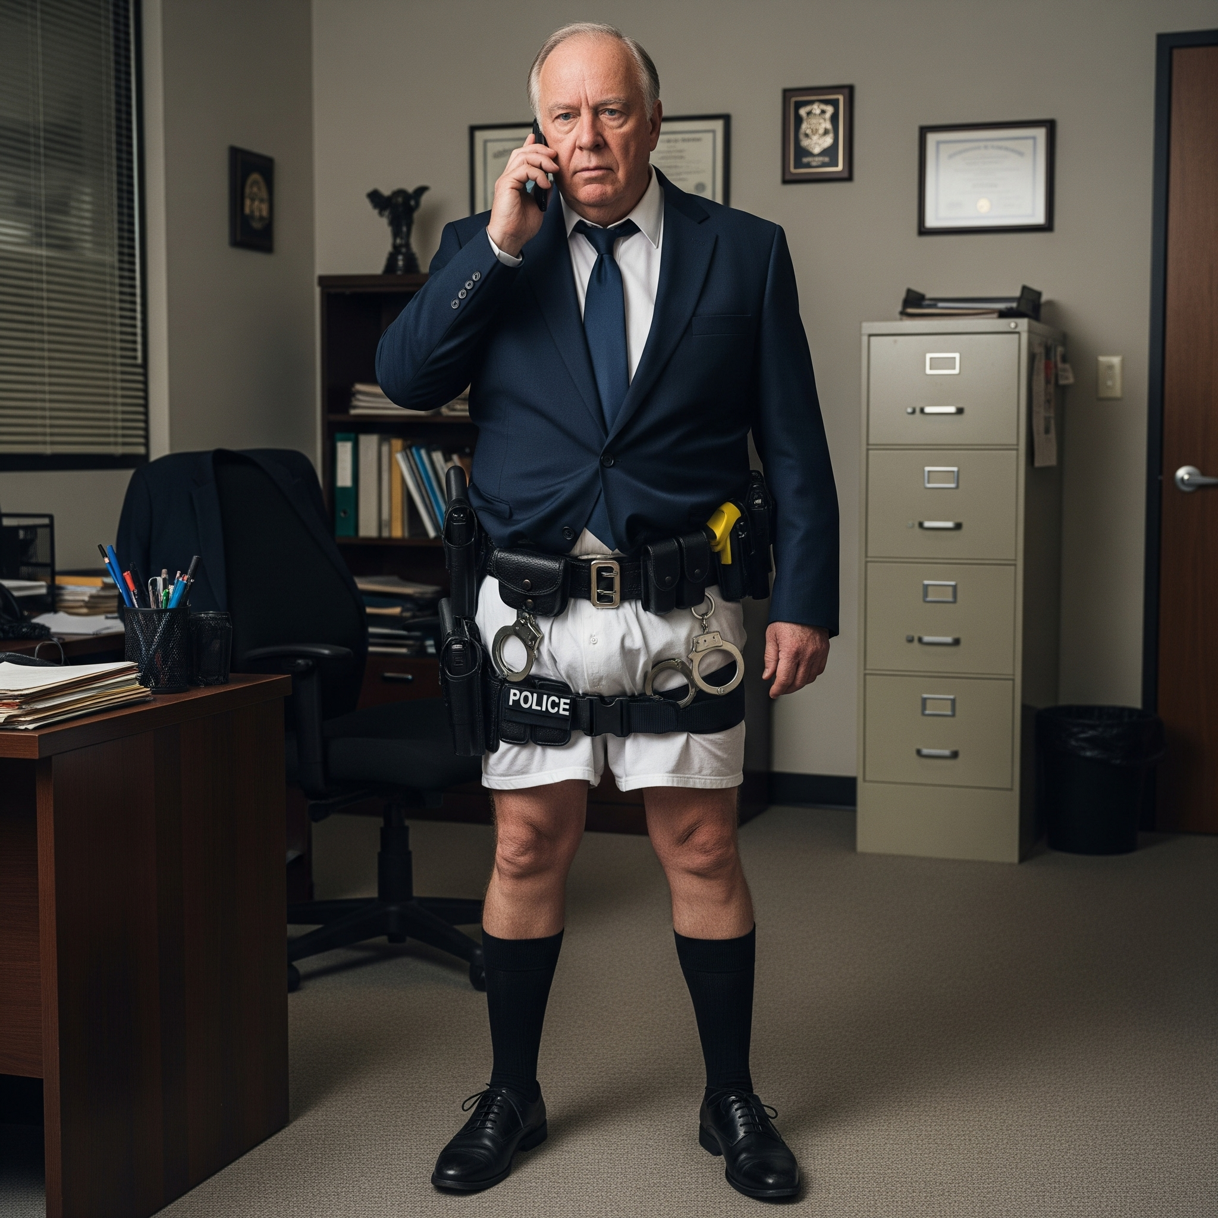
Use of Public Office for
Private Gain
Police officer used city-owned
phone as the contact number
for his private business,
and for coaching activities,
and sent inappropriate
pictures of himself
“displaying parts of his
anatomy …
partially undressed.”
Notes:
2021-15
A Mayor who was a candidate for the House of Delegates used a city-owned cell phone and service plan for his election campaign.

Slide 17

Use of Public Office for
Private Gain
Unauthorized Spending
The Ethics Commission has limited involvement in determining whether a proposed expenditure is okay.
    W. Va. Code
    Legislative Rules
    Attorney General Opinions
    Auditor Opinion Letters
    Agency’s attorney

Slide 18

Use of Public Office for
Private Gain
Spending Public Funds
2025-03 County Clerk may approve the use of county funds for an elected county official to attend the annual West Virginia Leadership program . . .
IF
there is express or implied authority to do so or if there is an overriding public benefit that justifies the County paying these expenses.

Slide 19

Use of Public Office for
Private Gain
If an elected public county official claims that his or her participation in a program provides an overriding public benefit and the request is not illegal on its face, then the county clerk may approve the payment.
2025-03

Slide 20
Private Gain
Political Activities
Political endorsements are okay. Ex. A sheriff may use his or her title to endorse his or her chief deputy. (AO 2012-15)
Law enforcement uniforms - current officers may not wear or use in campaign material. (AO 2019-14)
Public employees running for office - Ethics Act does not normally restrict. Do not use public resources. Ex. state employee may be a mayor. (AO 2019-21)

Slide 21

Use of Public Office for
Private Gain
The Ethics Act does not prohibit the City from providing free garbage services to its employees in lieu of a raise.
The Requester should adopt
appropriate ordinance.
Consult its legal counsel regarding any tax or other implications and the State Auditor’s Office re employee bonuses. 2025-06

Slide 22

Monetized Social Media
2026-01
A Mayor may post city-related content on his personal website if the content is readily available to the public.
He is permitted to post city-related material not readily available to the public on his personal social media page, provided the following conditions are met:
(1) City Permission: The city must grant general permission for the use of non-public city-related material.
(2) Financial Contribution: A reasonable amount of the net proceeds attributable to the city-related material not readily available to the public must be donated to either a charitable organization or the City.
(3) No Campaigning: The social media page may not simultaneously contain content related to campaigning for public office.​

Slide 23
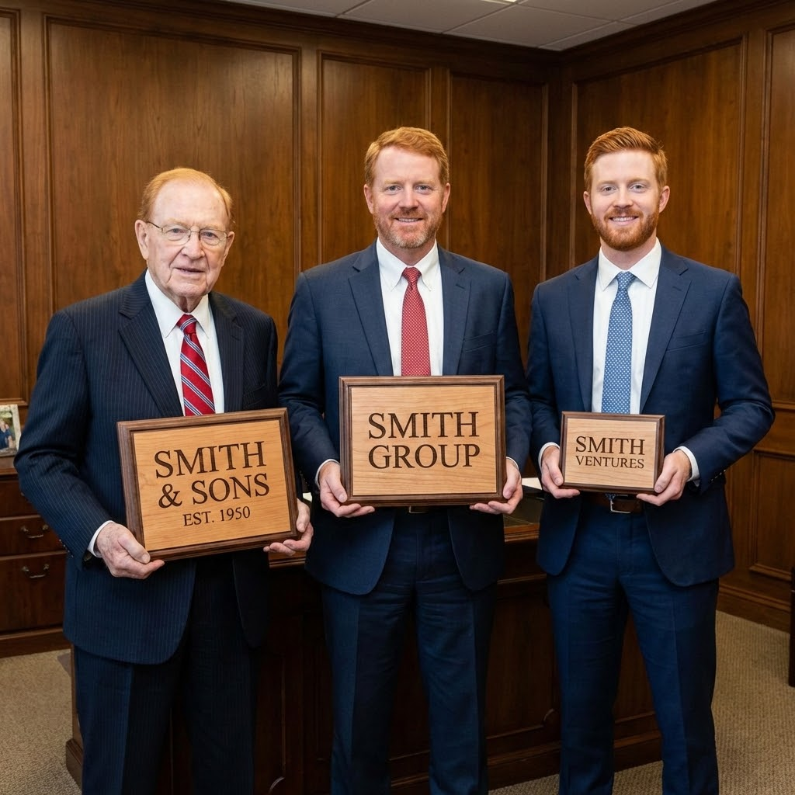
Nepotism
    May not directly supervise or
participate in employment or
working conditions
    of a relative or person living in
    same residence.
    Exception: Required by
    law and independent and third party involved.

Slide 24

    Nepotism
"Relative"
spouse
children
parents
siblings
grandparents
grandchildren
parents-in-law
siblings-in-law
“kids”-in-law

Slide 25
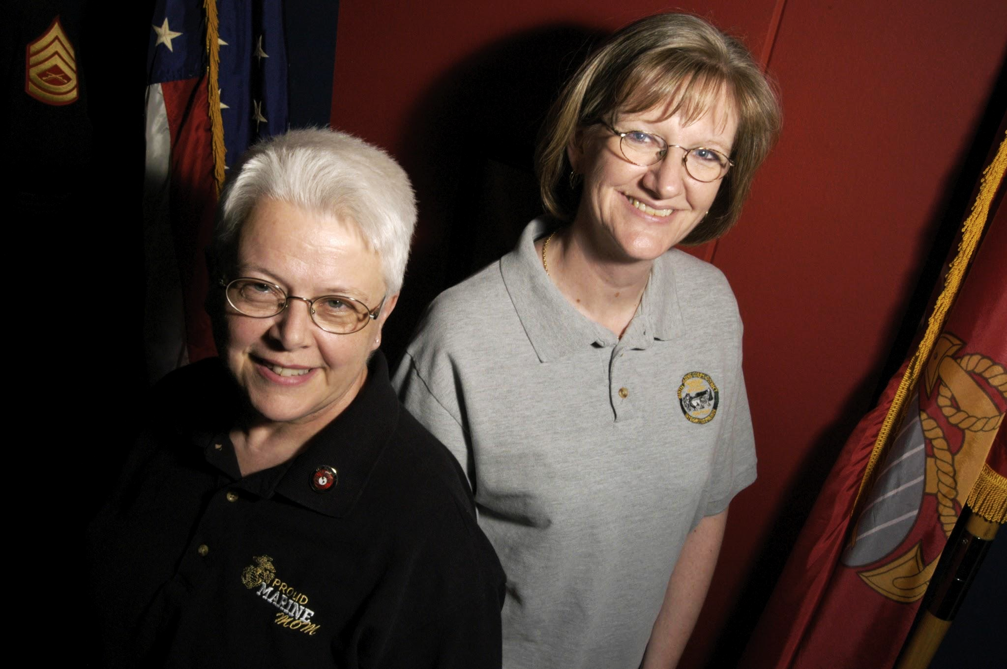
Private Gain
Nepotism
Mother and daughter working as co-workers
without supervising the other
When one’s work may only tangentially affect the workload of the other.
No intent to decrease the workload of her relative
AO 2024-11

Slide 26

Use of Public Office for
Private Gain
2024 Employee Recognition/Retirement Events
Food and beverages, entertainment, and gift or memento.
Total public funds = $25 per employee per year. May be allocated between events and employees.
See our Guideline for more.

Slide 27

Private Gain
Retirement Gifts/Events
May spend up to $100 of public funds to purchase plaque or another commemorative item.

Slide 28

Commercial
Endorsements
Do not endorse commercial products. Do not give testimonials such as town was a “satisfied customer.”
Exception: Overriding public benefit

Slide 29

Soliciting Subordinates
for Business
2025-04​ A BOE member may not hire a school bus operator during non-school hours, as his chauffeur. The school bus operator is a subordinate subject to the direction, supervision, and control of the Board of Education member. Violates § 6B-2-5(o).

Slide 30
Soliciting Subordinates
for Business Exceptions
(A) Supervisor public official advertises to general public in general using mail, pamphlets, or other printed media; or
(B) Supervisor posts notice in a communal work area; or
(C) Supervisor does not usually sell the property; or
(D) Subordinate goes to supervisor’s private business.

Slide 31

Gift Rules
No Gifts over $25 from Interested Persons
An interested person is:
A Lobbyist
Or one who:
Seeks or does business with the public servant’s agency (vendor);
Is regulated or controlled by the agency; or,
Has a specific financial interest which may be substantially affected by the performance or nonperformance of official duties.
Notes:
2020 – Even police officer saved by a bullet proof vest could not accept gift from vest man.

Slide 32

Gift Rules
No Gifts over $25 from Interested Persons
A University procurement officer accepted two free NFL tickets from a vendor.
Notes:
2020 – Even police officer saved by a bullet proof vest could not accept gift from vest man.

Slide 33

Gift Rules
Some Exceptions!
Meals and beverages of any value if the person purchasing them is present
Ceremonial gifts with insignificant value – for example, a plaque
Gifts that are purely private in nature
See Ethics Commission Gift Guideline – outlines other exceptions
Notes:
Return
Donate to charity
Donate to the agency

Slide 34

Solicitation for Donations or Gifts
Solicitation of gifts is generally prohibited.
W. Va. Code § 6B-2-5(c)

Slide 35

Gift Rules
Charitable Solicitations
W. Va. Code § 6B-2-5(c)
Gifts may only be solicited for a charitable purpose.
Public agency may impose stricter standards.
Supervisors may not solicit contributions from a subordinate.
Follow the Rules for Solicitation.

Slide 36
Gift Rules
Charitable Solicitations
W. Va. Code § 6B-2-5(c)
2025-07​ A City police department may not solicit donations for upgrading its firearms training facility - not a charitable purpose
but may ask the public for donations in exchange for plaques or signs noting the sponsorship of the business in locations accessible to the public.
Disclaimer

Slide 37
Gift Rules
Charitable Solicitations
W. Va. Code § 6B-2-5(c)
1996-19, “The operation of municipal recreation facilities [city pool] benefits the public at large, especially the children of the area, and as such the project does constitute a ‘charitable purpose.’”
2020-11, a veterans memorial is a charitable purpose.
1995-17, a statue for the county courthouse lawn was for a charitable purpose.
2016-16, the West Virginia Fallen Firefighter Memorial was for a charitable purpose.
2023-10 Outdoor concert series and similar events at the City's amphitheater serve a charitable purpose.
May use GoFundMe or similar crowdsourced funding
Comply with the manner of solicitation rule at W. Va. Code R. §§ 158-7-6 & 7
Check with Auditor's Office regarding the receipt of electronic donations by government agencies through these types of computer applications.

Slide 38

Public Official’s
Name or Likeness
    May not use public funds or public resources to display the public official’s name or likeness for the purpose of promoting public official or political party. W. Va. Code § 6B-2B-2(b).
Elect Jones
for Sherriff!
Notes:
Sheriff coins case

Slide 39
Public Official’s
Name or Likeness
A Sheriff’s Office may not place the Sheriff's name on a large 4' x 8' sign on the front of the Sheriff's Office building.
Excessive detail that fails to communicate the office's services or advance its public mission.
Exceptions related to "communicating with constituents" and "office signage" do not apply. AO 2026-02
Notes:
Sheriff coins case

Slide 40
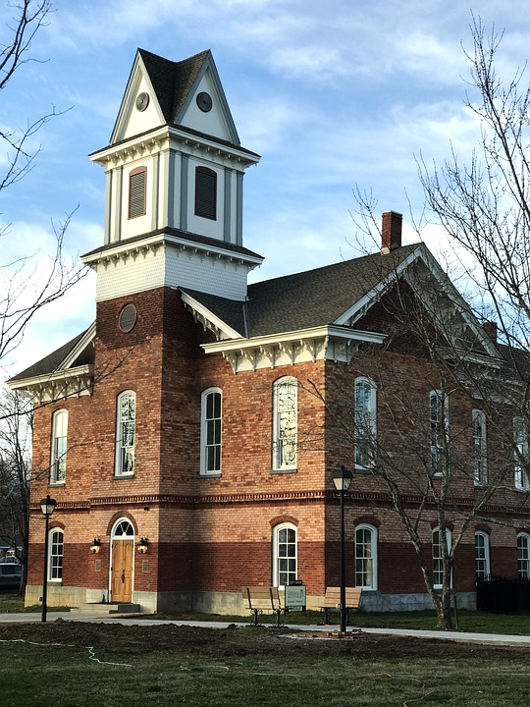
Public Official’s Name or Likeness
The law prohibits state, county and municipal entities from dedicating or naming any public building or public structure for a public official who is currently in office.
W. Va. Code §§ 5-6-4, 7-3-19, and 8-12-22.

Slide 41

Prohibited Interest in Agency Contracts
W. Va. Code § 6B-2-5(d)
Public servants (or the private boards they serve on) may not have a financial interest in a public contract under their direct authority or control.
Notes:
city council member’s business should not k with city.

Slide 42
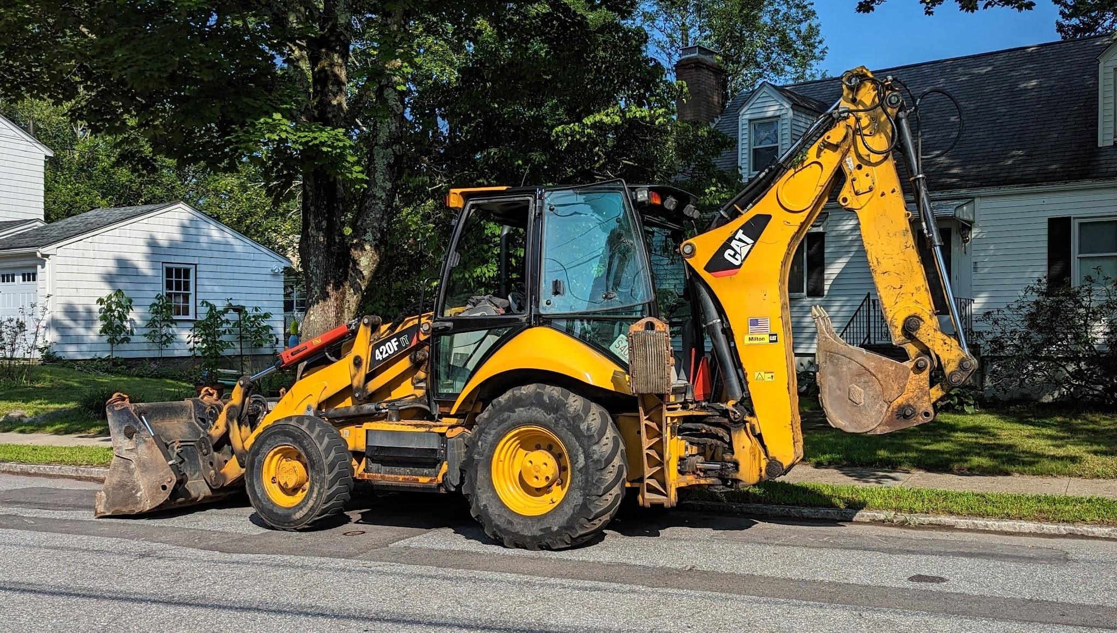
Prohibited Interest in
Agency Contracts
W. Va. Code § 6B-2-5(d)
A city’s contract for a new backhoe is under the “direct authority” or “control” of the Mayor and City Council members.
Notes:
city council member’s business should not k with city.

Slide 43

“Control” over an agency’s contract
include people who:
Instigate the contract - laborer who tells supervisor
she needs a new backhoe
Closely involved with the ultimate decision
Supervise or oversee the contract
Advisory Opinions 1992-03, 1995-02 & 1999-02

Slide 44

Prohibited Contracts
Exceptions
W. Va. Code § 6B-2-5(d)
$1,000 threshold
Part-time appointed officials and legislators are not subject to prohibition
Public employment
But must recuse themselves if a conflict arises
Notes:
Pop quiz. Chap 30-6 No member of any board in this chapter may receive compensation as an employee of the board.

Slide 45

Prohibited County
Contracts
W. Va. Code § 61-10-15
W. Va. Code § 61-10-15 prohibits county officials from having financial interests, directly or indirectly, in a contract, including employment, over which their public position gives them voice, influence or control.
Notes:
Criminal offense: $500 fine, 1 yr jail time and removal from public office and employment
List of officials: county commissioners, BOE members, district school officers, supervisors, superintendents, secretaries, any other county or district board or district officer. Examples: PSD members, airport authority, 2012-12 county health department officers Can’t accept referrals.
Employment and part-time officials. CC spouse may not work in the assessor’s office.

Slide 46
Prohibited County
Contracts and employment
Voice, Influence, or Control
County Commissioner Example
County Commissioners (and spouses) may not have contracts with or be employed by
Any County Office, e.g., Assessor’s Office, Sheriff’s, Clerk’s Office.
Appointment power- A board or commission whose board members were appointed by the county commission, e.g., county parks board and building authority.
Appropriations - A non profit to which the county commission contributes 7% of the nonprofit’s budget. County funds may not be used to directly fund the county commissioner’s employment position with the nonprofit. 2023-12
Notes:
Examples: PSD members, airport authority
Employment and part-time officials. CC spouse may not work in the assessor’s office.

Slide 47
Prohibited County
Contracts
Exceptions
Spouses may be employed in the public schools as principals, teachers and service personnel, and may be licensed health care providers at government- owned hospitals. 2023-04 A county commissioner’s spouse may be employed by the county ambulance service as a licensed emergency medical technician or paramedic.
County official may work for a county vendor as a salaried employee if the employee meets the five criteria found in W. Va. Code § 61-10-15(e). (No commission, not owner, etc.)
contracts for goods and supplies if the county official is the lowest bidder, gets opinion from Commission, and meet other conditions.
County official (and spouses) may work for banks regardless of a county’s fiduciary interests in the bank.
Notes:
2015-15-prohibits a County Board of Education from employing the Superintendent’s spouse as a literacy coach, only can as a principal or teacher or auxiliary or service employee

Slide 48

Prohibited County
Contracts
W. Va. Code § 61-10-15
AO 2024-10 A County Farmland Protection Board member may not participate in a public farmland program in which the Board would pay him for a conservation easement on his farmland.
Notes:
Criminal offense: $500 fine, 1 yr jail time and removal from public office and employment
List of officials: county commissioners, BOE members, district school officers, supervisors, superintendents, secretaries, any other county or district board or district officer. Examples: PSD members, airport authority, 2012-12 county health department officers Can’t accept referrals.
Employment and part-time officials. CC spouse may not work in the assessor’s office.

Slide 49

Public
Contract
Ethics Commission can grant an exemption to public entity based upon undue hardship or excessive cost.

Slide 50
Public
Contract
​

Slide 51
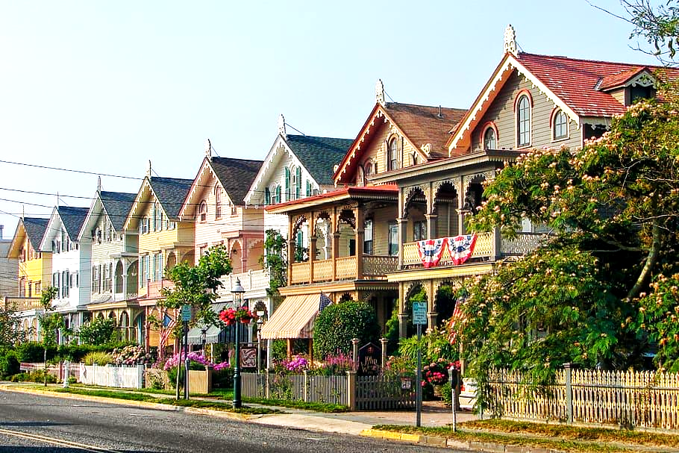
Voting
May not vote if public official, or an immediate family member, or a business with which they or a family member is associated, has a financial interest.
Public officials may not vote on a personnel matter involving a relative.
(Class exception - five similarly situated) 2019-08 hotel development in mayor’s neighborhood
Notes:
Class example: a physician or health care provider to vote on health care legislation or for a teacher to vote on matters affecting education, or for a coal miner to vote on laws regulating the coal industry.

Slide 52


Slide 53
Voting
Planning
Planning Commissioners, who are adjacent property owners to a proposed solar power plant, are part of a class of five or more similarly situated persons, based on the detailed parcel maps and the planning administrator's statements.
Permitted to participate in all planning commission and committee matters concerning the solar development project.
The solar developer's offer of a "good neighbor agreement" to a commissioner does not create a prohibited financial interest, as the offer was not accepted by the commissioner. 2026-04
Notes:
Class example: a physician or health care provider to vote on health care legislation or for a teacher to vote on matters affecting education, or for a coal miner to vote on laws regulating the coal industry.

Slide 54

Recusal
Disclose his or her interest
Leave the room during both the discussion of, and the vote on, the issue
Minutes must reflect recusal
Notes:
5.2. Making a full disclosure of one's interest means making a prior public disclosure including the amount of interest held directly or indirectly by a public employee or public official or immediate family thereof in a public contract.

Slide 55

Employment Restrictions
W. Va. Code § 6B-2-5(h)
Full-time public employees may not seek employment with any person who:
Had a matter on which they or their subordinate took regulatory action within the past 12 months, or
Currently has a matter before their agency on which they or a subordinate is working, or
Is a vendor over which they exercise control
Employment Exemptions available
2019-17 and 2020-05
Notes:
Fire code deputy owned bar ok

Slide 56

Post-employment Restrictions
Representation
A former public official or employee may not represent a client before her former agency when the employee had “personally and substantially participated” on behalf of the agency in that particular matter (in a decision- making, advisory, or staff support capacity) - absent agency consent.
A staff attorney, accountant or other professional employee who has represented a government agency in a particular matter may not represent another client in the same or closely related matter before a tribunal if the client’s interests are adverse to the agency - absent agency consent.

Slide 57

Post-employment Restrictions
          Revolving Door
No elected or appointed public official or full-time staff attorney or accountant, shall:
for ONE YEAR after the termination of that service, represent a client before the entity he or she served in:
  A contested administrative matter,
  To support or oppose a proposed rule,
  To support or oppose issuance of a license or permit,
  Rate-making proceedings, or
  To influence the expenditure of public funds.
W. Va. Code § 6B-2-5(g)

Slide 58
Financial Disclosures
February 1 annually
(1) Elected state and county officials and school superintendents.
(2) All members of state boards, commissions and agencies appointed by the Governor; and
(3) Secretaries of departments, commissioners, deputy commissioners, assistant commissioners, directors, deputy directors, assistant directors, department heads, deputy department heads and assistant department heads.

Slide 59
Disclosure of $1 million State Contracts
Disclosure of Interested Parties, such as
contractors, owners, and subcontractors. State agency must file with the Commission before beginning work.
W. Va. Code § 6D-1-1, et seq.
$1,000,000

Slide 60

Lobbying Contracts
W. Va. Code § 6B-3-10:
Disclosure requirements for government agencies that contract for lobbying services, including filing lobbyist contracts with the Ethics Commission

Slide 61

Sanctions
  Public reprimand
  Restitution
  Fines of $5,000 per violation
  Reimbursement to the Commission
  Recommendation that a Respondent be terminated from employment or removed from office.

Slide 62
Visit our Website
Ethics.wv.gov

Slide 63

Open Meetings Act
State, county, and municipal administrative and legislative bodies, and any other bodies that meet the definition of ‘public agency,’
are subject to the Act. Committees, too.

Slide 64

OMA Topics
Meetings subject to OMA
Meetings not subject to OMA
Notice/Agenda for meetings
Executive sessions
Meeting minutes
Violations

Slide 65

Meeting defined
A meeting is subject to OMA when:
  A quorum of a governing body meets
  In order to make, or deliberate toward,
  A matter that requires official action.
Notes:
A gathering where a quorum of the governing body meets with staff is a “meeting” within the scope of the Act.
W.Va. Code § 6-9A-2(5)
OMAO 2011-02
One member of the body meeting with staff is not governed by the Act.

Slide 66
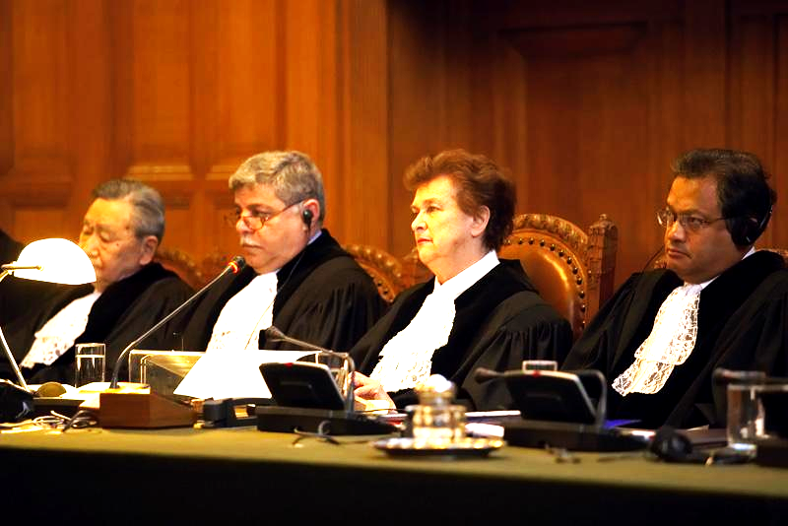
Meetings NOT Subject to OMA
Logistical matters
e.g., creating the agenda 2019-03
Adjudicatory
e.g. suspending a license
On-site inspection
e.g., Construction site
Political party caucus
Notes:
2008-08 Board of Funeral Service Examiners
Public hearings regarding disciplinary matters are not "meetings" subject to the requirements of the Act.

Slide 67
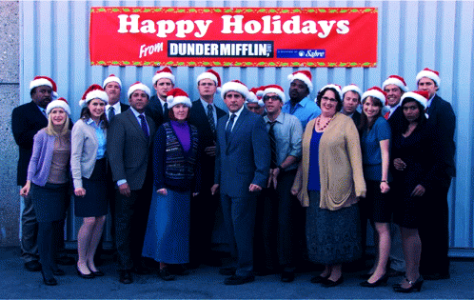
Not Subject to OMA
General Discussions at planned or unplanned gatherings; training, ceremonial, or similar settings
Without intent to conduct public business
No intention for the discussion to lead to an official action

Slide 68

In-person Meeting
OMAO 2023-01​
The Open Meetings Act does not require a governing body to provide a physical meeting space but requires only that citizens be given access to a meeting by telephone conferencing or other
electronic means.

Slide 69

The Open Meetings Act requires posting advance notice of the
date
time
place of the meeting
in a reasonable place

Slide 70

Meeting Notice/Agenda Time
Promulgate Rules or
Regular meeting notice = 3 business (unless you meet every week, then 2 days)
‘Special meeting’ = 2 business days
Notes:
Each governing body shall promulgate rules by which the date, time, place and agenda of all regularly scheduled meetings and the date, time, place and purpose of all special meetings are made available, in advance, to the public and news media.
In regard to emergency meetings, W. Va. Code § 6-9A-2(2) states as follows:
(2) "Emergency meeting" means any meeting called by a governing body for the purpose of addressing an unexpected event which requires immediate attention because it poses:
(A) An imminent threat to public health or safety;
(B) An imminent threat of damage to public or private property; or
(C) An imminent material financial loss or other imminent substantial harm to a public agency, its employees or the members of the public which it serves.
W. Va. Code § 6-9A-2 also reads:
(h) In the event of an emergency a governing body may call an emergency meeting.
(1) The governing body of a state executive branch agency shall electronically file a notice for an emergency meeting with the Secretary of State, as soon as practicable prior to the meeting. Any other governing body shall notice an emergency meeting in a manner which is consistent with this article and the Ethics Commission Committee on Open Governmental Meeting's opinions issued pursuant to the authority of section ten of this article, as soon as practicable prior to the meeting.
(2) The emergency meeting notice shall state the date, time, place and purpose of the meeting and the facts and circumstances of the emergency.

Slide 71

Emergency Meeting
W. Va. Code § 6-9A-2-(2)
To address an unexpected event
which requires immediate attention for:
(A) An imminent threat
to public health or safety;
(B) An imminent threat of damage
to public or private property; or
(C) An imminent material financial loss
or other imminent substantial harm
Notes:
Each governing body shall promulgate rules by which the date, time, place and agenda of all regularly scheduled meetings and the date, time, place and purpose of all special meetings are made available, in advance, to the public and news media.

Slide 72

Be Specific on Agenda
Put the public on notice of intended action.
Vague headings are insufficient, e.g.,
Old Business
New Business
Personnel
Opening sealed bids
Instead, use ”fill position of office manager,” or “‘open sealed bids for city hall roof repair project.”

Slide 73

Meeting Agenda
Don’t take up issues not on the agenda.
Hold them over for next agenda.

Slide 74
Executive Session
W.Va. Code § 6-9A-4
Only for reasons permitted by the OMA.
The agenda need not state “executive session,” but must identify the item being taken up. [Hiring new executive director]
The motion to go into executive session must identify the reason for entering the session.
Vote must be made in public (except for student matters).
Notes:
OM 2001-24 – may interview engineering firm in an executive session

Slide 75

Executive Session
Reasons
W. Va. Code § 6-9A-4
Personnel matters of a particular public official or employee. But must vote in public and announce employee’s name. OMAO 99-10
Involving commercial competition, which if made public, might adversely affect a public financial or other interest
Confidential - by express provision of federal law or state statute or rule of court
Student disciplining, suspension or expulsion in a public school or public college or university, unless the student requests an open meeting
Notes:
(4) To issue, effect, deny, suspend or revoke a license, certificate or registration under the laws of this state or any political subdivision, unless the person seeking the license, certificate or registration or whose license, certificate or registration was denied, suspended or revoked requests an open meeting;

Slide 76
Executive Session
Reasons
W. Va. Code § 6-9A-4
(4) To issue, effect, deny, suspend or revoke a license, certificate or registration under the laws of this state or any political subdivision, unless the person seeking the license, certificate or registration or whose license, certificate or registration was denied, suspended or revoked requests an open meeting;
Notes:
(4) To issue, effect, deny, suspend or revoke a license, certificate or registration under the laws of this state or any political subdivision, unless the person seeking the license, certificate or registration or whose license, certificate or registration was denied, suspended or revoked requests an open meeting;

Slide 77

Executive Session
Reasons
OMAO 2025-02 Hampshire County Commission
A county commission may meet in executive session with its attorney to discuss matters covered by the attorney-client privilege.
This exception is not limited to matters related to current and pending litigation.
Notes:
(4) To issue, effect, deny, suspend or revoke a license, certificate or registration under the laws of this state or any political subdivision, unless the person seeking the license, certificate or registration or whose license, certificate or registration was denied, suspended or revoked requests an open meeting;

Slide 78
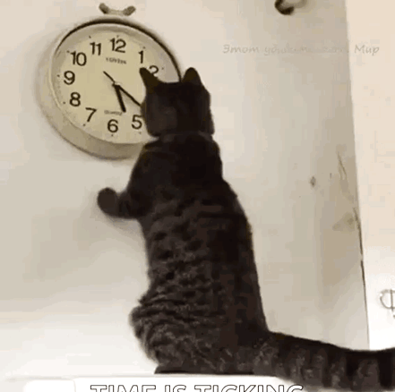
Minutes
The date, time and place of the meeting;
The name of each member of the governing body present and absent;
All motions, proposals, resolutions, orders, ordinances and measures proposed, the name of the person proposing the same and their disposition, and
The results of all votes and, upon the request of a member, pursuant to the rules, policies or procedures of the governing board for recording roll call votes, the vote of each member by name.

Slide 79

Violations
W.Va. Code § § 6-9A-6 and 7
An intentional violation is a criminal misdemeanor subject to prosecution by the county prosecutor and up to a $500 fine. ($1,000 for additional violations)
May also be liable to wronged parties in civil court. (within 120 days of action)
Court may annul vote taken in violation of Act.

Slide 80
West Virginia
Ethics Commission
210 Brooks Street, Suite 300
Charleston WV 25301
(304) 558-0664
ethics.wv.gov
Email: ethics@wv.gov

