Slide 1
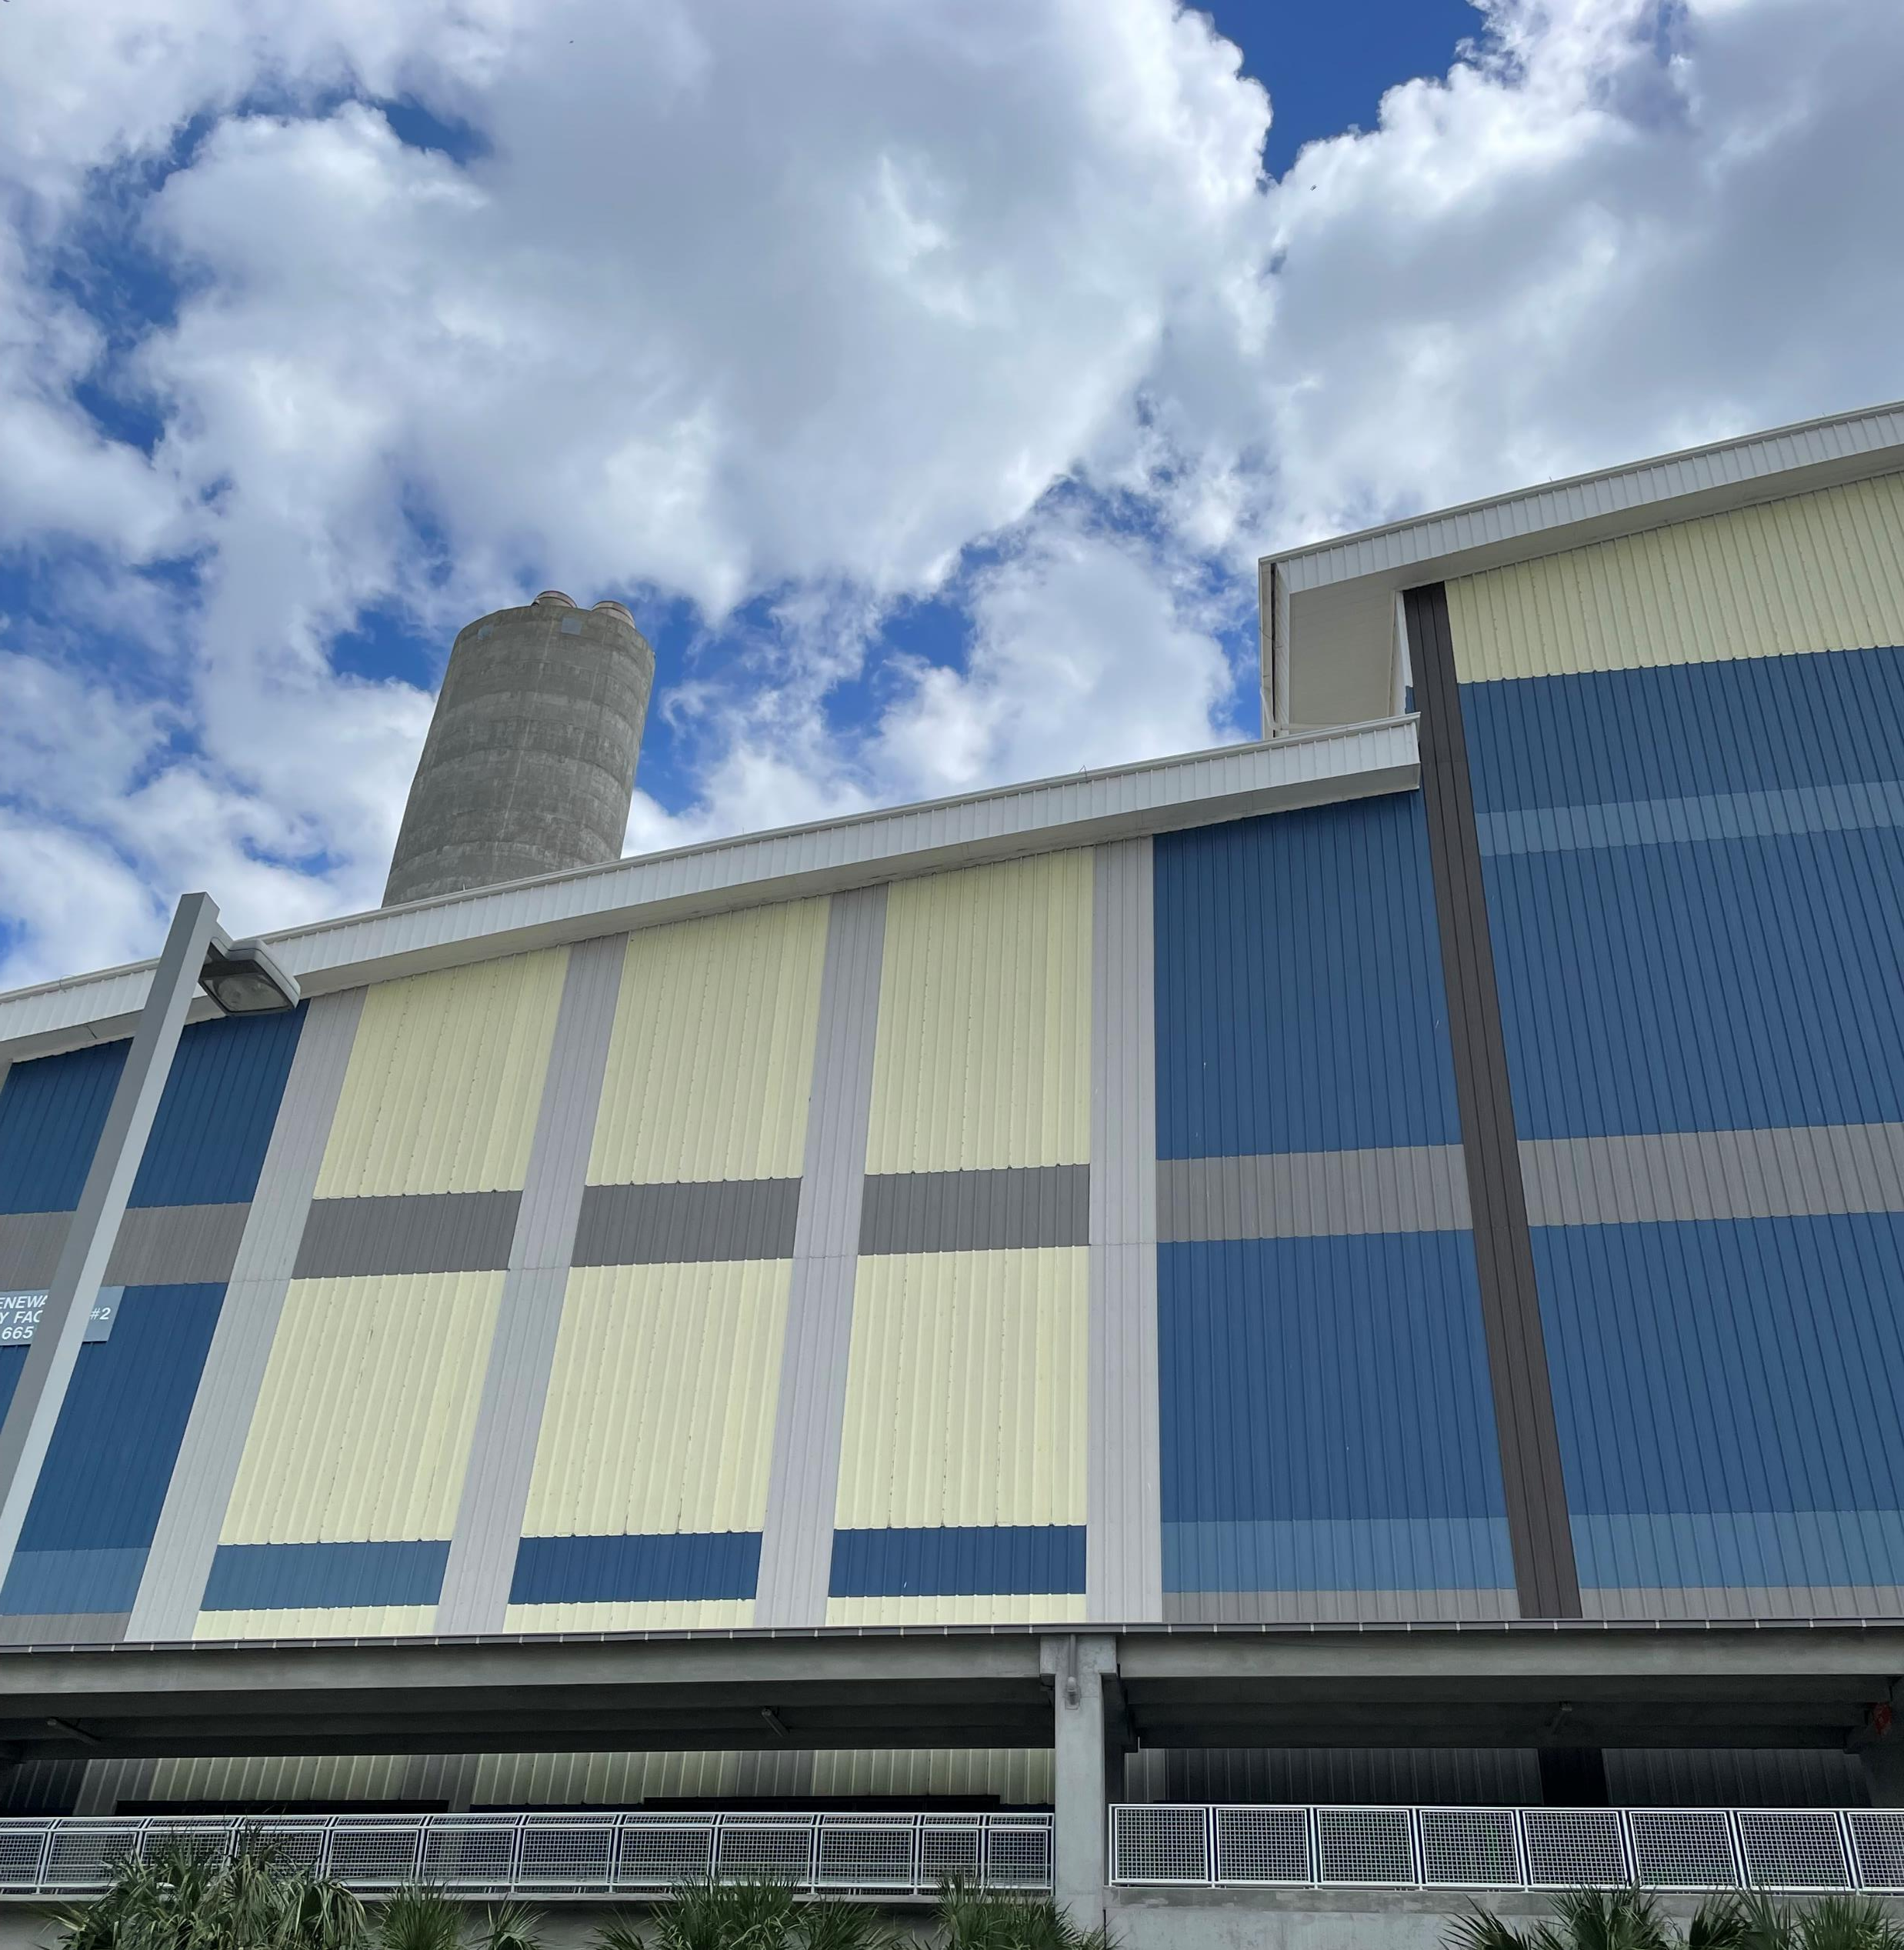
The Future of Waste to Energy
How West Palm Beach is Doing it Right

Slide 2
Palm Beach SWA Model
All MSW goes to the Renewable Energy Facilities (Flow Control)
Reduces volume landfilled by 90%
Resource Recovery – metals, energy, and aggregate
Since 1989 enough metals recovered to produce 1.1 million vehicles
Generates enough electricity to power 90,000 homes

Slide 3
Renewable Energy Facility 1 (REF1)
Online in 1989 and refurbished in 2009
Uses refuse-derived fuel (RDF)
Capacity: 2000 tons per day
Electricity generation: 67 MW (32,000 homes)
Metals Recovery: 25,000 tons/year
Ash and residue landfilled

Slide 4
Renewable Energy Facility 2 (REF2)
Online in 2015 at over $700 million
Only new renewable energy facility in US in over 25 years
Cleanest, Greenest most efficient REF in the world
Uses mass burn technology
Capacity: 3000 tons per day
Electricity generation: 96 MW (68,000 homes)
Ash is landfilled

Slide 5
Renewable Energy Facility 1 Replacement (REF 1R)
REF 1R will replace REF 1 with more modern, advanced, cleaner, greener technology
Capacity: will be 3000 tons/day to accommodate future growth
Cost: $1.5 Billion, largest infrastructure project in Palm Beach County history
Approved by the Palm Beach SWA Board in October 2025

Slide 6
Annual Landfill Diversion
1.8M tons of MSW diverted
Equivalent to:
  686 Olympic pools
  89,750 SWA tractor trailer trucks, bumper to bumper, which would span the distance from West Palm Beach, FL, to Pittsburgh, PA

Slide 7
Annual Energy Recovery
1,401,600 MWh gross production
Enough to power
  90,000 homes
  18M full EV charges
  350,400 EV charges/year
  21 EV trips to the Sun
  160,816 EV trips around the Earth

Slide 8
Annual Metals Recovery
Ferrous Metals Equivalent to:
  65,633 tons
  53,853 cars recovered from steel
  A paperclip chain wrapped around the Earth 66 times
Non-Ferrous Metals Equivalent to:
  8,045 tons
  486M aluminum cans
  4M aluminum bicycles

Slide 9
Palm Beach SWA System
Two REFs
A Recoverd Material Processing Facility for recyclables
A Biosolids Processing Facility pelletizing 95% of the wastewater solids in the county
A landfill with capacity to 2071
Six Transfer Stations
Seven home chemical and recycling centers
Collection in unincorporated areas of the county

Slide 10
How is this environmentally friendly?
Every ton of waste processed at a WTE facility avoids a ton of CO₂ equivalent emissions
The renewable fuel portion of MSW, the emissions impact of the post combustion metals recycle, and the avoidance of landfill methane emissions provides a significant net reduction in GHG emissions with WTE technology, and thus, a negative GHG footprint.

Slide 11
States Recognizing Environmental Benefits
Pennsylvania recommends increasing WTE by 40% by 2030
Maryland recognizes WTE as a Tier 1 renewable energy source
Maine relies on WTE as part of its GHG reduction effort and estimates it will cost ~40% less per ton of carbon compared to its solar water heater program

Slide 12
Other Benefits to WTE
Pathogen, pharmaceutical, and problematic chemical destruction
Emissions are more than 70% below Maximum Achievable Control Technology (MACT) standards except for NOx, which operates at ~35% below emissions standards
U.S. counties and municipalities that utilize WTE consistently show an increased recycling rate

Slide 13
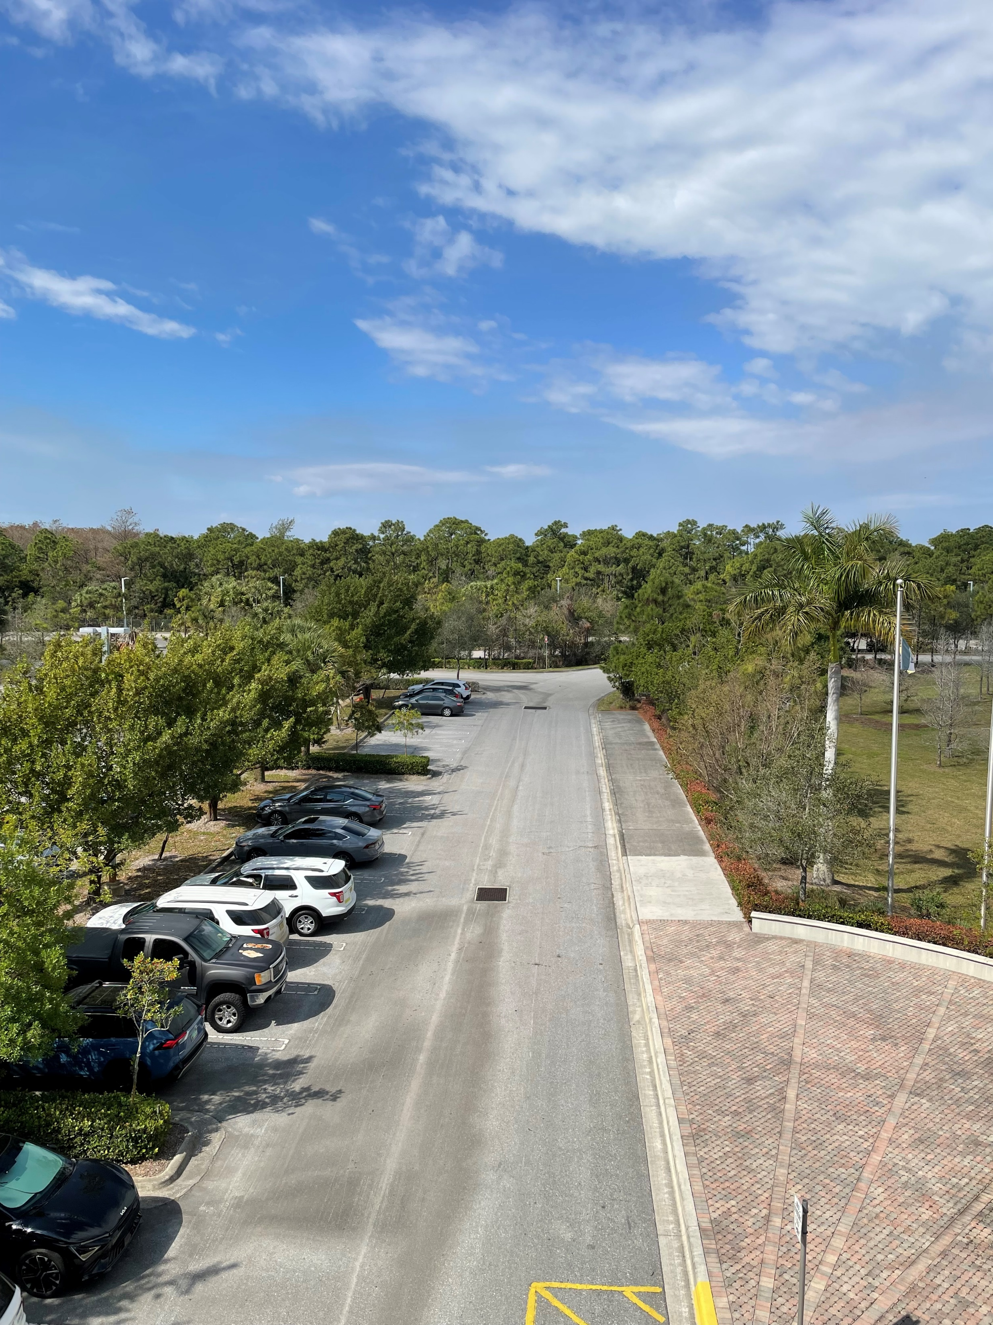
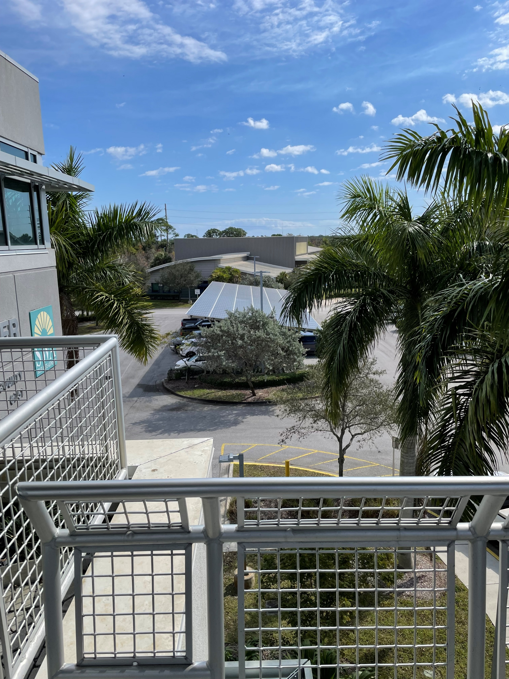

Slide 14
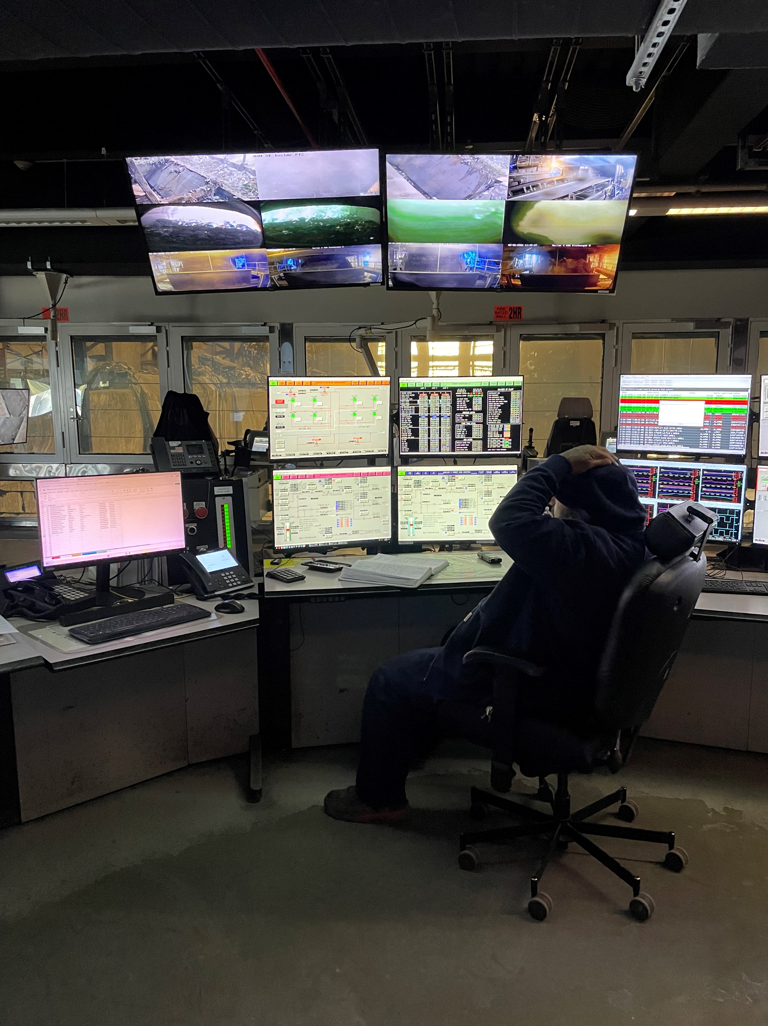
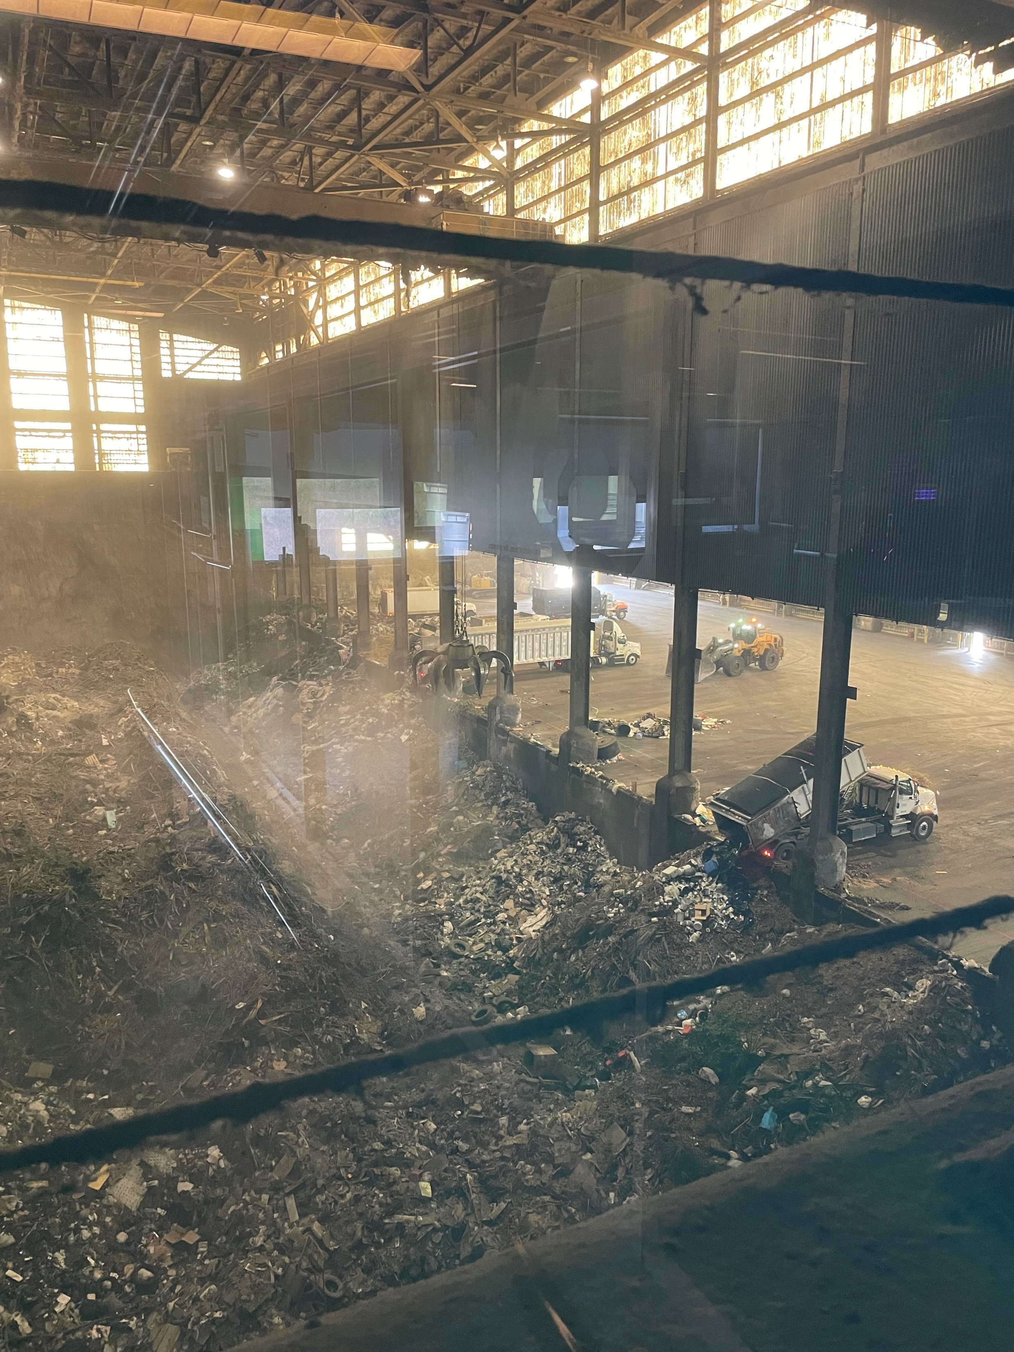

Slide 15
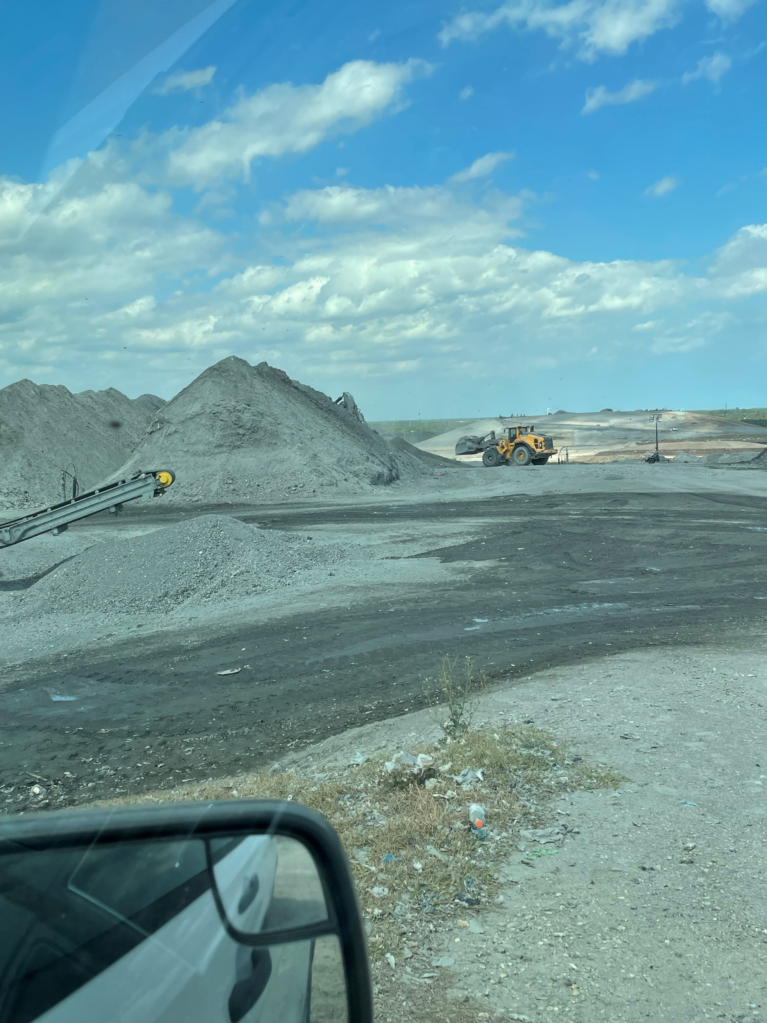
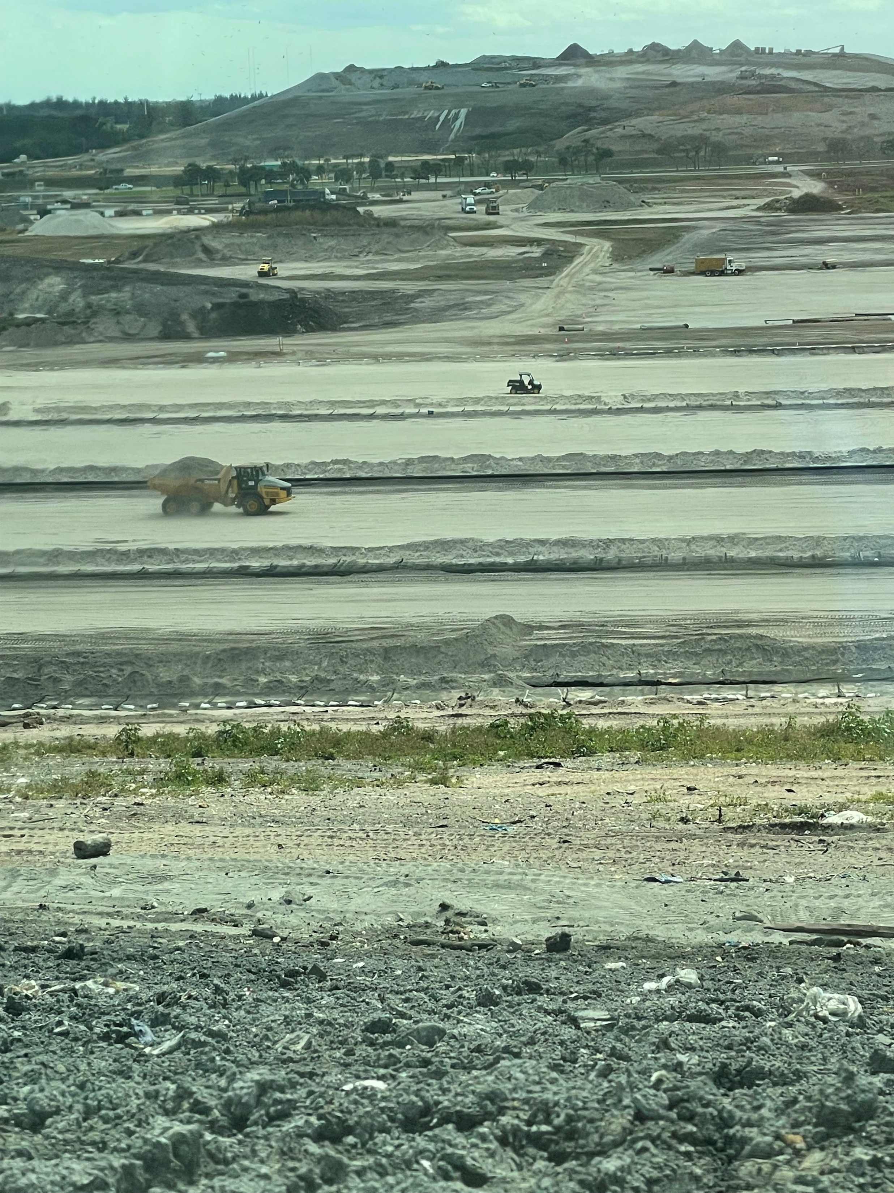

Slide 16
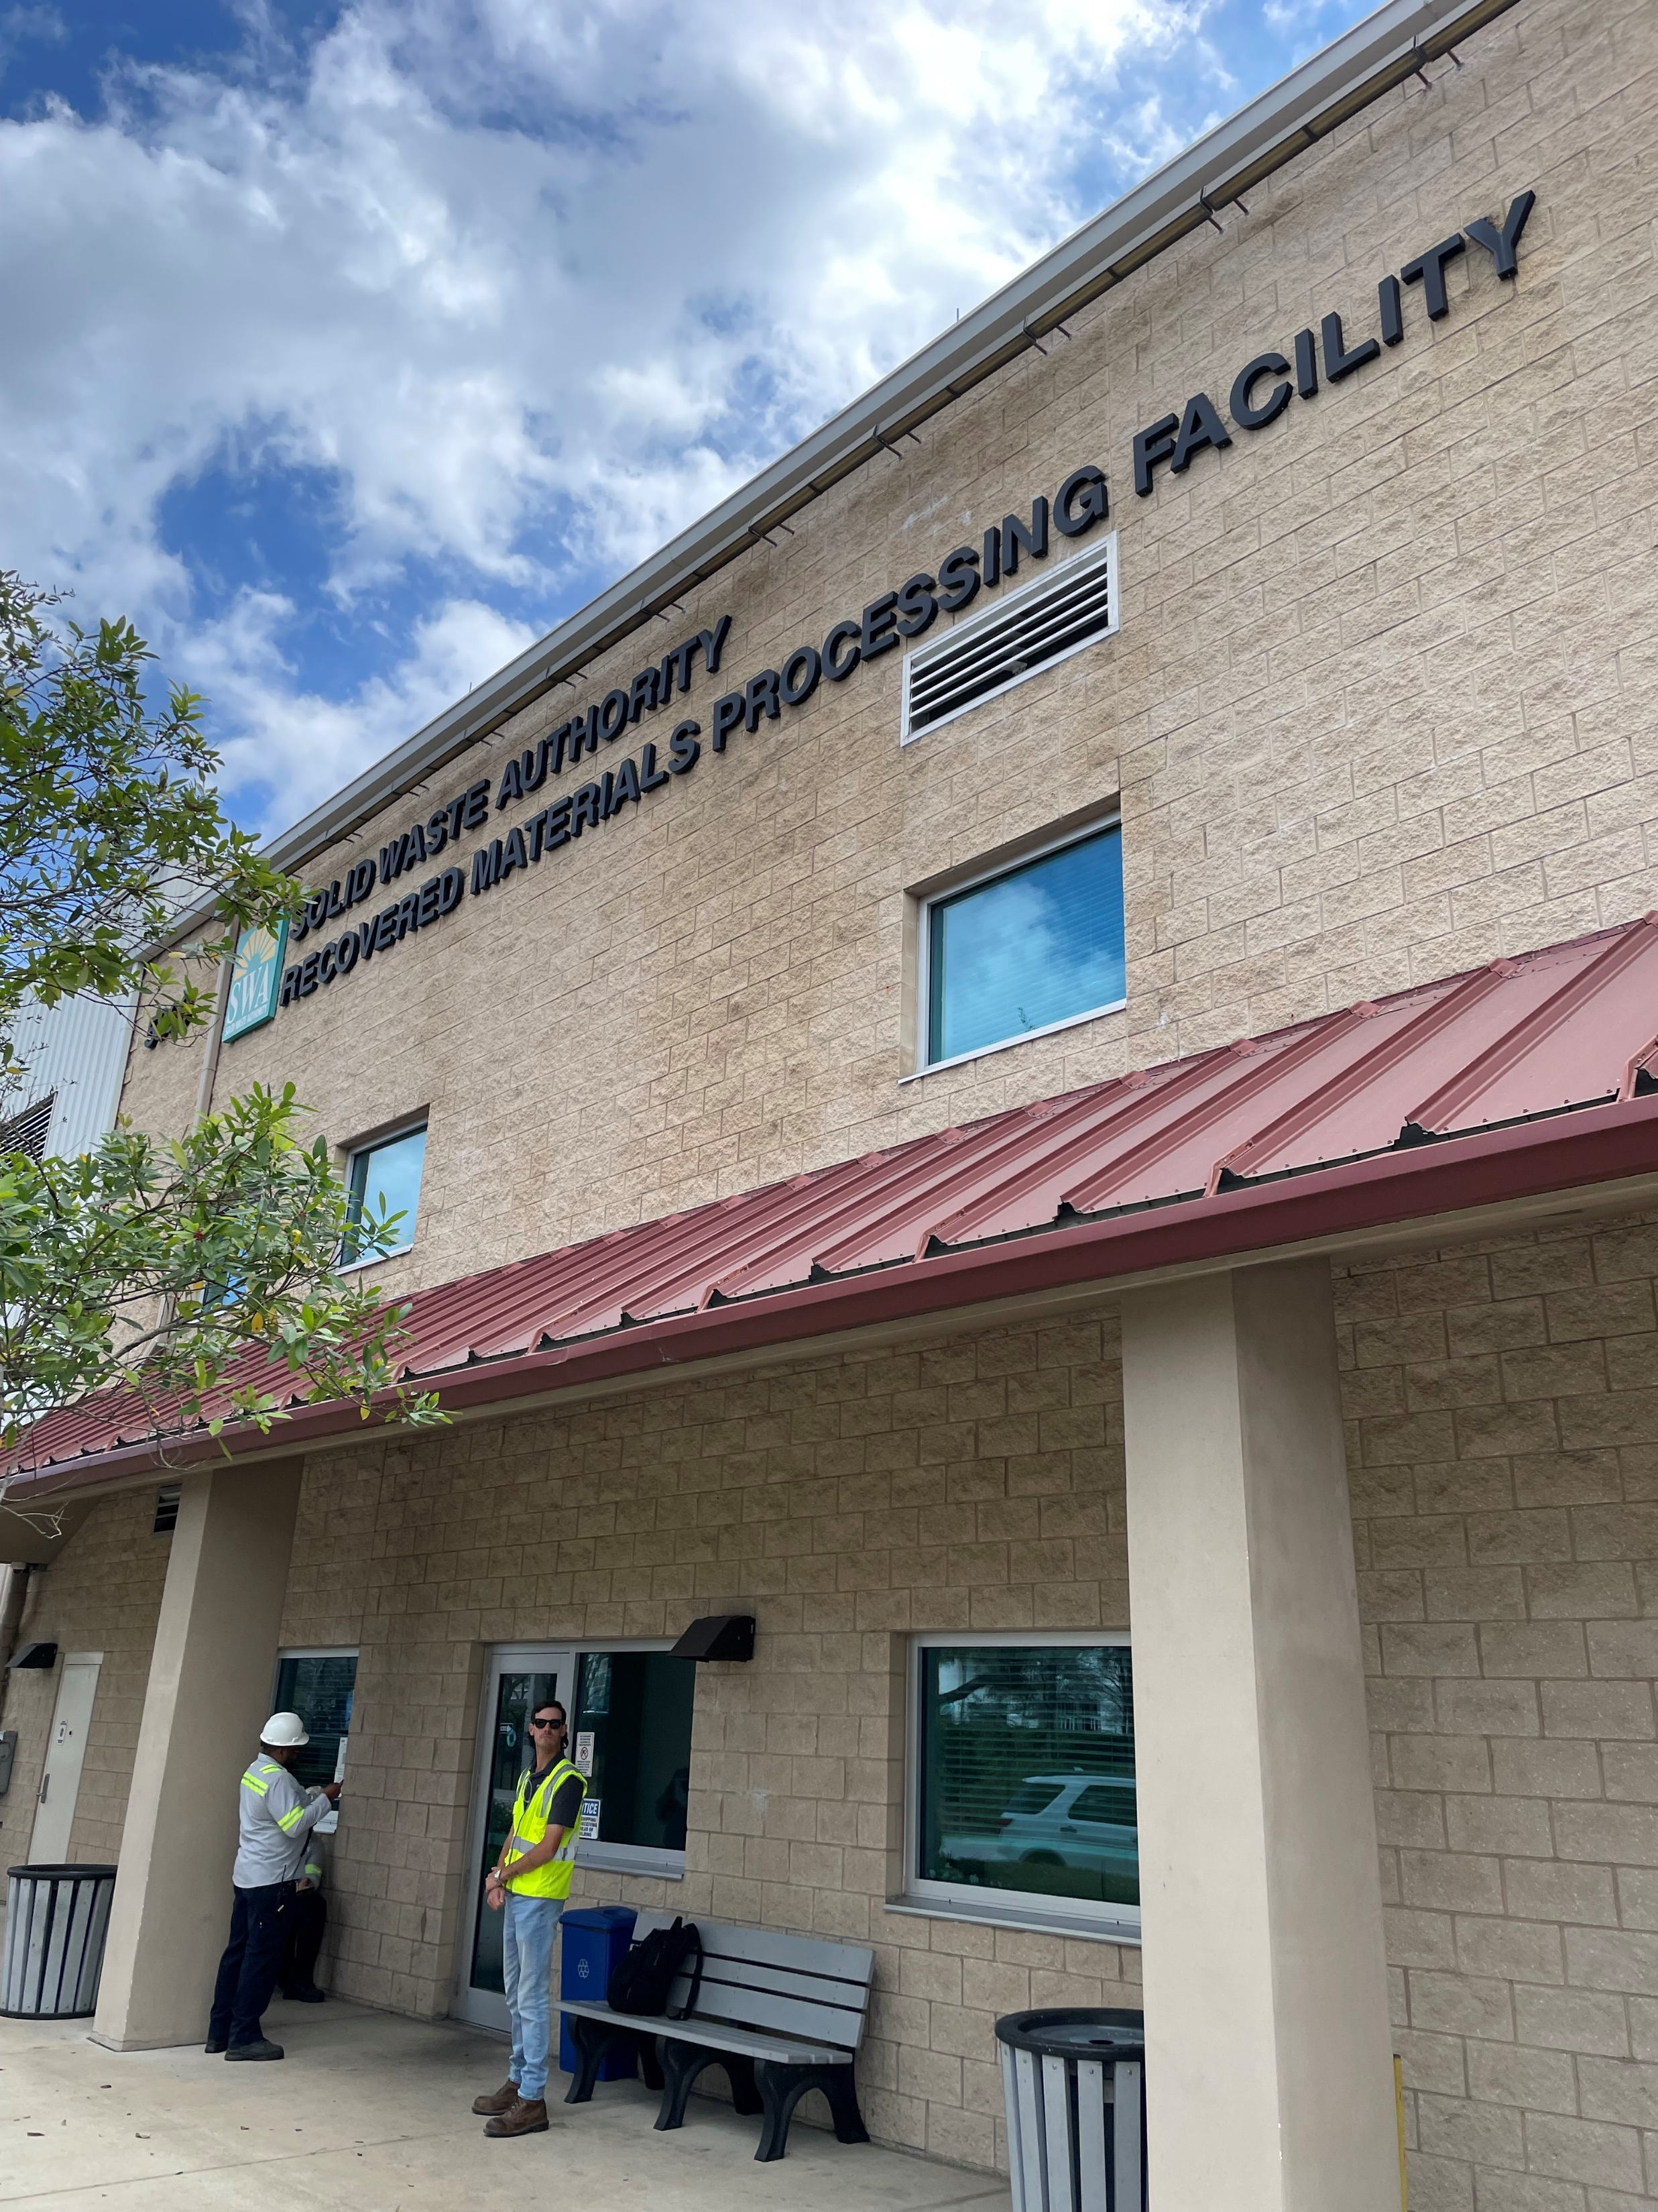
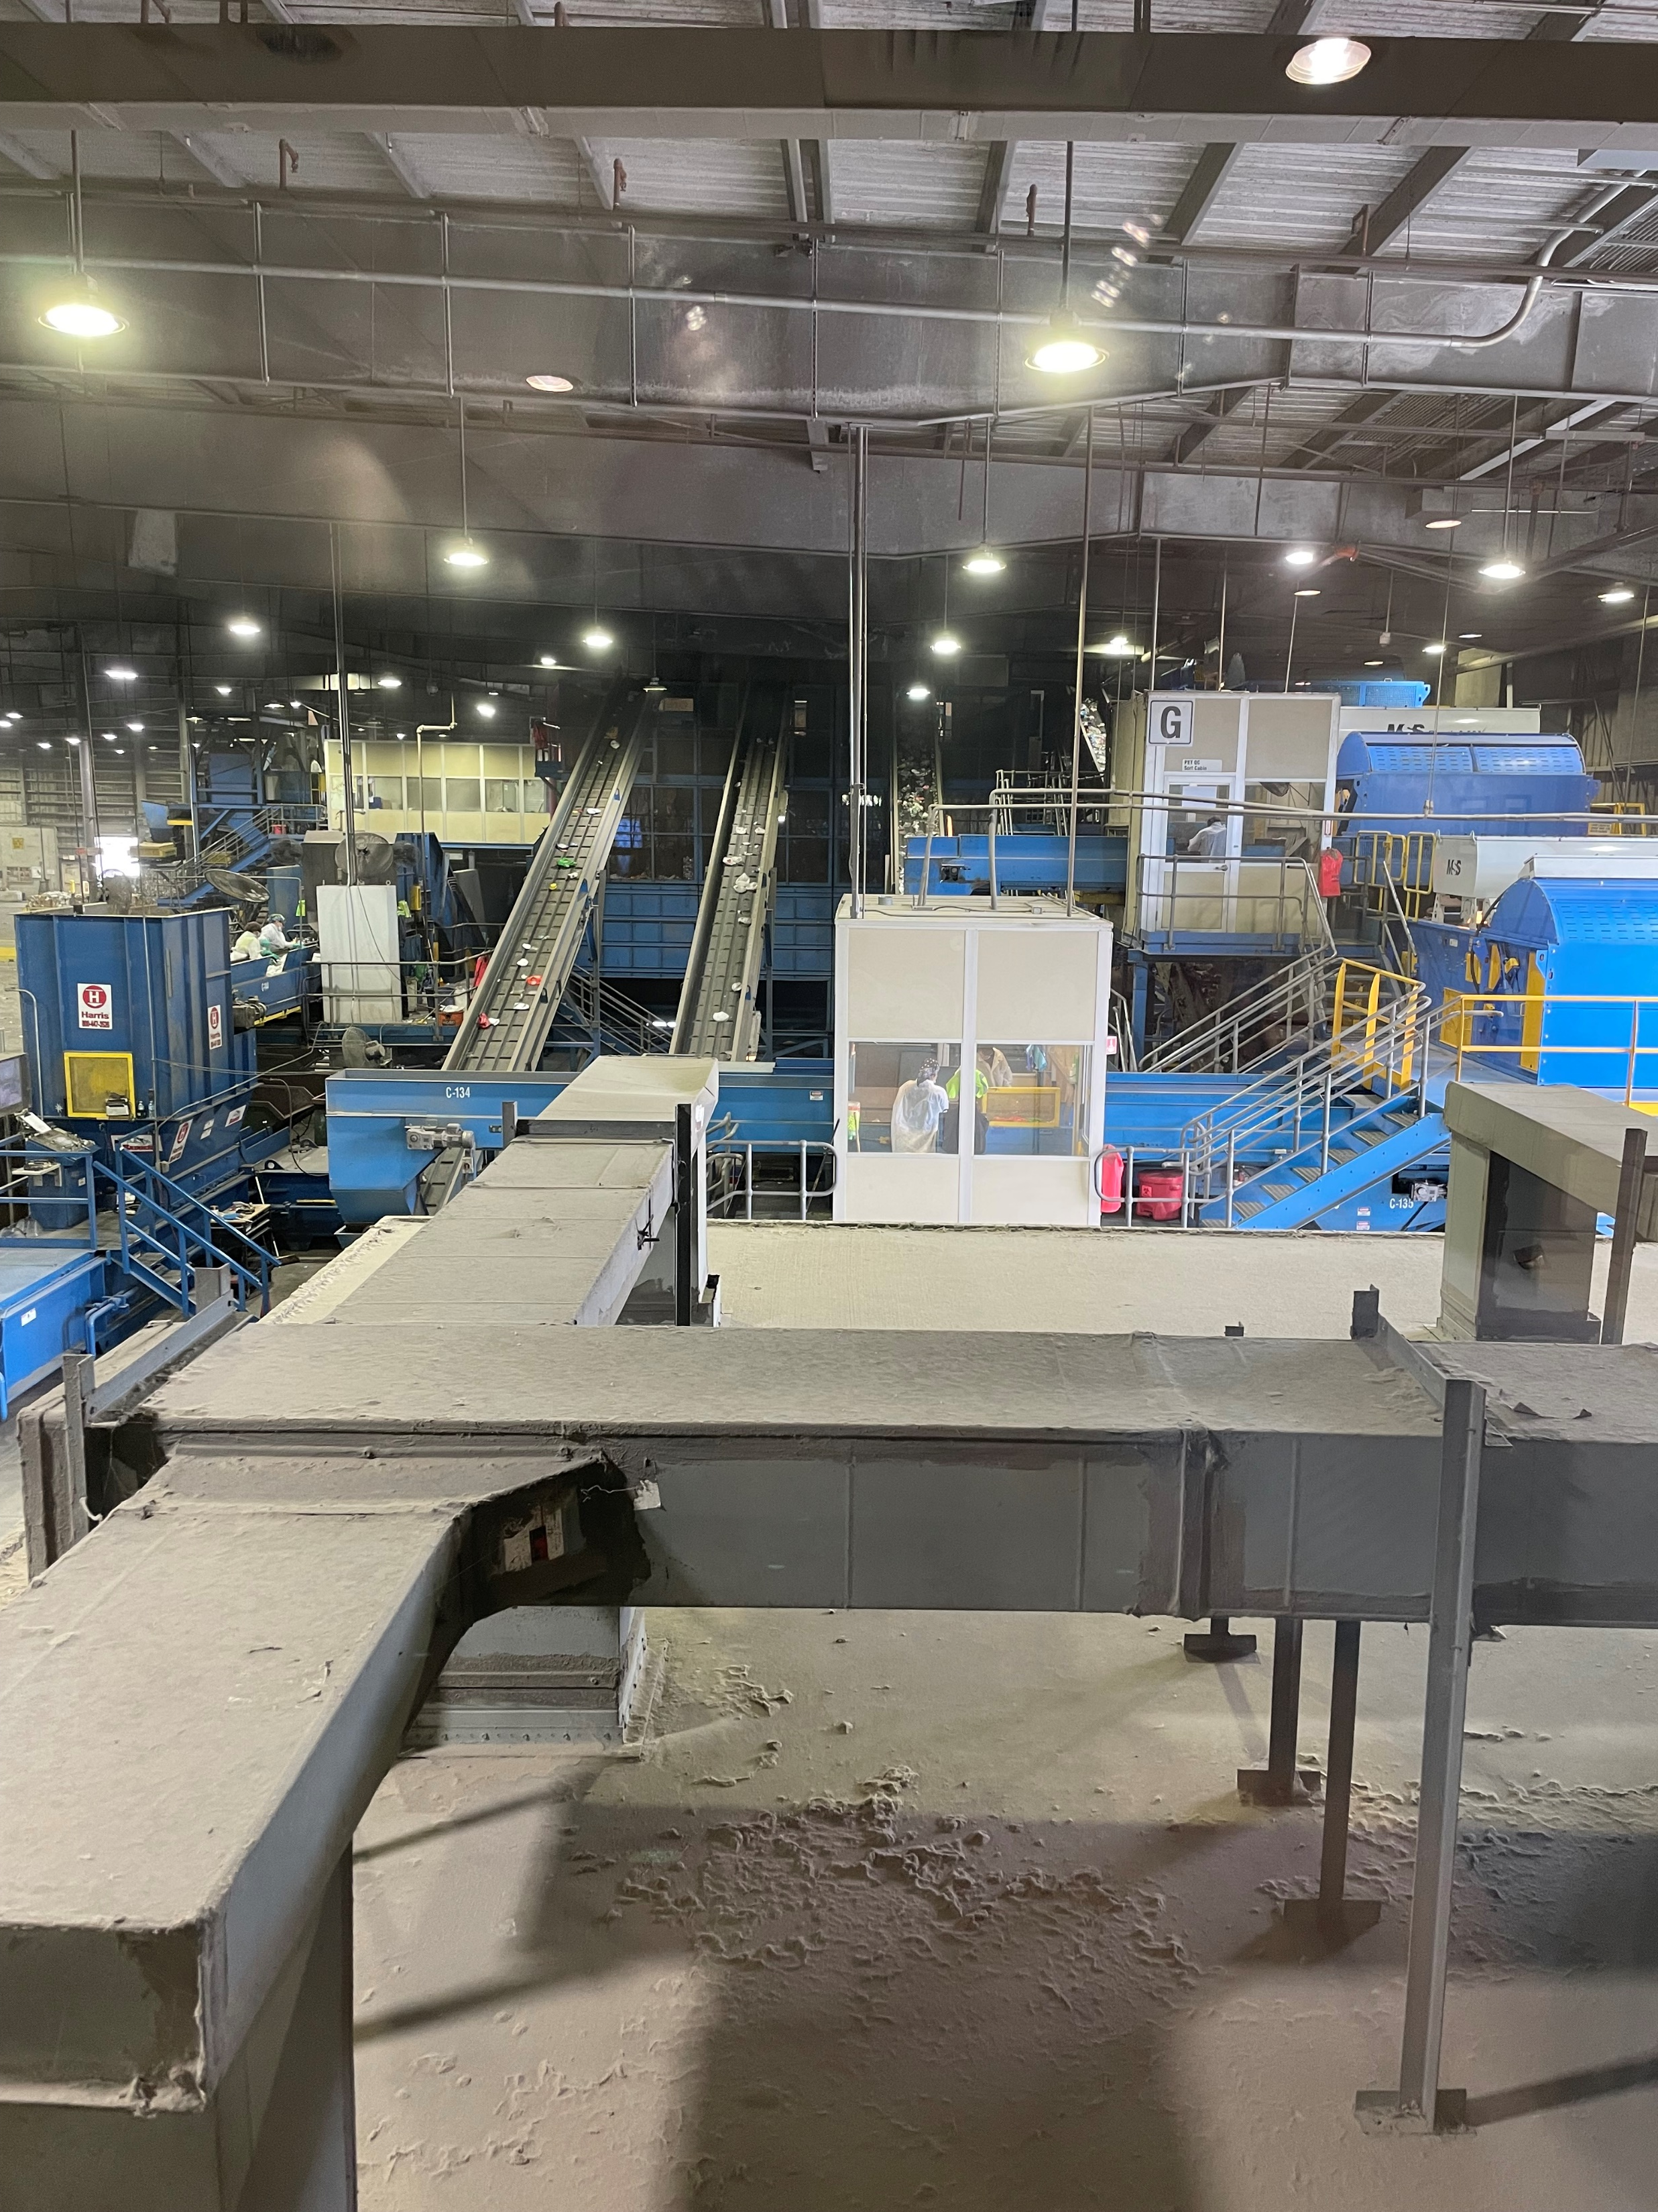

Slide 17
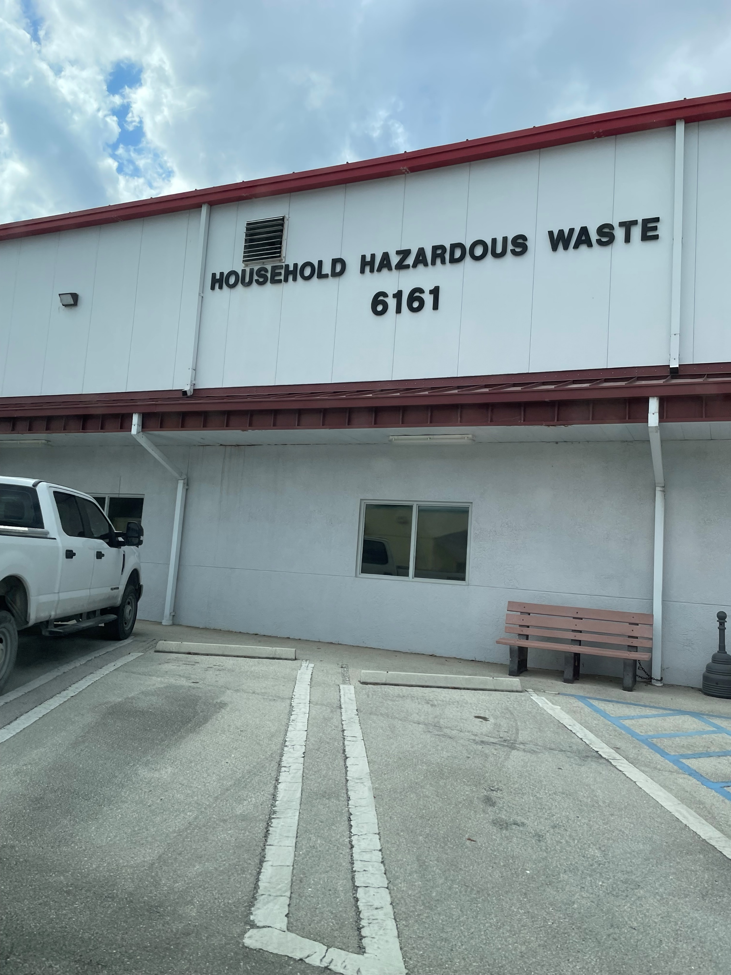
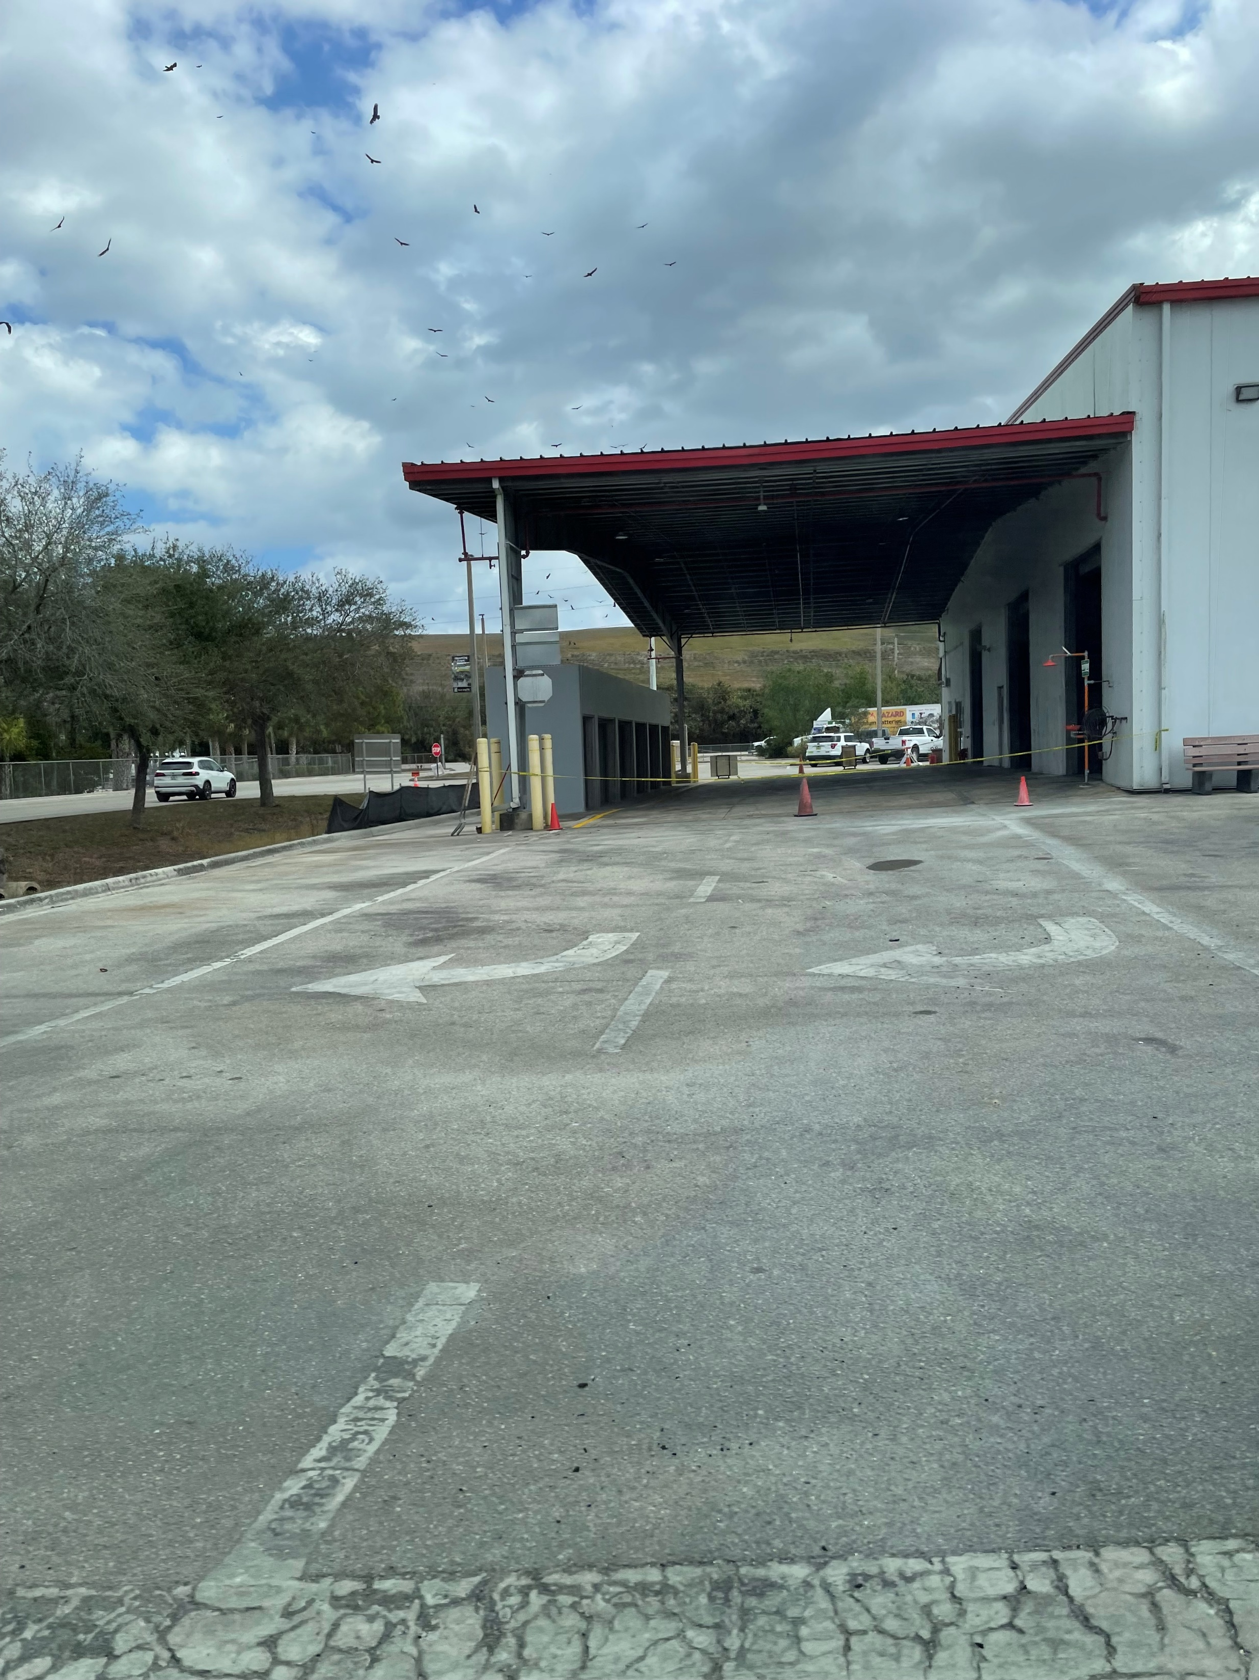

Slide 18
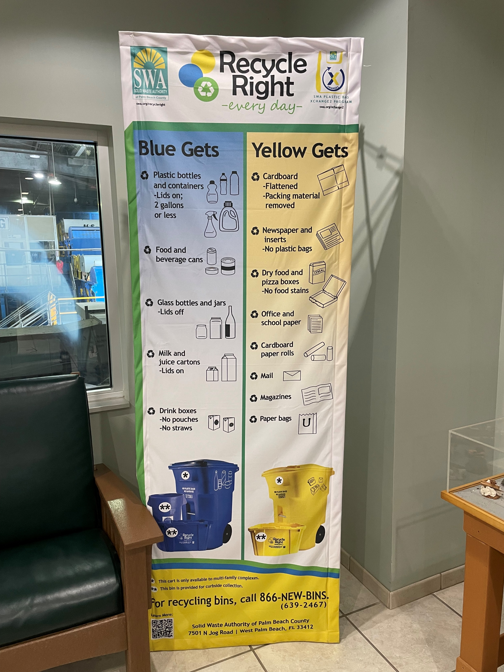
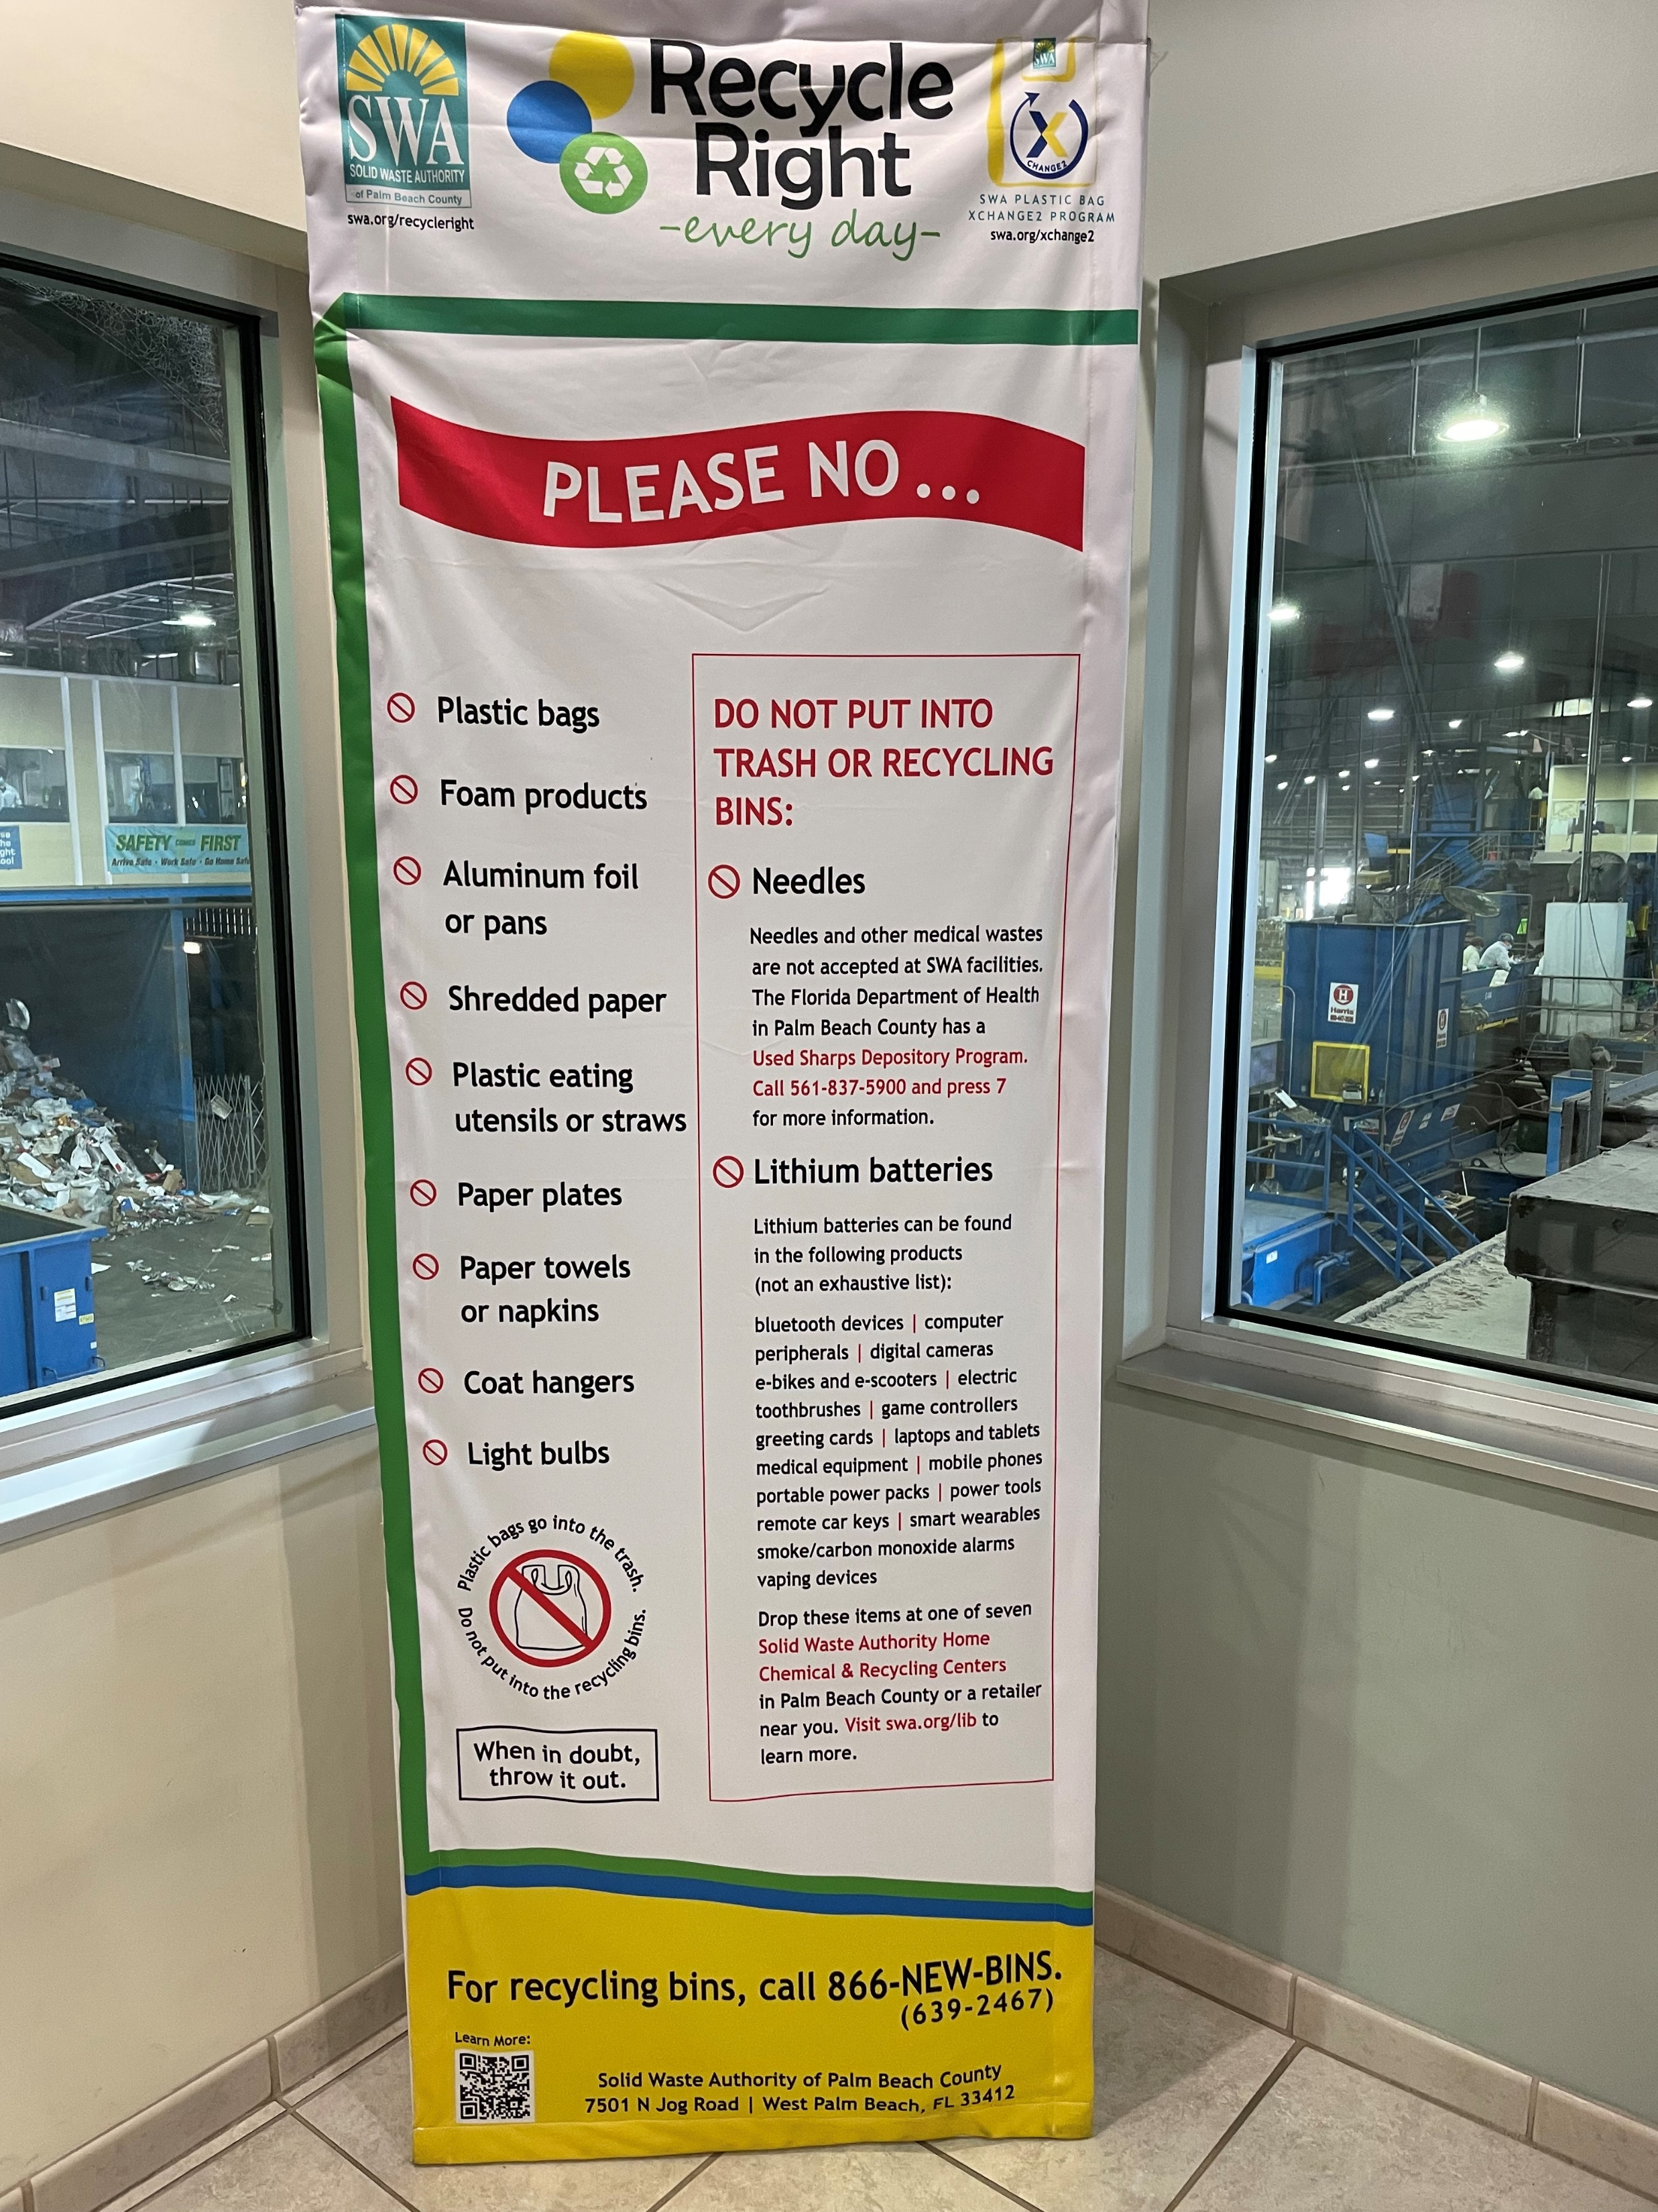

Slide 19
Information for this slide credited to:
Palm Beach County Solid Waste Authority
Scientific Truth About Waste-to-Energy by Marco J. Castaldi, Ph.D. – Chemical Engineering Department, City College of New York City, University of New York

