Slide 1
Minimize Waste & Maximize Resources
Keep communities clean with cooperative purchasing
April 28, 2026

Slide 2
“I have absolutely no idea how I could ever spend all of this extra money in my budget.”
Notes:
Let’s start out with this quote I found and see if you can guess who said it…

Slide 3
“I have absolutely no idea how I could ever spend all of this extra money in my budget.”
— No One Ever
Notes:
You guessed it… No one has ever said that… especially no one connected to public service. And, that’s why we are all here today. Let’s figure out how we can maximize resources during budget uncertainty.

Slide 4
Sourcewell is Government
Local unit of government
Headquarters in Staples, MN
Cooperative purchasing program in U.S. and Canada
  1,000+ contracts
  50,000+ participating agencies
Notes:
Authorized by the State of Minnesota. For government; by government.
Sourcewell is a local unit of government established in 1978 with a cooperative purchasing program. Sourcewell is a government agency just like you. It serves government, education, Sourcewell can speed up your buying process by offering competitively awarded contracts with hundreds of suppliers you care about.

Slide 5

Three Quick Answers
  What is public procurement?
  What is cooperative purchasing?
  What do I do next?
Notes:
We are going to start out with three quick questions to drive our conversation today. Most importantly, you can expect three quick answers to these questions by the end of the session.
Learning objectives/outline:
1. Leave with a deeper understanding of public procurement.
2. Learn how Sourcewell could fit into your purchasing/procurement strategy
3. Learn how to get started with Sourcewell
4. There’s always a human connection with Ashley as dedicated POC

Slide 6
Before We Begin: Defining a Few Key Terms
Procurement
The public process of planning, sourcing, evaluating, and purchasing goods and services in a fair, transparent, and compliant way.
Cooperative purchasing
A purchasing method that allows public agencies to use competitively awarded contracts established by another public entity or cooperative.
Request for proposal (RFP)
A solicitation used when an agency is seeking the best overall solution and will evaluate factors beyond price, such as experience, service, quality, and approach. Contracts resulting from an RFP are typically awarded based on best value or lowest price.
Best value
A purchasing approach that considers the combination of price, quality, performance, service, and long-term benefit to the public agency.
Total cost of ownership (TCO)
The full cost of a purchase over its useful life, including acquisition, operation, maintenance, repairs, training, and disposal or replacement.
Notes:
Before we begin, it would be helpful to first define a few key terms that we will be discussing a bit more in depth today.
Procurement
CP
RFP
Best Value
TCO

Slide 7
Understanding Your Role in the Procurement Process
Notes:
So… As solid waste management professionals, you may be wondering, just how does any of this pertain to keeping communities clean, collecting refuse, and processing recycling? Well – lets set the stage.

Slide 8
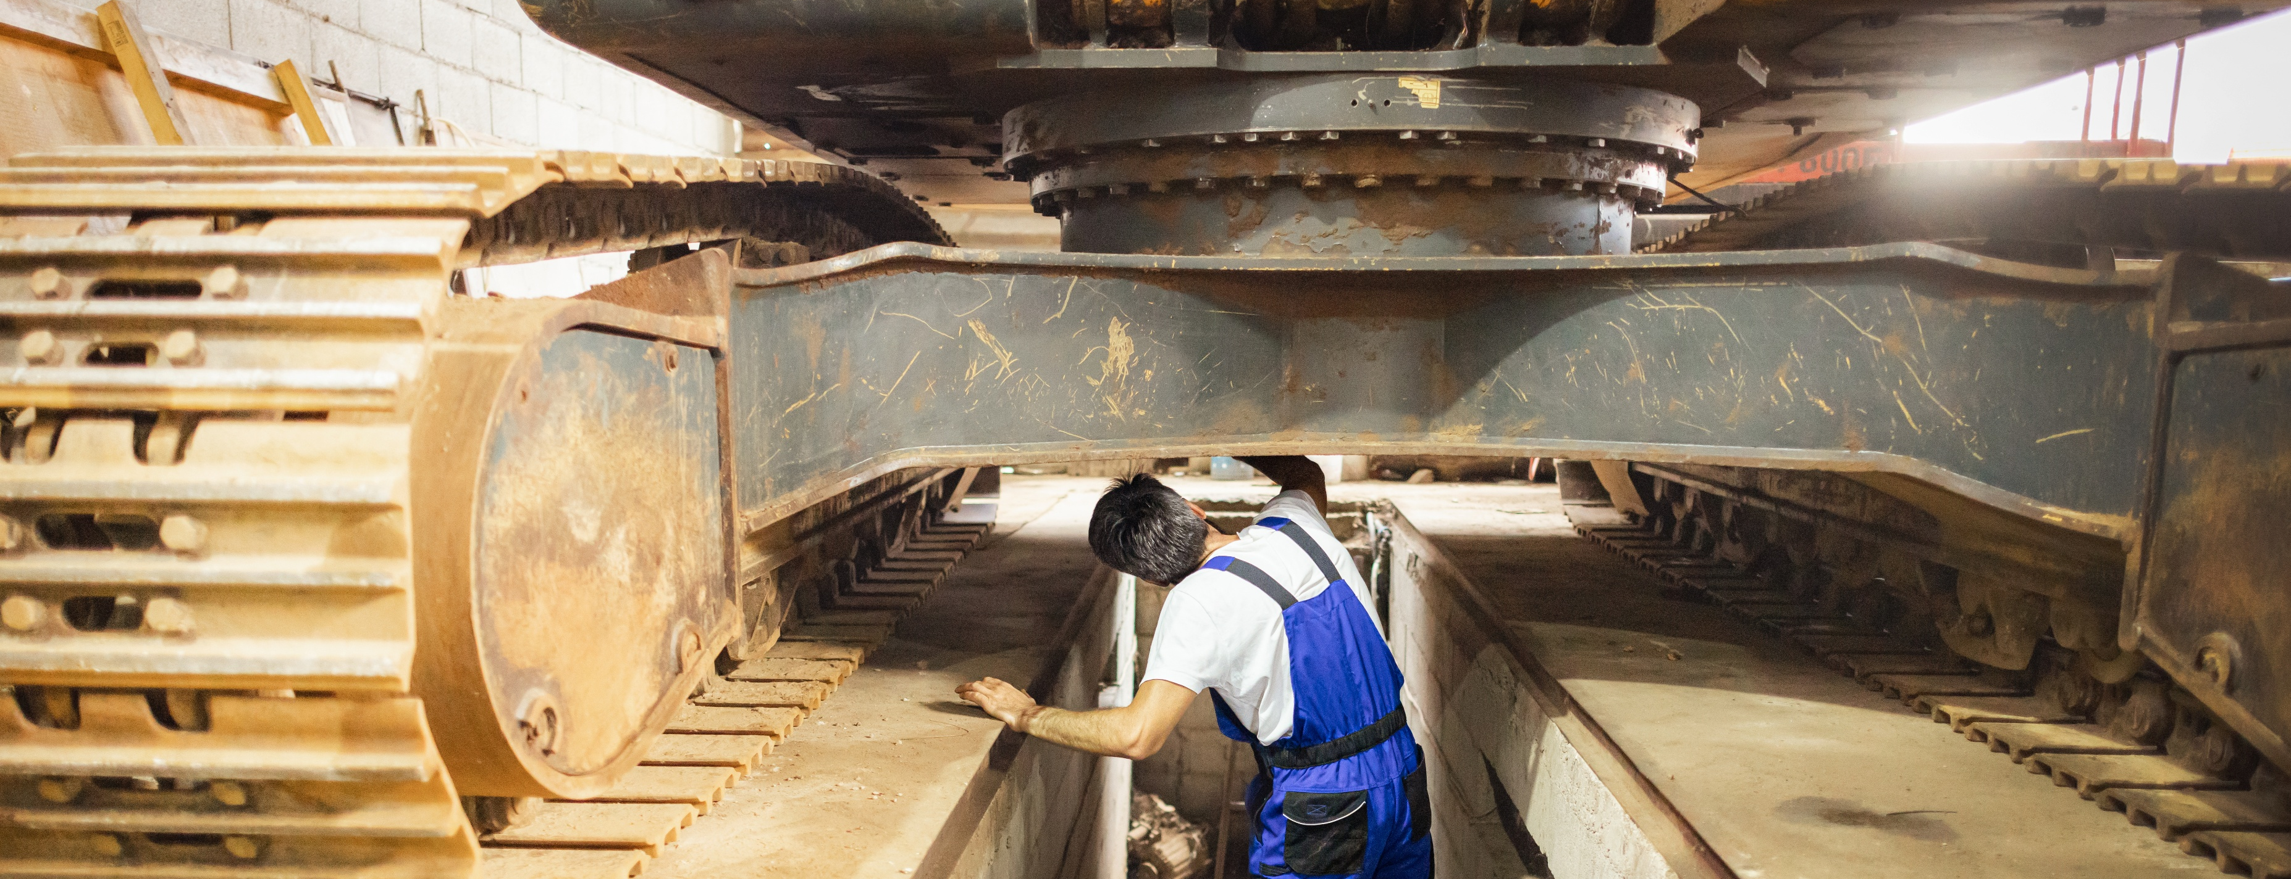
Setting the Stage
Notes:
To set the stage today, lets consider the following scenario:
"It is 7:15 on a Tuesday morning. The landfill opens soon, trucks are lining up, and one of the pieces of equipment you rely on every day is acting up again. Maybe the loader will not start consistently. Maybe the compactor is down. Maybe a baler at the recycling center has been limping along for weeks and now it is fully out of service. At that moment, nobody on site is thinking, “This is a procurement issue.” They are thinking: How do we keep the site running today? How long can we work around this? Do we have a backup plan? Who can fix it? How fast can we get parts or replacement equipment? That is exactly where procurement becomes real. Procurement is not just paperwork in an office. Procurement is the process that helps turn an operational problem into a legal, documented, and timely solution. It is how public agencies get the equipment, parts, repairs, and services they need to keep work moving. For solid waste operations, procurement matters because when equipment is down, operations slow down. Safety risks increase. Maintenance costs rise. Customers wait longer. Staff have to improvise. Small problems become expensive ones. And the most important thing to understand is this: Procurement does not start at a desk. It starts with the people doing the work.“
The landfill operator who notices the machine is failing more often.
The recycling center employee who knows a conveyor is no longer keeping up.
The mechanic who sees that repair costs are starting to outweigh replacement.
The supervisor who knows the current equipment no longer matches the workload.
Those people are often the first step in the procurement process.

Slide 9






Understanding Your Critical Role in Procurement
See something wrong?
Say something.
Document everything that’s happening.
Communicate risks and tradeoffs to stakeholders.
Identify what is actually needed.
Share expertise and past vendor experiences.
Help review quotes, specs, or product fit.
Notes:
You help procurement by:
spotting problems early before they become emergencies
documenting what is happening in the field
explaining how downtime affects operations and safety
identifying what equipment, parts, or services are actually needed
sharing vendor information or options you know from experience
helping review quotes, specs, or product fit from an end-user perspective

Slide 10





How Procurement Helps You Succeed
Keeping you compliant and protecting tax dollars.
Getting the best price in a transparent manner.
Reducing overall agency risk.
Helping compare options objectively.
Moving the needle toward PO or contract.
Notes:
Procurement helps you by:
making sure the purchase follows the rules
getting pricing in a fair and documented way
reducing risk for the agency
helping compare options objectively
moving the need toward a purchase order or contract

Slide 11
How Does Procurement
Work?

Slide 12

Your Buying Decisions
  What are you going to buy?
  How are you going to buy it?
Notes:
Every public purchase starts with two basic questions
Decision 1: What to buy
Decision 2: How to buy
The Answers usually start by looking at the price tag

Slide 13






Public Procurement Spending Thresholds
Document process often 3 quotes
Lower limit
Upper limit
Buy whatever you want
Formal RFP Process
Notes:
For those of you newer to public procurement, here’s a quick snapshot of the way most public entities structure their procurement policy. They will generally have a lower limit and an upper limit. If you're buying something below the lower limit… like 5-10 thousand dollars, then you can just usually get a PO and cut a check.

Slide 14
Public Procurement Spending Thresholds
Document process often 3 quotes
Lower limit
Upper limit
Buy whatever you want
Formal RFP Process
Notes:
If your price tag then sneaks above the lower limit but is still below the upper limit, which we will say is 50-thousand dollars, then you are generally required to obtain three quotes. Let’s say you are buying some new body armor for 35-thousand dollars, then you are in that middle range between upper and lower limit requiring documented quotes.

Slide 15
Public Procurement Spending Thresholds
Document process often 3 quotes
Lower limit
Upper limit
Buy whatever you want
Formal RFP Process
Notes:
Because a lot of our purchases in public safety are big-ticket items, they often push past that upper-limit threshold and require a formal RFP process. Formal RFP doesn’t mean you have to do your own RFP. You can tap into other entities who’ve done most of the work for you in advance… through state contracts and cooperative purchasing contracts… Like Sourcewell.

Slide 16
You Have Choices
Brand A
Brand B
Brand C
RFP
RFP
RFP
OR
OR
Cooperative (Sourcewell)
State contract
OR
Cooperative (Sourcewell)
Notes:
When the price tag gets over the upper threshold... Your big-ticket items forces you to go through a competitive solicitation process, on your own or through a procurement partner. In this example... you can always do your own traditional RFP for any product. Brands A and C also have cooperative options... and Brand C has a state contract option. When you do your own RFP, you always run the risk of low bid/low quality responses which can limit choices.
More Explanation… if time permits…
In the public sector, there are three main ways that agencies have at their disposal to procure goods and services LEGALLY (the operative word there being legally).
Your first method is a standalone solicitation – be it an RFP, ITB, IFB, etc. Your agency is self-managing the process, from scoping the solicitation, to conducting the formal process, evaluating respondents, and then awarding contracts on the basis of lowest cost or best value. This is the bread and butter of the procurement domain, with virtually every public entity conducting at least one of these a year. The biggest consideration here to remember though is “Garbage in, garbage out.” If the solicitation is inaccurately scoped, you may find that your respondent pool is lacking in depth and quality – which can ultimately result in sub-optimal performance from awarded suppliers.
The second method at your disposal is going to be accessing state contracts. These contracts have been adapted by a state agency, and are made available for a broader audience to be able to procure from. This option represents a fast pass if you will, to begin purchasing what you need, when you need it, without having to conduct your own solicitation.
The third and final option is cooperative purchasing, a fast pass with the built-in-benefit of being able to aggregate purchasing power from a plethora of agencies, resulting in competitive pricing and T’s and C’s that quite often times will be more advantageous than those that are as a result of a standalone RFP. These agreements have been competitively solicited and awarded to suppliers, usually on the basis of best value, with cost usually being one of the main considerations.

Slide 17
So….. What is cooperative purchasing?
Procurement conducted by, or on behalf of, one or more government units for use by other government units.
Notes:
“Cooperative purchasing means the heavy competition work is done up front by a national or regional program. Cleveland can piggyback on those pre‑competed, awarded contracts instead of starting from scratch. You still define what ‘good’ looks like—performance, fit, training, service. The cooperative simply shortens the middle and gives Purchasing a compliant path to buy.
Common myth: ‘Isn’t that sole‑source?’ No. The competition already occurred at the cooperative level. You’re using an awarded contract that met public procurement standards. You still keep our specs brand‑neutral unless there is a documented, safety‑critical need.”
Bridge: “Alright—if that’s the concept, what are the takeaways?”
Transition: “Three fast answers.”

Slide 18
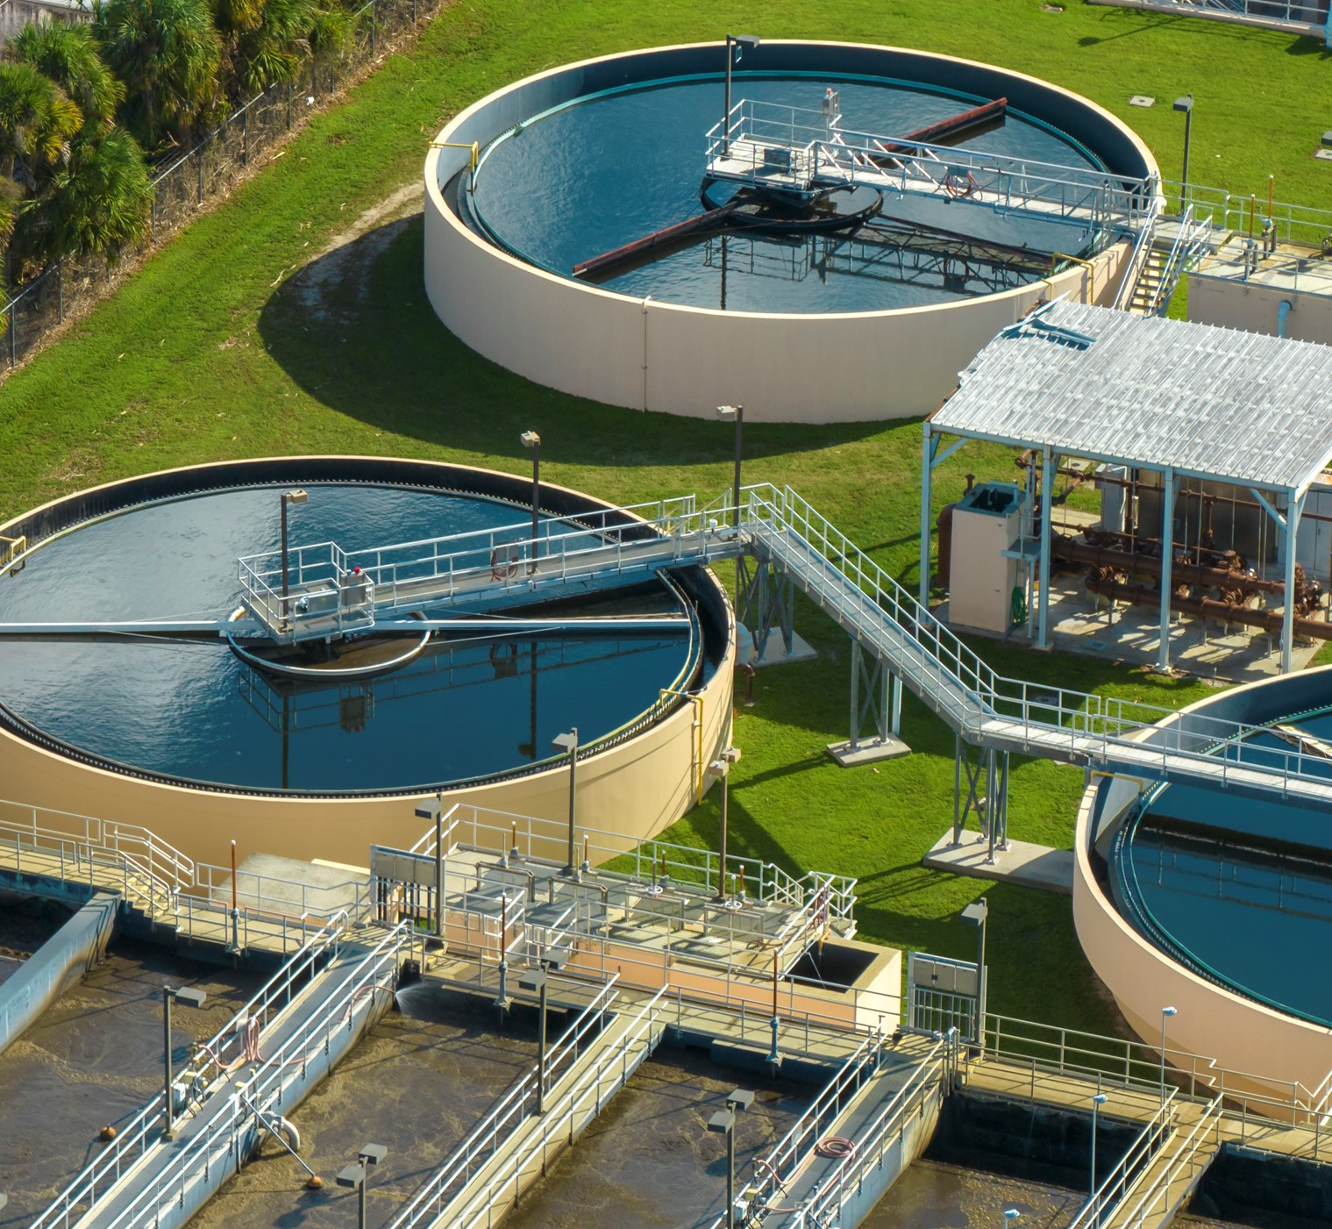
Cooperative Purchasing Benefits
  Provides competitively awarded contracts
  Creates efficiency and savings
  Get what you need, when you need it
  Enables you to work with local suppliers
Notes:
For those of you not familiar with cooperative contracts… here’s a quick snapshot of the advantages… with the biggest one being the first bullet where you do fulfill the legal obligation to go through a competitive solicitation for those big-ticket purchases.

Slide 19
Traditional Procurement Process
Time
Define need
Create Specs
RFP/Solicitation
Place order
Varies with need
Notes:
When you look at the traditional procurement, where an entity does their own RFP… the amount of time it takes to buy goods and services varies according to what you are buying. However,… the common thread anytime using this method is… the solicitation process is the most time-consuming part of the purchase. The whole process will take time, and the RFP/solicitation will always eat up a majority of any timeline.

Slide 20
Traditional Procurement Process
Less Time
Define need
Create Specs
Cooperative
Place order
Time Savings
Also saves money!
Notes:
When using a cooperative, you are replacing your own solicitation process with a cooperative contract already competitively solicited on your behalf. If you can replace the time-consuming part of purchasing with a cooperative contract, then you’ll save time… which is always means saving money, especially when you can free up staff resources for other purchases.

Slide 21
The Outlook for Cooperative Purchasing
National Co-op Sales Trend & Forecast
Billions of Dollars
$109.5
$93.5
$79.8
$64.8
$54.4
$40.7
2018
2020
2022
2024
2026
2028
Source: GovWin from Deltek 2026
Notes:
Cooperative purchasing continues to grow as a recognized best practice for public purchasers.
Latest Deltek data projects CP will almost triple in dollars spent during a 10-year span starting in 2018.
Even in the pandemic years, you can see continued growth in cooperative usage. Through those first covid years in 2020 and 2021, the use of cooperatives for PPE and other critical needs really became apparent.

Slide 22
West Virginia Agencies Leverage Sourcewell
(FY ‘22-‘23 thru March ‘26)
Local Government & Special Districts
$64.82M
181
579
Total spend
Contracts utilized
Registered agencies
Top Spend Categories
Fleet & related
Public safety
Construction equipment
Source: Internal data, Sourcewell (2026)

Slide 23




Making a Purchase – A Simpler Process
Decide what
you need
Choose suppliers
and request quotes
Work directly
with local business
Make purchase
Notes:
Cooperative purchasing makes procuring solutions, goods, and services for your fleet much more simple – you already have long lead times to contend with as a normal component of business – why NOT simplify your process and save time where you can?
1-Decide what you need: internally figure out what you or your end users need.
2-Choose suppliers and request quotes: search the cooperative’s website for awarded suppliers (for reference- SW website includes contacts on each vendor landing page)
3-Work directly with supplier: agree terms & conditions with the supplier, delivery, installation, etc. (this can often look like introducing those terms & conditions through an addendum at the purchase order level)
*Make note of contract expiration dates-you may need to add T&C to extend pricing if delivery will be after maturity date.
4-Make purchase: if you choose to go ahead with the purchase, the PO goes out to the supplier. Include your cooperative account # and supplier contract # on all documentation to create a paper trail in case you are audited
*When audited, Auditor can come right to our website for access to all supporting docs-transparency is key
Now, with a simpler process, just how much time exactly though does cooperative agreements save agencies on average?
Up until recently, this question required a bit more abstract thought – the RFP process from needs identification to the awarding of the contracts is nuanced and varies in intensity for different procurements, with each agency having their own set of requirements to satisfy as well. To help provide clarity around the efforts and costs of standalone solicitations, the National Cooperative Procurement Partners (NCPP for short) conducted a pioneer study, attempting to quantify the administrative costs associated with running a solicitation. The findings are illuminating, and help to offer insights on what it costs you each time you go to bid, as well as the potential cost savings offered by leveraging competitively solicited cooperative agreements instead of running your own solicitation.
.

Slide 24
Contracts

Slide 25
Available Offerings
Water treatment chemicals and equipment
Water service line inventory and management systems
Sewer vacuum, hydro excavations, and municipal pumping equipment
Underground infrastructure inspection and rehabilitation equipment
Water collection and control products

Slide 26
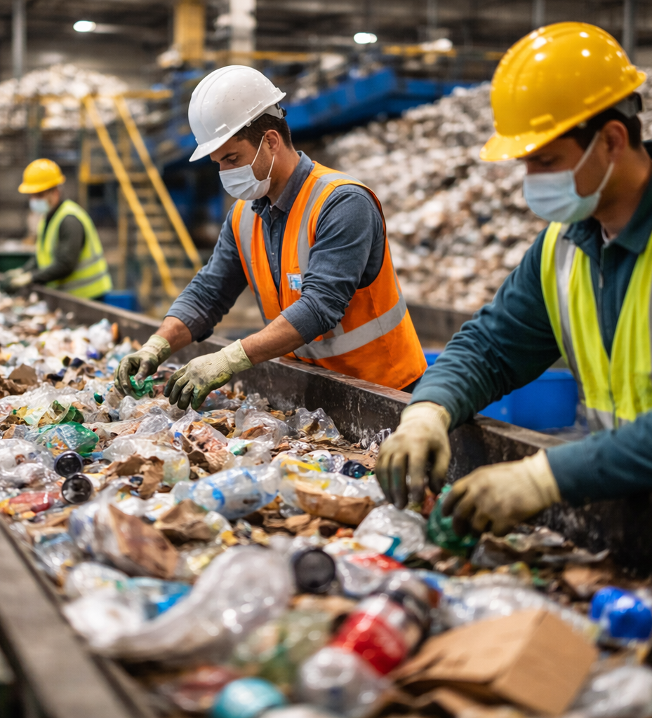
Waste Management Categories
Chassis
Waste, recycling equipment & containers
Plastic refuse & recycling containers
Compactor & baler rental
Refuse collection trucks (front-, rear-, side-loading)
Cutting edge environmental processing equipment
MRO
Uniforms
PPE
Fuel delivery & management

Slide 27
Waste Management Contracts: Pickup to Processing
Battle Motors
Bobcat
Box Gang Manufacturing
Cascade Engineering
Caterpillar Inc.
Compactor Rentals
Curbtender
Ecoverse
EDGE Innovate
Fastenal
Grainger
Heil Environmental
Labrie Environmental Group
Marathon
Max-R
McNeilus Truck
New Way FleetForce
Pac-Man
Petersen Industries, Inc.
Rehrig Pacific Company
Rotochopper, Inc.
Routeware
Safeware
Terex/CBI & Ecotec
Terex/EvoQuip
Terex/Powerscreen
Toter
UniFirst
Viably
Vestis Services
Wastequip

Slide 28


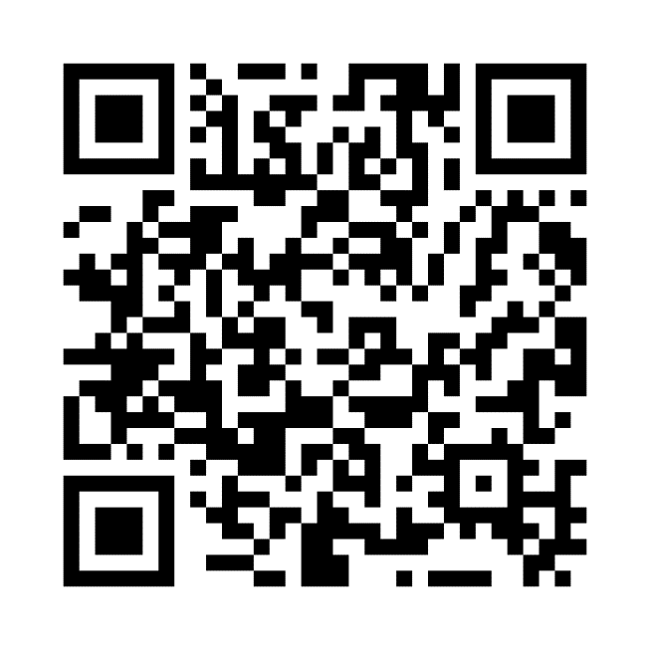
Start here.
Notes:
Products and offerings can evolve quickly. For a list of current contracts, please visit our website or reach out to your Sourcewell representative.

Slide 29
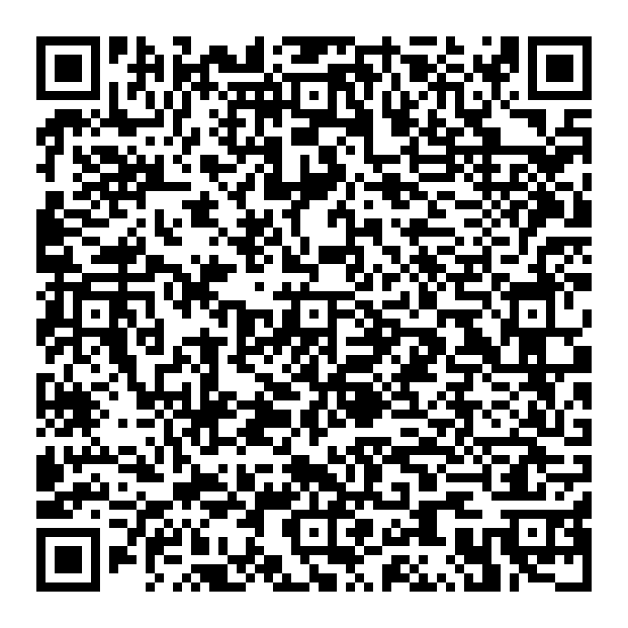

Questions?
Ashley Nielson
218-610-0649
ashley.nielson@sourcewell-mn.gov

