Slide 1


Slide 2
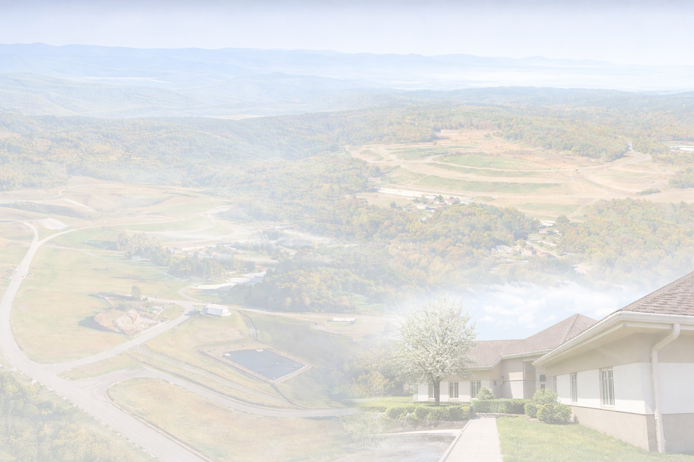
WELCOME
Travis Kiblinger – Executive Director
Employed with RCSWA since 2000
Sherrie Hunter – Director of Education
Employed with RCSWA since 2001

Slide 3
RCSWA Facility
Scale House Public Tipping Area
Last Chance Mercantile Administration
Operations Recycling
New River Clean Energy Plant Wooton Park
Litter Control Litter Crew
Vegetable Initiative

Slide 4
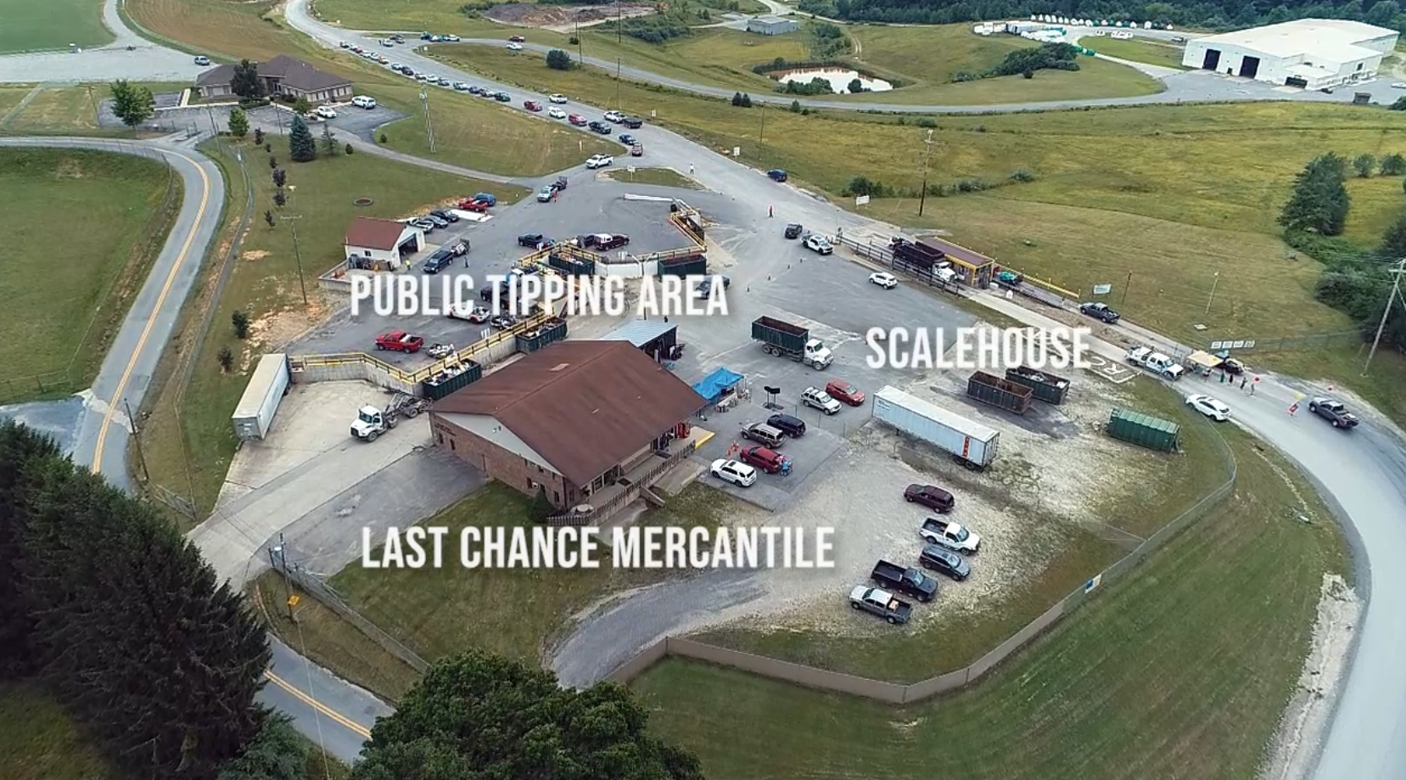
On Average 700 Additional Customers on Free Day
Donations for Last Chance Mercantile are Accepted at the Public Tipping Area and Mercantile Building

Slide 5
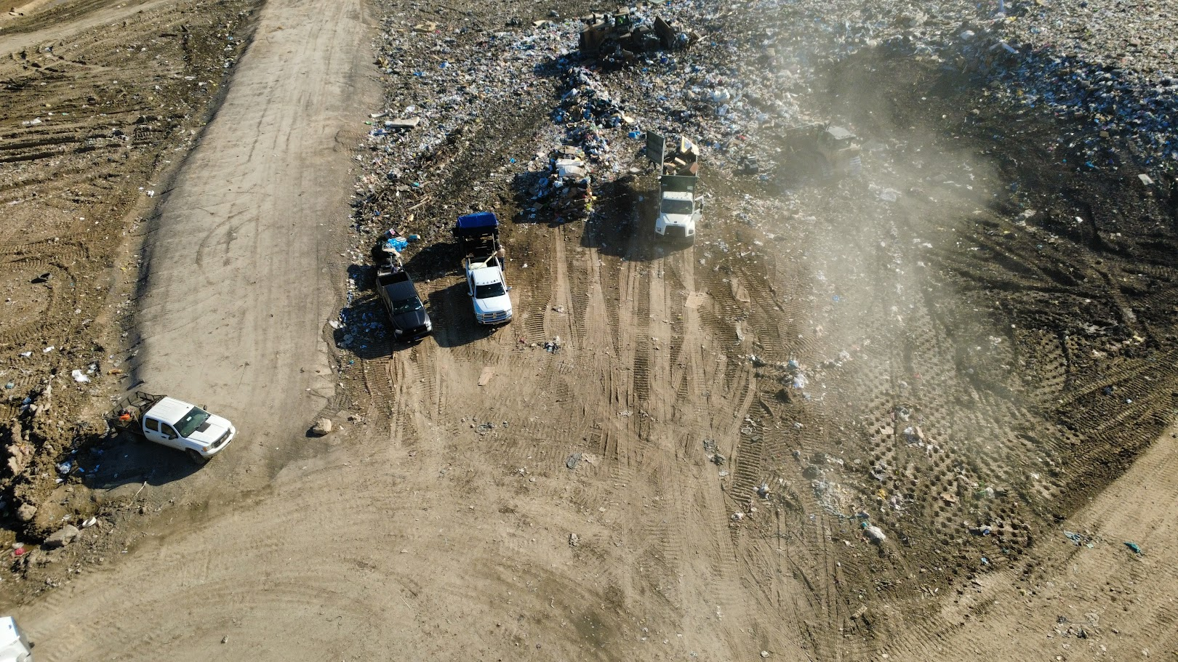
RCSWA Receives About 520 Tons Of Waste Daily
Annual Tonnage Of About 145,000 Tons

Slide 6


Slide 7
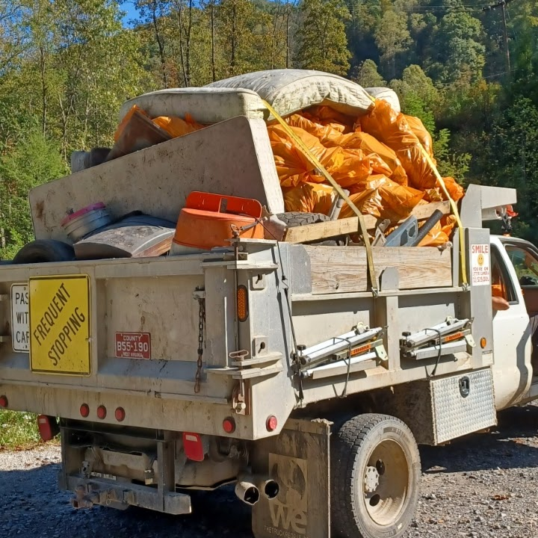

Slide 8

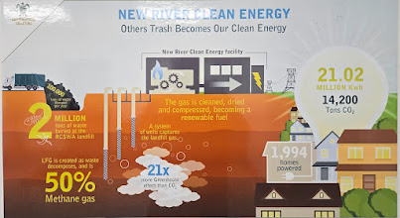

Slide 9
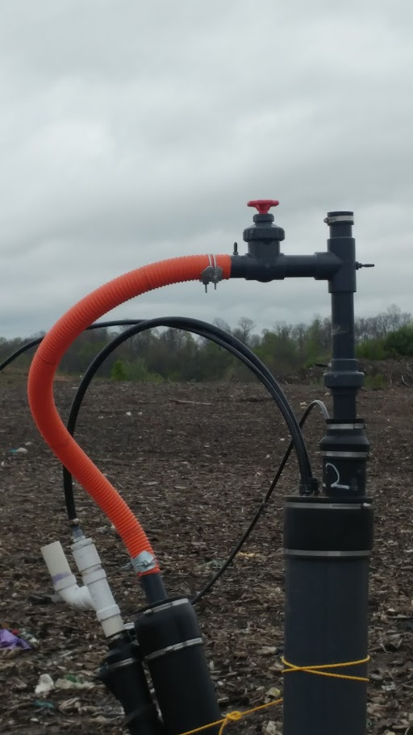
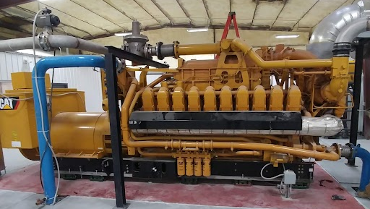
3520C Caterpillar engine genset fueled by
Landfill Methane
Producing 1.2 mega watts of electricity enough electricity to the grid to power about 1000 average homes 24 hours per day

Slide 10
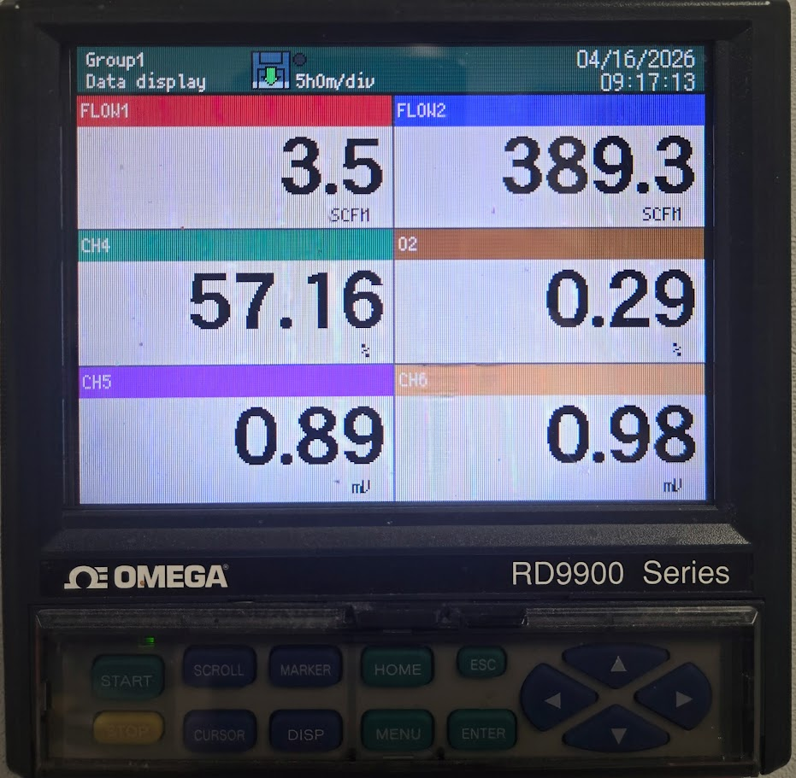
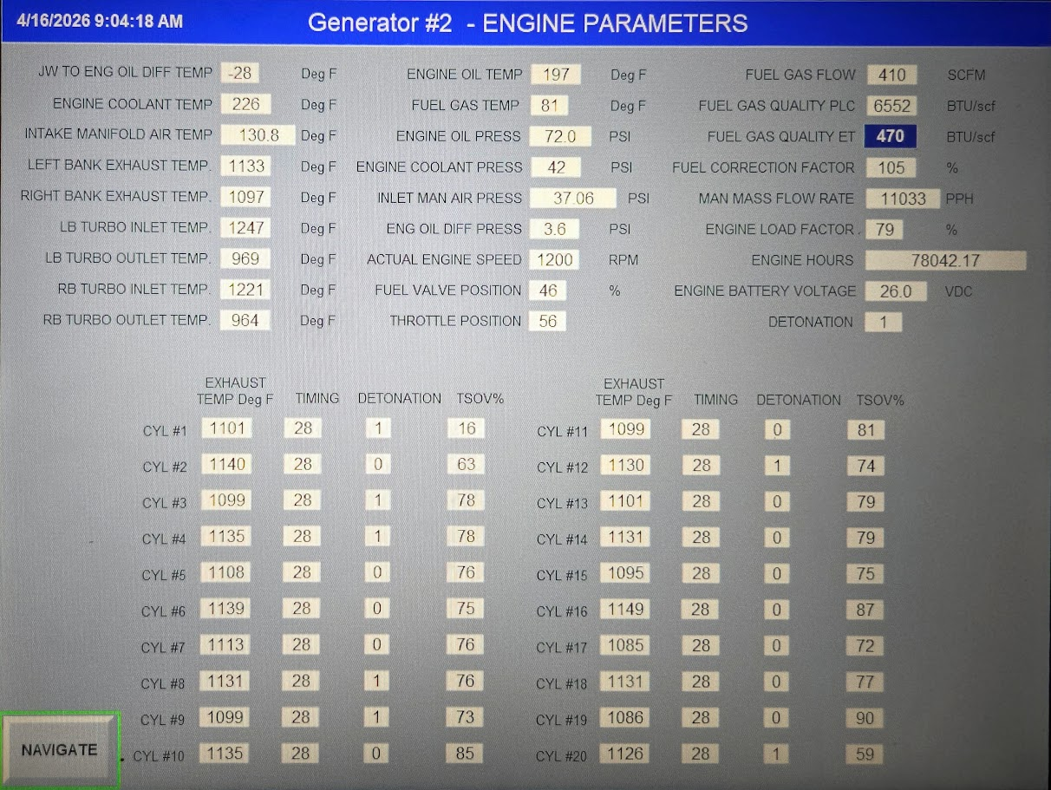

Slide 11
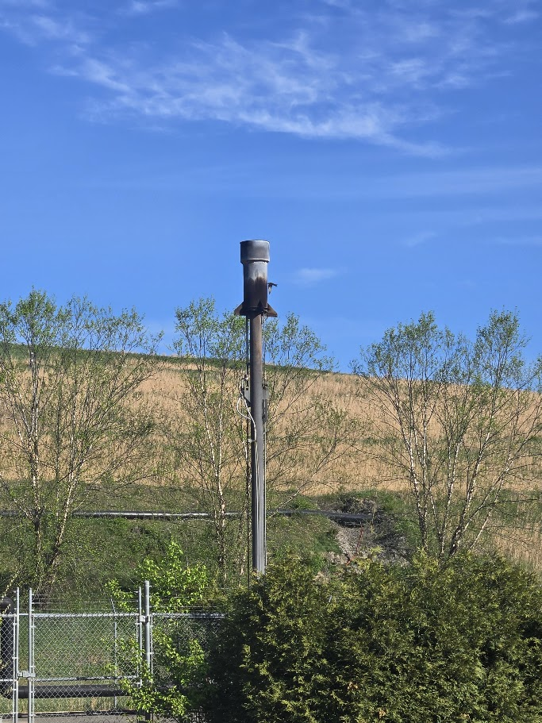

Slide 12
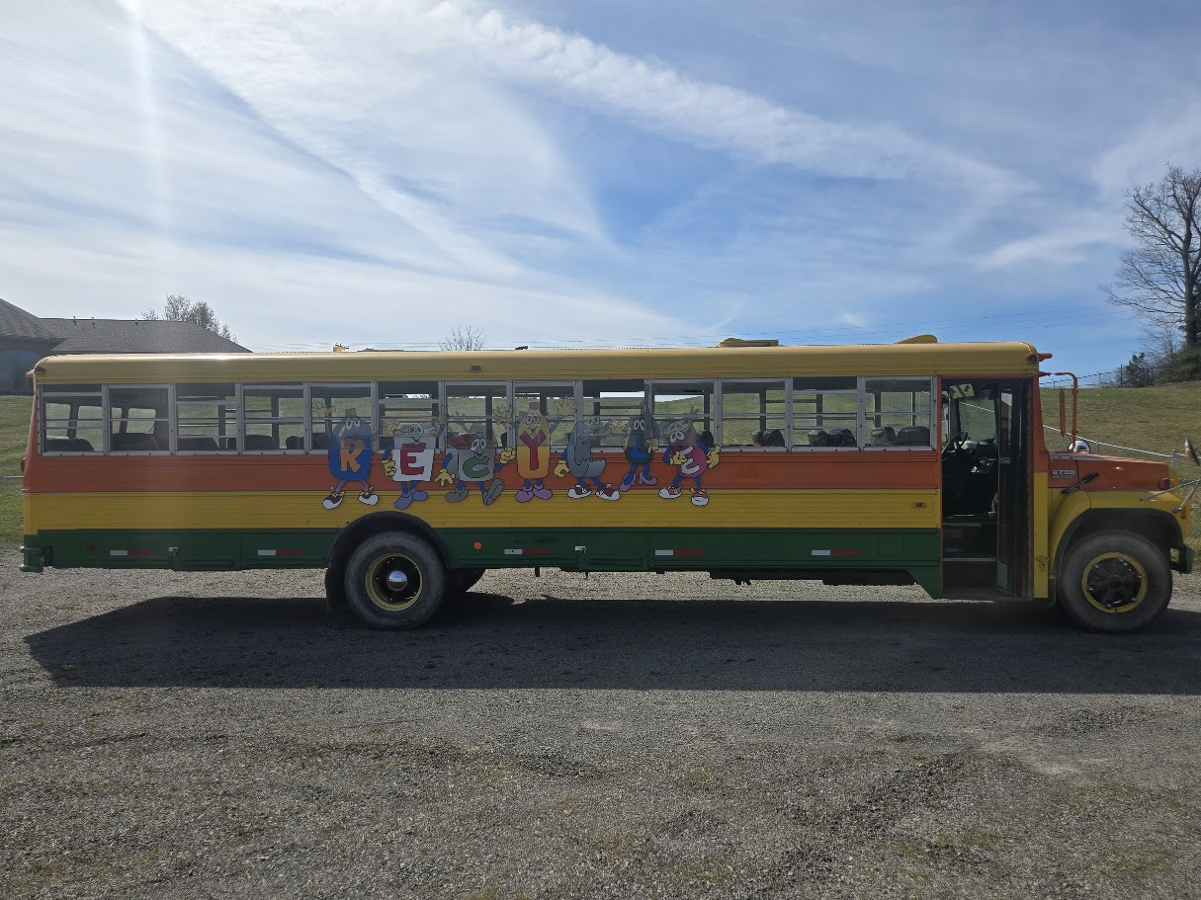
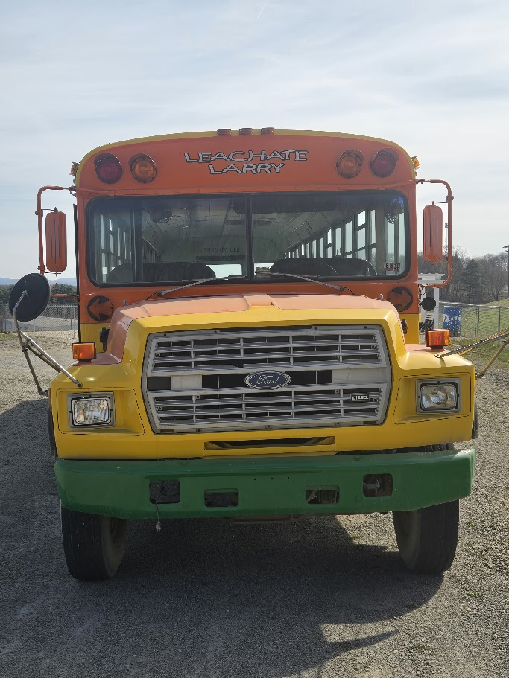
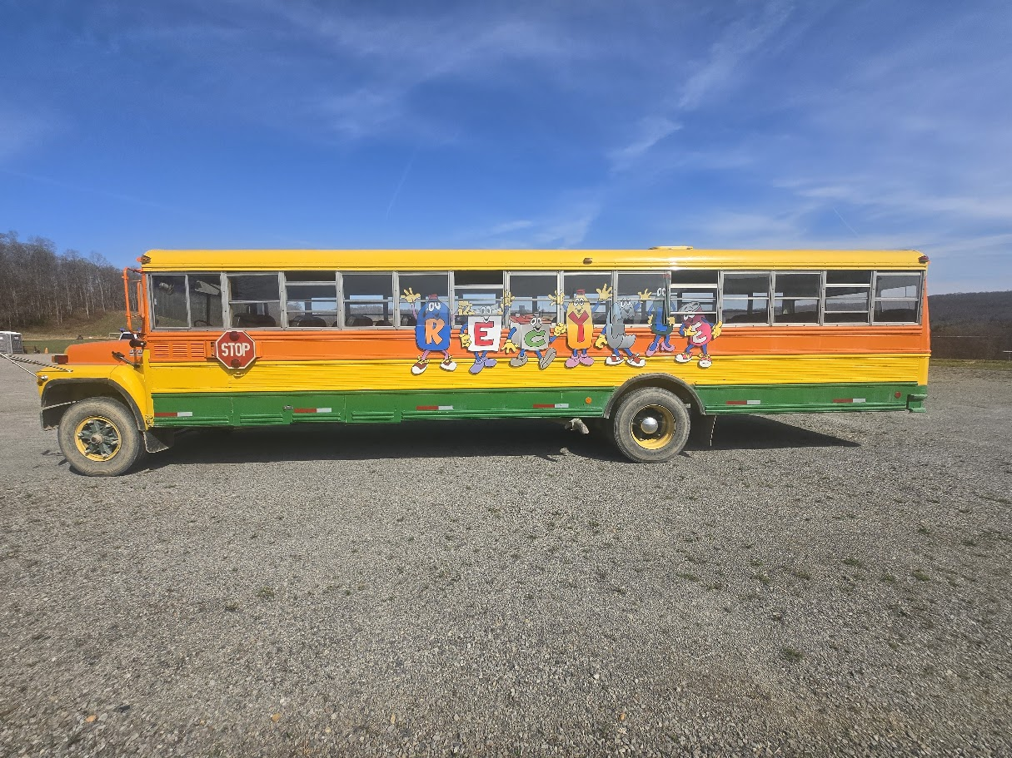


Slide 13
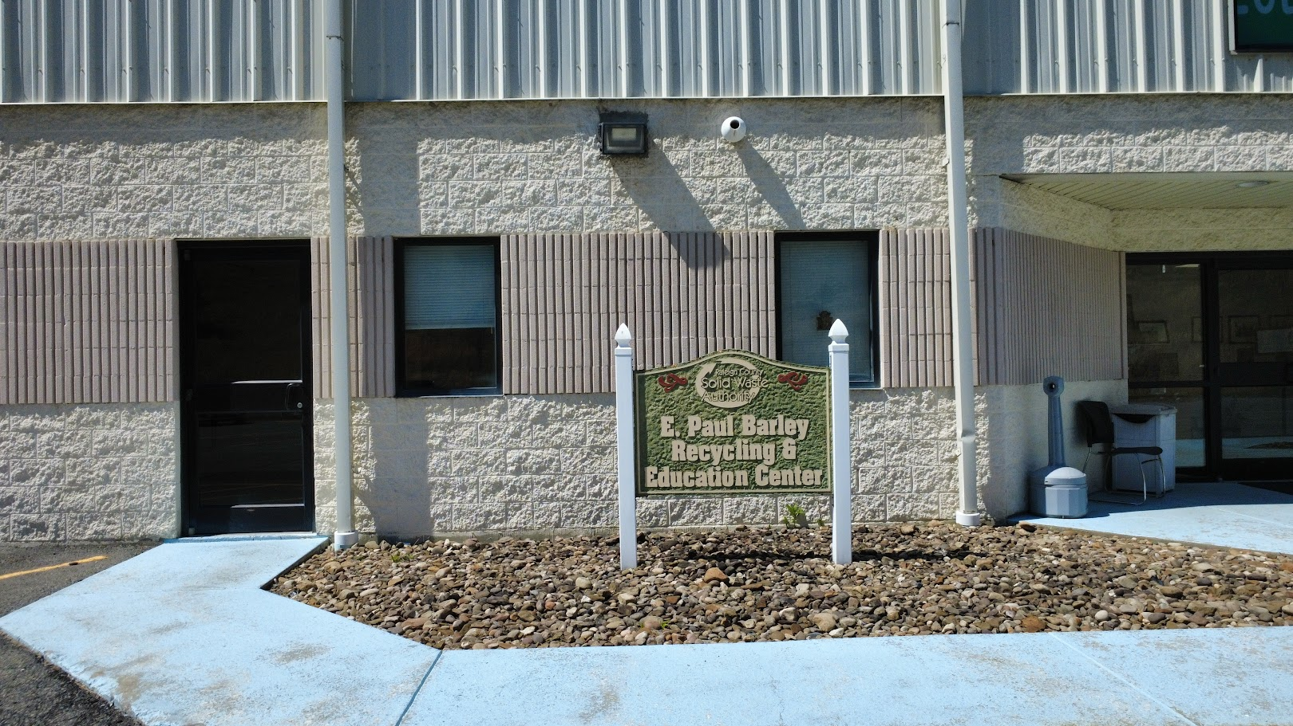

Slide 14
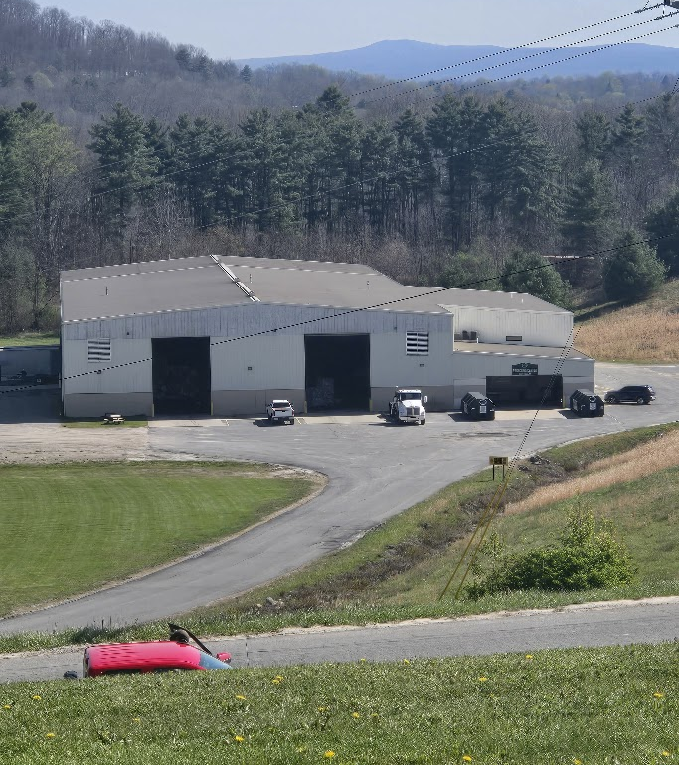
Opened in October 2004
43,000 sq.ft

Slide 15
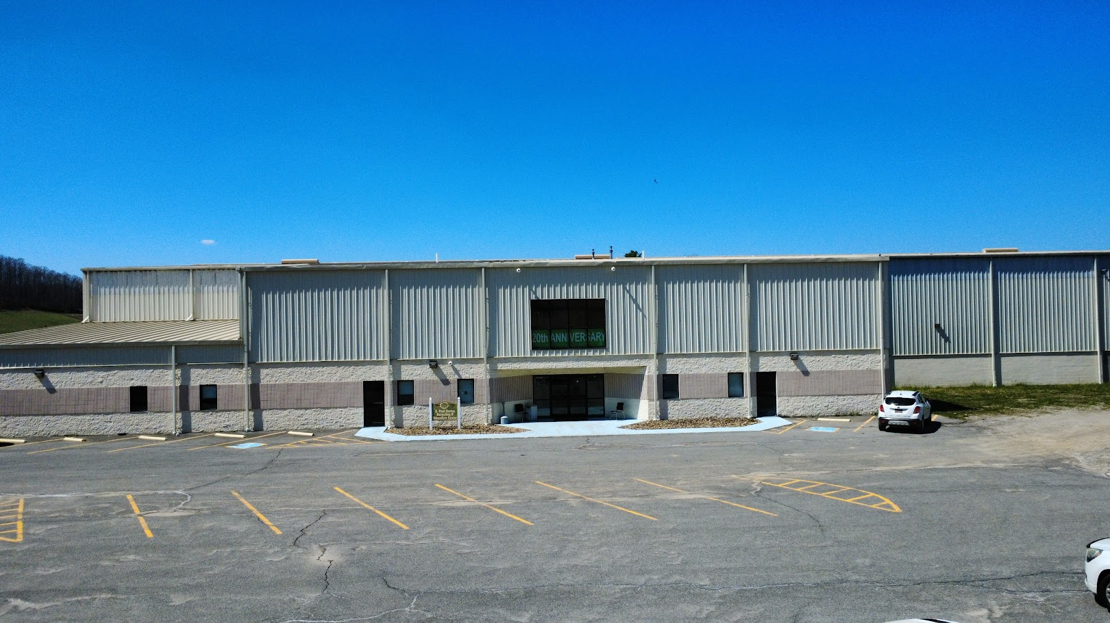

Slide 16
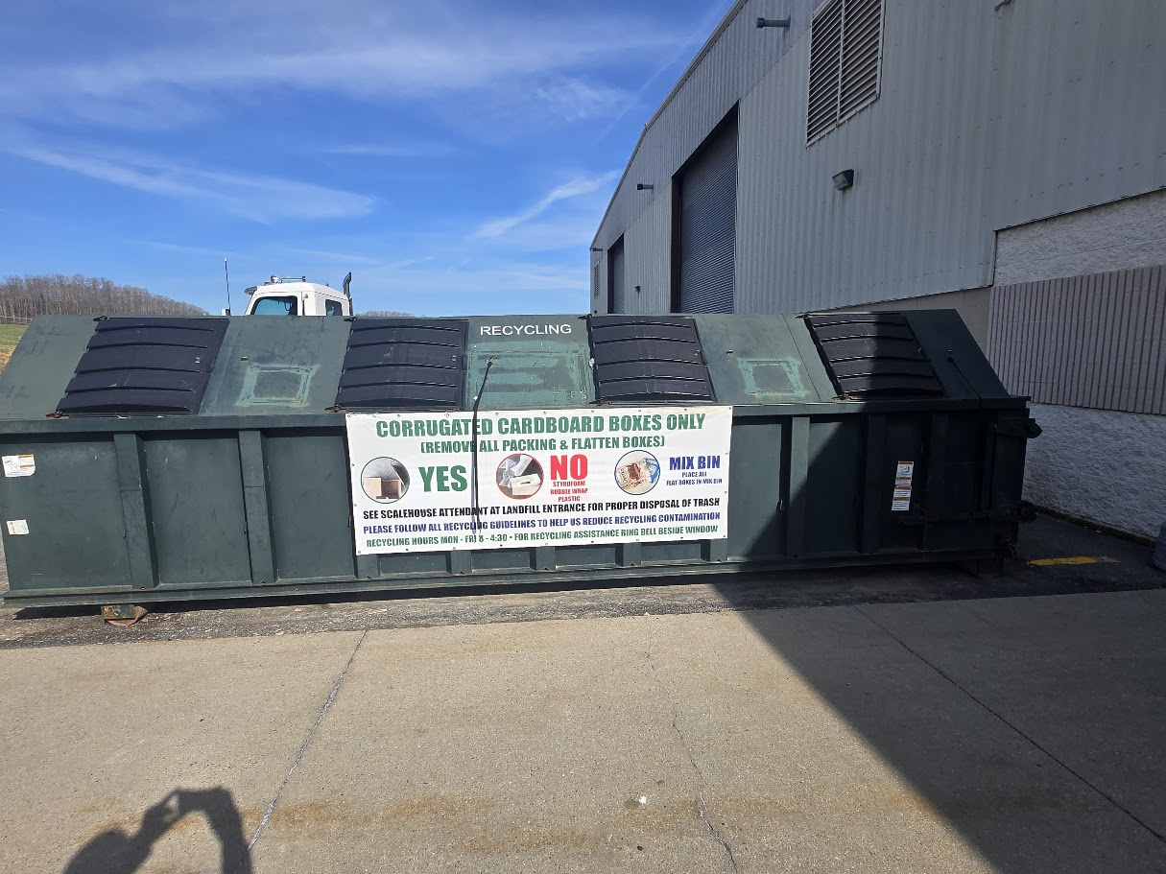

Slide 17
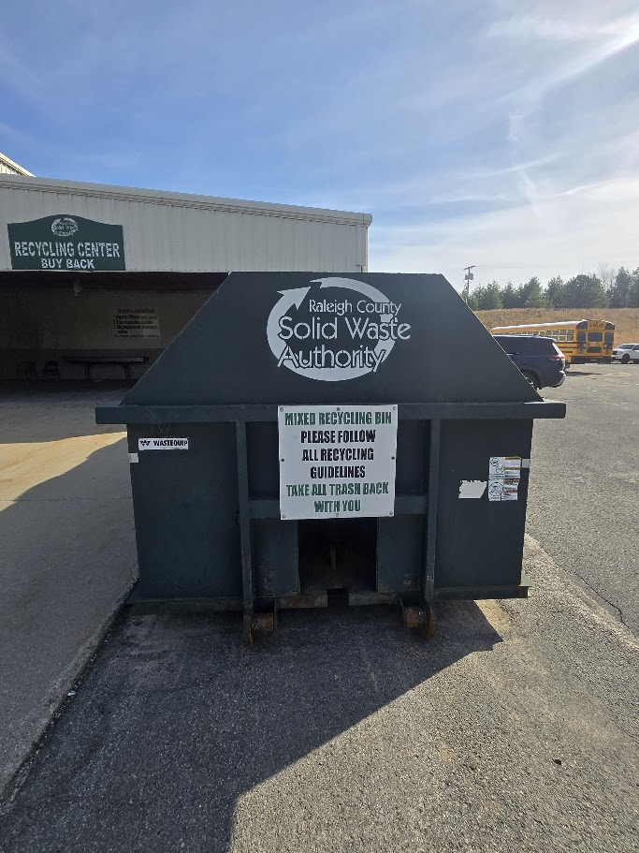

Slide 18
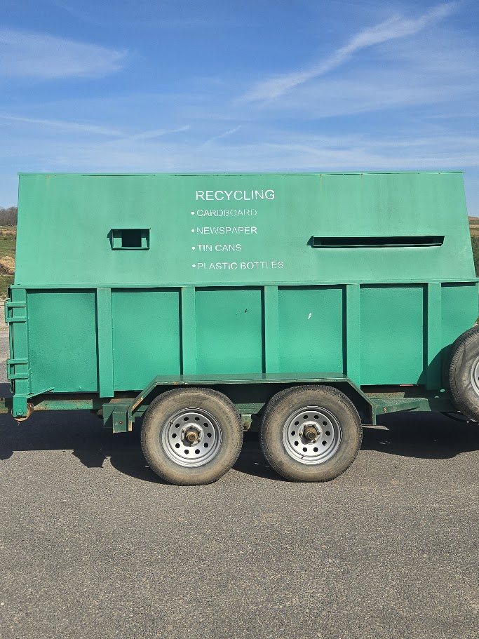

Slide 19
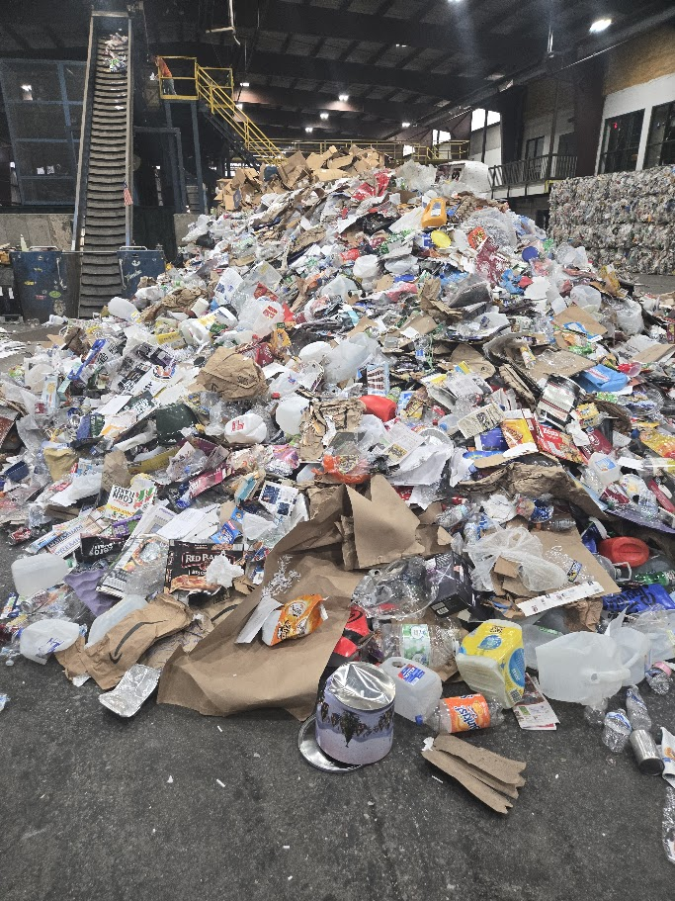
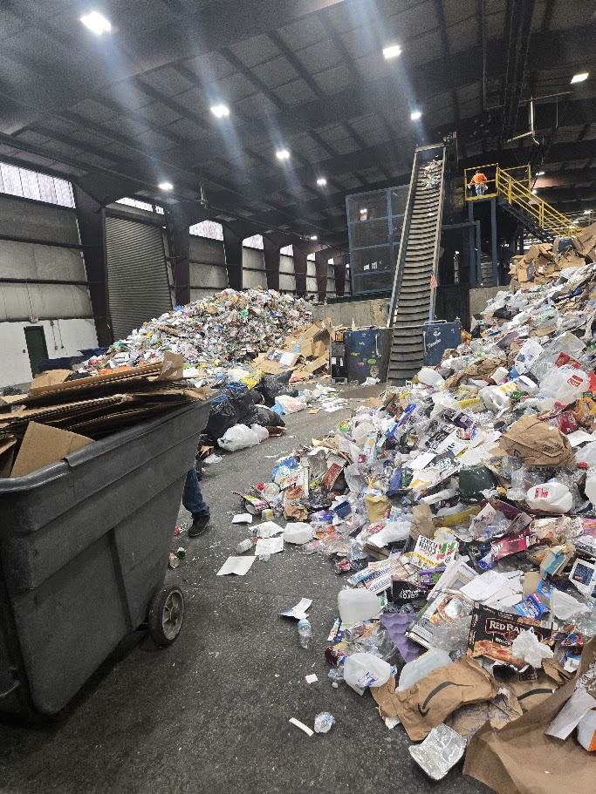

Slide 20
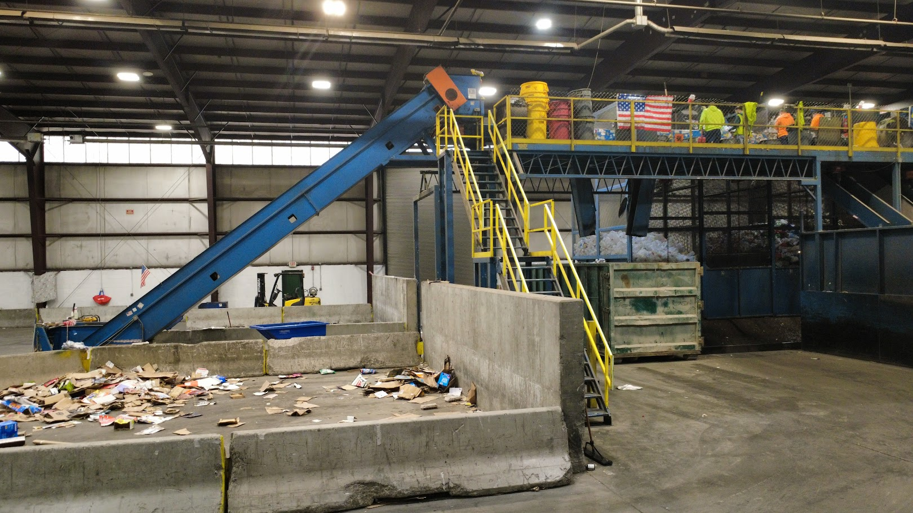

Slide 21
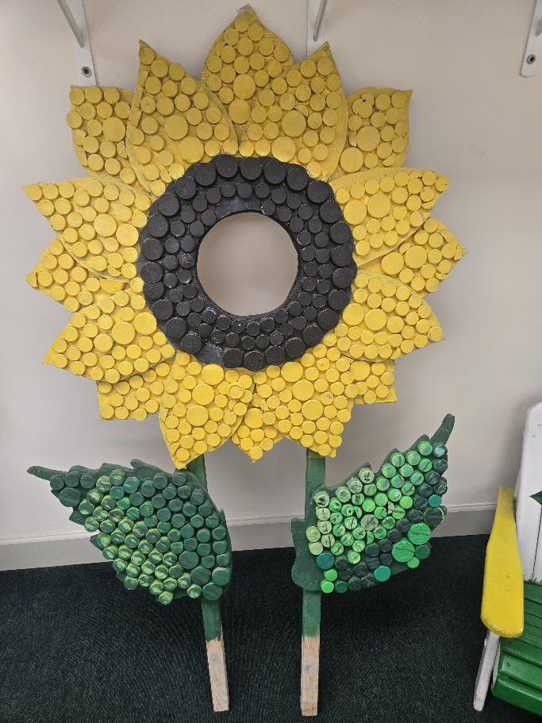
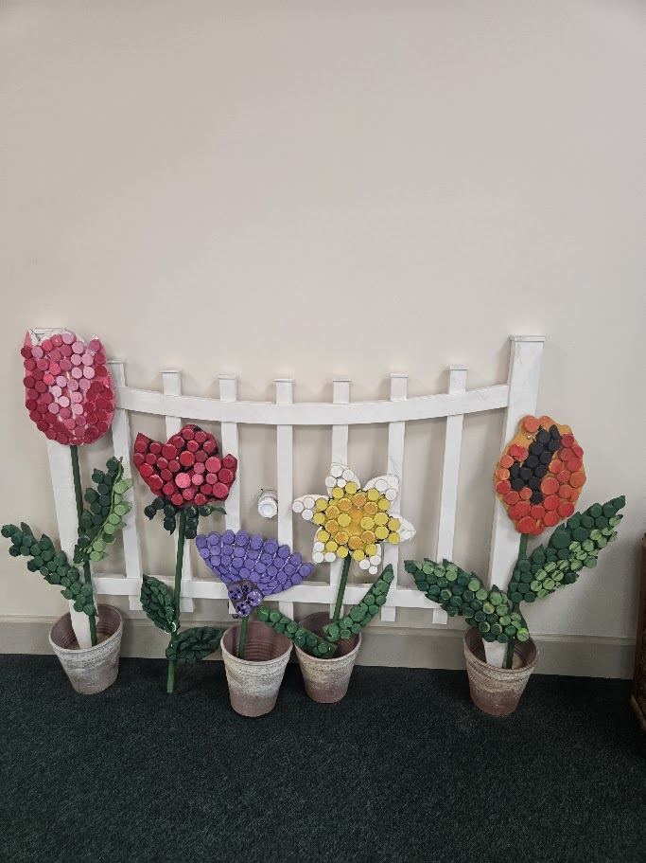

Slide 22
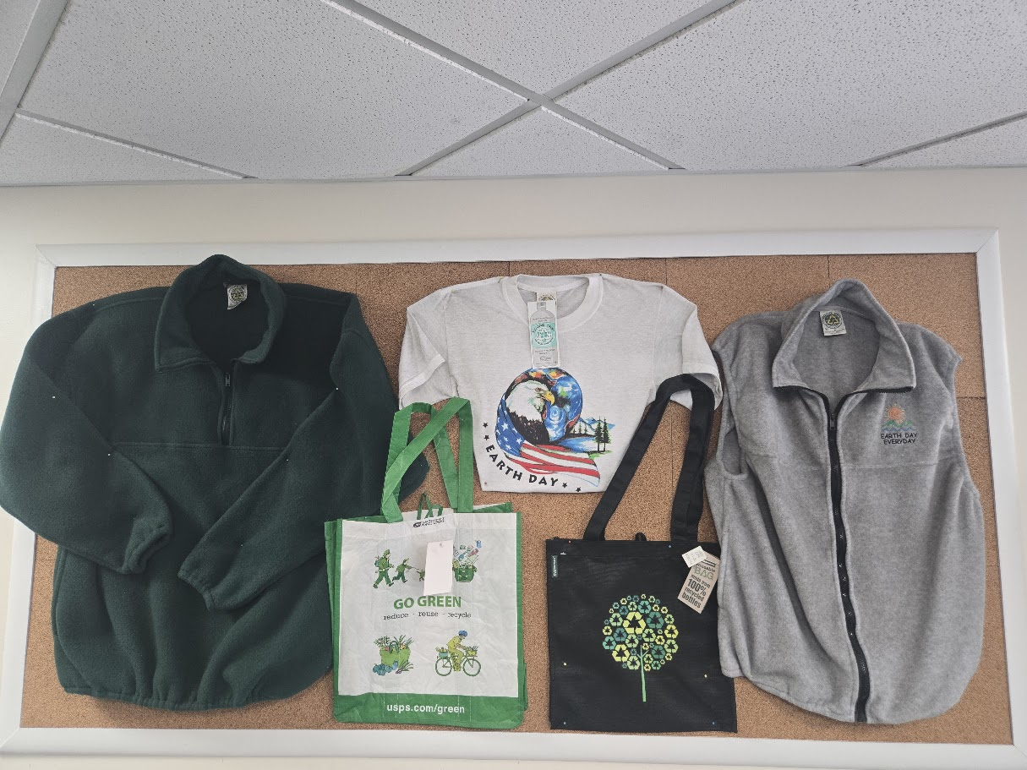
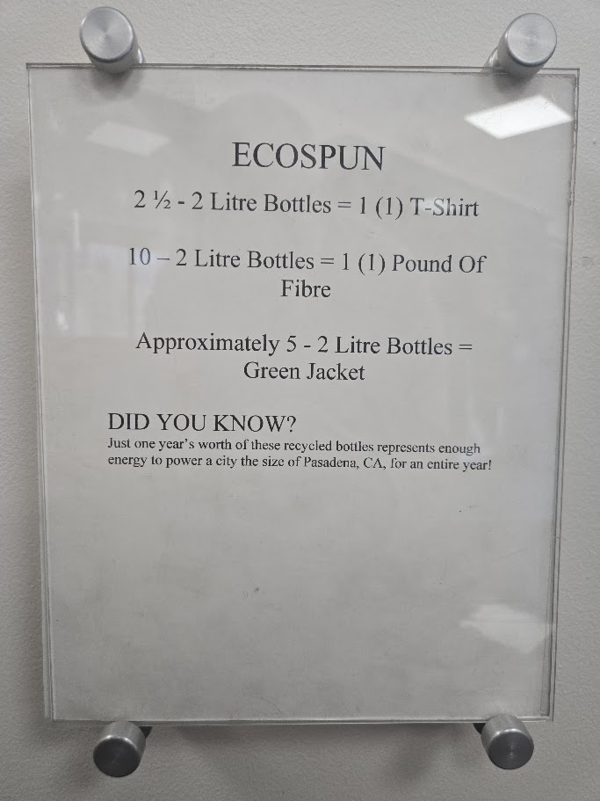

Slide 23
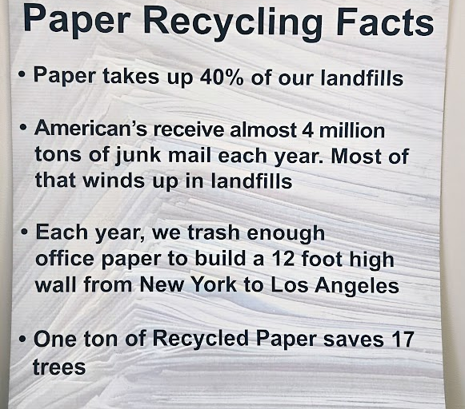


Slide 24


Slide 25
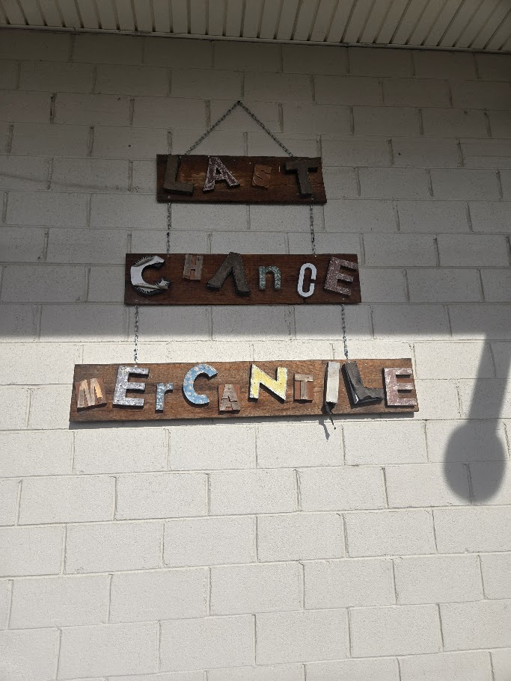
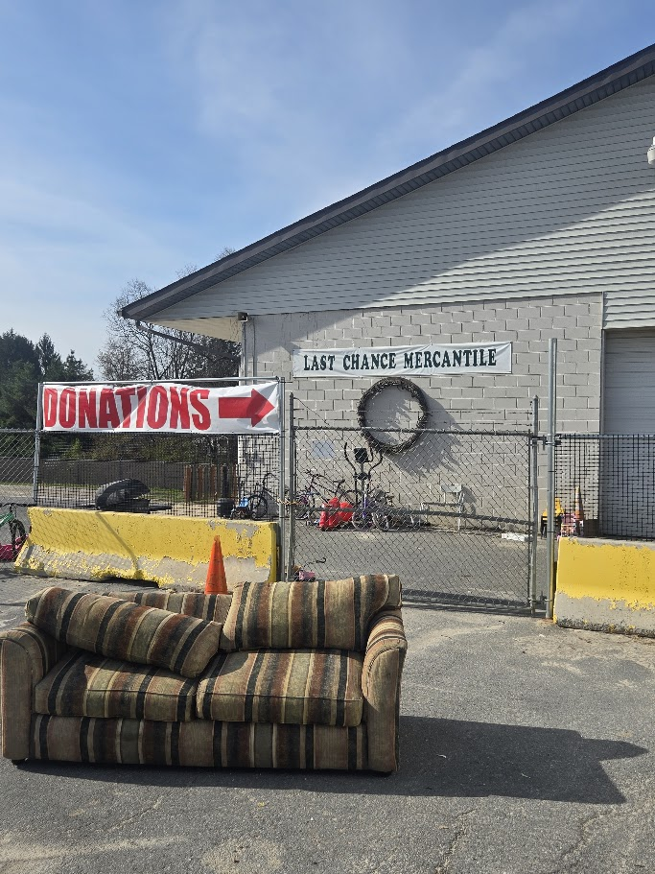

Slide 26
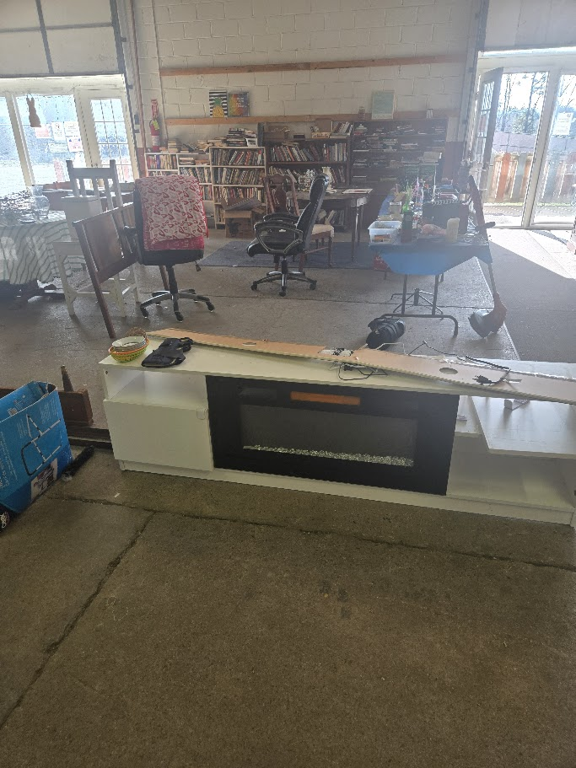
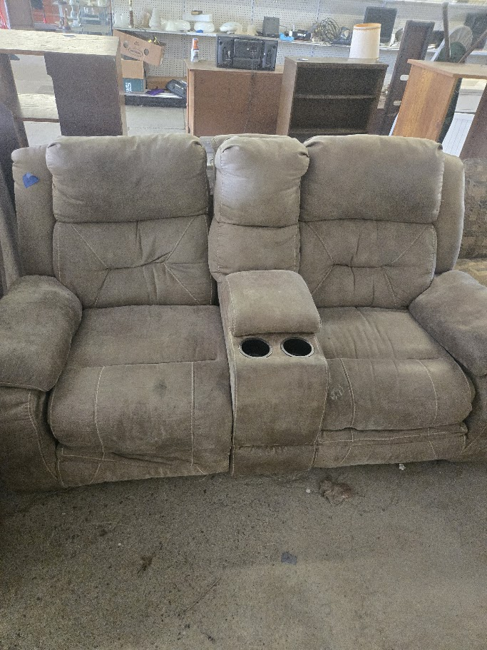

Slide 27
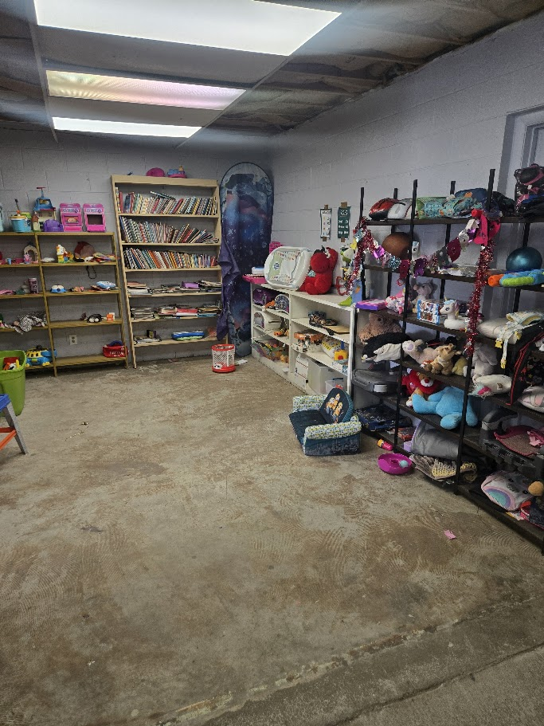
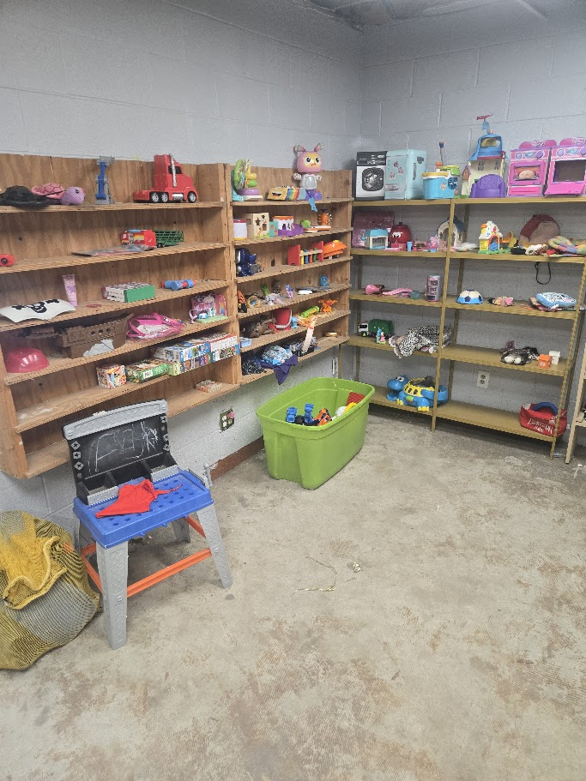

Slide 28
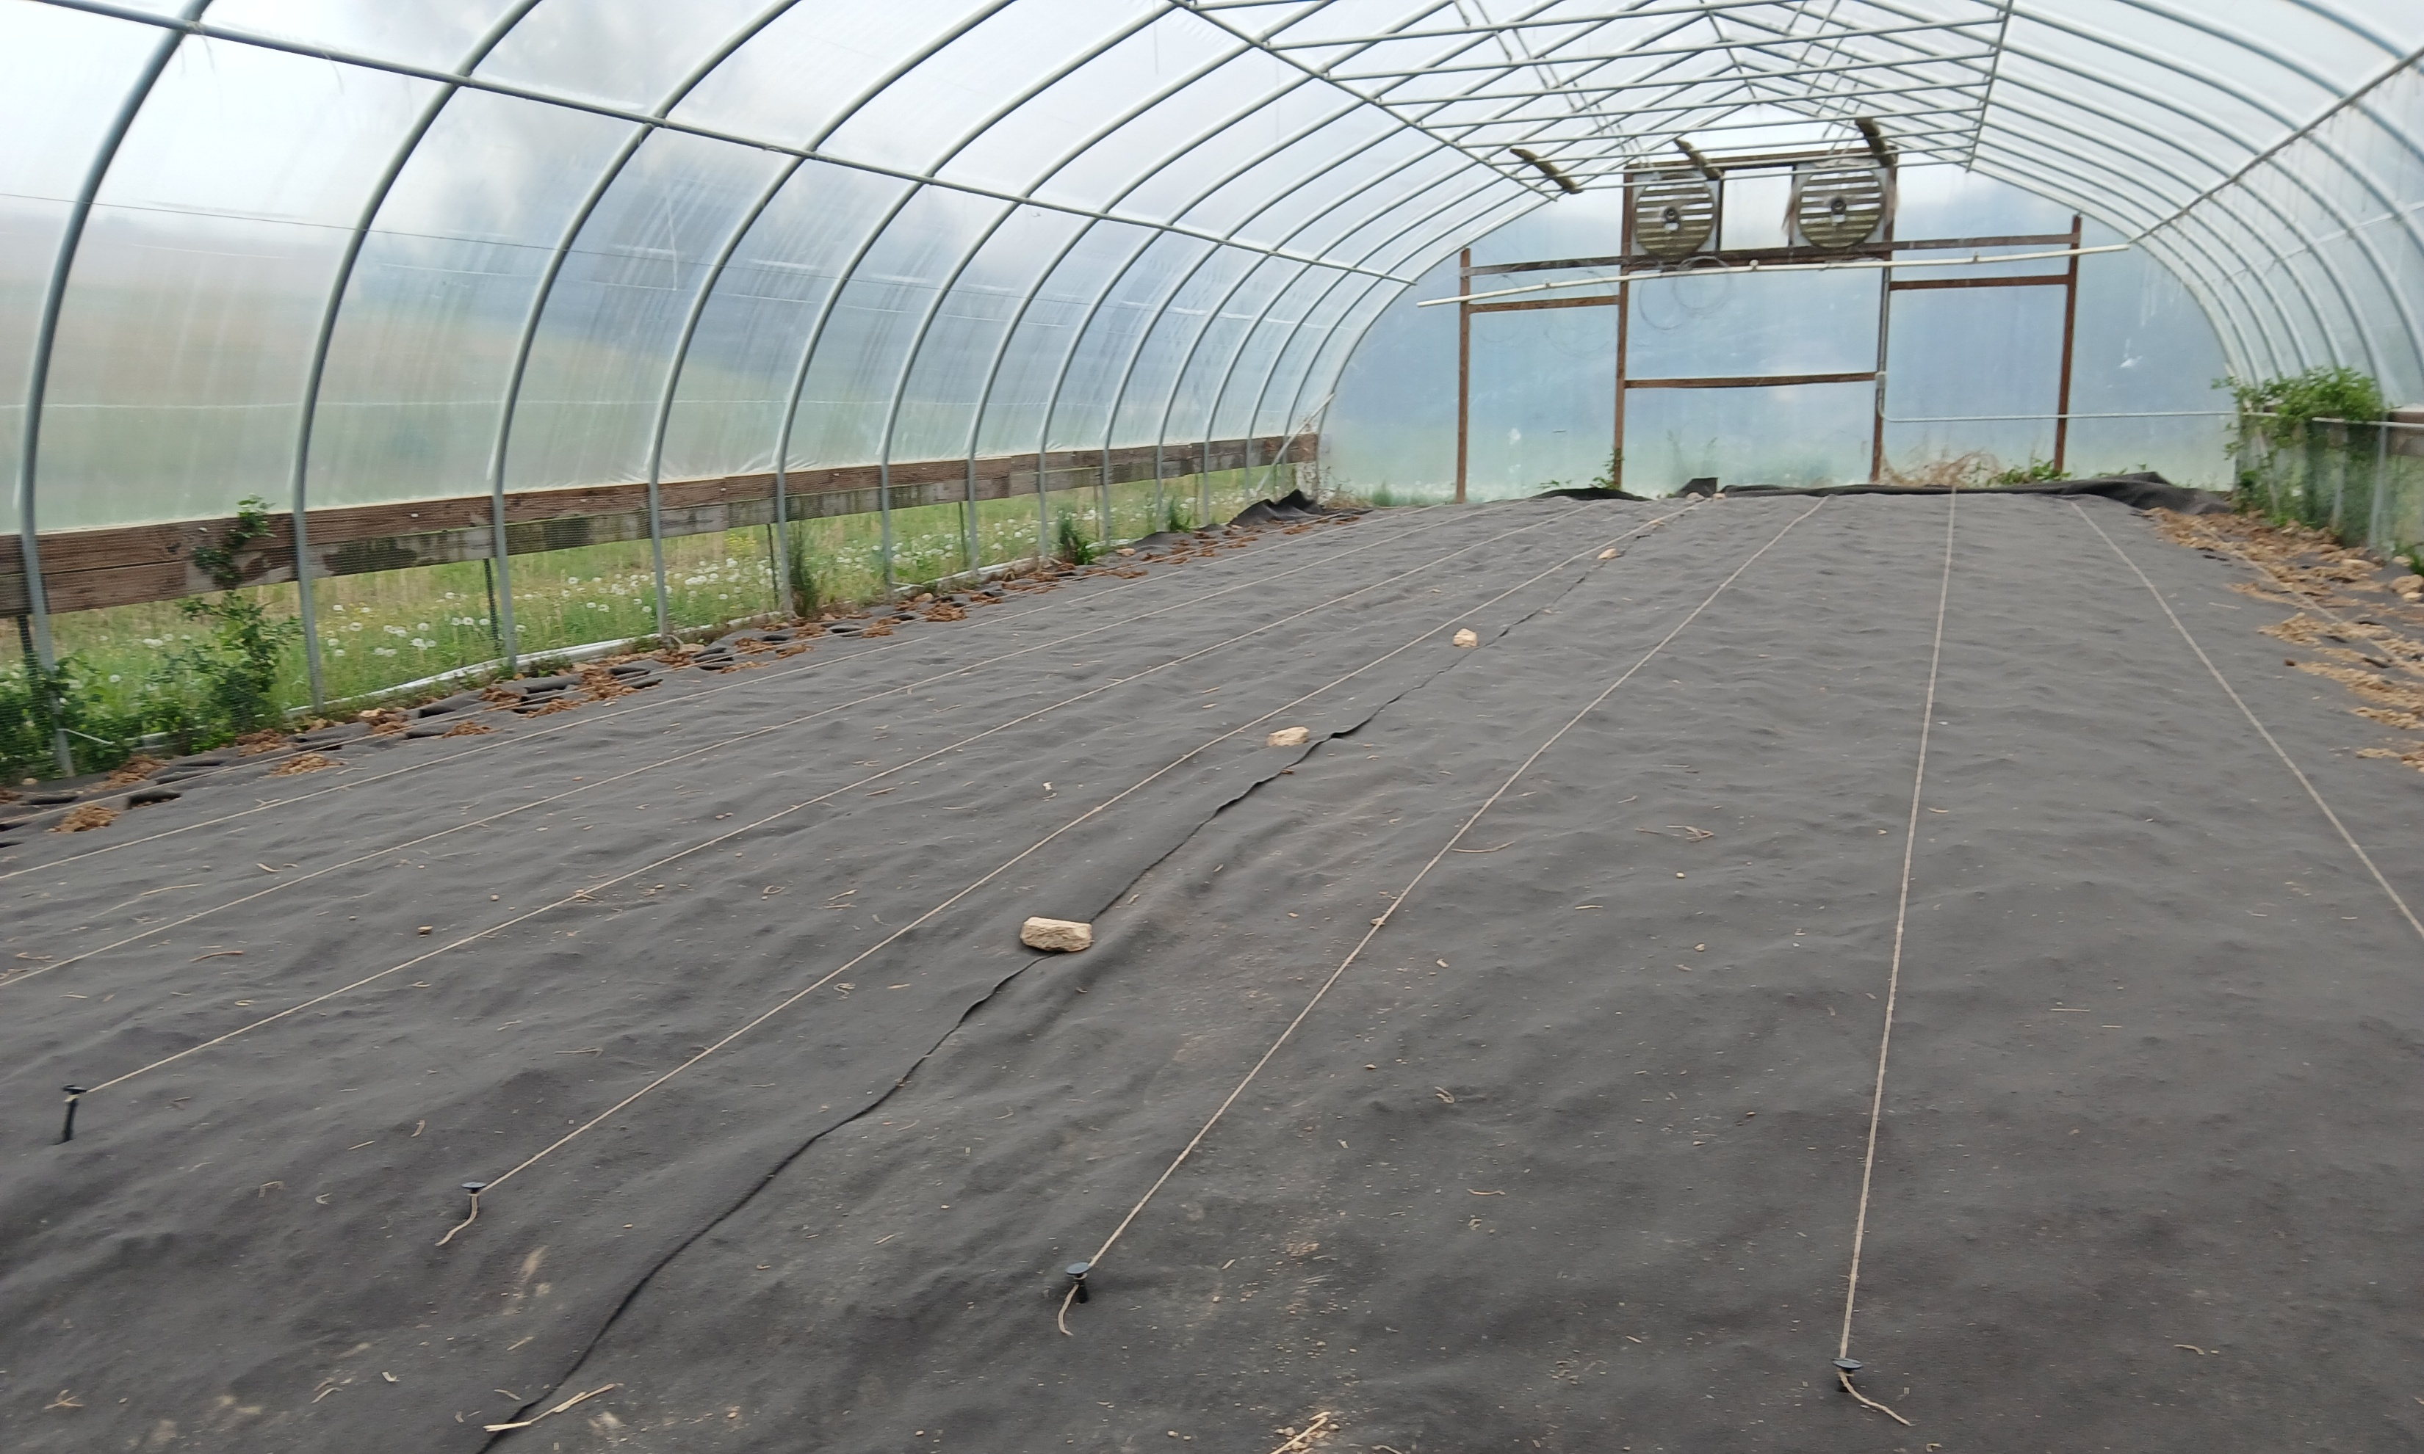
Vegetable Initiative

Slide 29
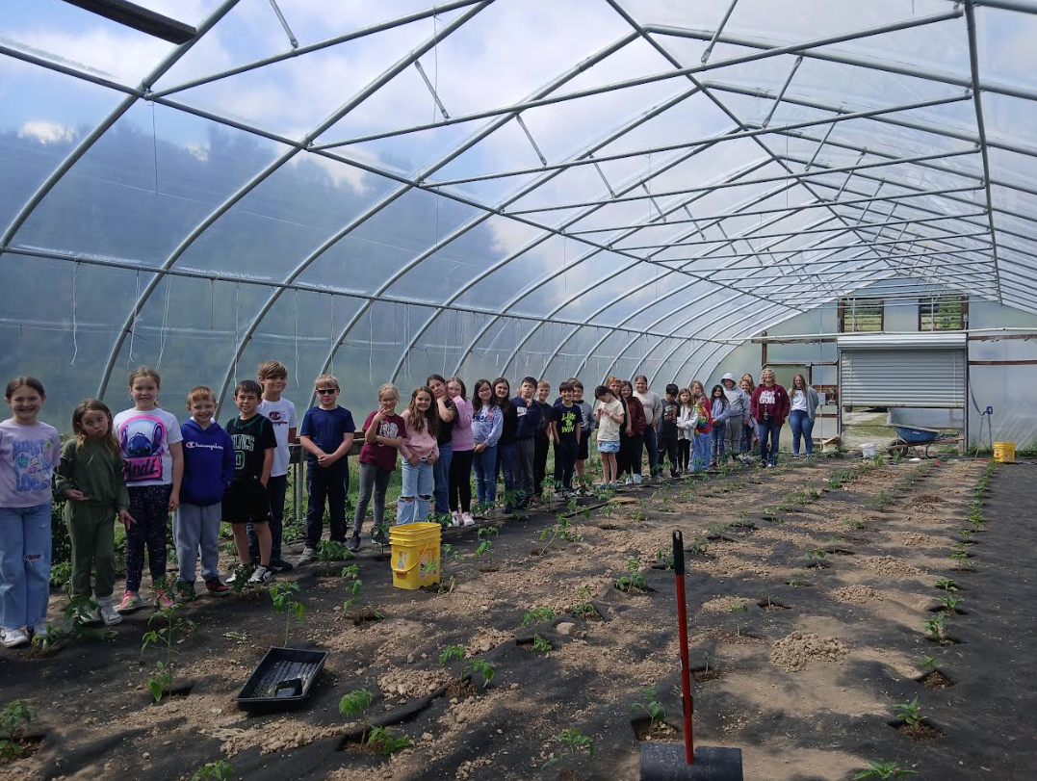
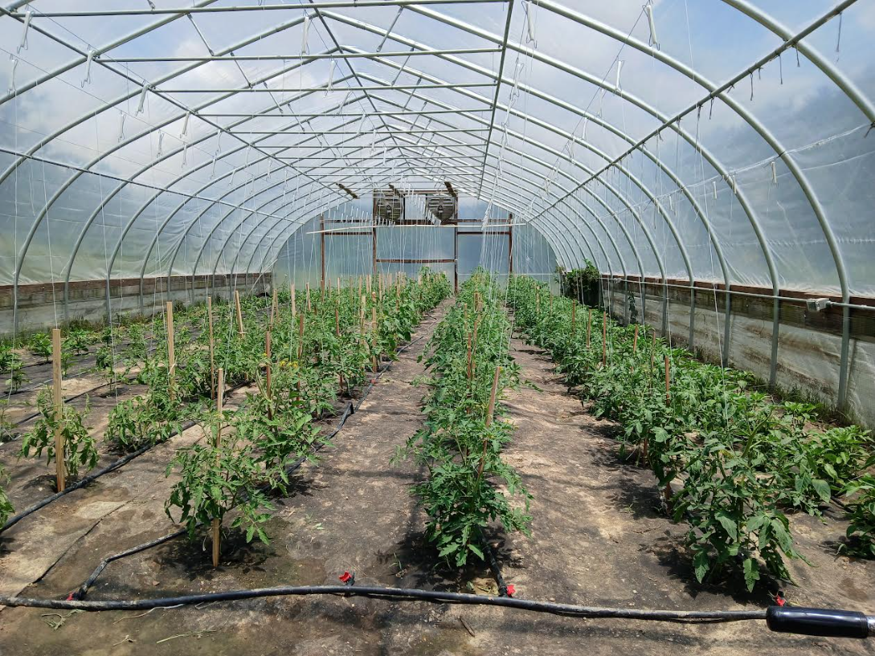

Slide 30
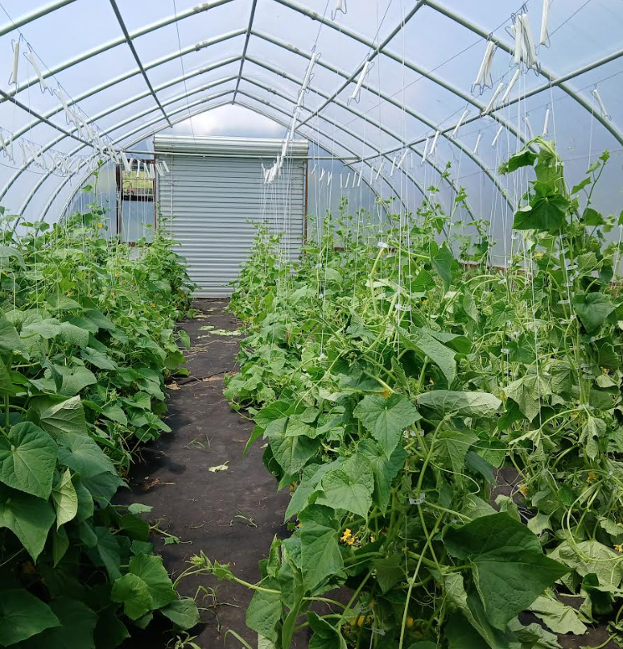
1,038 lbs. of vegetables delivered to home bound seniors in 2025
Only possible because of Sherrie Hunters dedication to the High Tunnels

Slide 31
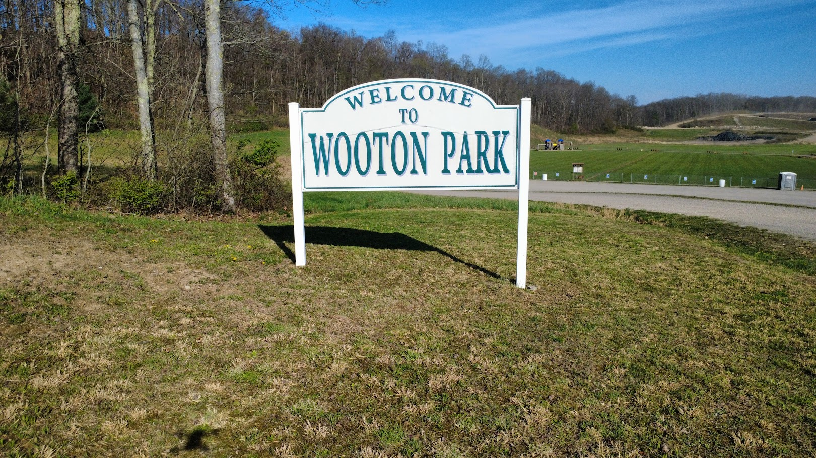

Slide 32
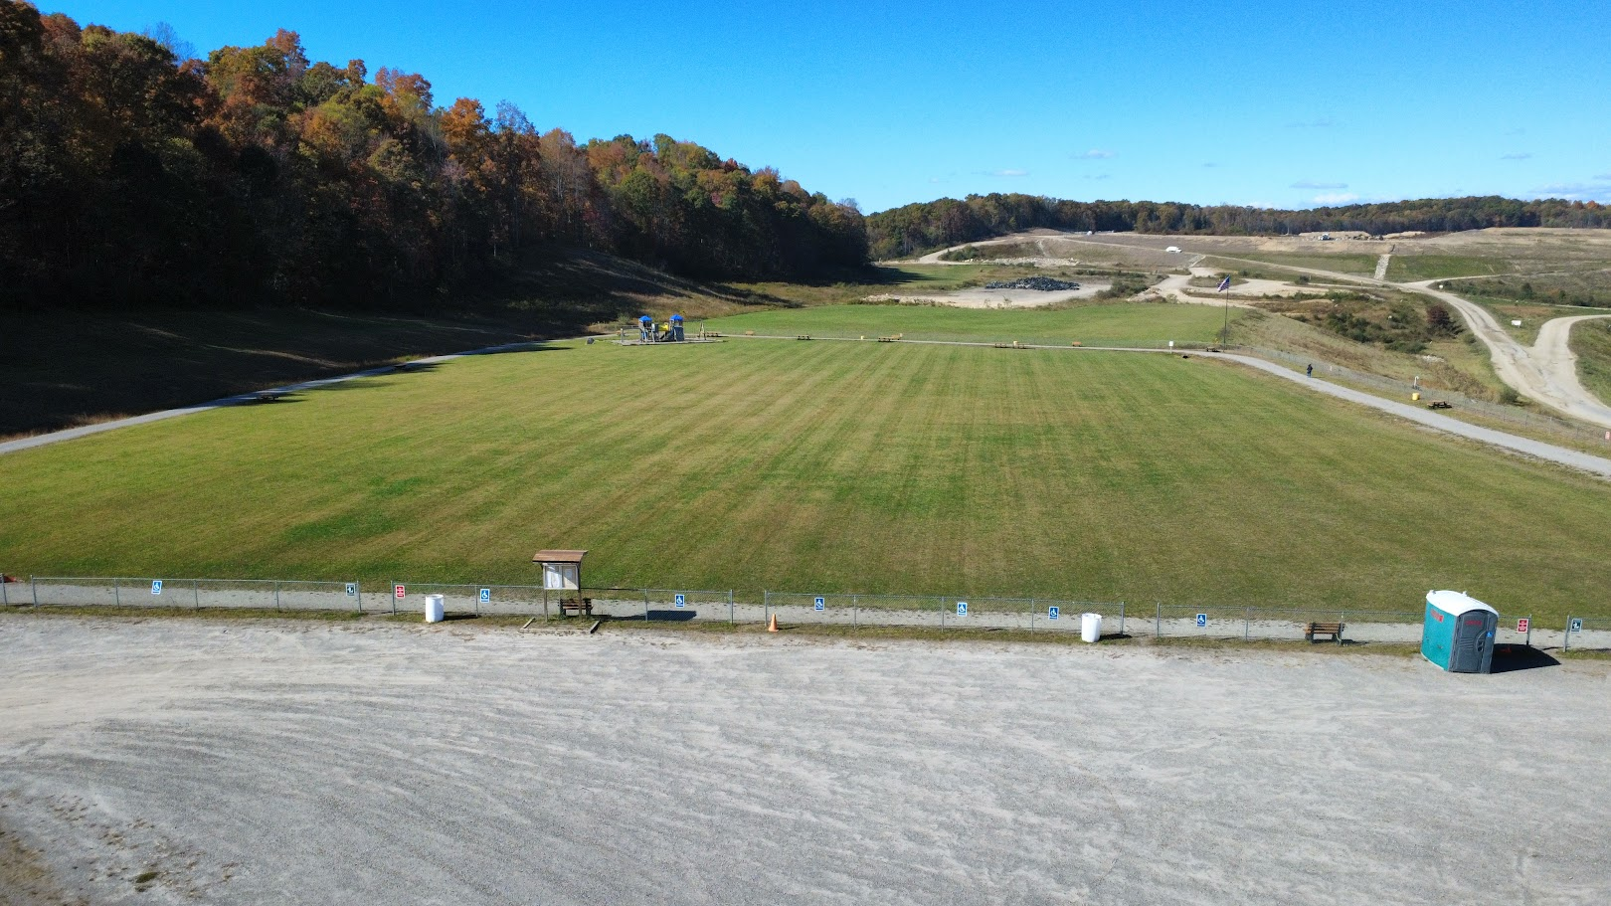

Slide 33
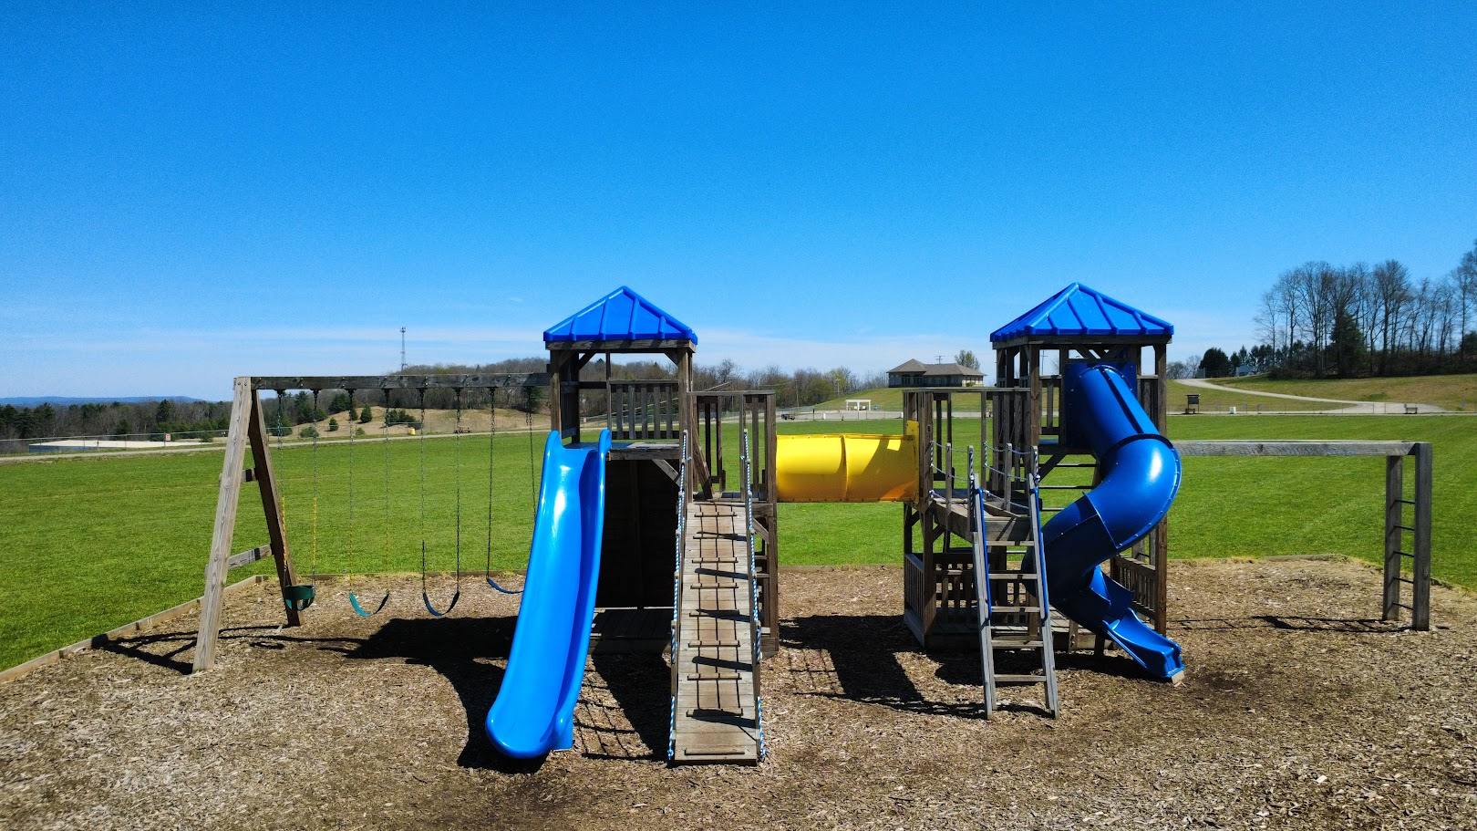

Slide 34
You Are Invited To Our First Ever Trash to Treasure Fall Festival at Wooton Park
September 12th 2026, 10:00am – 3:00pm
200 Fernandez Drive Beckley, W.V. 25801
Landfill Tours, Scavenger Hunt, Fall Games, Educational Information And Much More.

Slide 35
Thank You
A Special Thanks To Sherrie Hunter For Everything You Have Done Over The Last 24 Years 10 Months For The Raleigh County Solid Waste Authority. We Hope You Enjoy A Well-Deserved Retirement Come June 30th ,2026.

