Slide 1



PARTNERSHIPS
THAT WORK
Building Sustainable Solid Waste Programs
Through Community Collaboration
Rob Vanater (ED) / Putnam County Solid Waste Authority

Slide 2
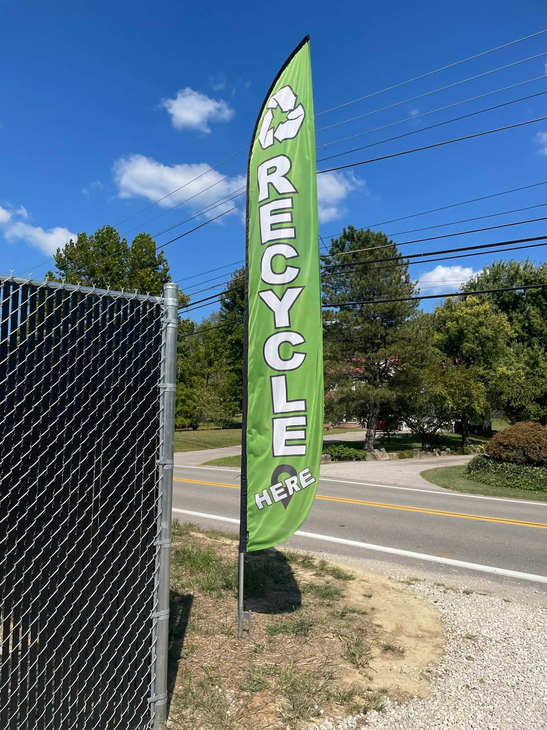



ABOUT PCSWA
  Serves Putnam County, WV’s 60,000+ residents.
  Recycling access and environmental education.
  Limited funding and staff
Notes:
The Putnam County Solid Waste Authority provides recycling access and environmental education across our county in West Virginia. Like many solid waste authorities, we operate with limited staff and limited funding. Because of that reality, we rely heavily on partnerships and collaboration to deliver services and expand programs.

Slide 3
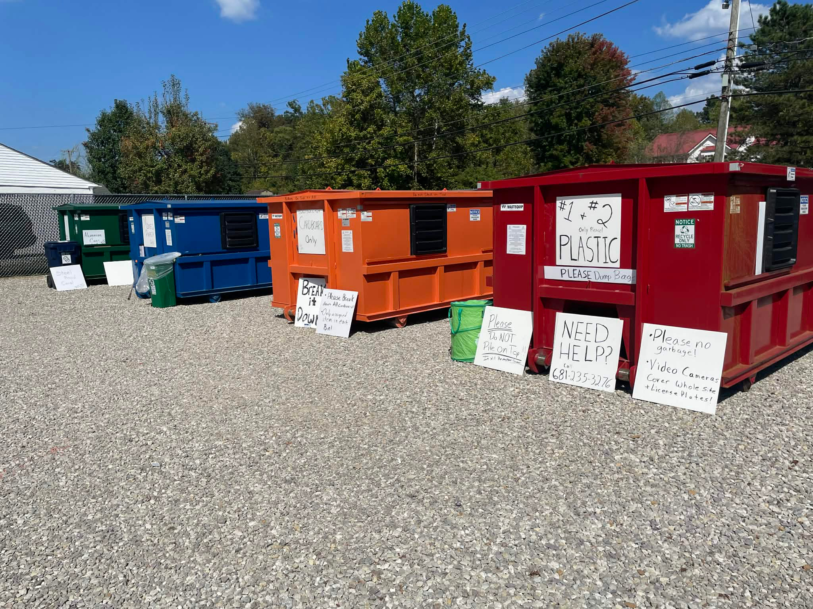


COMMON CHALLENGES
THINGS WE ALL FACE
  Limited operational funding
  Growing community expectations
  Need for recycling infrastructure
  Staffing Limitations
Notes:
Many solid waste authorities face similar challenges. Funding is limited, yet expectations from the community continue to grow. Residents want better recycling access, more environmental education, and improved services. At the same time staffing and budgets often remain flat. That creates a gap between what communities want and what agencies can realistically fund.

Slide 4

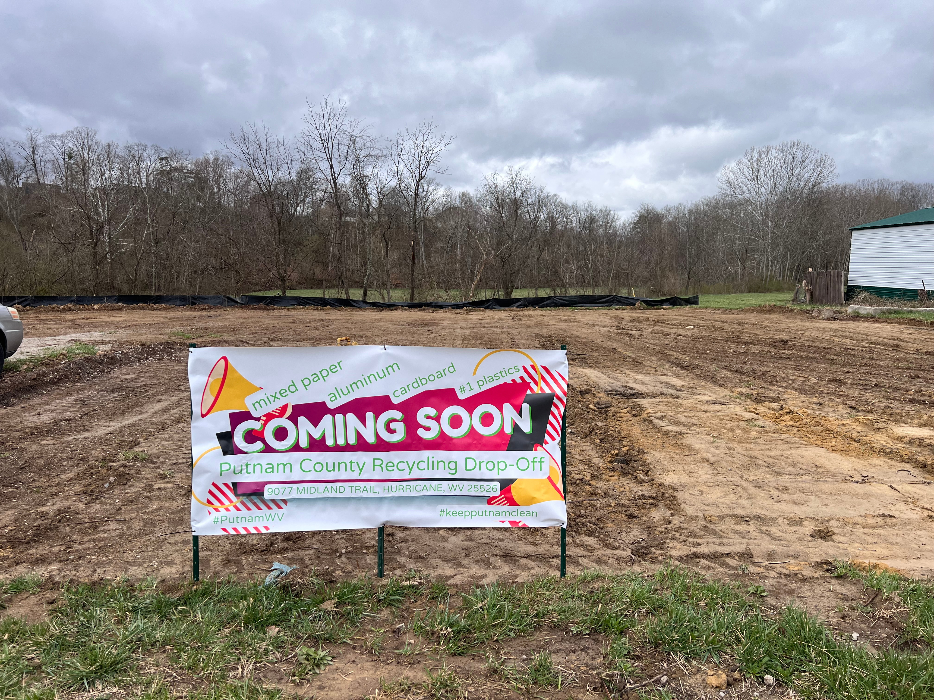
OUR SOLUTION:
Partnership-Based Operations
  Municipal partnerships
  County support
  Local business engagement
  Volunteer and community groups
Notes:
Our response to those challenges has been to build strong partnerships. We work closely with municipalities across the county, coordinate with county government, engage local businesses, and involve volunteers and community organizations. By combining resources from many partners, a small organization can accomplish much more.

Slide 5
WHY PARTNERSHIPS WORK
Shared Resources, Shared Goals
  Shared Maintenance
  Reduced costs
  Community Ownership
  Faster project implementation
Notes:
Partnerships work because they allow organizations to share resources. One partner may provide equipment, another may contribute labor, and another may provide materials or logistical support. These shared contributions reduce costs, speed up projects, and create a stronger sense of community ownership.

Slide 6


REAL WORLD EXAMPLE
A RECYCLING DROP SITE
  Community needed easier recycling access
  Limited funding access
  Partnership-driven solution
Notes:
One of the best examples of this approach was the development of one of our recycling drop sites. The community clearly needed better recycling access. However, traditional funding for building a site simply wasn’t available. Instead of shelving the project, we began asking partners what they could contribute.

Slide 7



HOW IT ALL CAME TOGETHER
Needs assesment
and gather population data to
evaluate locations
Open lines of communication with municipal leaders to partner on property vs purchasing.
Partner with other SWA’s, and local processors/ haulers to take your product.
Promotion and educational campaign via print and social media.
Site Prep, Construction, order bins, set up, and GO!
Notes:
The project came together through collaboration. Municipal partners provided equipment and labor to help prepare the site. As well as providing the land use for the pilot center. Community members and volunteers contributed their time in helping spread the word. While each contribution by itself seems small, together they made the project possible.

Slide 8

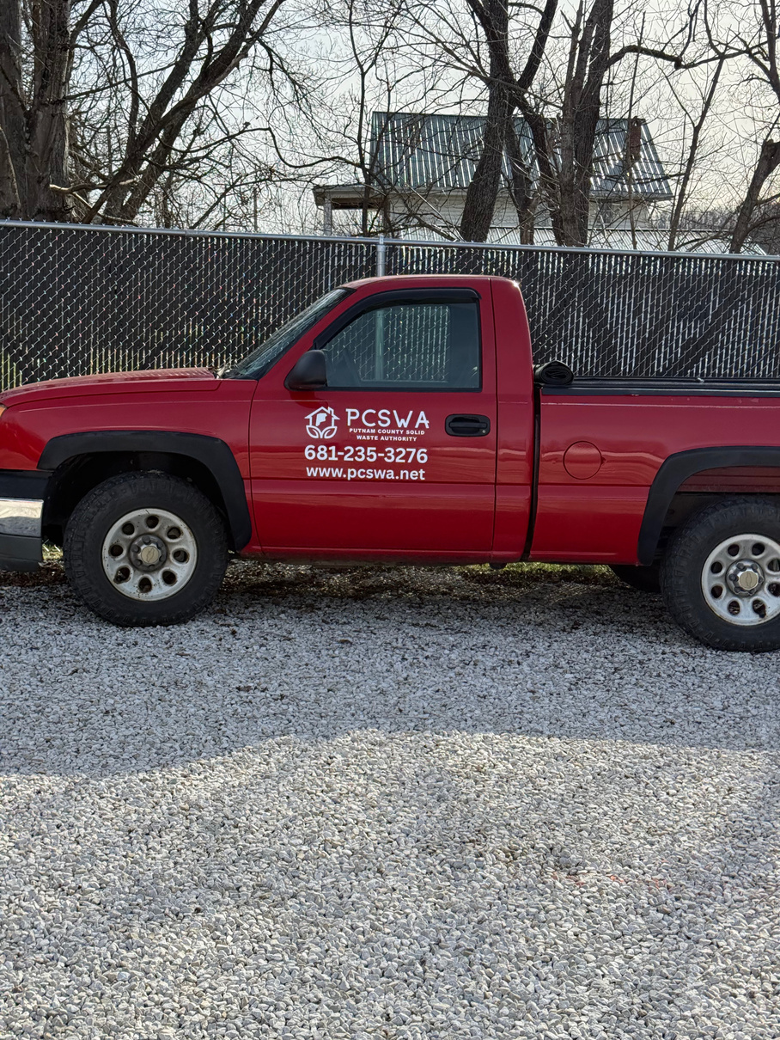
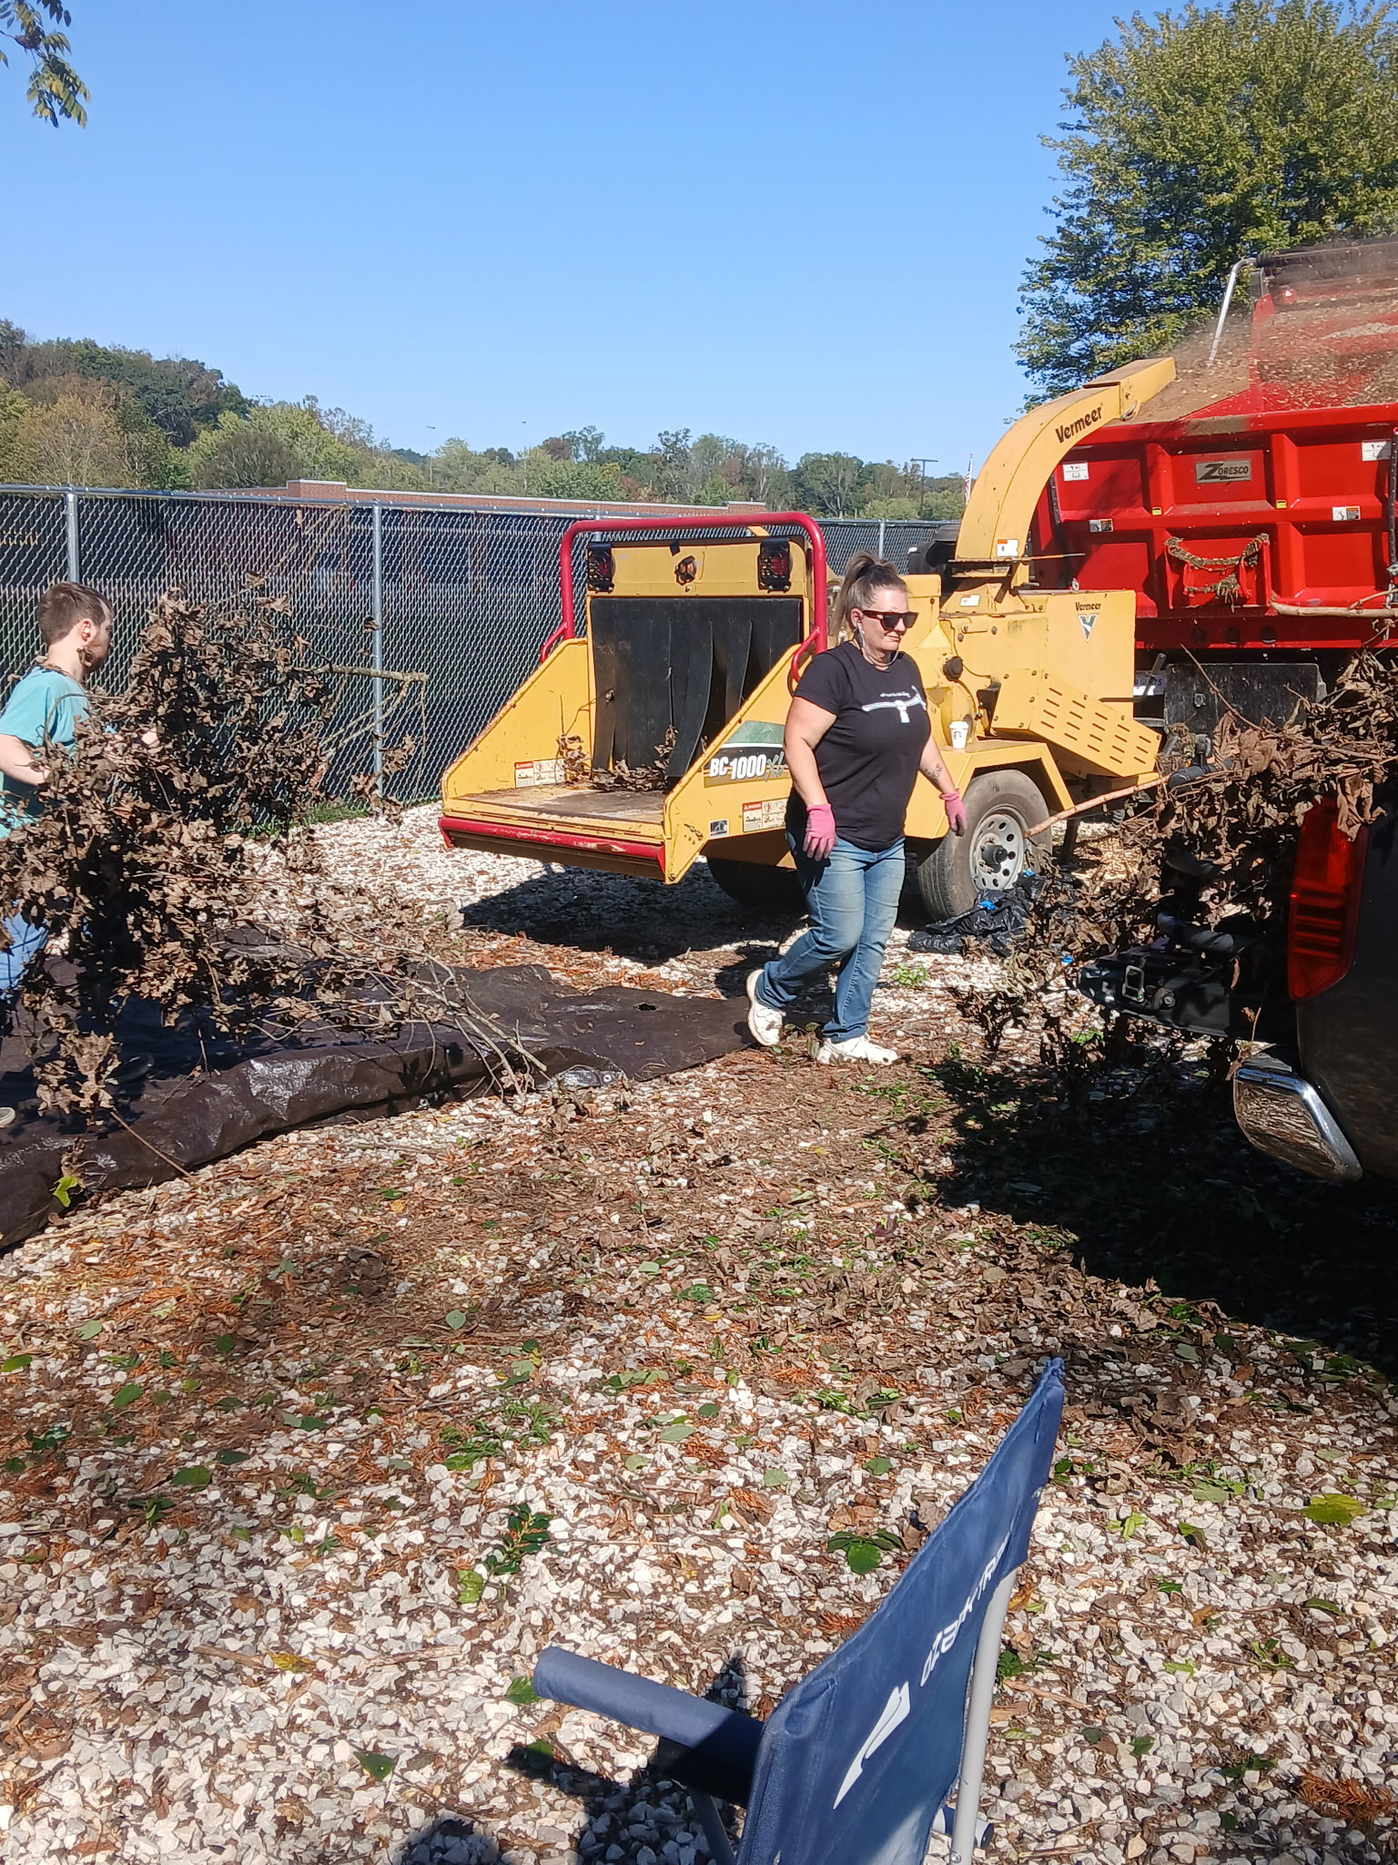
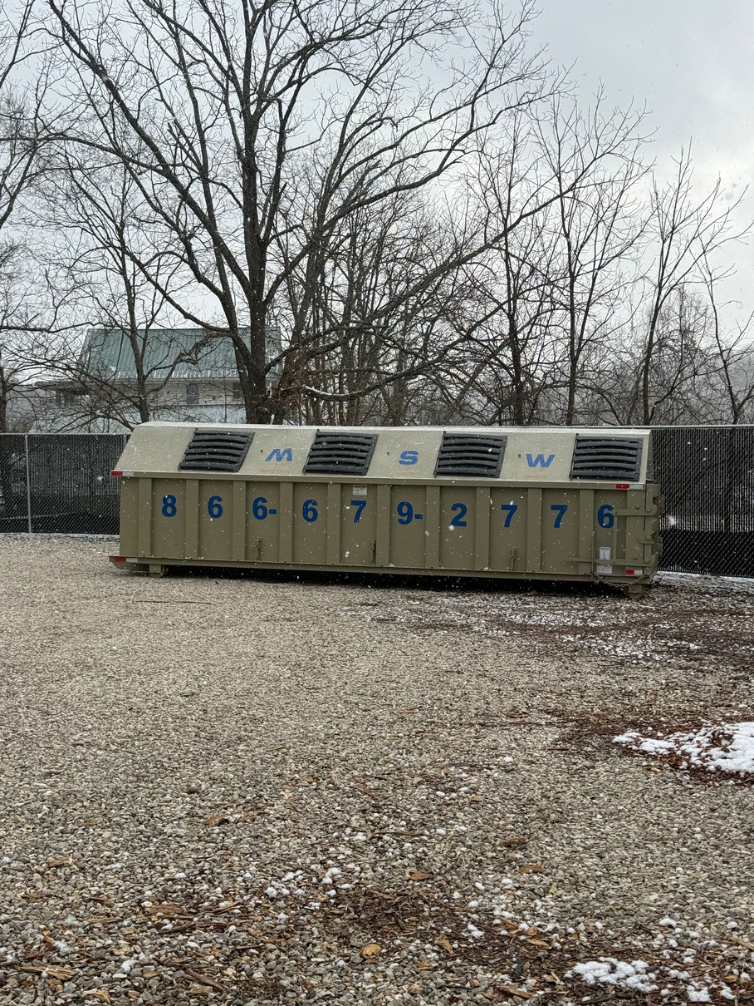
WHAT PARTNERSHIPS MADE
Since opening to the public mid-July 2025, we have steadily increased traffic to between 500-600 cars per week.
Notes:
Running 2 full loads of cardboard a week, plastics once every other week, mixed paper once a month, and cans once every two to three months.

Slide 9
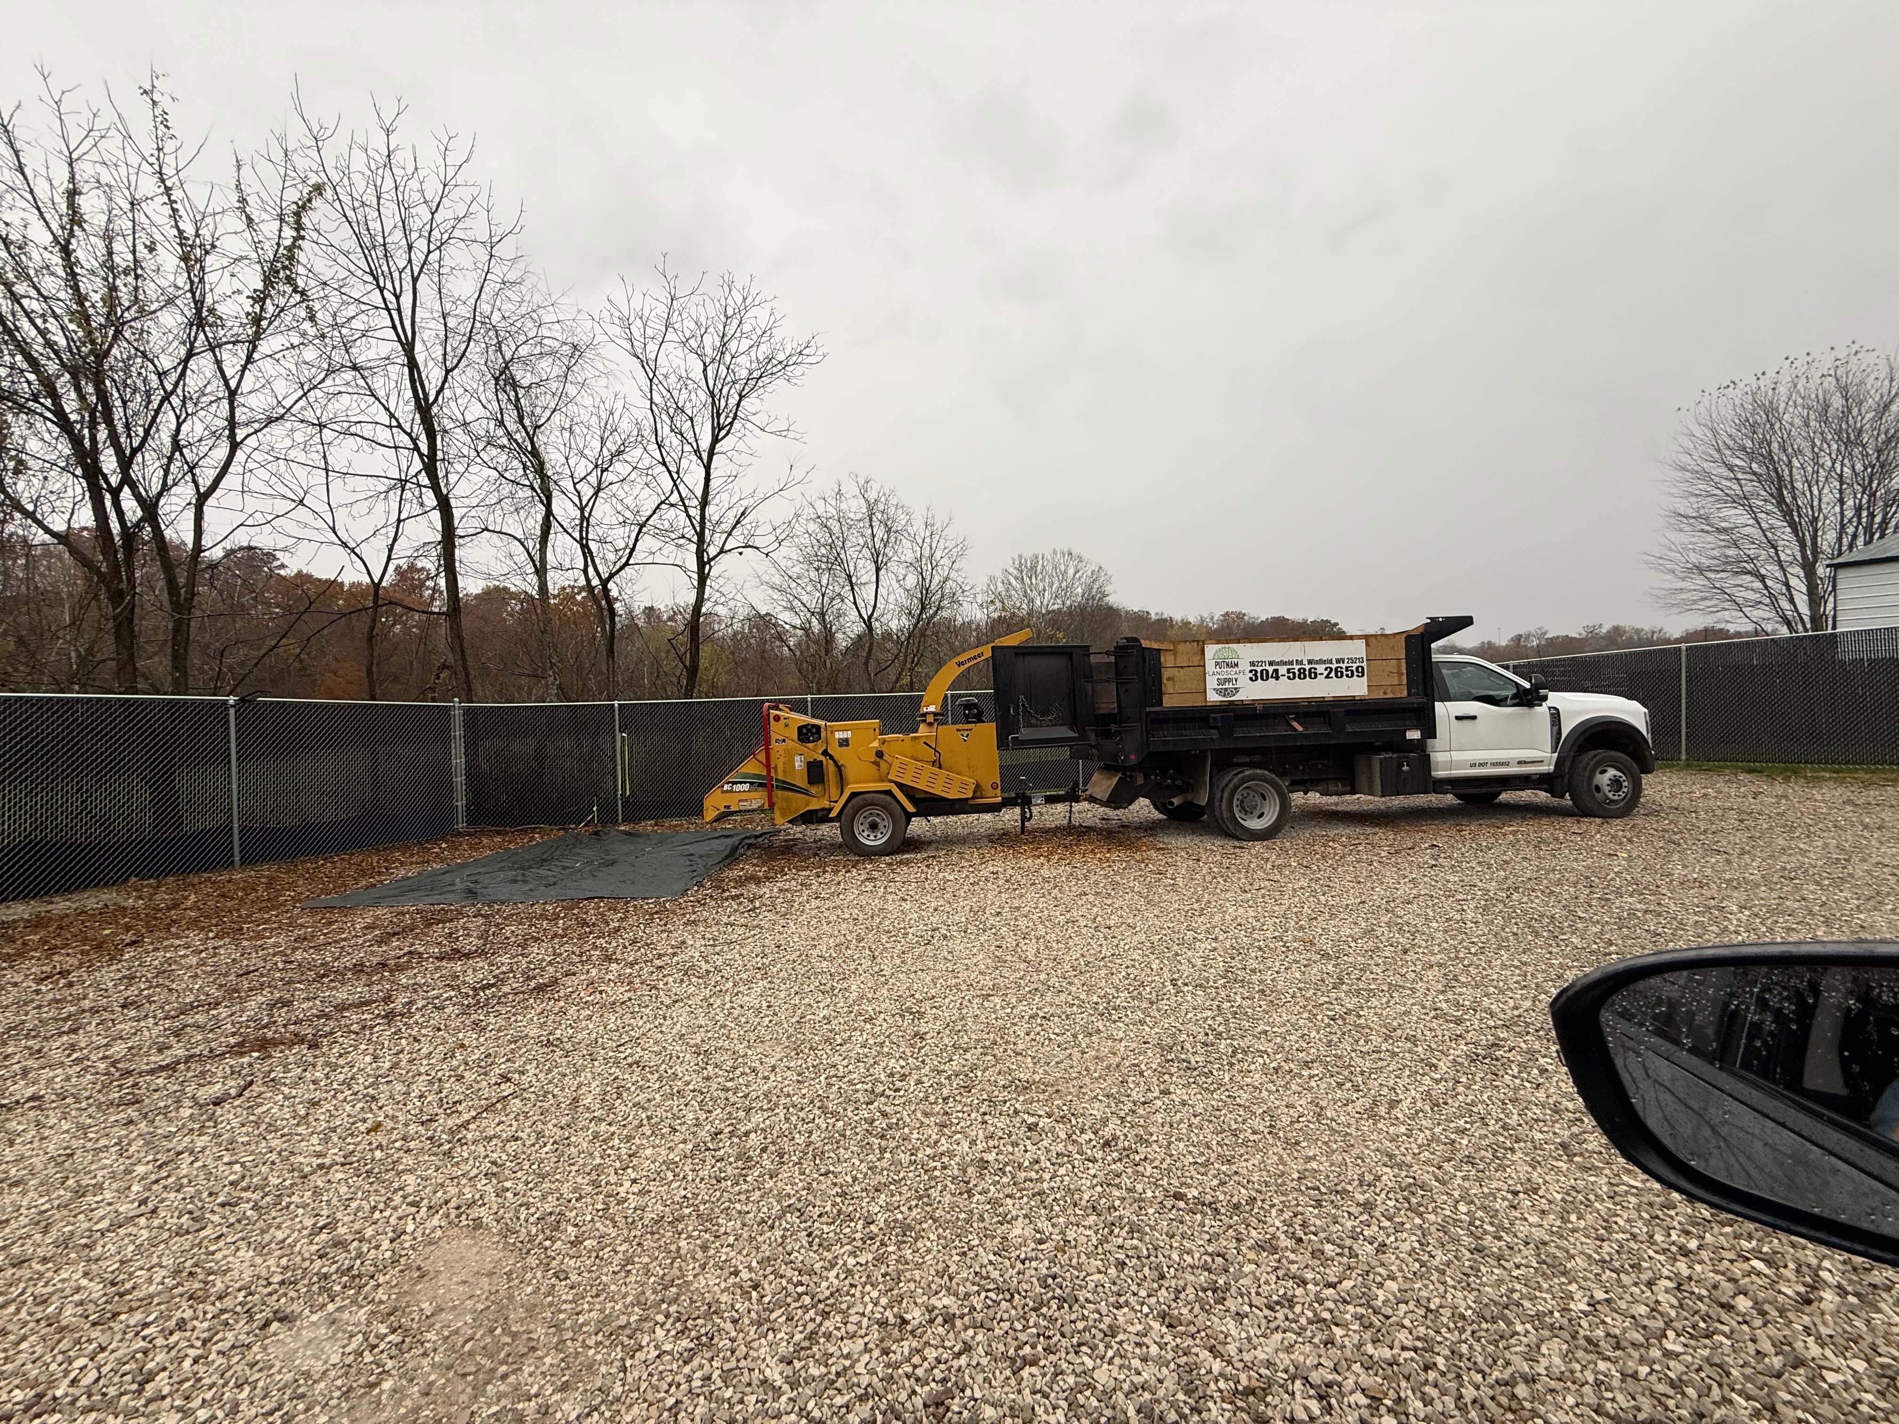
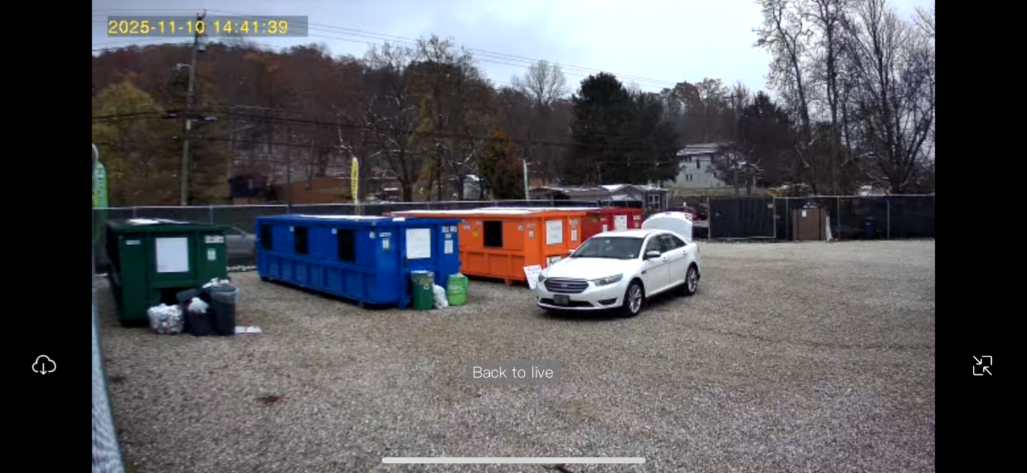
THE RESULT
  Functional recycling drop site
  Minimal financial investment
  Community Pride and ownership
Notes:
The result was a functioning recycling drop site created with minimal direct funding. More importantly, the community felt a sense of pride and ownership in something they helped build. This project demonstrated that partnership is not just a philosophy — it is a practical strategy that produces real results.

Slide 10
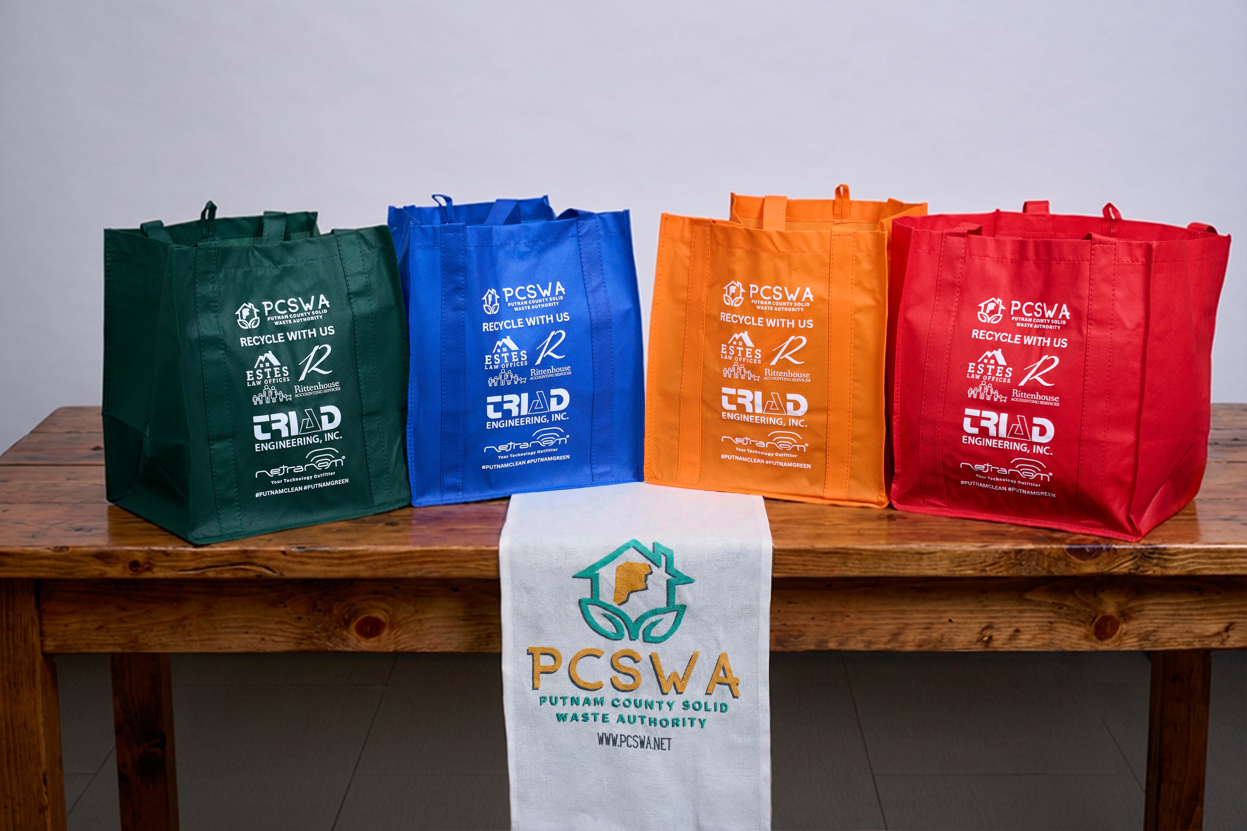
SUSTAINING PROGRAM REQUIRES FUNDING
  Infrastructure is only the beginning
  Programs require ongoing support
  Need for sustainable funding
Notes:
Building infrastructure is only the first step. Recycling sites need ongoing maintenance, education programs require materials, and outreach efforts require funding. Sustaining programs over time requires creative solutions. To help support these programs long term, we developed sponsorship initiatives that allow local businesses to support environmental efforts while gaining meaningful community visibility.

Slide 11
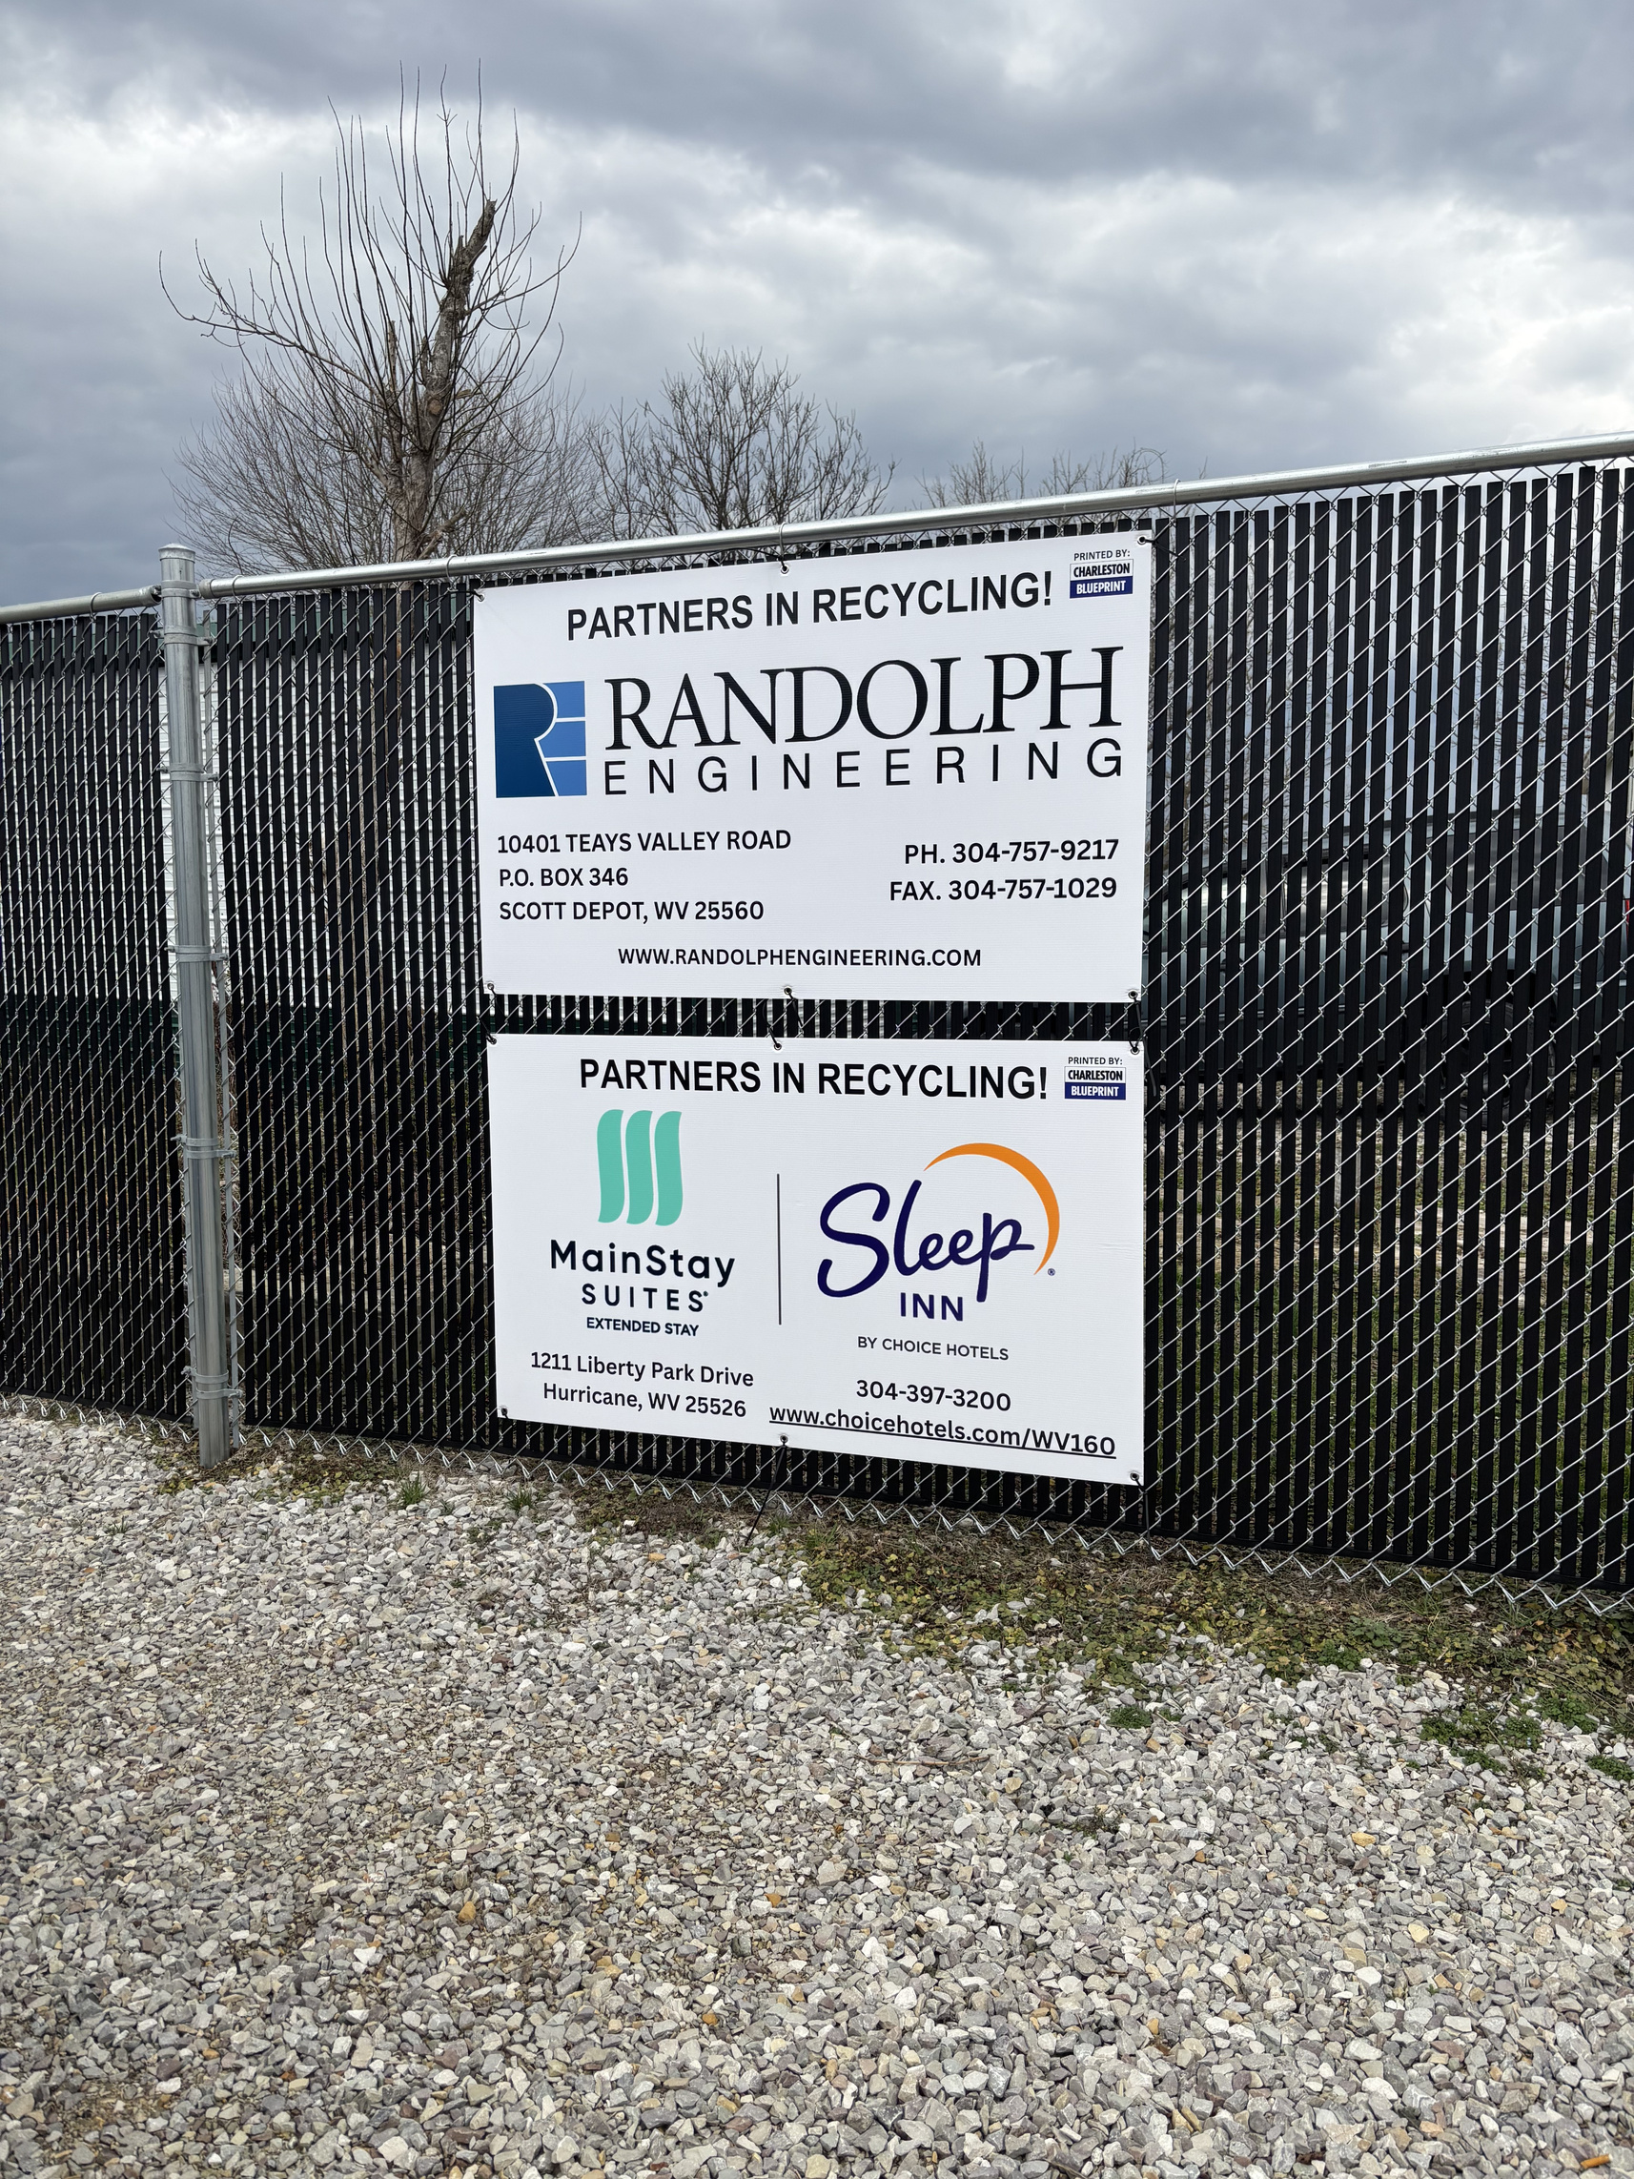


FENCE SIGN SPONSORSHIP PROGRAM
BUSINESSES SPONSOR FENCE SIGNAGE
VISIBLE COMMUNITY RECOGNITION
REVENUE SUPPORTS RECYCLING PROGRAMS AND YOUTH SCHOLRSHIPS
Notes:
One example is our fence sign sponsorship program. Businesses sponsor signage displayed INSIDE recycling lot. Sponsors receive community visibility while their support helps fund recycling operations.

Slide 12
REUSABLE RECYCLING BAG PROGRAM
  SPONSORED REUSABLE BAGS
  PROMOTES RECYCLING PARTICIPATION
  BUSINESS VISIBILITY
Notes:
Another initiative is our reusable recycling bag program. Businesses sponsor reusable bags that are distributed to residents. These bags encourage recycling participation while reducing single‑use materials.

Slide 13
A WIN-WIN MODEL
  COMMUNITY BENEFIT
  BUSINESS VISIBILITY
  SUSTAINABLE FUNDING
  YOUTH IMPACT
Notes:
These programs create a win‑win model. Businesses gain positive community visibility. Residents receive improved environmental programs. And the Authority gains sustainable funding to support operations.

Slide 14

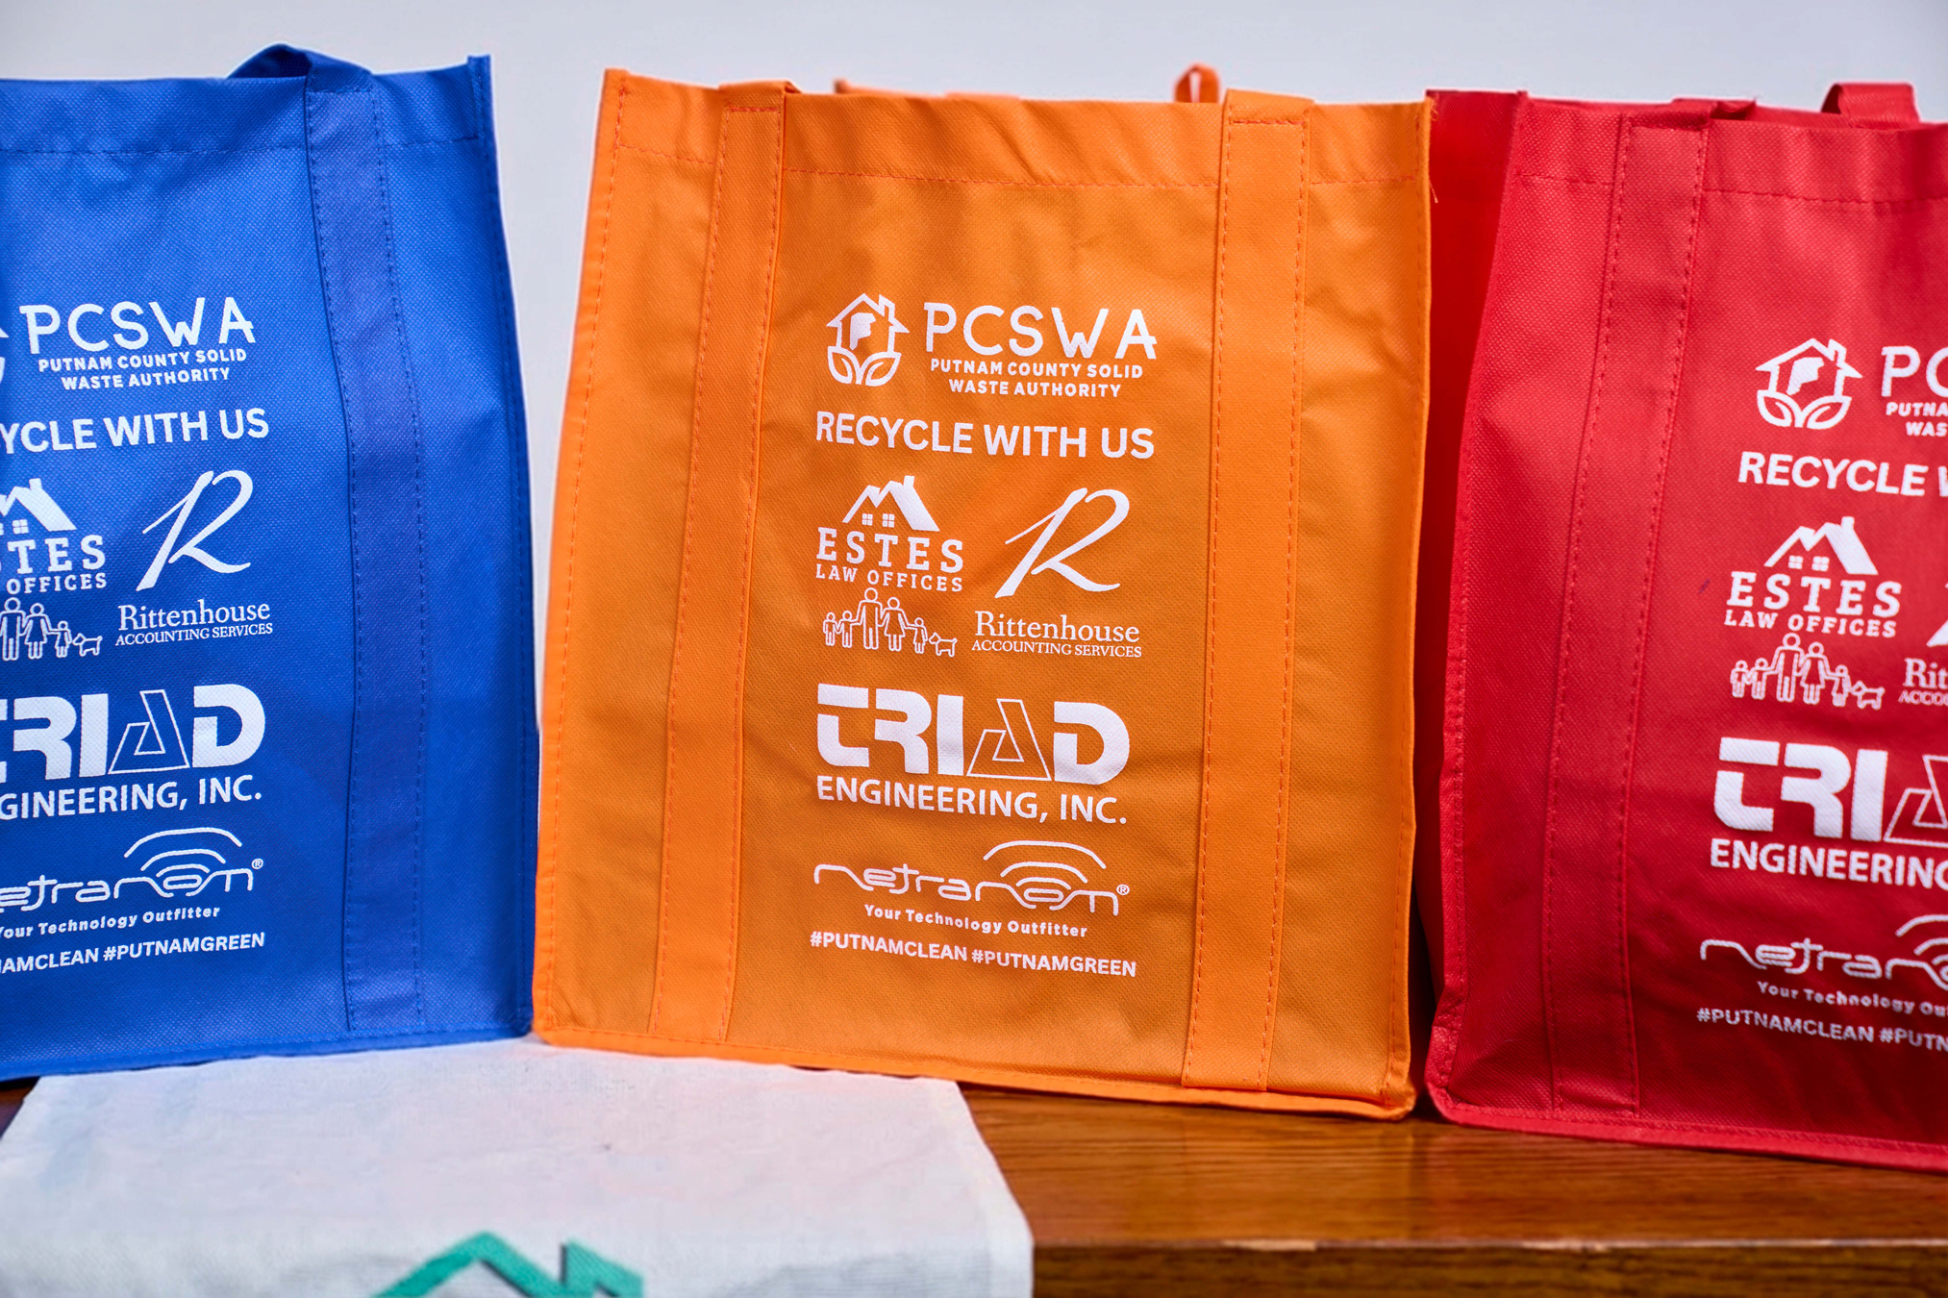
TRANSPARENCY MATTERS
PUBLIC ENTITY RESPONSIBILITIES
ETHICAL OVERSIGHT
PUBLIC TRUST
Notes:
Because we are a public entity, transparency and accountability are essential. Any partnership involving funding must be handled carefully and ethically to maintain public trust.

Slide 15
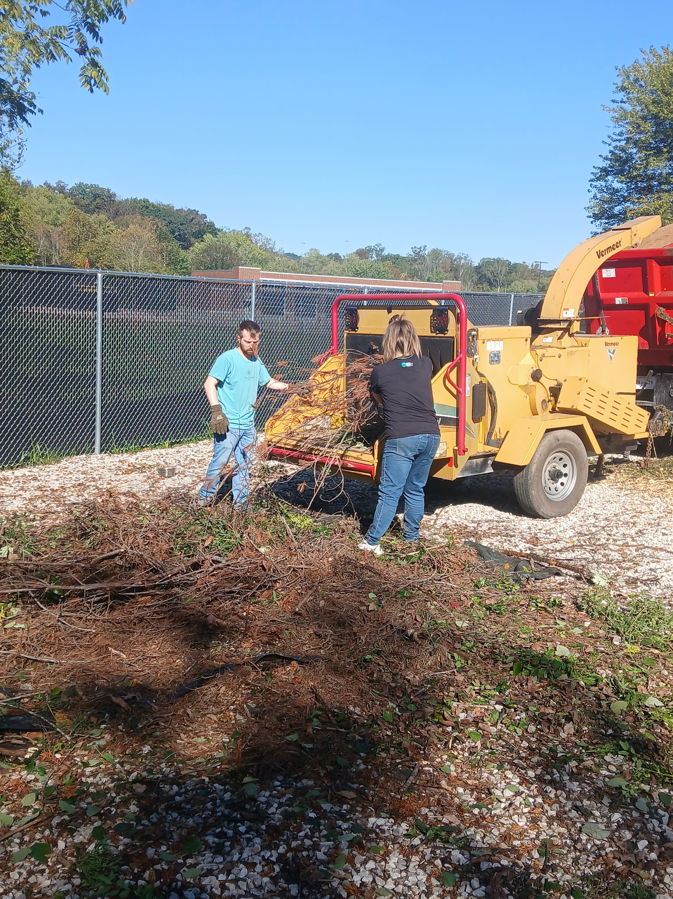
WV ETHICS COMMISSION GUIDANCE
  FORMAL ETHICS OPINION REQUESTED
  ENSURED COMPLIANCE
  REINFORCED PUBLIC TRUST
Notes:
Before implementing our sponsorship programs, the Authority sought a formal opinion from the West Virginia Ethics Commission. This ensured our approach complied with state ethics rules and helped reinforce public accountability.

Slide 16
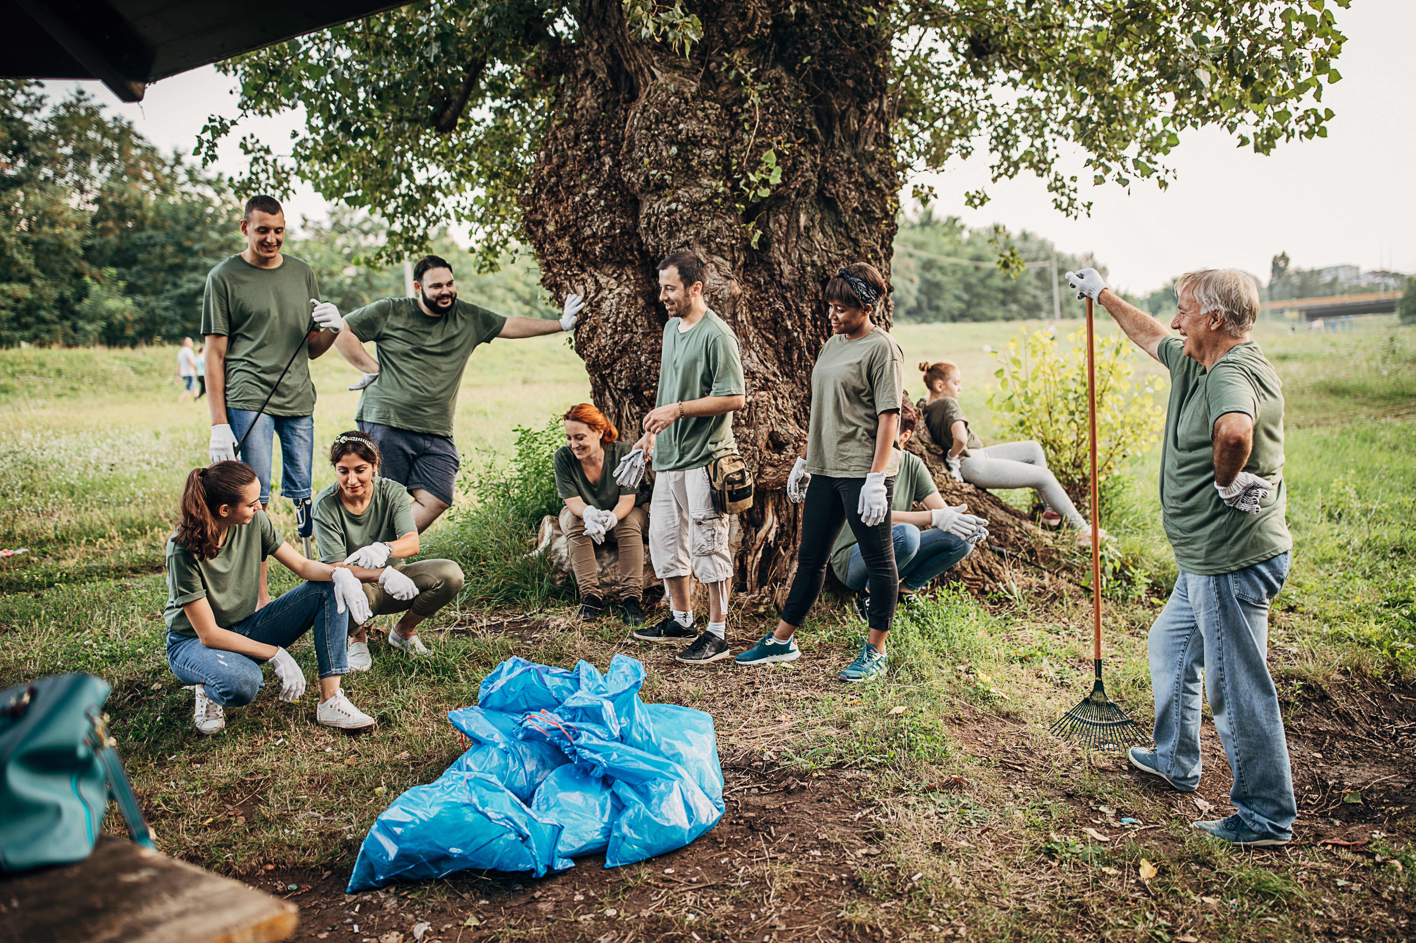
LONG-TERM COMMUNITY IMPACT
  ENVIRONMENTAL EDUCATION
  COMMUNITY INVESTMENT
  YOUTH PROGRAMS
Notes:
These partnerships allow us to reinvest resources back into the community through environmental education and outreach programs.

Slide 17


YOUTH ENVIRONMENTAL PROGRAM SCHOLARSHIPS
SUPPORT FOR STUDENTS
ENVIRONMENTAL LEADERSHIP
FULL-CIRCLE COMMUNITY BENEFIT
Notes:
One long‑term goal is supporting youth environmental initiatives and potential scholarships. Operational success today can help support the next generation of environmental leaders.
By rolling our “Emergency Hauling Fund” over each year into YEP scholarships, we can retain emergency funding year around, while also providing opportunities to local youth. (These funds ARE NOT AN ASSET) they are emptied each year on the renewal of their sign.

Slide 18
KEY TAKEAWAYS
  Partnerships multiply resources
  Creativity can overcome limited funding
  Sponsorships can sustain programs
  Transparency protects public trust
Notes:
There are several key lessons from our experience: partnerships multiply resources, creativity can overcome limited funding, sponsorships can sustain public programs, and transparency protects public trust.

Slide 19
  SMALL ORGANIZATION CAN HAVE A BIG IMPACT
  COLLABORATION IS THE KEY
FINAL THOUGHTS
Notes:
Even small organizations can create meaningful environmental infrastructure when communities work together. Collaboration allows us to accomplish far more than any organization could do alone.

Slide 20



THANK
YOU!
Working together for a stable and sustainable ecosystem.
Notes:
Thank you for your time today. I’d be happy to answer any questions and discuss ideas about partnership models that might work in your communities.

Slide 21
Rob Vanater
Executive Director
rob.vanater@pcswa.org
681-235-3276

