Slide 1

GRANTS MANAGEMENT
FOR SWAs
Notes:
Kyla touched on your Authorities purpose.
Now we’re going to talk about some FINANCIAL RESOURCES TO SUPPORT THE AUTHORITIES plans and programs.
SWMB & REAP GRANT PROGRAMS AVAILABLE

Slide 2
SWMB Grant Code and Rule
The Solid Waste Management (SWMB) Board Grant program established by WV Code §22C-4-30.h.2.a
SWMB Grant Rule - 54 Code of State Rules 5 (54CSR5)
Each fiscal year, the SWMB will determine both total amount of funds available for grants and maximum grant amount per applicant.

Slide 3
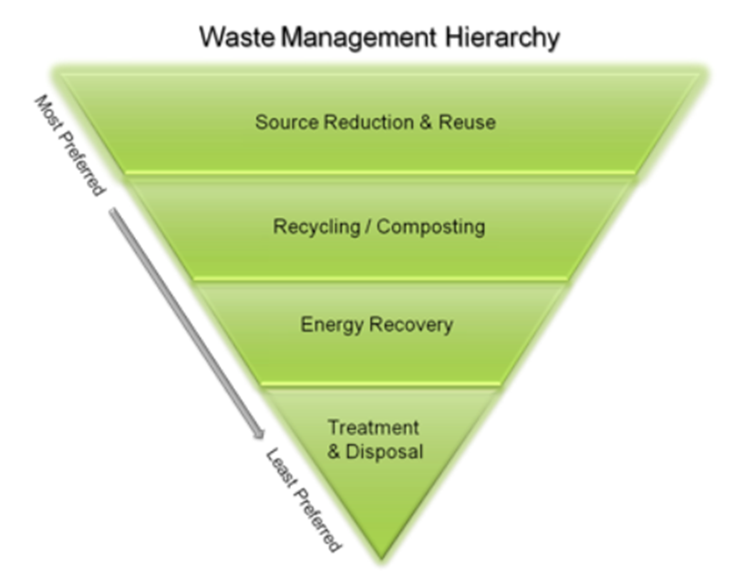
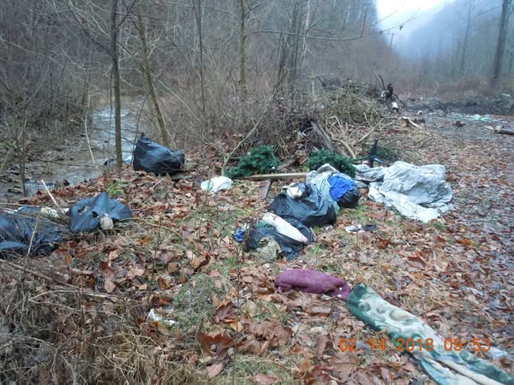
SWMB Grant Proposals
The Board will give preference to grant projects for:
  Source Reduction
  Reuse of materials
  Recycling, composting, processing, marketing of recovered materials
  Mandatory disposal, open dump cleanup and litter control
  Transfer stations
  Landfills/Solid Waste Facilities
  Administration Costs for any of the above
  Projects for development, purchase, or delivery of educational materials, programs, seminars.
Notes:
Versatile
For any legislative purpose established in WV Code 22C-4-1 and needs to be consistent with the Authority’s Comprehensive Litter and Solid Waste Control Plan and the state Solid Waste Management Plan

Slide 4
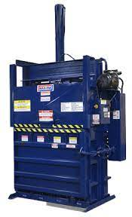
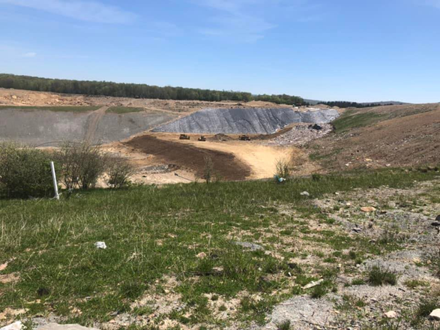
SWMB Grant Proposals
Physical resources, such as equipment or facilities, may receive preference over funding of operations or salaries of employees.
The grant may not be used to replace existing personnel currently being provided by the local government.
Applicants with a current grant may not be eligible for the next cycle of grants.
Notes:
Applications for physical resources, such as equipment or facilities, may receive preference over funding of operations or salaries of employees.
The grant may not be used to replace existing personnel currently being provided by the local government. (54-5-5.2)
Applicants with a current grant may not be eligible for the next cycle of grants (54-5-4.11)
Looking at all 3 points, the grant guidelines encourage projects that are not heavily reliant on annual grant funding.

Slide 5
SWMB Grant Eligibility
  Approved Comprehensive Litter and Solid Waste Control Plan & Commercial Solid Waste Facility Siting Plan
    Updated every 5 years and approved by SWMB
  Audit, Review, or Small Government Monitoring report completed within the last three fiscal years
  Compliant with WV Code §12-4-14 Grant Reporting Requirements
  Solid Waste Facility laws & rules
  Compliant with final reports from previous grants
  Incomplete applications will not be considered
  Any other laws, rules, or regulations, including labor laws
Notes:
12-4-14 Grant Transparency and Accountability Act
Outlines accountability, reporting, audits - Stop payment, recovery of funds, issues…

Slide 6
SWMB Grant Considerations
  The grant program is competitive.
  Historical performance of each applicant is considered.
    Severe and repeat audit findings are considered for new grant recommendations.
    We will be assessing efficient use of grant funds awarded.
    Was a large amount of funds returned? Why?
    Budget Revisions and Grant Extensions are allowable.
Notes:
12-4-14 Grant Transparency and Accountability Act
Outlines accountability, reporting, audits - Stop payment, recovery of funds, issues…

Slide 7
SWMB Grant Application Timeline
  Before March 1: GFO posted to grants.wv.gov
  Before March 1: SWMB GFO Live Email Notification
  March 1-April 30: Authority Approves/Submits Applications
  April 30: Deadline to Submit Application in VSS Portal
  May: SWMB Staff Review for Completeness & Eligibility
  June: Presented to SWMB Grant Committee
  July: Final Approval of Full Solid Waste Management Board
  August: Notice of Approval/Denial; Grant Award Documents Sent out for SWA Signatures
Notes:
12-4-14 Grant Transparency and Accountability Act
Outlines accountability, reporting, audits - Stop payment, recovery of funds, issues…

Slide 8
wvOasis Vendor Self-Service
Update SWA Account Information
  Account is set up with proper Tax ID (FEIN Number) for SWA
  Address, Contact Name, Phone Number, and Email
  Verify current SWA Officers and authorized users
  Perform regular maintenance and updates to account
  Oasis Helpdesk available Mon-Fri 7am – 5pm helpdesk@wvoasis.gov or (855)-666-8823
  https://www.wvoasis.gov/
  Please notify the SWMB of address changes in VSS
Notes:
Most important thing to say: PLEASE UPDATE WELL IN ADVANCE OF GRANT DEADLINES that you’ll hear today.
You need updated and contact and email addresses. When state grant funding opportunities go live in OASIS, you should be getting email notifications. Both SWMB and WVDEP REAP try to send our own notifications as well.

Slide 9
wvOasis Vendor Self-Service
Video tutorial can be found here:
  https://www.youtube.com/watch?v=9SEqr0mERfs
Notes:
Most important thing to say: PLEASE UPDATE WELL IN ADVANCE OF GRANT DEADLINES that you’ll hear today.
You need updated and contact and email addresses. When state grant funding opportunities go live in OASIS, you should be getting email notifications. Both SWMB and WVDEP REAP try to send our own notifications as well.

Slide 10
WVSAO E-Pay Registration
EFT Deposits for disbursements
  WVSAO limits paper check distribution
  EFT Disbursement more secure
  Financial institution verification and updates required
  Verify correct banking information - grant-specific account
  Wet signature required!
  WVSAO E-Pay Division 800-500-4079
Notes:
Again-Please leave ample time to
??? Suggest holding grant accounts open with $10.00 balance if they don’t want to

Slide 11
WVSAO E-Pay Registration
Use this link to access instructions on E-Pay setup & changes on the Auditor’s Office website:
https://www.wvsao.gov/electronicpayments/default
*Requires wet signature.
Notes:
Again-Please leave ample time to
??? Suggest holding grant accounts open with $10.00 balance if they don’t want to

Slide 12
Locate Grant Funding Opportunity (GFO)
UPDATED EMAIL ADDRESS AND CONTACT INFORMTION IS KEY!
wvOASIS Vendor Account
Solid Waste Management Board
WVDEP-REAP
GFO ANNOUNCEMENTS: published by early March or sooner
        All counties with updated emails should get a notice from wvOASIS
        SWMB also emails all Solid Waste Authorities when the GFO is live.
    SWMB GRANT APPLICATION DEADLINE: Closes April 30th at 11:59pm
    Prescribed application forms available on GFO Attachment page.
    Upload completed application and attachments in Vendor Self Service (VSS).
    PLAN AHEAD
    UPDATE wvOASIS Vendor Account ASAP
    Your Board needs to approve grant proposal no later than an April board meeting. Signatures needed by deadline.

Slide 13
Locate Grant Funding Opportunity (GFO)
The video tutorial on locating a GFO can be found at this link:
https://www.youtube.com/watch?v=MzfnWvvSiU4

Slide 14
Grant Applications
SWMB Grant Applications must include:
Application Cover Sheet: Contact and general information
Program Overview: Questions to get to know your operations, staff, educational programs.
Grant Program Narrative: Describe your purpose and objectives
Budget Form: Include one quote for each budget item that is equal to, or exceeds $5,000
Budget Itemization Supplemental Form (If necessary)
Grant Stipulation Form
Signed SWA Resolution Authorizing the Application
Signed Drug Free Workplace Form
Look for two submission confirmations! You should get one confirmation from wvOASIS. SWMB will also email you once we find your submission in our caseload.
Please also send SWMB staff an email confirming your application submission. Follow up until you receive confirmation!

Slide 15
SWMB Grant Award Cycle Timeline
Grant Award Date – August 1st
Semi-annual Period Closes – February 1st
Semi-annual Report Due – 15 Business Days after February 1st
Grant Period Ends – July 31st
Final Report Due – within 30 Days of completion of the project and at the time all grant funds have been expended. Not to exceed August 30th unless extension was approved by SWMB.
NOTE: The Board may consider EMERGENCY grant applications at any time at its sole discretion

Slide 16
Grant Award Documentation
Grant Agreement (Signed by Chair)
Grant Invoice (Signed by Chair)
Sworn Statement of Confirmation (Signed by Chair and Notarized)
Online Grant Training Quiz Instructions
Grant Budget (Approved by SWMB)
Bank Form (must verify SWA will be managing funds via separate bank account)
Verbal Bid Quotation Summary (if applicable)
MUST BE COMPLETED BEFORE GRANT FUNDS CAN BE RELEASED

Slide 17
Budget Revisions & Extensions
Budget Revisions and Extensions require SWA Board approval and submission of the following:
  Cover Letter
  Resolution signed by Chair
  Draft copy of board minutes
Authority can request an extension of the grant period of up to 90 days
Reallocation of unused funds is encouraged!!
ALL BUDGET REVISIONS AND EXTENSIONS
MUST BE RECEIVED BY JULY 1ST

Slide 18
Verbal and Sealed Bids
Documented verbal bids on purchases between $10,000-$19,999
Sealed written bids on purchases over $20,000
Sealed Bids should be solicited by:(54CSR-5.4.9)
  Class II legal ad
  Appears twice within 14 days prior to bid submission
  Largest newspaper serving your area

Slide 19
Semi-Annual and Final Report
Semi-annual and Final reports should contain:
(54CSR-5.9.1.1)(54CSR-5.9.3)
  All pages from the reporting forms provided in the award packet.
  Grant Bank Statements
  Grant Invoices or Itemized Receipts
  Cancelled Check Images
  Grant Bids and Advertisement (if applicable)

Slide 20
SWMB Inspection & Audit of Records
(54CSR-5-8.5)
The Board reserves the right to:
  Conduct on-site inspection of facilities related to the grant.
  Conduct an audit of program records during or after the grant period.
  RECORD RETENTION: The applicant shall retain all financial records, statistical records, and all other documents relating to the grant for a period of 3 years from the end of the grant period or until audited, whichever is later.

Slide 21
Grant Reporting Issues
Not including program narrative with semi-annual and final reports. (54CSR-5.9.1.1 and 54CSR-5.9.3)
Non-compliance with requirements for sealed bids(54CSR-5.4.9)
Unauthorized expenditures (54CSR-5.10.1)
Insufficient documentation, i.e. bank statements, invoices
(54CSR-5.9.1.1 and 54CSR-5.9.3)
Reimbursements to and from SWA account and grant account
Do not include Social Security Numbers or other PII (Personally Identifiable Information) with reports. Please redact all PII before submitting reports.
Timesheets should have rate of pay included.

Slide 22
WV Code §12-4-14 Grant Reporting Requirements
Total FY State grant funding under $50,000 – Sworn Statement of Expenditure
  File, sign, and notarize a sworn statement of expenditure (SSOE) provided by SWMB
Total FY State grant funding over $50,000 – Audit/Agreed Upon Procedure (AUP)
  Schedule of State Grant Receipts and Expenditures with an in-relation opinion
  Submitted within two years after the end of the fiscal year the funds were received
  Reports and statements need to be filed with grantors and Auditor’s office.
Notes:
WV GRANT TRANSPARANCY & ACCOUNTIBILITY ACT

Slide 23
Grant Related Compliance/Audit Issues
Timely submission or failure to comply with §12-4-14.
Most Common Audit Finding: Failure to establish a separate checking account through which all grant project related financial transactions shall take place.
AUDIT IMPROVEMENT:
If a separate account cannot be opened until receipt of grant funds, transfer grant funds immediately into separate grant account (should be the only transfer occurring between SWA accounts).
Ability to keep a grant account that is registered in your OASIS Vendor Account open with a small balance?
Notes:
If possible, hold grant accounts open with keeping a $10.00 minimum balance.

Slide 24
SWMB Contact Information
The Solid Waste Management Board is here to assist you!
If you have ANY questions regarding your grant,
please call us at 304-926-0448
or toll free at 866-568-6649.
Or email the SWMB Grant staff:
SWMBgrants@wv.gov
Isaiah.S.McCoy@wv.gov – 304-414-1121
Niki.N.Davis@wv.gov – 304-414-1124

