Slide 1

WVDEP
REAP
Pollution Prevention Open Dump
Program

Slide 2
Goals for REAP
Protect human health and the environment
Eradicate litter and illegal dumps throughout the state
Educate the public about the merits of pollution prevention and recycling
Make WV the cleanest state in the nation assisting in the recruitment of new businesses and making us a top tourist destination
Cooperate with municipalities/counties in adopting and enforcing ordinances and organizing programs that assist in accomplishing these goals

Slide 3
REAP Overview
The Rehabilitation Environmental Action Plan (REAP), created in 2005, houses the DEP’s cleanup programs:
Pollution Prevention Open Dump Program
Tire Remediation Program
WV Make It Shine
Adopt A Highway
Adopt A Stream

Slide 4
Pollution Prevention Open Dump Program
REAP’s Pollution Prevention Open Dump Program (PPOD) is responsible for the remediation of illegal dumps and tire piles throughout the state. Although some of these cleanups are volunteer driven, the majority are accomplished through a system of district contracts. In addition to PPOD’s dump/tire pile remediation work, the program also bears the following responsibilities:
Logistical/material support for the Adopt A Stream and Make It Shine Programs
Coordination of the DEP’s Tire Remediation Program
Recruitment and training of county litter control officers
Community cleanup assistance
Special projects
Maintenance of online complaint system

Slide 5
Pollution Prevention Open Dump Program
Statistical Highlights (1990 to 2025)
Dumps reclaimed: 32,623
Tons of solid waste collected: 218,606
Tires collected: 5,772,591

Slide 6
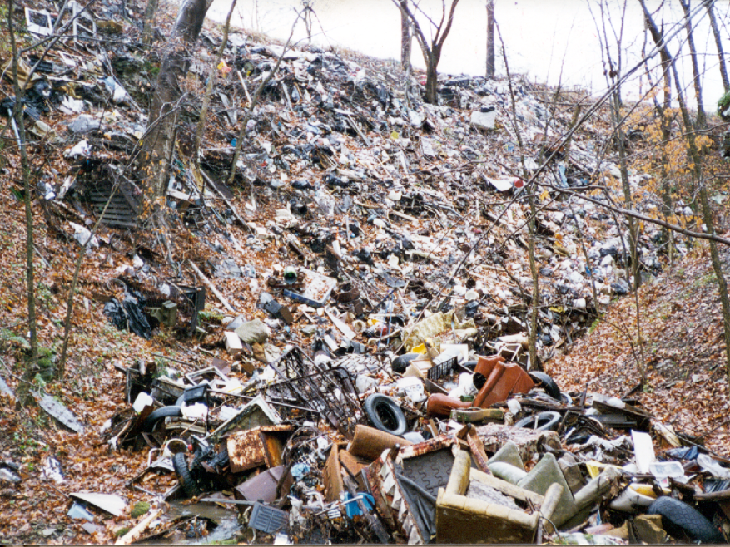
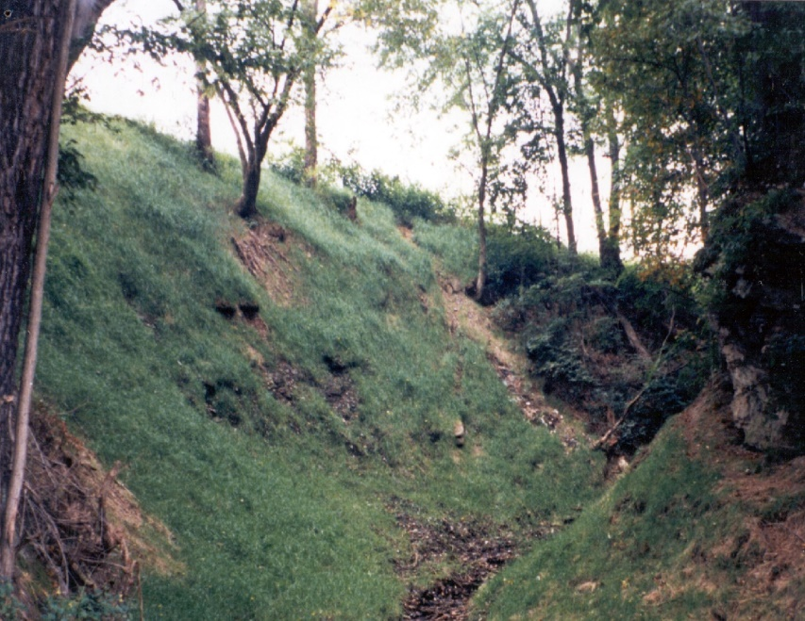
PPOD Dump Reclamation
Glen Falls Road- Harrison County
Before
After

Slide 7

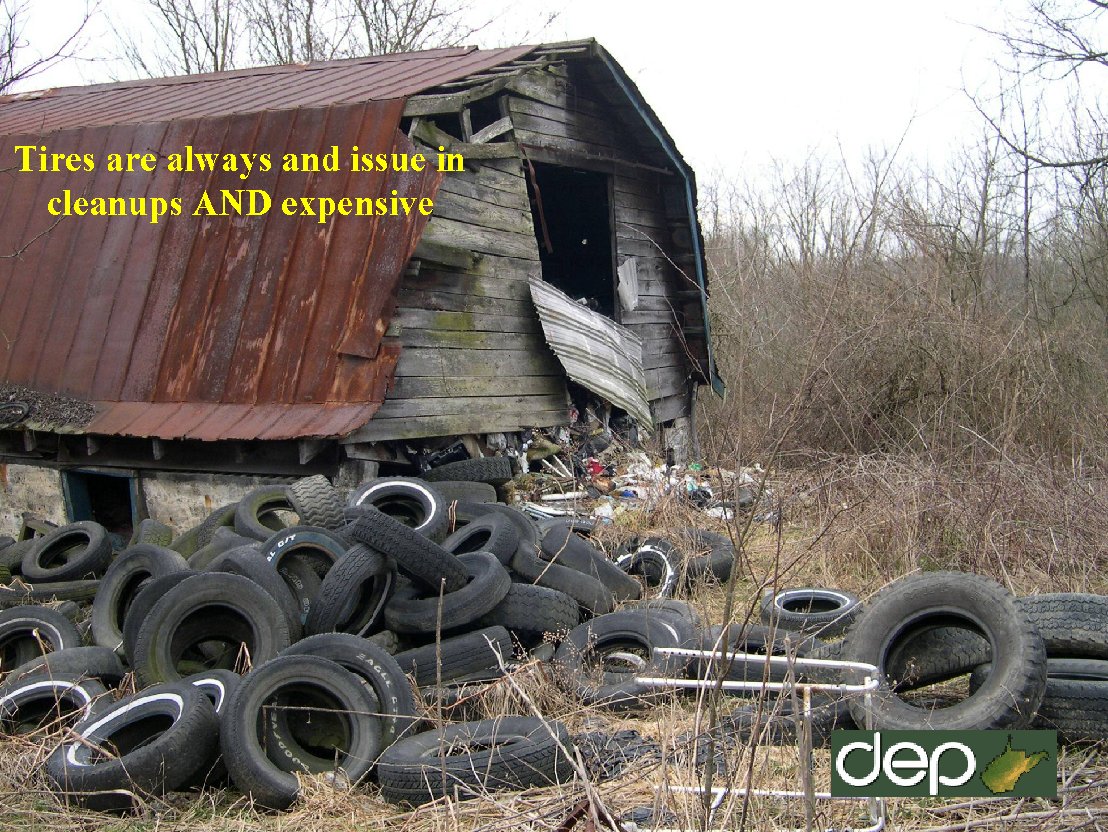
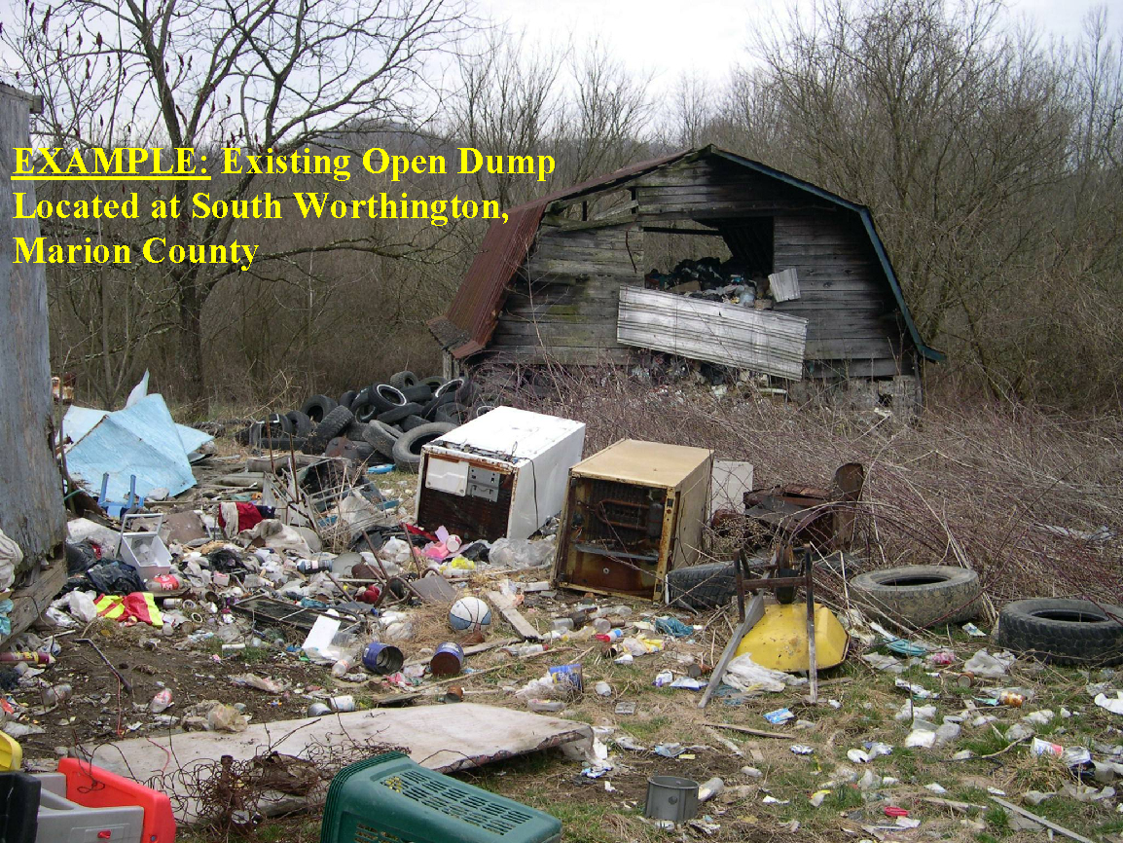

Slide 8
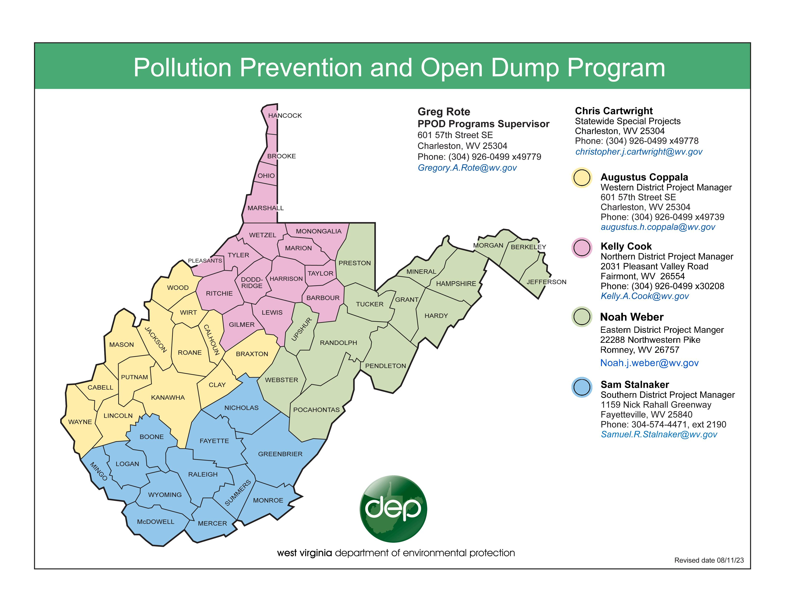

Slide 9
Tire Remediation Program
In addition to PPOD’s remediation of illegally dumped tire piles, the program also coordinates the DEP’s Tire Remediation Program. This program operates in the following manners:
Single day, once a year, tire collection events open to the public.
Continuous events, usually held at county recycling centers, that occur daily, weekly, bi-weekly, or monthly.
A schedule of tire collection events may be found at the following link:
https://dep.wv.gov/environmental-advocate/reap/tires/Pages/TireCollectionEvents.aspx

Slide 10
Tire Remediation Program Rules
The DEP’s Tire Remediation Program operates under the following rules:
Events are open to the public, but citizens must be able to provide a valid WV identification
There is a 10 tire limit per resident
Businesses are not eligible to participate
Tires on wheels are not accepted
Only passenger car and light duty truck tires are accepted

Slide 11
County Litter Control Officers (LCOs)
§7-1-3ff(c) establishes the authority of county commissions to hire a county litter control officer(s). §7-1-3ff(d) gives county litter control officers citation writing authority. There are currently 25 LCOs in 21 WV counties.

Slide 12
LCOs Continued
County Litter Control Officers have citation writing authority for the following sections of WV State Code:
§22-15-10. Open Dump
§22-15A-4. Unlawful Disposal of Litter
§22C-4-10. Mandatory Disposal

Slide 13
LCO Map
21 WV counties have hired county litter control officers. REAP maintains an updated contact list for these officers (handout available).

Slide 14
PPOD Assistance
PPOD can provide assistance in the following situations:
Remediation of dumps and tire piles originating from state road right of way
Granting waivers for tire collection rules when there is an ongoing enforcement action
Assisting in cleanup orders resulting from an enforcement action
Coordination between DNR NRPOs and County LCOs
Special projects

Slide 15
PPOD Reporting Procedure
To request the remediation of an illegal dump or tire pile by calling, texting, or emailing their PPOD Project Manager. To simplify the process, please include the following information:
County name
Road name
GPS coordinates in decimal degree format. Please provide detailed directions if GPS coordinates are not available.
Pictures or a detailed description of site
Contact information

Slide 16

WVDEP REAP
Greg Rote, Field Supervisor
Pollution Prevention Open Dump Program
601 57th Street, SE
Charleston, WV 25304
304-389-8181
gregory.a.rote@wv.gov

