Slide 1


Slide 2
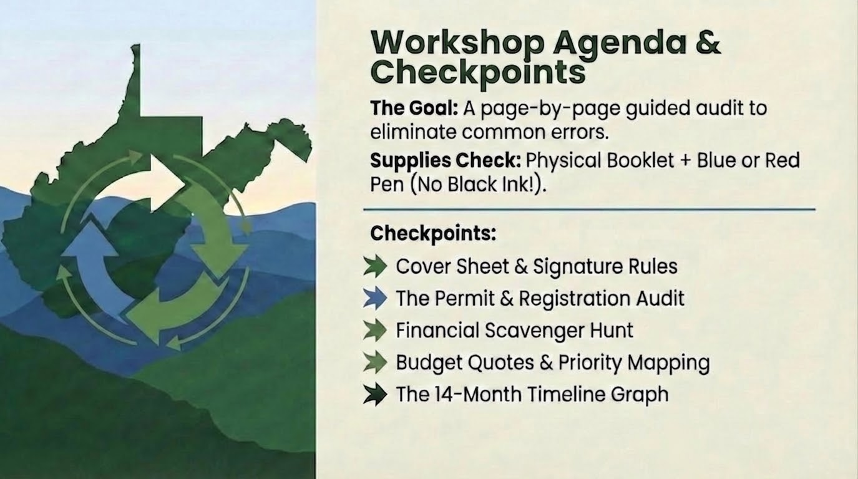

Slide 3
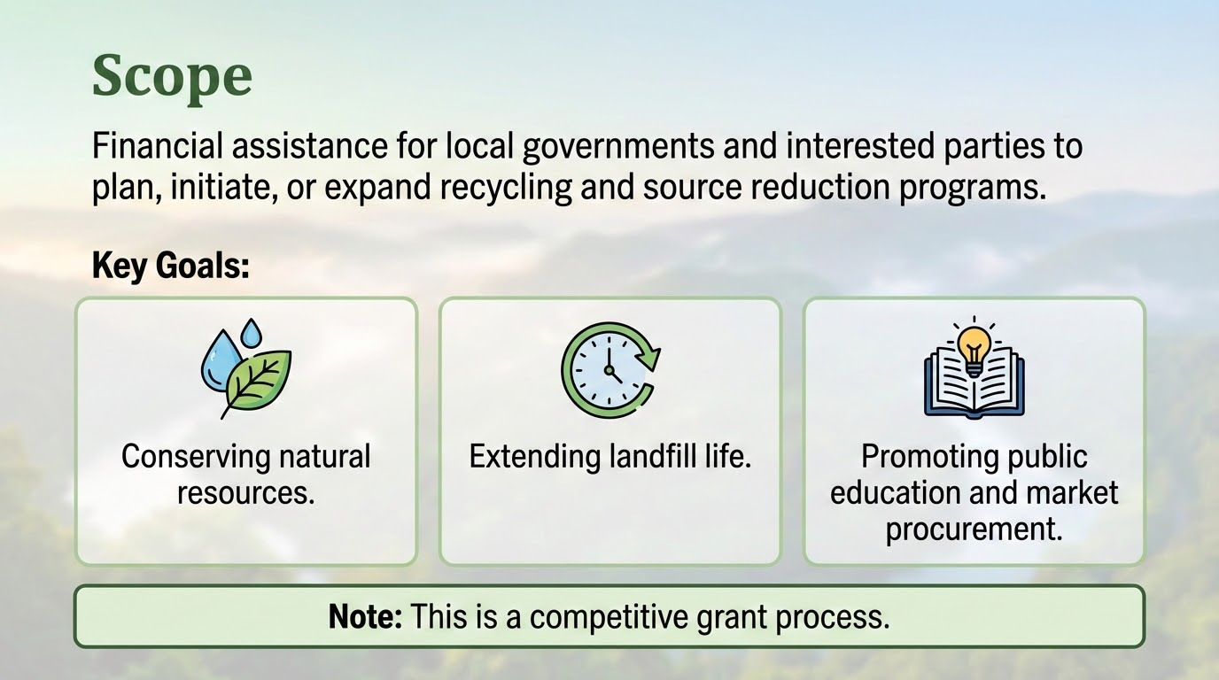

Slide 4
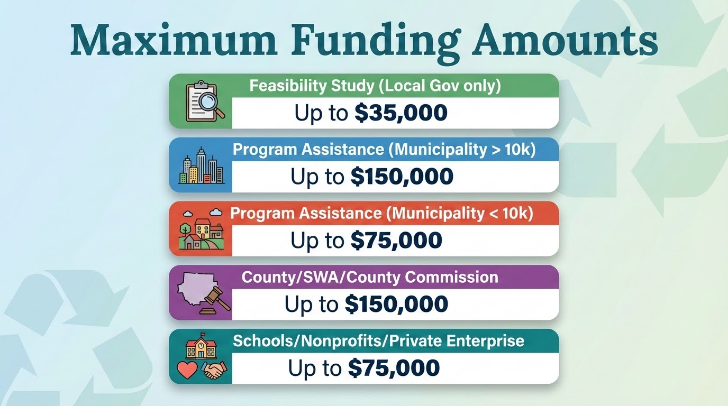

Slide 5
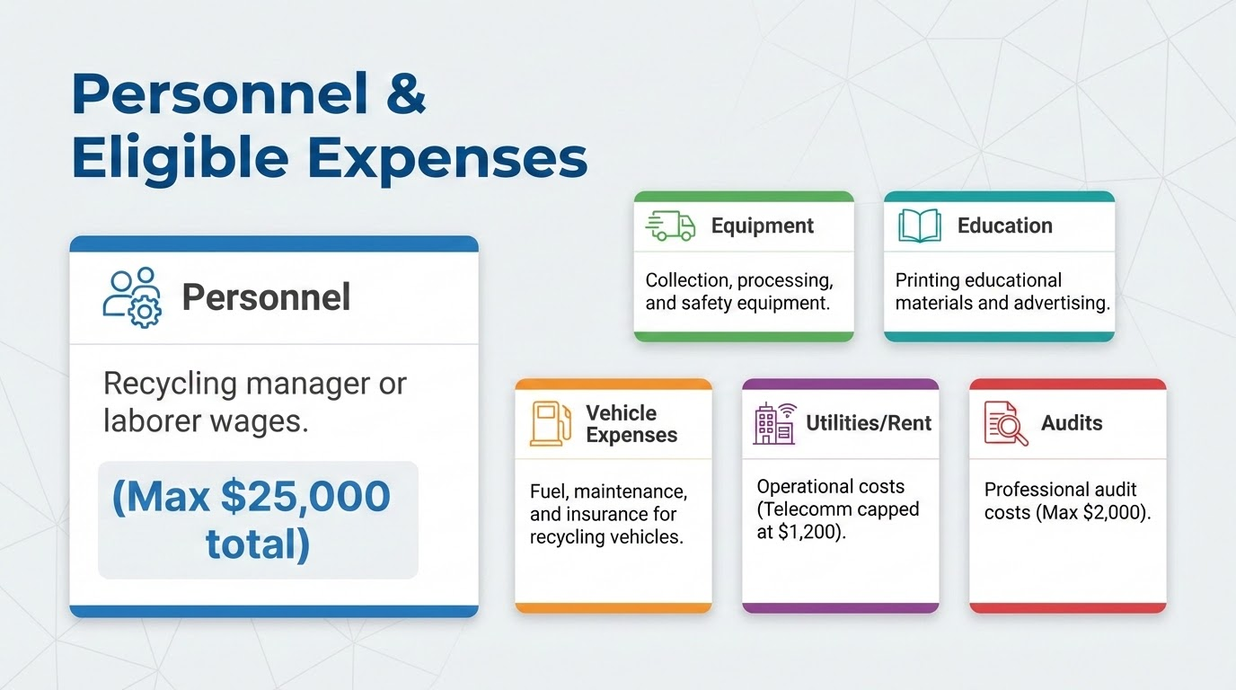

Slide 6
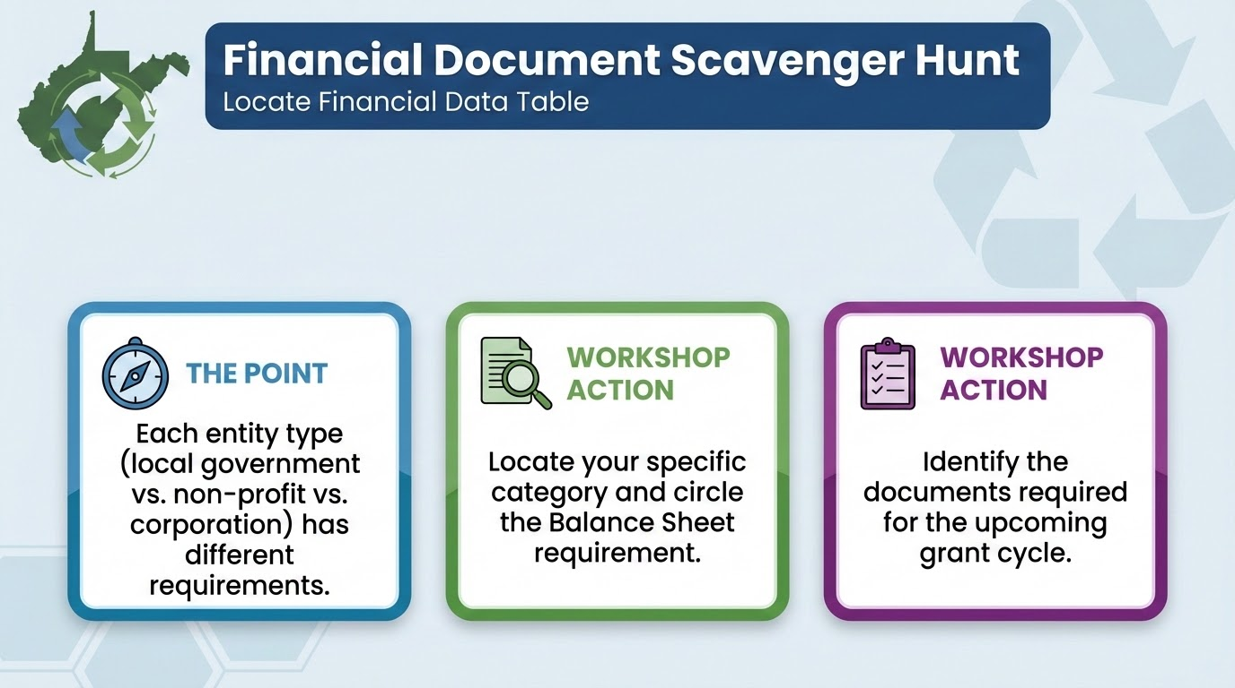
Notes:
Now that we know how much money your project qualifies for, let's look at the 'Proof of Stability' the State requires. We are going to call this the Financial Document Scavenger Hunt. Please locate your Financial Data Table Handout. This is the point where many people realize they need to call their CPA or Treasurer immediately to get the right documents.

Slide 7
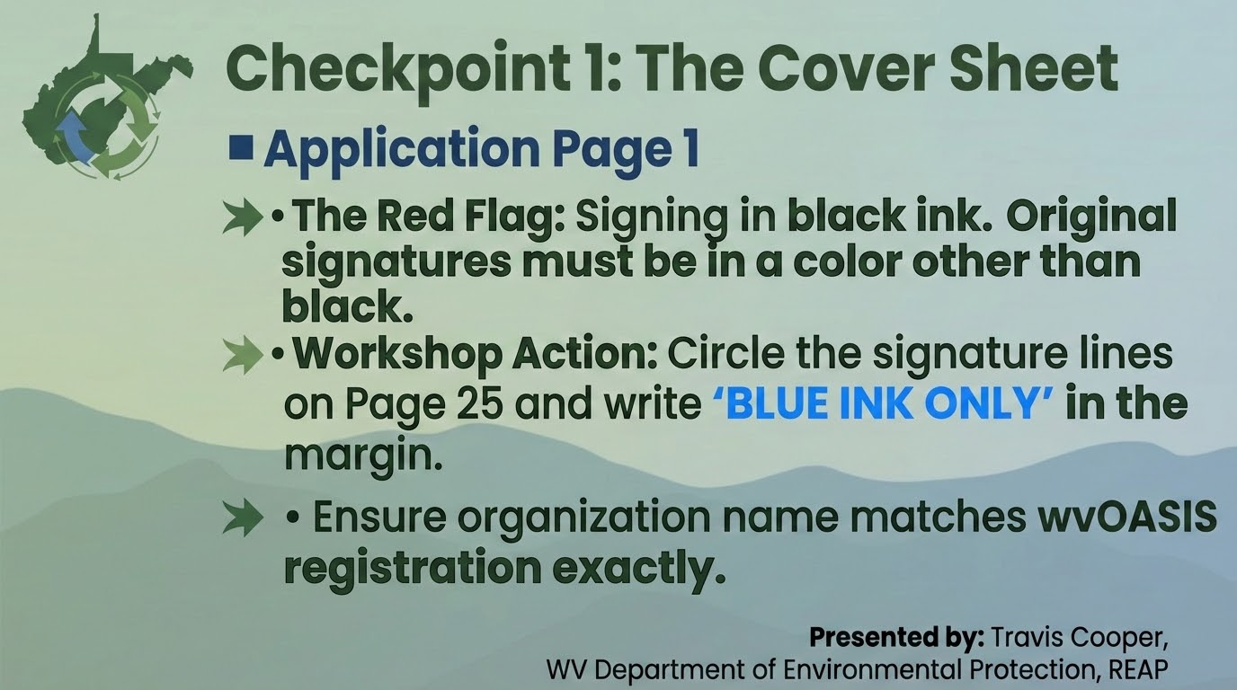
Notes:
On Slide 7, we are looking at the very first page of the actual application. This is where one of the most common mistakes occur. Look at the bottom of Page 1. If you use the pen you've used for your whole life, a black on, you will end up having to sign it again or gathering new signatures during the cure period. Use blue. It’s a simple rule, but it’s a must.

Slide 8
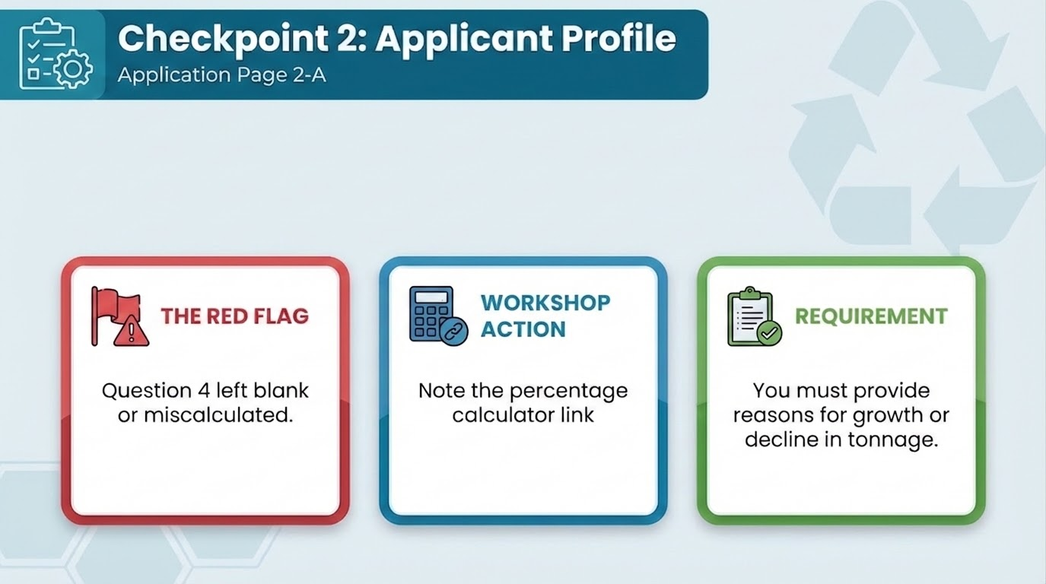
Notes:
The committee wants to see if your program is growing or shrinking. Don't just give them the raw numbers in Question 3; you also have to do the math for them in Question 4. If you aren't a 'math person,' use the website link printed right there in the booklet. We provide an example of how to explain a decline—be honest about why your numbers shifted.

Slide 9
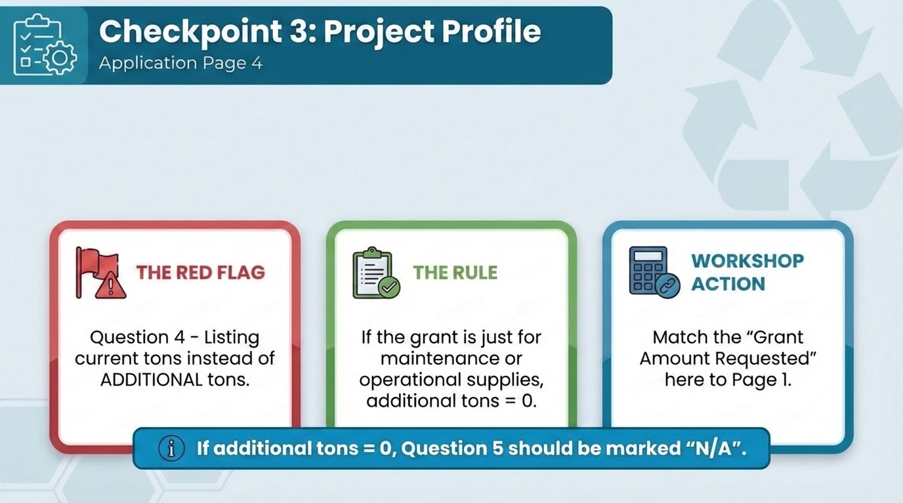
Notes:
Everyone, please look at Page 4 of the application. You might refer to this as the 'Efficiency Page.' The biggest mistake we see is people putting their current annual tonnage in Question 4. If you already collect 500 tons a year, and this grant is just to buy a new truck to replace an old one, your additional tons are zero. The State needs to know what new impact their money is buying.
Also, consistency is key. If you ask for $75,000 on the front page but write $70,000 here, it is going to be flagged. Make sure those numbers match perfectly before you move on. Finally, look at Question 5. We do not like blank spaces. If you aren't adding new tons, write 'N/A' so they know you didn't just skip the question.

Slide 10
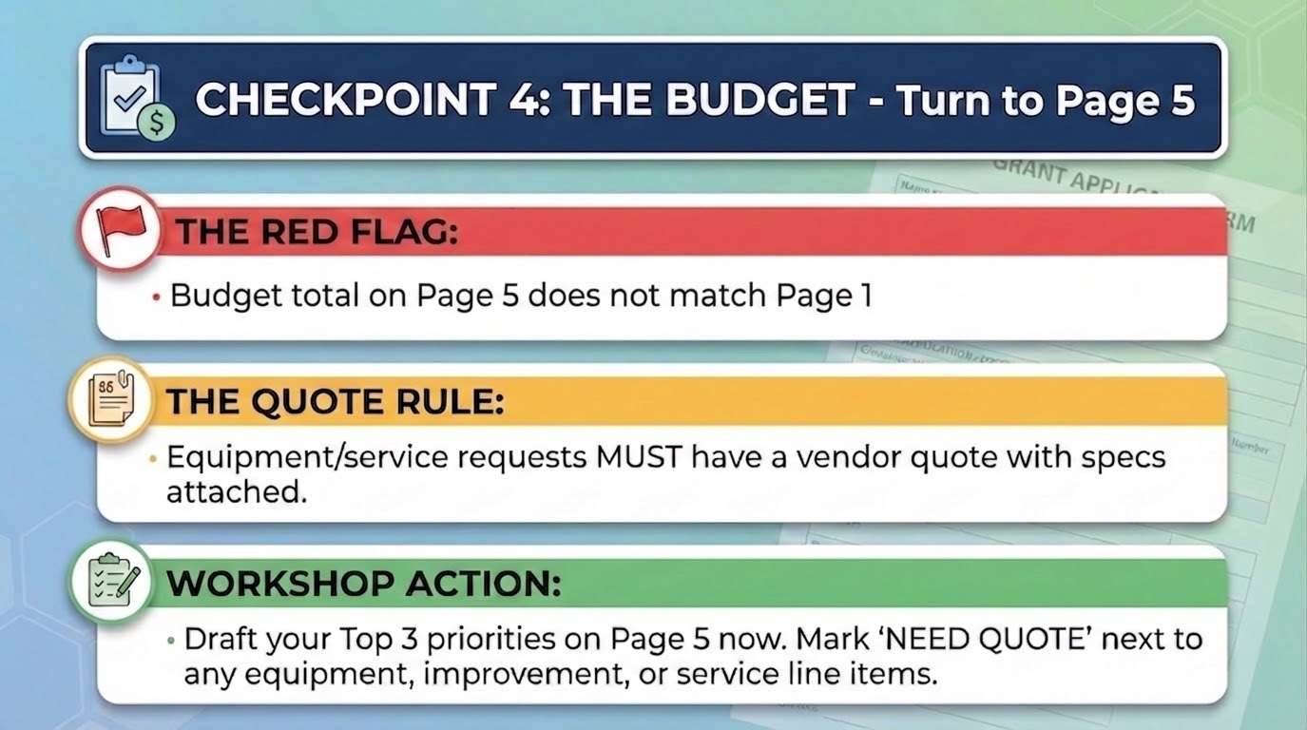
Notes:
Let’s look at Page 5. This is the heart of your proposal. If your math is off by even one dollar between the Cover Sheet and this Budget page, then one of the pages must be corrected so that they match.
Here is a quick tip: Complete your itemized budget on Page 5 first. Once you have that final total, go back to Page 1 and enter that number in the 'Amount Requested' box. Then, flip to Page 4 and put it in Question 4. This 'working backward' approach ensures all three pages stay in sync. Also, remember that on Pages 6A-6C, you have to explain every single item. If you put a truck on Page 5 but don't explain the need for it on 6A, it will be flagged for correction.

Slide 11
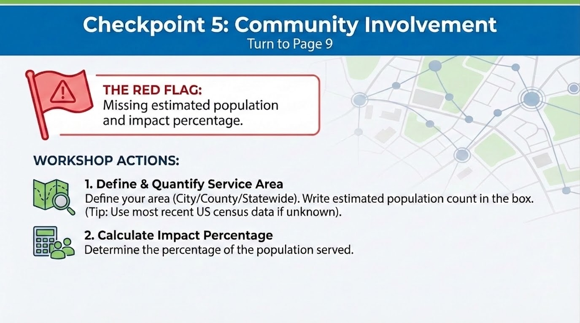
Notes:
Let’s flip to Page 9. This page is about your program’s reach. The Committee isn’t going to fund a program that only a handful of people use. The biggest mistake here is being too vague. Don't just say 'we serve the whole county.' You need to provide the estimated population and the percentage of people impacted.
If you're a school, your population is your student body and staff. If you're a municipality, it's your residents. If you don't know your population, look it up on your phone right now at www.census.gov. Write it in the box of Page 9 so you don't forget it. If your project area has 2,000 people and you expect 1,000 to participate, write down '50% impact.' The committee needs these hard numbers to measure the impact of the program and grant.

Slide 12
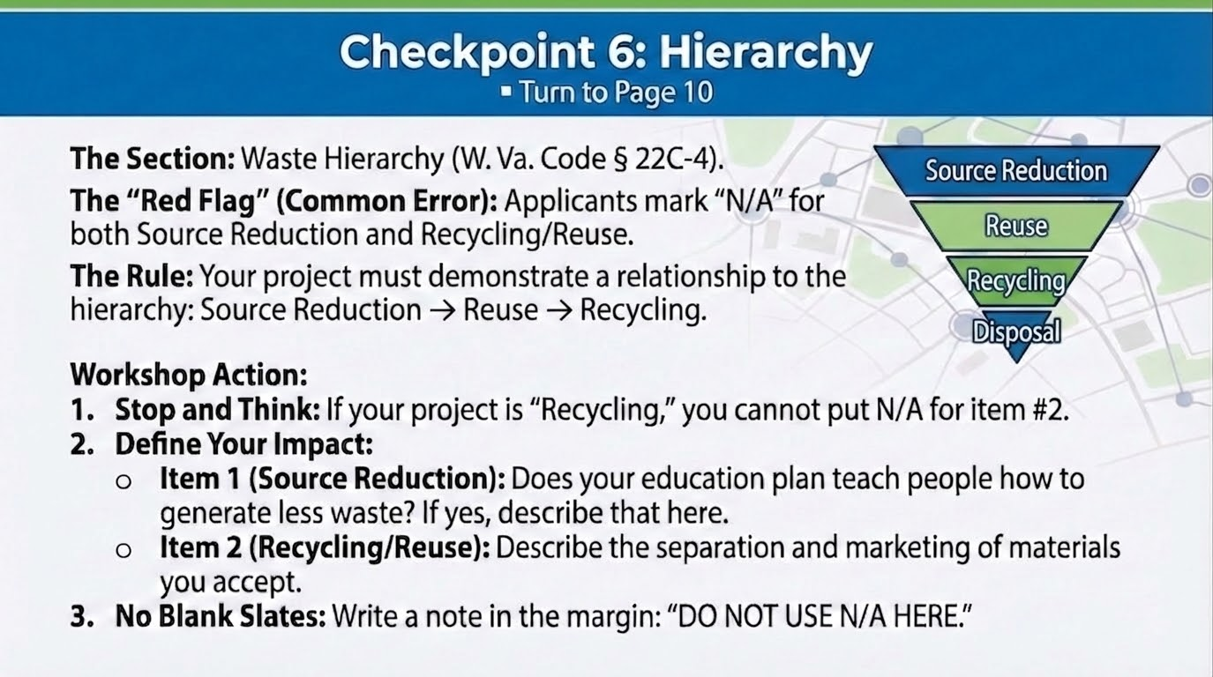
Notes:
Flip to Page 10. This page gets rejected a lot because the applicant lits N/A in both boxes or leaves the boxes blank. The Legislative Rule says your project should support the state's waste hierarchy. If you write 'N/A' for everything, you are telling the DEP your project doesn't fit. If you're recycling, you're doing item #2—so be sure to describe it!

Slide 13
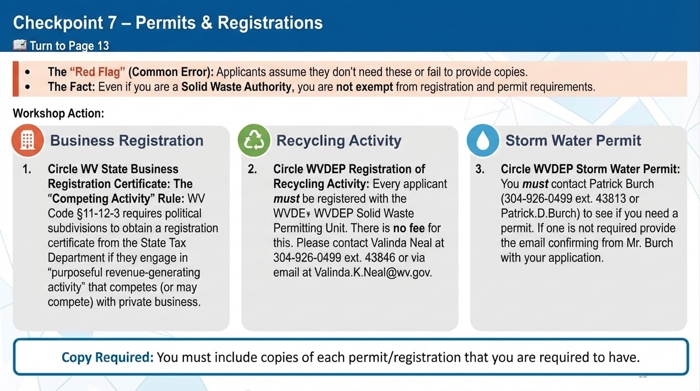
Notes:
Our legislative rules states that applicants shall be in compliance with all federal, state, and local laws, codes, ordinances, rules, and regulations to be eligible for a grant. Page 13 addresses this 'Compliance Check.' For instance, if you purchase metal from the public, you must be registered as a Scrap Metal Dealer with the Secretary of State. If you handle materials, you must have a DEP recycling registration number. I ask that you do not leave these boxes blank. If the item does not pertain to you, please state so in the comment box or if you don't have the permit yet, explain that you are working to obtain it. Keep in mind that if you are awarded a grant, the DEP can hold your funds if you fall out of compliance.

Slide 14
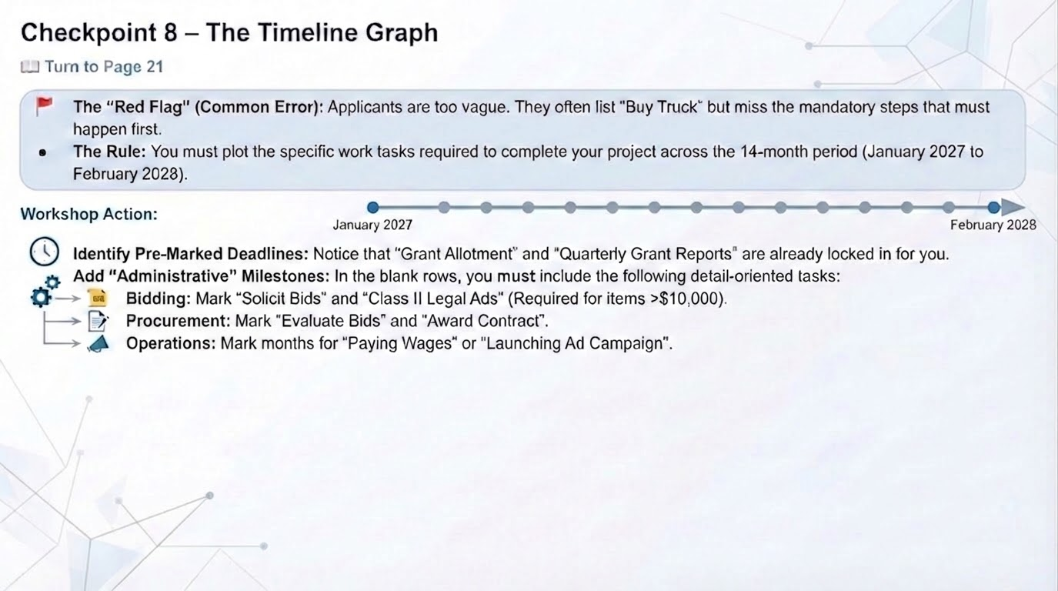
Notes:
Let’s look at Page 21. Don’t think of this as just a calendar; think of it as your project's 'To-Do' list. The biggest mistake here is missing the steps between the big goals. If you're buying a piece of equipment over $10,000, the law says you must run a Class II legal ad in the newspaper twice within 14 days .
If your chart shows “Purchase Baler' in February, then you should have something addressing the bidding process in January. It can say solicit bids or “run class II lega ad”.
As part of this process, let’s fill this in with an example. Go ahead and write “Run class II Ad” for January. Next, let’s add evaluate bids and submit to DEP in Feb. and finally let’s add purchase baler for March.
Make sure your timeline shows you doing the paperwork before you spend the money.

Slide 15
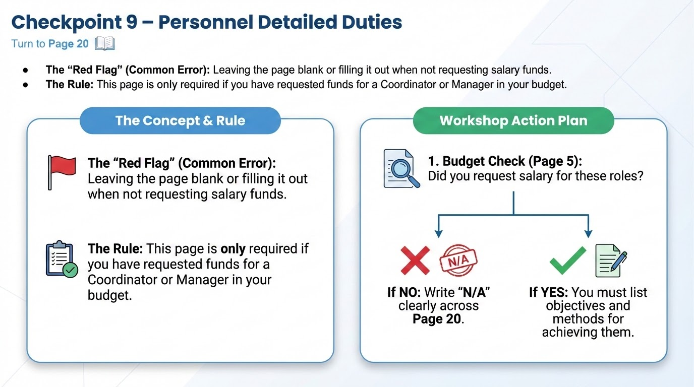
Notes:
Page 20 is to be used if you are requesting wages for a recycling coordinator, director, or manager. If you are only asking for wages for laborers, you do not have to complete this page.

Slide 16
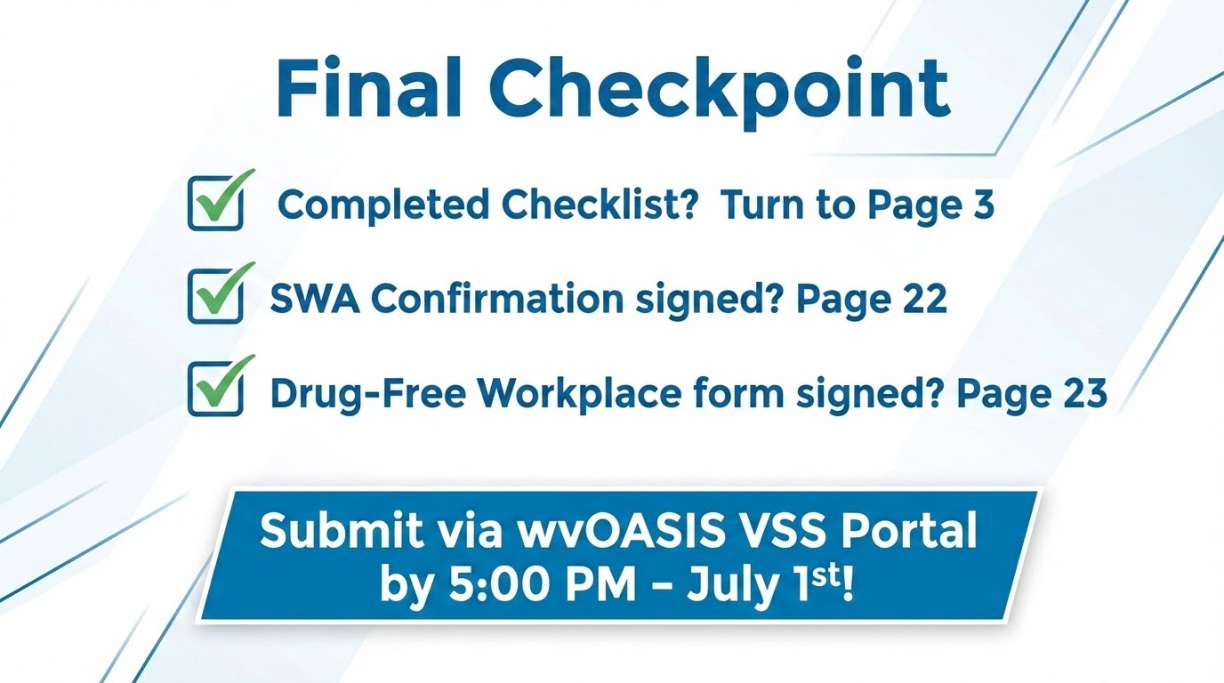

Slide 17
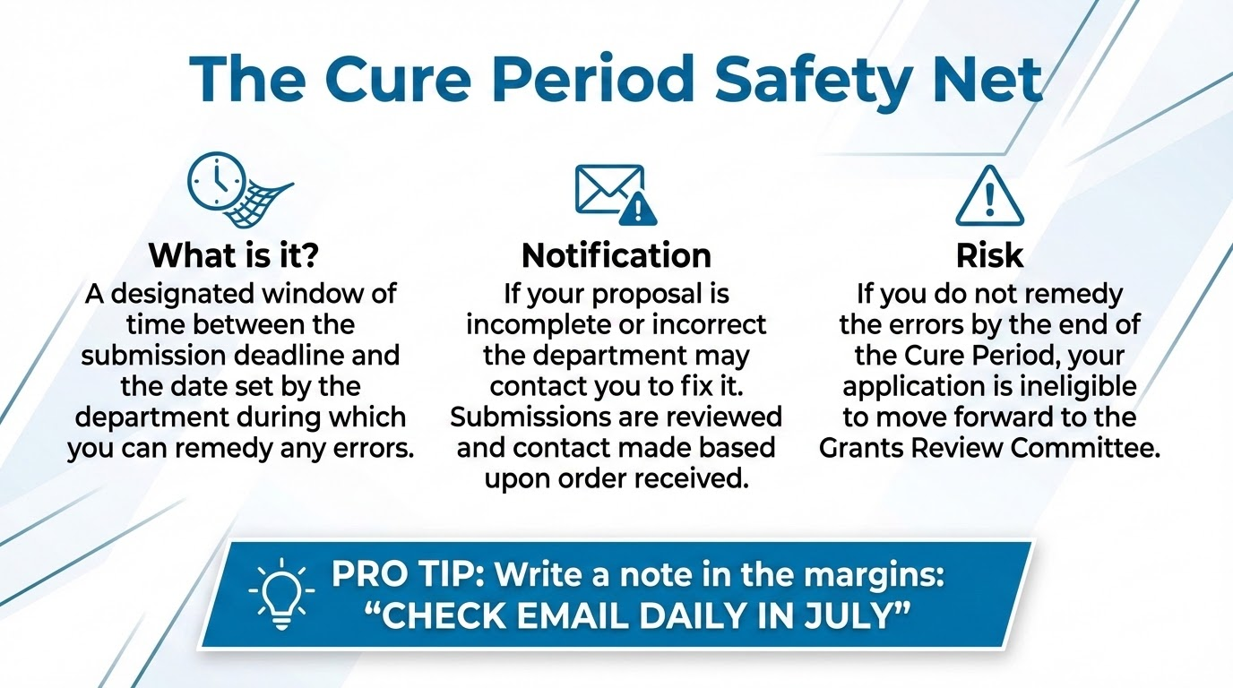
Notes:
Finally, let's talk about your 'Safety Net.' Despite our work today, you might still miss a document or a signature. This is where the Cure Period comes in.
If the DEP staff finds an error, I will contact you. But here is the catch: you only have so many days to fix it. If you are on vacation in July and don't check your email, you may miss the window, and your application will be rejected .
Also, keep that blue pen handy because corrections also needs to be color scans signed in blue ink!

Slide 18


Slide 19
