Slide 1


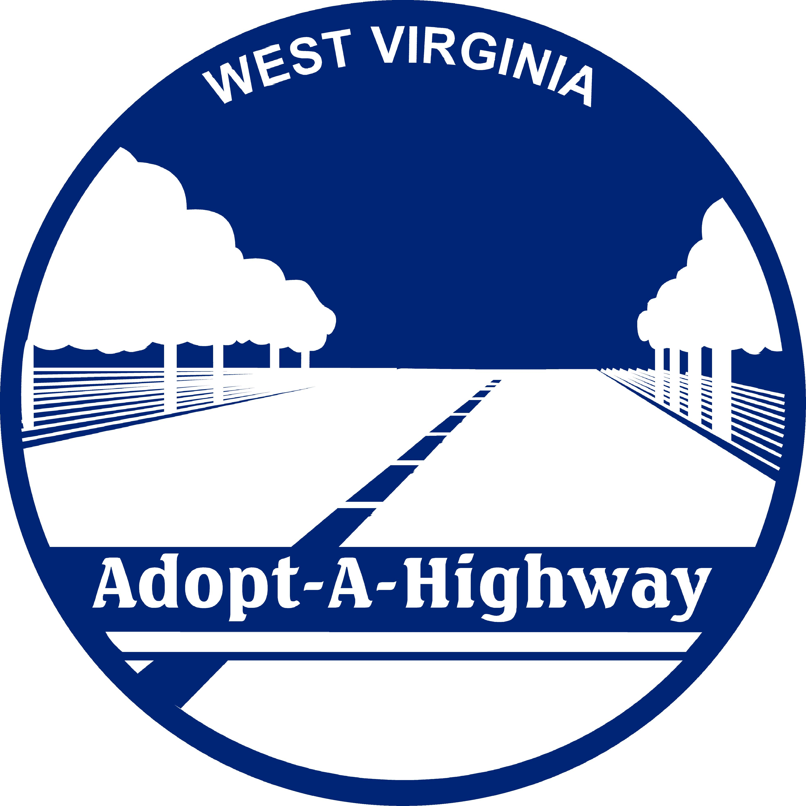
Adopt a highway & adopt a spot
Partnering to Reduce Litter and Improve Communities

Slide 2
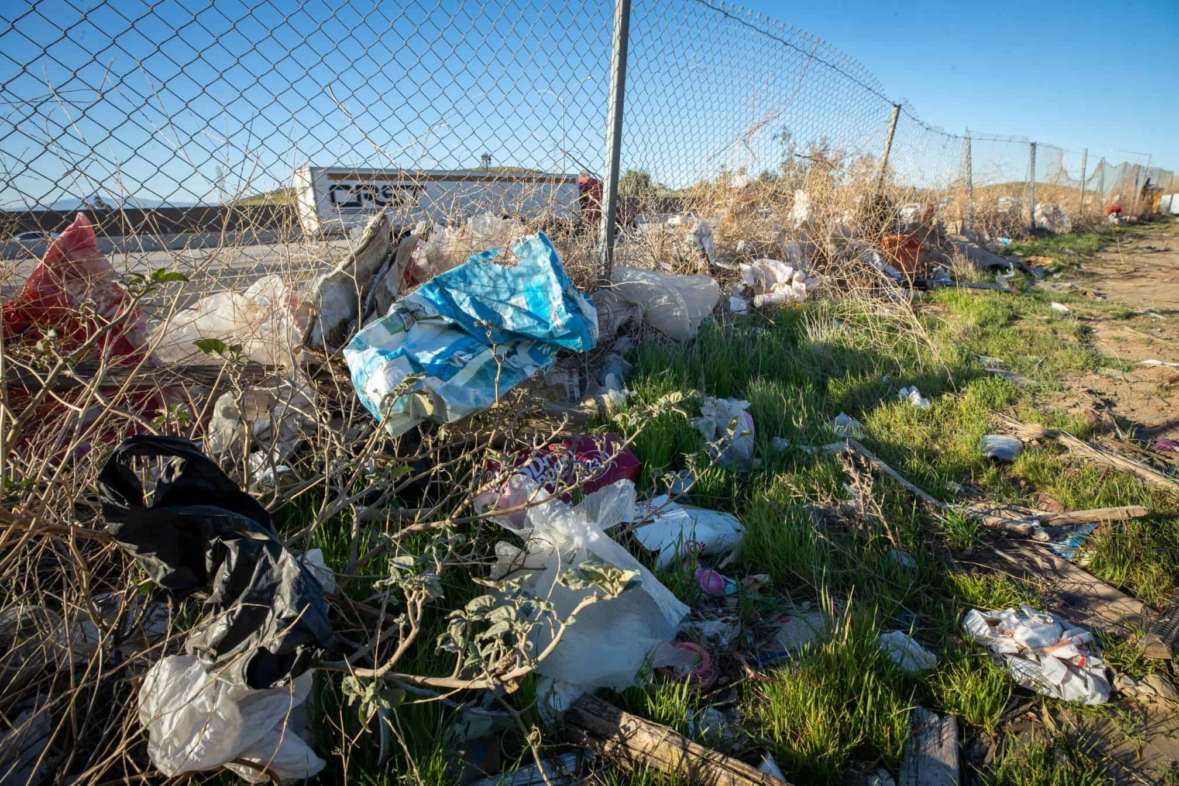
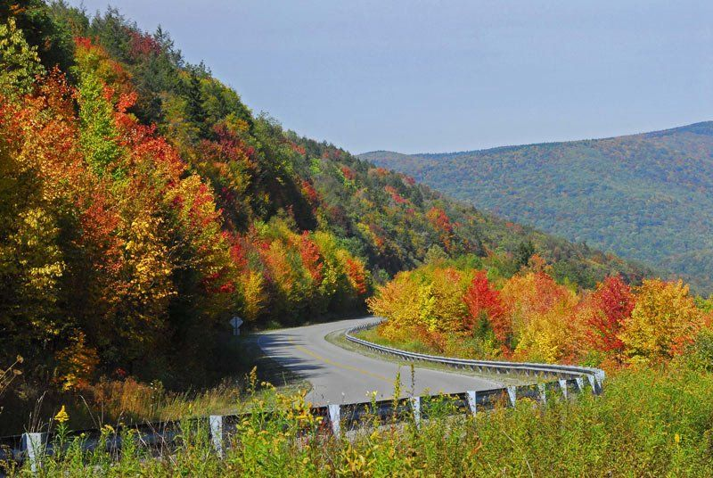
THE WINDSHIELD THEORY

Slide 3
WHY DOES IT MATTER?
Wildlife and Waterways
Stormwater Systems
Community Pride & Tourism
Litter & Economic Development

Slide 4
LITTER AND ECONOMIC DEVELOPMENT
In West Virginia, the correlation between litter and economic development is not just a matter of "curb appeal"; it is a direct financial relationship. The state’s economy relies heavily on natural capital—tourism, outdoor recreation, and site selection for new industries—all of which are negatively impacted by the presence of roadside and stream-side waste.
ECONOMIC SECTOR | IMPACT OF HIGH LITTER | RESULTING FINANCIAL LOSS
REAL ESTATE | Reduced “curb appeal” and perceived safety | Lower property tax assessments
PUBLIC WORKS | Diversion of DOH labor to trash pickup | Delayed bridge and road repairs
PUBLIC HEALTH | Breeding grounds for vectors; rodents/mosquitoes | Increased public healthcare expenditures
ENVIRONMENT | Microplastics and toxins in watershed | Higher water treatment costs for municipalities

Slide 5



HISTORY OF
ADOPT A HIGHWAY PROGRAM

Slide 6
HOW / WHY THE PROGRAM STARTED
Adopt A Highway began in Texas in 1985
WV adopted program in 1989
Originally housed under the DNR before moving to the REAP (Rehabilitation Environmental Action Plan) program within the DEP

Slide 7
WHY DOES WEST VIRGINIA NEED ADOPT A HIGHWAY?
Maintains thousands of miles of state roadways
AAH helps by increasing cleanup frequency, creating local ownership, and discouraging through visibility
Cleanup by state crews are costly, time consuming, and repetitive in some locations
Litter problems include household trash, construction debris, and tires/bulky waste

Slide 8
West Virginia code: §17-2A-21.
Commissioner authorized to contract for implementation of litter control programs.
In addition to all other powers granted and duties imposed upon the Commissioner, he or she shall contract with the Secretary of the Department of Environmental Protection and expend moneys from the highway litter control fund to implement the litter control program and litter control maintenance of the highways pursuant to article fifteen-a, chapter twenty-two of this code.

Slide 9
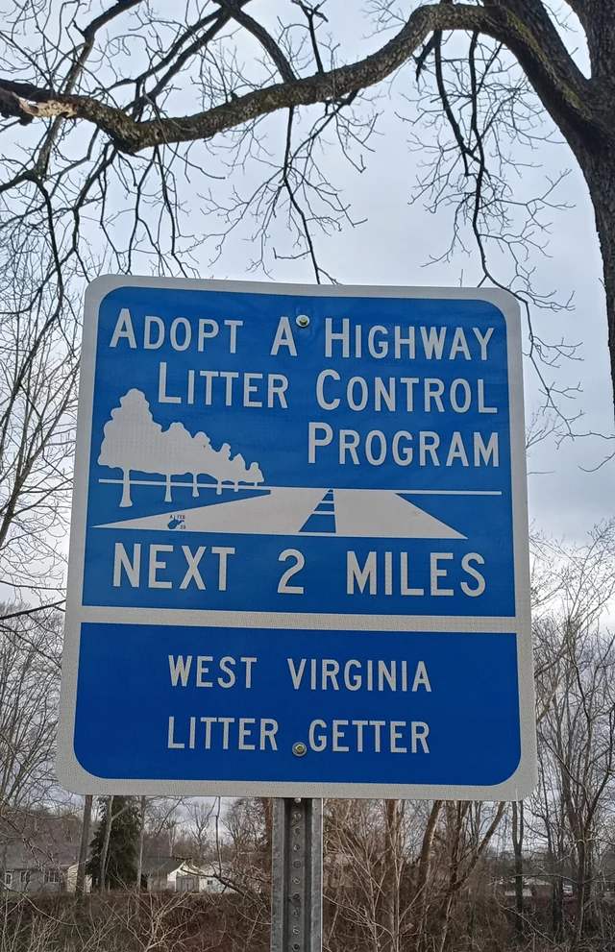
Early Years of
Adopt A Highway
Community groups “adopted” a section of state roadway
  included churches, scout troops, schools, volunteer fire departments, families, and civic organizations
WV Division of Highways provided trash bags, vests, and coordination of pickup and disposal
The DNR was responsible for managing volunteer applications, coordinating with civic groups, and tracking environmental impact data
KEY RESULT: Roadways with adoption signs were noticeably cleaner than non-adopted roads.

Slide 10

CO-SPONSORSHIP
BETWEEN WVDEP AND WVDOH
The DEP’s Role: The "Administrator"
The DEP manages the program through REAP (Rehabilitation Environmental Action Plan).
Volunteer Management: We handle recruitment, applications, the two-year contracts renewals, and the database of who has adopted which stretch of road.
School Involvement: Our Youth Environmental Program recruits through schools and youth groups, framing AAH as a way for students to earn community service hours
Communication: We run the 1-800-322-5530 hotline and coordinate the large "Statewide Cleanup" events in the spring and fall.
Education: We provide the safety training materials (videos/handouts) and the certificates of accomplishment signed by the Governor during our annual Adopt A Highway Appreciation Day.
The DOH’s Role: The "Logistics Provider"
The DOH provides the "boots on the ground" infrastructure.
Supplies: The local DOH county garages are the distribution hubs. This is where volunteers go to pick up their "kit": safety vests, specialized orange trash bags, gloves, and "Litter Ahead" signs.
Signs of Recognition: The DOH is responsible for fabricating and installing the blue-and-white signs that feature the name of the adopting group.
The Heavy Lifting: This is the most critical part for the volunteers—once the bags are filled and left at the shoulder, the DOH crews pick them up and dispose of them.

Slide 11
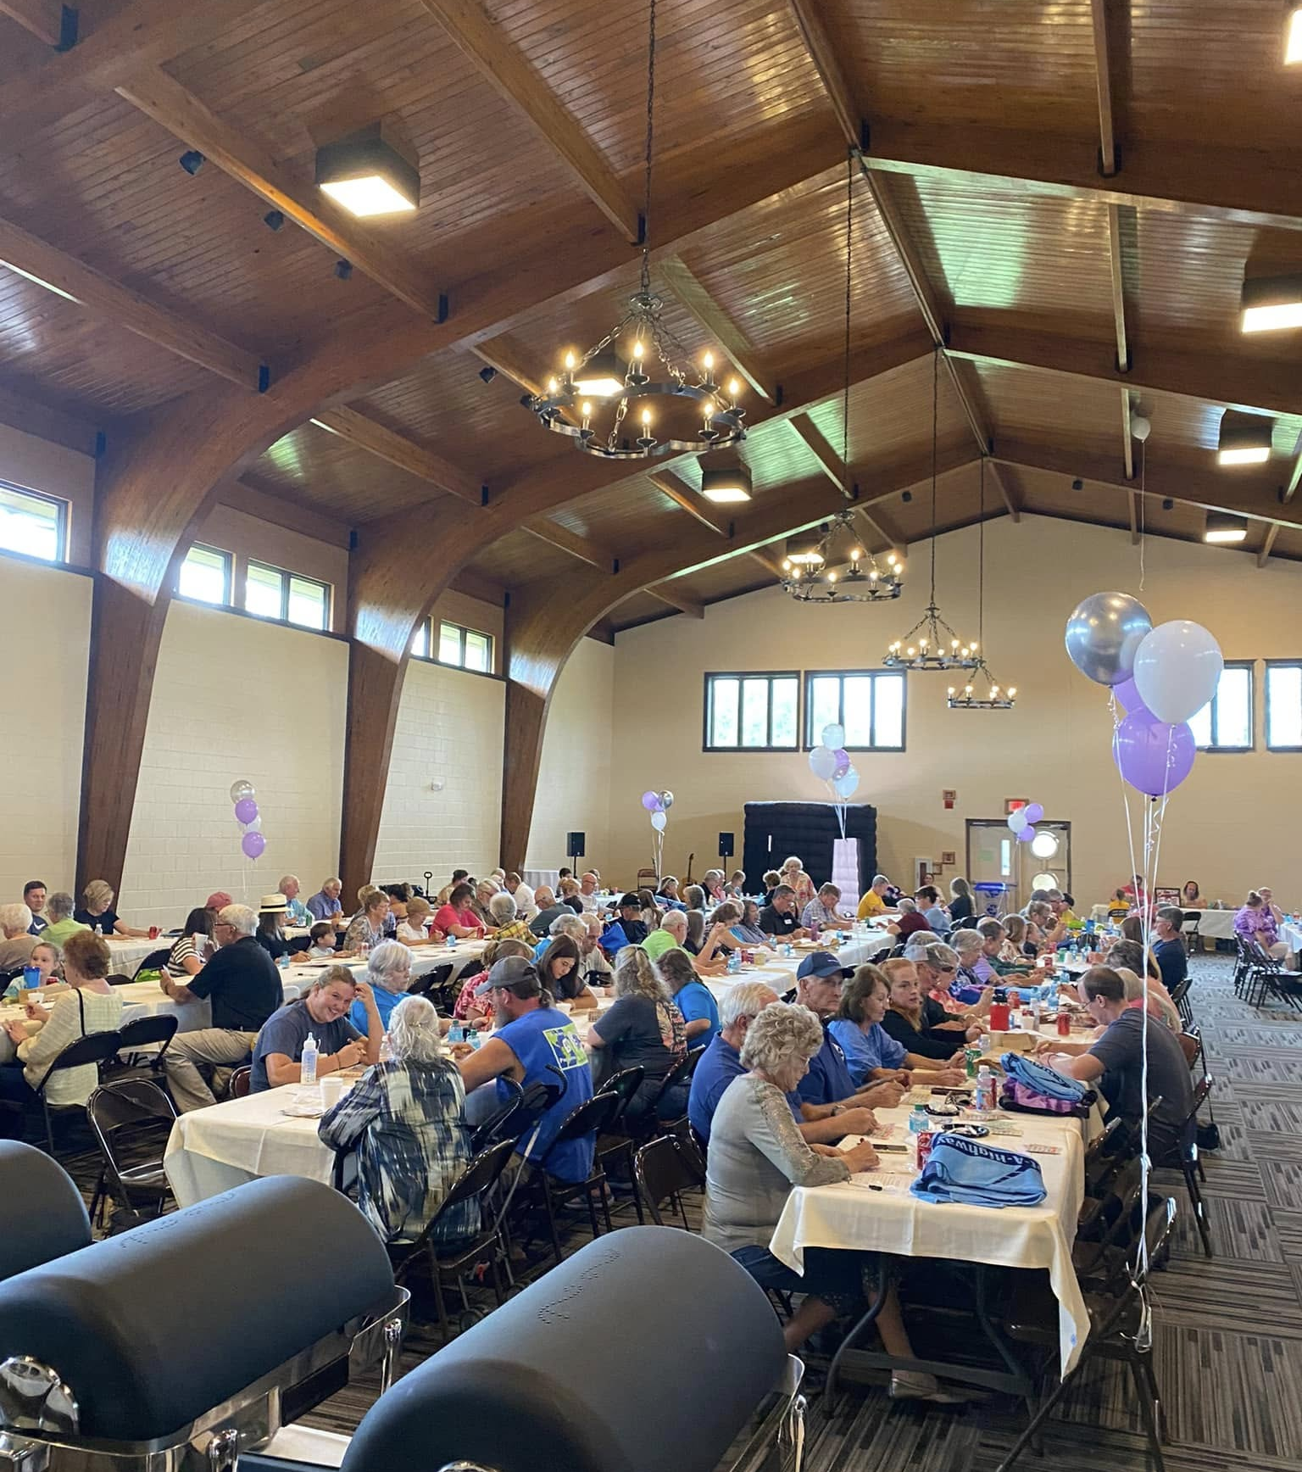
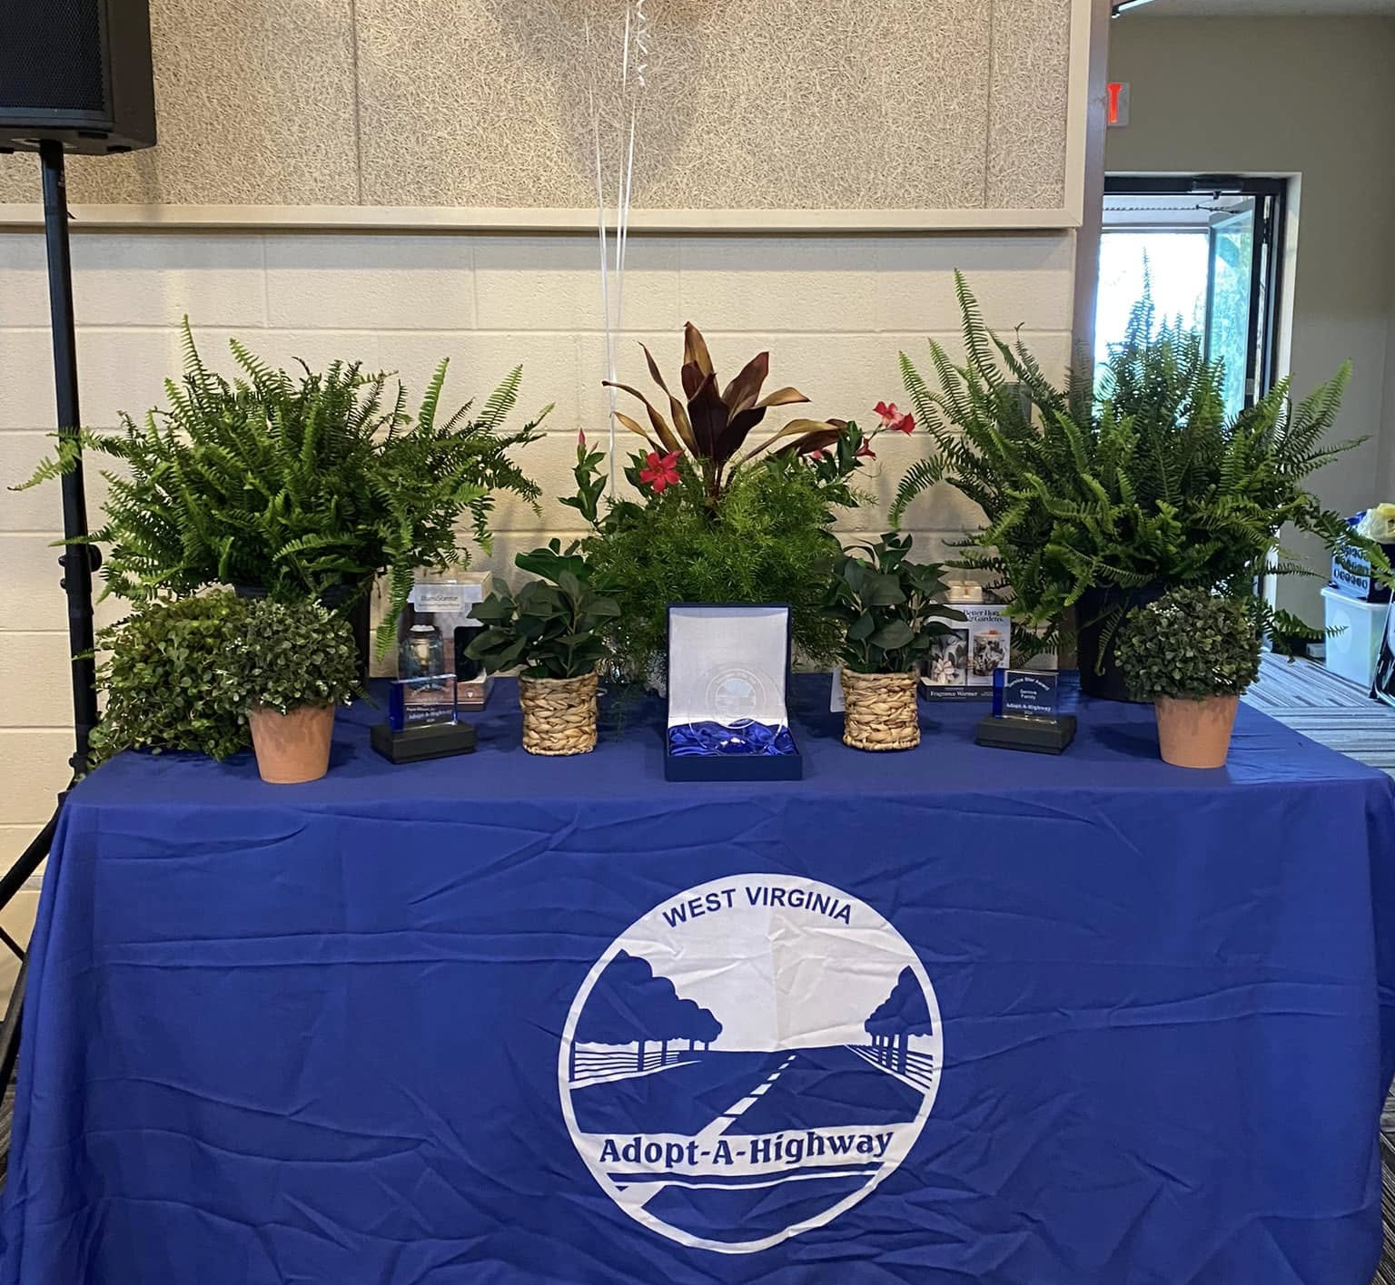
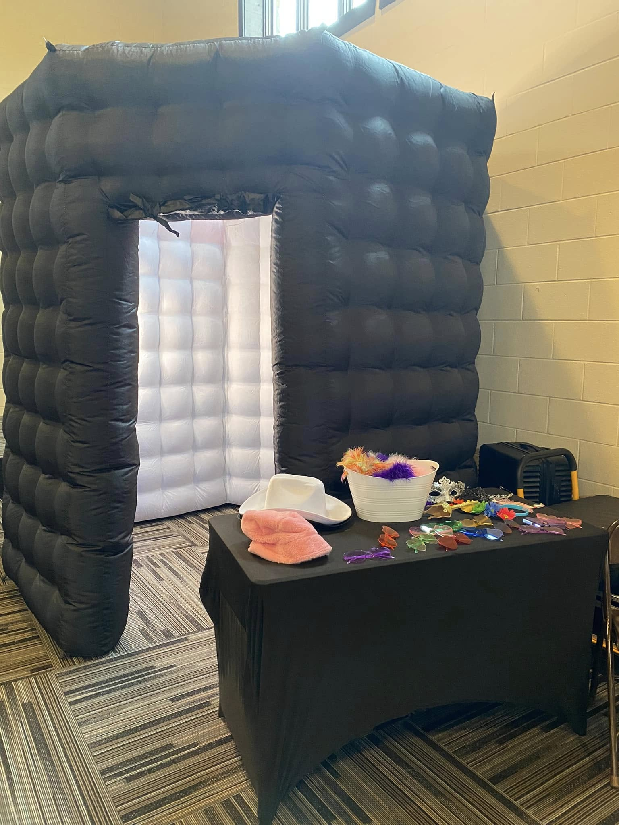
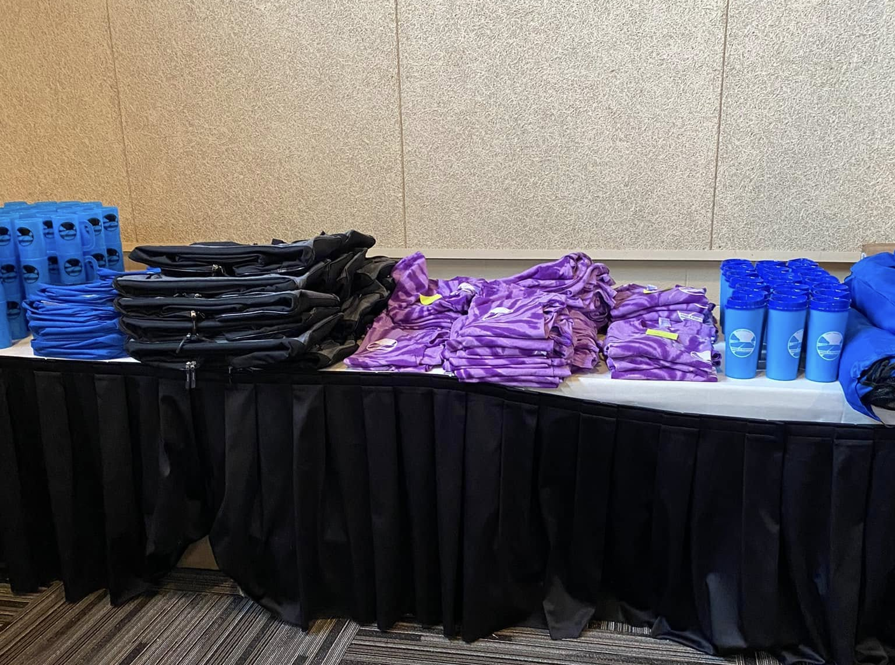
Adopt A Highway
Volunteer Appreciation Day

Slide 12
WHY THIS MATTERS TO SWAs
These programs are resources to combat litter in your county!
Zero Disposal Cost for Volunteers: Because the DOH handles the disposal, it removes a major barrier for community groups who want to help but can’t afford landfill tipping fees.
Safety Standards: The DOH ensures that the stretches of road being adopted are actually safe for pedestrians (excluding interstates or high-hazard zones).
Unified Support: An SWA doesn't have to "reinvent the wheel." If a local group wants to clean up, the SWA can simply point them to the DEP for the paperwork and the DOH for the bags.

Slide 13
Stats From Past Five Years: 2021-2025
New Groups Recruited | Miles Cleaned | Bags Collected | Pounds (Bags x 25) | Tons (Pounds / 2000) | Tires | Man Hours
324 | 9,281 | 50,769 | 1,269,225 | 634.61 | 2,405 | 747,655

Slide 14

Reported Stats From
Beginning to Current!
Orgs: 4,480 Pounds: 22,975,425
Participants: 139,998 Tons: 11,487.7125
Miles: 129,679 Tires: 10,528
Bags: 919,017 Man Hours: 15,604,165

Slide 15
FUN WV RELATED FACTS!
139,998 participants — that’s enough people to fill Milan Puskar Stadium in Morgantown twice (it holds about 61,500 fans)!
If every Adopt-A-Highway volunteer formed their own town, it would be the 3rd largest city in West Virginia, right behind Charleston and Huntington.
129,679 miles of roadway is enough to drive across West Virginia’s mountains from Harpers Ferry to Huntington over 5,200 times!
That’s enough miles to circle all 35 West Virginia state parks nearly 3,700 times!
If each pound of trash were a football, you could cover every square inch of Milan Puskar Stadium in Morgantown more than 100 times!

Slide 16
Implementation of Adopt A Spot
Not all litter problems occur on state highways
WV communities needed flexibility to address parks, boat ramps, and park and rides
Adopt A Spot programs emerged locally, often led by Solid Waste Authorities, County commissions, and nonprofits

Slide 17
DIFFERENCES BETWEEN AAH AND AAS
Adopt-A-Highway (AAH):
Adopt-A Spot (AAS):
Distance: Requires a minimum of 2 miles of both sides of state-maintained road.
Environment: Focuses on rural or suburban stretches where litter accumulates over distance (roadside ditches, embankments).
Minimum Age: Participants must be at least 12 years old.
Distance: Requires a maximum of ¼ mile, one side of the road.
Environment: Think of "pockets" of the community: city entry points, intersections, small roadside parks, or even "welcome to" signs.
No Hard Minimum Age: The state reserves the right to deny an adoption or a specific cleanup if they deem the area unsafe for the ages of the volunteers involved.

Slide 18
As an SWA, use these two programs as different tools in your "litter toolkit":
Feature | Adopt A Highway | Adopt A Spot
Best For | Large civic groups, churches, hunting clubs. | Garden clubs, small businesses, "Main Street" groups.
Goal | Removing volume (pounds of trash) | Improving community image and pride.
SWA Benefit | Cleans up long corridors where illegal dumping starts | Eliminates “eye sores” in high-traffic town centers
Visibility | 2-mile stretch; signs at both ends | Maximum of ¼ of a mile; sign on one side of the road

Slide 19
The 4 Steps of Adoption:
From Paper to Pavement
Step 1: The Application
  The group leader (the "Coordinator") submits an application to the WVDEP REAP office. The group must specify the 2-mile stretch (for Highway) or the specific location (for Spot) they want.
Step 2: Safety Training
  The Coordinator must ensure all volunteers watch the official Safety Training Video. Every participant (or parent) signs the Terms and Conditions. This is a crucial step that protects the state and the organization
  Once the DEP and DOH approves the stretch of road, a two-year agreement is signed. The group commits to 2 cleanups per year.
Step 3: The First Cleanup
  The Coordinator contacts their Local DOH County Garage 4–5 days before the cleanup. They collect the "Supply Kit" (Orange bags, vests, gloves, and "Litter Ahead" signs). They perform the cleanup and leave the filled bags well off the travel portion of the road. The Coordinator submits a "Cleanup Report" to the DEP stating the date of the cleanup, number of tires collected, how many bags were collected, how many volunteers worked.
Step 4: Sign Fabrication & Install
  The DOH Sign Shop creates the custom blue-and-white signs. DOH crews install two signs (one at each end of the 2-mile stretch). For Adopt-A-Spot, a single smaller sign is placed at the location. These signs remain the property of the DOH but serve as a permanent "Thank You" to the community.

Slide 20
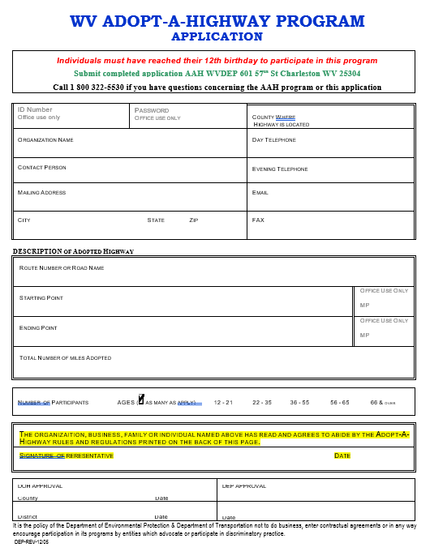

Slide 21

Key Takeaways and Final Thoughts
WVDOH ensures roadway safety and program oversight
WVDEP strengthens litter prevention and environmental education
Solid Waste Authorities connect communities to action
Together, we:
  Reduce roadside litter and illegal dumping
  Protect WV’s roads, waterways, and communities
  Build long-term stewardship through local involvement

Slide 22
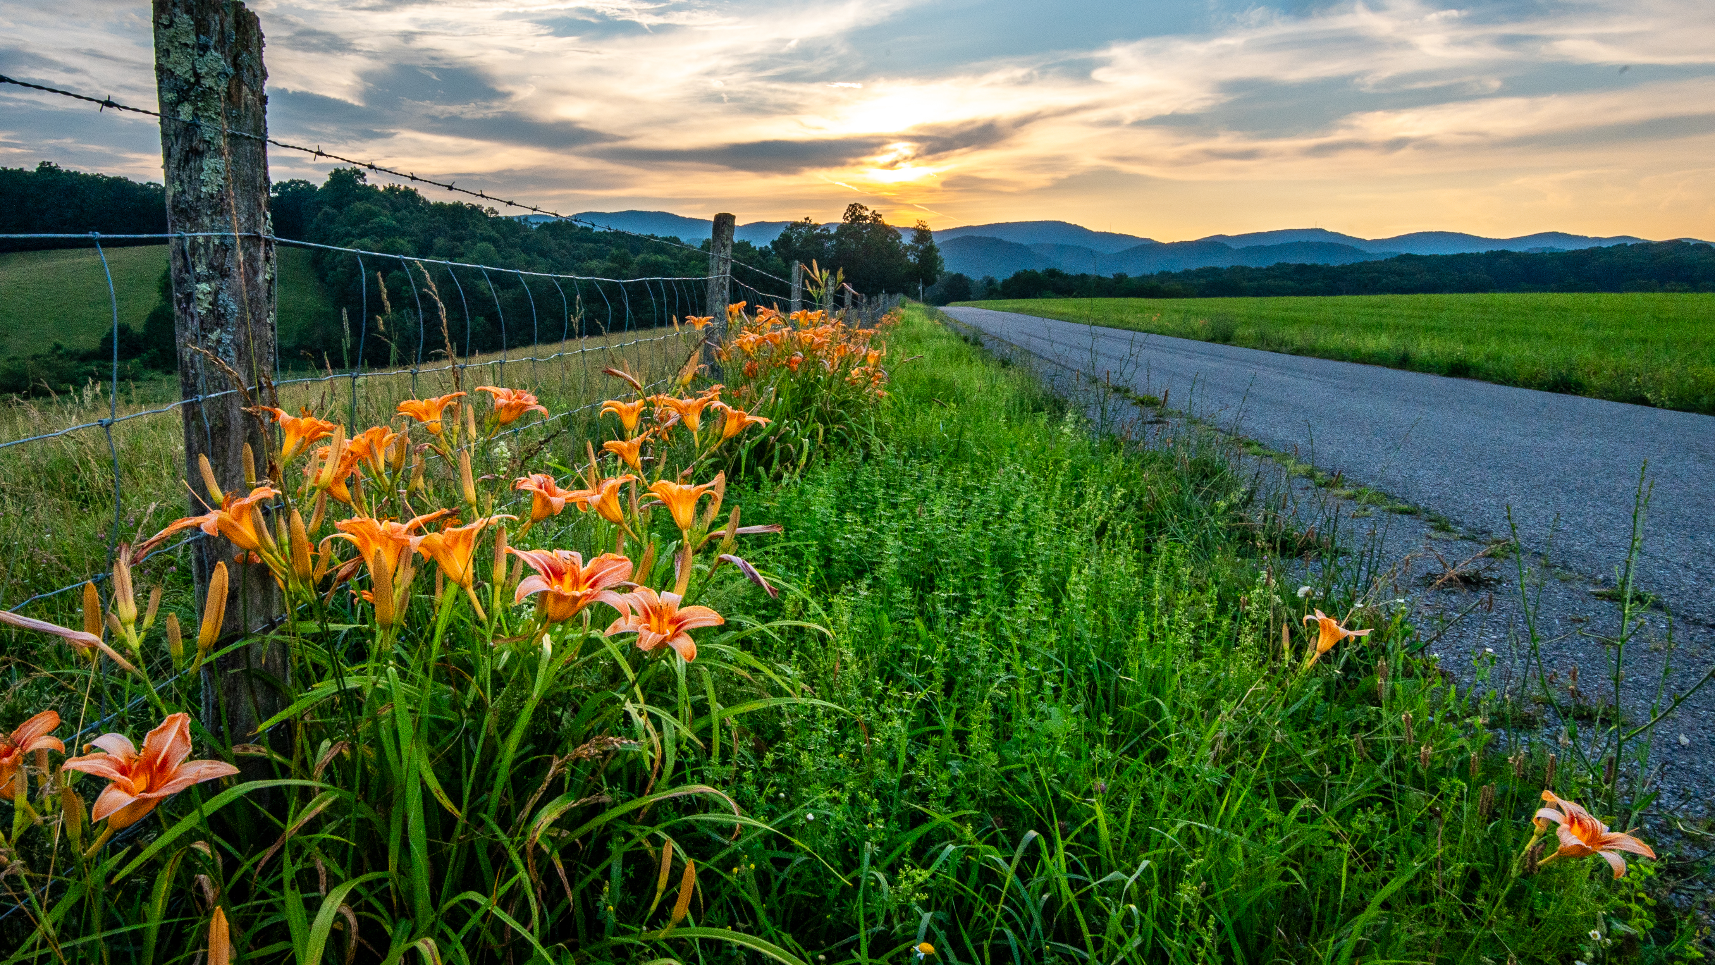
Contact us
Chelsea Runion
Adopt A Highway Coordinator
chelsea.runion@wv.gov OR dep.aah@wv.gov
1-800-322-5530

