Slide 1
Purchasing with Purpose
Efficiency and Oversight through the PCard/Participating in the WVSAO PCARd PRogram
Sherri Vazquez
West Virginia State Auditors Office
Notes:
Good morning, everyone. My name is Sherri Vazquez, and I manage the Local Government Purchasing Card Program.
Today we’re going to talk about purchasing with purpose—specifically how we can improve efficiency while still maintaining strong oversight through the use of Pcards.
PAUSE 2 SECONDS
And this is something that really impacts all of us—because purchasing touches almost every part of our daily work.
If you think about it, even small delays in purchasing can slow down operations, create frustration, and add unnecessary work.
On the other hand, moving too quickly without the right controls can create risk.
So today, we’re really focusing on how to find that balance—how to move faster but still stay accountable.
Pause 1-2 seconds.

Slide 2

Today’s Session
What is a PCard
Why it matters
Benefits and risks
Oversight and controls
Best practices
WVSAO PCard Program
Notes:
Let me walk you through what we’ll cover today.
What exactly is a PCard?
Why do they matter?
What are the benefits and risks of using Pcards?
What do we need to do to have good oversight and controls in place?
What are the best practices to have a smooth, well working PCard Program?
We’ll start with what a PCard is—just to make sure we’re all on the same page, regardless of experience level.
Quick Pause
Then we’ll talk about why it matters—because this isn’t just a process change, it directly impacts efficiency, time, and workload
We’ll also go through the benefits and the risks—because while PCards make things faster, they also require responsibility and structure.
We’ll spend some time on oversight and controls—this is really the foundation of a successful program.
And finally, we’ll wrap up with best practices—what works, what doesn’t, and what helps keep the program running effectively.
My goal is that by the end of this session, you feel confident not just in using a PCard—but in understanding how to use it correctly and effectively.

Slide 3
Quick Question
How many of you currently use a PCard?
Notes:
Before we go any further, I want to get a sense of the room.
How many of you currently use a PCard?”
Pause
Of those who raised your hand—how often are you using it?
Pause
Would you say your experience has been mostly positive—or are there some frustrations?
Respond to replies.
Thank you—that’s really helpful context as we go through this.

Slide 4
~ Company-issued purchasing card
~ Used for business purchases
~Simplifies procurement process
~ faster purchasing process
What is a PCard
Notes:
A PCard is simply a company-issued credit card used for business-related purchases.
It’s designed to make purchasing faster and easier—especially for smaller, everyday items.
So instead of filling out forms, waiting for approvals, and processing invoices…
you can make the purchase, record it, and then it’s reviewed afterward.
It simplifies the process while still maintaining accountability.
Pause

Slide 5
Traditional Challenges
⏳ Slow approvals
📄 Manual processes
💰 High admin cost
🔁 Complex workflow
Notes:
Let’s think about the traditional purchasing process.
You often have multiple approvals, paperwork, and steps just to make a simple purchase.
In many cases, it takes longer to process the purchase than it does to actually use what was purchased.
Pause
And that creates frustration—not just for staff, but for vendors as well.

Slide 6

Why PCards Exist
Traditional Process Vs PCard Process
Traditional:
Approvals → PO → Invoice → Payment
PCard:
Purchase → Record → Review
Notes:
PCards exist to solve that problem.
On the traditional side, you have approvals, purchase orders, invoices, and payments.
With a PCard, it becomes much simpler—purchase, record, and review.
That’s a major shift.
Pause
You’re not eliminating control—you’re changing when the control happens.
And that’s really the foundation of how PCards work.

Slide 7

Efficiency
Faster purchasing
Fewer steps
Immediate access
Less paperwork
Notes:
This is where we really start to see the impact of PCards—efficiency.
Go through bullets slowly
Instead of multiple steps and delays, employees can make purchases immediately.
Let me give you a simple example.
In a traditional process, a single purchase might involve 5 to 10 steps—request, approval, PO creation, invoice processing.
With a PCard, that same purchase can often be completed in just a few steps.
Now imagine doing that dozens of times a month—what does that save?
Pause
That’s where efficiency really starts to add up.

Slide 8
Financial Impact
Lower processing cost
Fewer invoices
Rebates
Improved cash flow
Notes:
This isn’t just about time—it’s also about cost.
Every step in a traditional purchasing process has a cost—staff time, processing, approvals, and delays.
When you reduce those steps, you’re reducing the cost of each transaction.
Even small savings per transaction can add up significantly across an organization.
That’s where organizations start to see real financial impact—not just convenience.

Slide 9
Empowerment
Faster decisions
Reduced Delays
Improved Productivity
Notes:
Another major benefit of PCards is empowerment.
Employees don’t have to wait for approvals for every small purchase.
They can make decisions quickly and keep work moving forward.
That reduces bottlenecks and allows people to focus on their actual responsibilities.
It’s about enabling people to do their jobs more effectively.
Pause

Slide 10
Risks
⚠ Risks in PCard Use
Misuse
Fraud
Missing Receipts
Policy Violations
Notes:
Now let’s shift to the other side of the conversation—risk.
Misuse
Fraud
Missing Receipts
Policy Violations
These are all valid concerns.
And these are often the reasons organizations hesitate to adopt or expand PCard programs.
But these risks can be managed—with the right controls in place.
And that’s what leads us into the next section.
Pause

Slide 11
Risk Example
Example Scenarios
Outside Policy Purchase
Missing Receipt
Late Reconciliation
Notes:
Slowly
Let’s walk through a quick example.
An employee makes a purchase outside of policy…
They don’t submit a receipt…
And the transaction isn’t reviewed for several weeks.
Where did the breakdown happen
Exactly—policy wasn’t followed… controls weren’t enforced… and review didn’t happen.
This isn’t unusual—this is exactly what happens when oversight breaks down.
This is why oversight is not optional—it’s essential.

Slide 12
Oversight
Monitoring
Accountability
Structured Review
Notes:
Now let’s talk about oversight.
PCard programs do not reduce control—they shift it.
Pause
In a traditional process, control happens before the purchase.
With PCards, control happens after the purchase—through monitoring and review.
That requires structure, accountability, and consistency.
And when done correctly, it actually increases visibility.
This is where efficiency and control come together.

Slide 13
Controls
  Spend Limits
  Vendor Rules
  Reviews
Notes:
Controls are what make a PCard program successful.
These include things like spend limits, vendor restrictions, and transaction reviews.
Each of these serves a specific purpose—preventing overspending, restricting inappropriate purchases, and ensuring compliance.
These are not optional—they are essential.
Without controls, the risks we discussed become much more likely.

Slide 14
~ Reconcile Transactions
~Submit Receipts
~Transaction Approval
~Audit Trail
Approval Process
Notes:
Another key component is the approval process.
Cardholders submit receipts, transactions are reconciled, and managers review and approve.
This ensures that every transaction is accounted for and properly documented.
It also creates a clear audit trail.
This is where accountability is reinforced.
Pause

Slide 15
Visibility
Real-time tracking
Reporting
Audit-Ready
Notes:
One of the biggest advantages of a PCard program is visibility.
Transactions can be tracked in real time, and detailed reports can be generated quickly.
This allows organizations to monitor spending patterns and identify issues early.
This isn’t less control—it’s smarter control.
Pause
You’re not losing visibility—you’re actually gaining it.

Slide 16
Best Practices
CLEAR POLICIES AND PROCEDURES
Training
Audits
Monitoring
Support
Notes:
A successful PCard program doesn’t happen by accident.
It requires clear policies, proper training, regular audits, and ongoing monitoring.
Pause
That’s a common challenge.
Consistency is what makes these programs effective.

Slide 17
Common Pitfalls
Lack of enforcement
Poor communication
Inconsistent Reviews
Notes:
These are some of the most common issues we see.
Lack of enforcement, poor communication, and inconsistent reviews can weaken even a well-designed program.
And over-controlling can slow things right back down
It’s about finding the right balance.
Pause

Slide 18
Before Vs after
Before: Slow, manual
After: Fast, streamlined
Notes:
This slide really summarizes the transformation.
Before PCards, the process is slow, manual, and limited in visibility.
With PCards, it becomes faster, more streamlined, and more transparent.
That’s the value of doing this correctly.
It’s not just faster—it’s smarter.
PAUSE

Slide 19

KeY takeaways
Efficiency + Control
Faster Purchasing
Stronger Oversight
Notes:
Let me leave you with a few key takeaways.
Efficiency and control can absolutely coexist.
PCards streamline purchasing, reduce administrative burden, and improve visibility.
But success depends on structure, policy, and accountability.
When those are in place, the program works.
Pause

Slide 20
WVSAO PCard Program
Benefits of Participating
Program Management
PCard Policies and Procedures

Slide 21
Benefits of Participating
Increased control and monitoring
Streamlines payment/purchasing process
Cost and time saving tool
Faster payments to merchants
Accountability/transparency

Slide 22

Minimum Standards
Framework
WVSAO Pcard Policies and Procedures

Slide 23
Required Trainings
Program Coordinators and Department Coordinators
Policies and Procedures
How to assist with issues
Website training

Slide 24
Required Trainings con’t
Cardholder Trainings
New cardholders
Duties/Responsibilities
Required procedures
Repercussions
Statement Reconciliation
Filing disputes
Who to contact for help

Slide 25
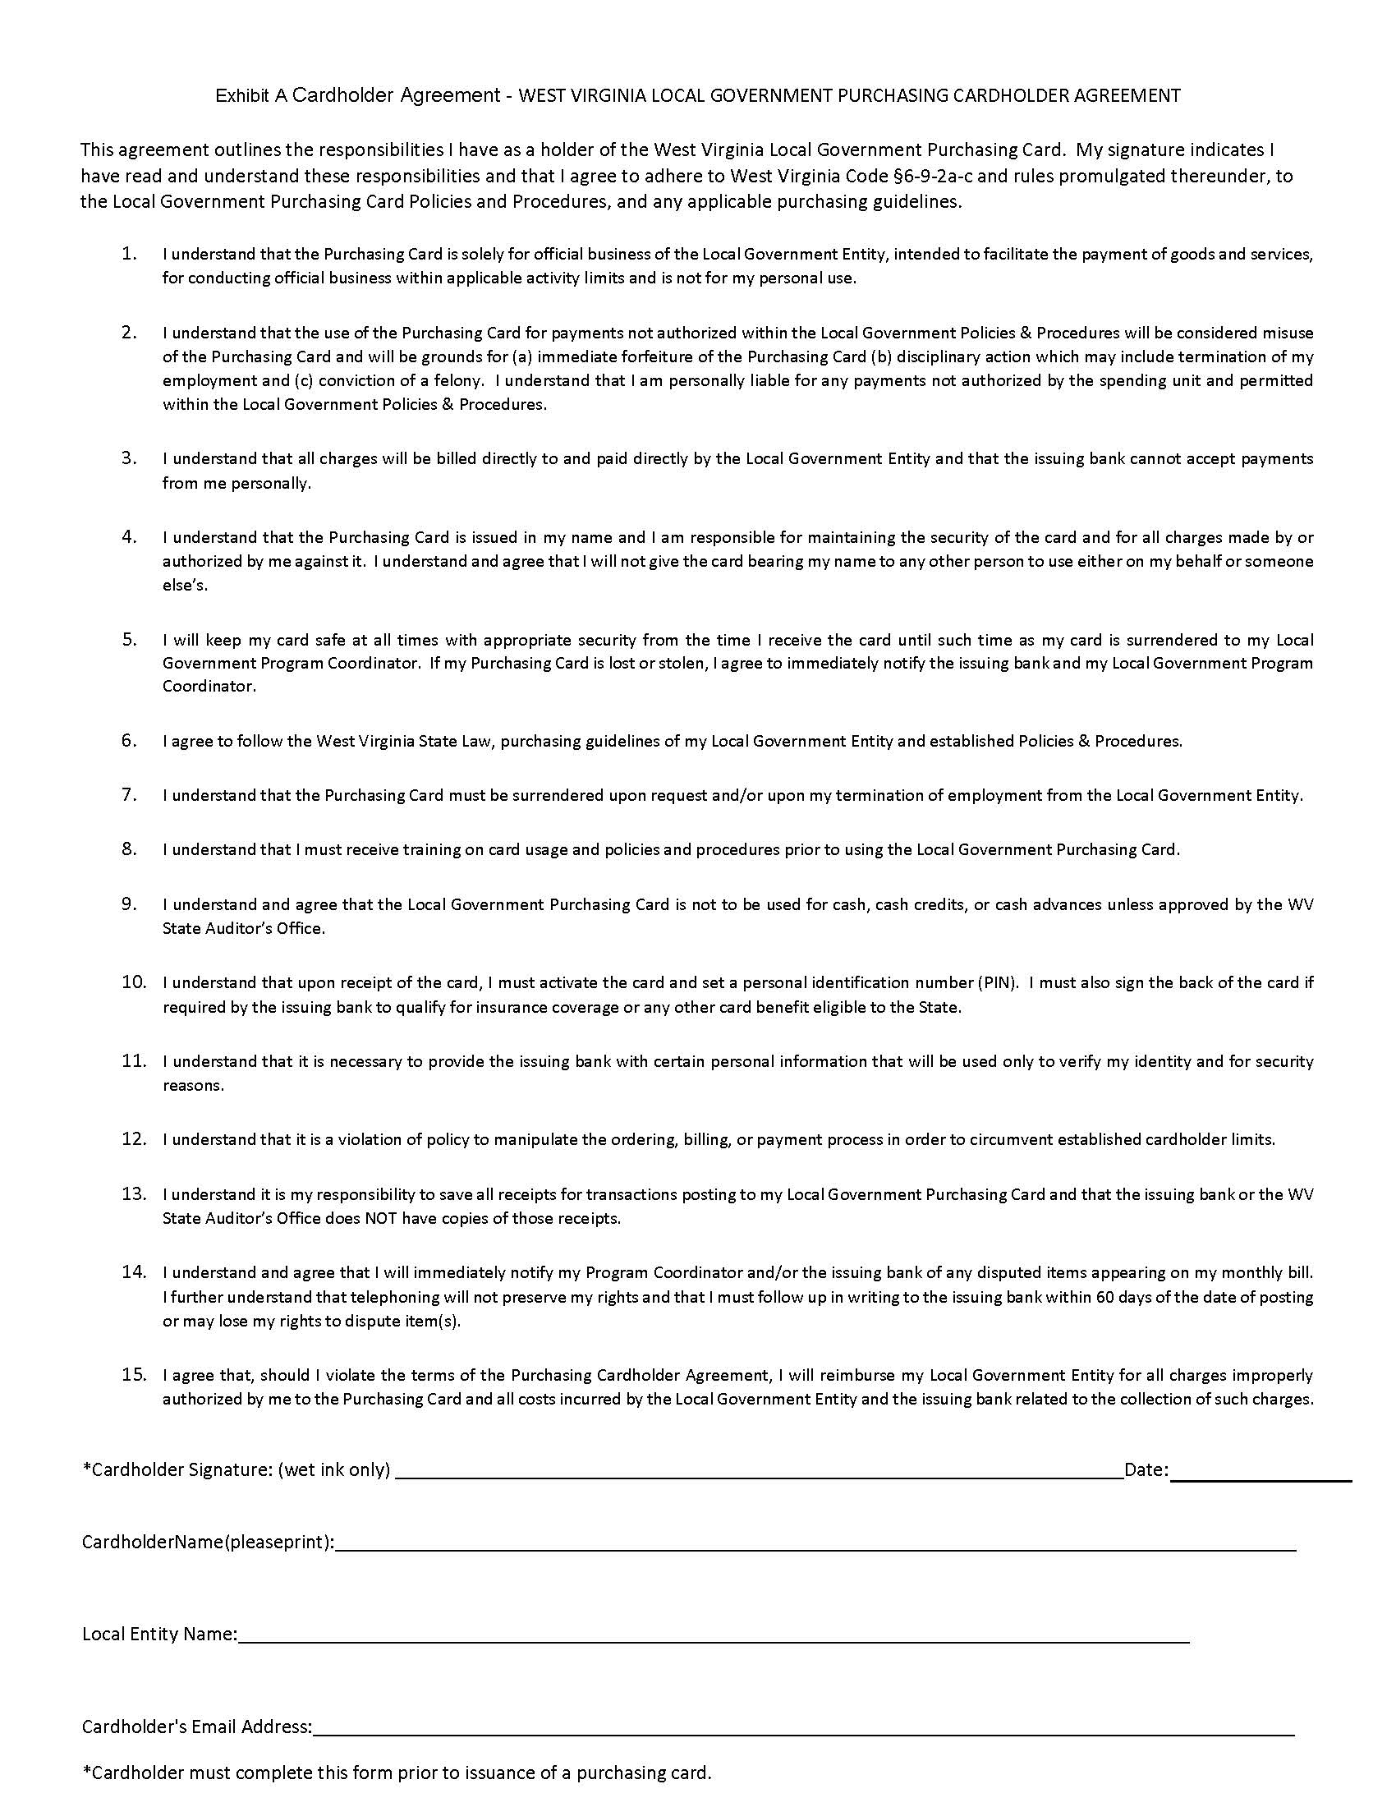
Employee fraud liability insurance

Slide 26
Individual card vs department card
Individual Card
Highly recommended
Issued in cardholder’s name
Provides more accountability
Should never be shared (Pcard Delegation)
~Increases risk of fraud
~Increases cardholder liability
Department Card
Not recommended due to accountability.
Must be sure proper controls are in place.
Should be limited to specific users.
Timelier to maintain (tracking, trainings, CHAs)
Requires a Shared Purchasing Card Log Sheet

Slide 27
controls
Single Purchase Limits
Daily Dollar Amount
Daily Transaction Limit
Merchant Restrictions

Slide 28
Prohibited charges and purchases per the WVSAO Policy and procedure
Per the WVSAO the following are not permitted to be authorized/purchased with Pcards:
Cash advances (cash back at stores, ATM withdrawals).
Unauthorized expenditures, including personal purchases.
Alcoholic beverages other than for resale.
Notes:
Slowly
Let’s walk through a quick example.
An employee makes a purchase outside of policy…
They don’t submit a receipt…
And the transaction isn’t reviewed for several weeks.
Where did the breakdown happen
Exactly—policy wasn’t followed… controls weren’t enforced… and review didn’t happen.
This isn’t unusual—this is exactly what happens when oversight breaks down.
This is why oversight is not optional—it’s essential.

Slide 29
Transaction Disputes
Authorized Transaction Disputes
Fraudulent Transaction Disputes
Notes:
Let me walk you through what we’ll cover today.
What exactly is a PCard?
Why do they matter?
What are the benefits and risks of using Pcards?
What do we need to do to have good oversight and controls in place?
What are the best practices to have a smooth, well working PCard Program?
We’ll start with what a PCard is—just to make sure we’re all on the same page, regardless of experience level.
Quick Pause
Then we’ll talk about why it matters—because this isn’t just a process change, it directly impacts efficiency, time, and workload
We’ll also go through the benefits and the risks—because while PCards make things faster, they also require responsibility and structure.
We’ll spend some time on oversight and controls—this is really the foundation of a successful program.
And finally, we’ll wrap up with best practices—what works, what doesn’t, and what helps keep the program running effectively.
My goal is that by the end of this session, you feel confident not just in using a PCard—but in understanding how to use it correctly and effectively.

Slide 30
Fraud prevention and awareness
Fraud monitoring measures are designed to protect you and your Entity from fraudulent purchases
Card providing institution provides 24/7 electronic monitoring
  Notifies you and/or Coordinator if a transaction is questionable
Public Integrity Fraud Unit (PIFU) monitors randomly pulled transactions for fraud, misuse and abuse as an additional layer of protection for local governments
  PC may reach out for further details on transactions

Slide 31
Perks of the Program
1099s
Rebate Money
Prompt Payment Incentive
Fuel Tax Filings
Quick Assistance and Knowledge from LG PCard Staff

Slide 32
Maximize Your Spending by Utilizing the Cards
Wherever card payments are accepted, make the card the required method of payment.
Make checks a last resort.
Increased spending=increased rebate payments.
Easier tracking.
Less hassle of 1099s
Less hassle if compromised

Slide 33
Efficiency and Oversight through the PCard /Participating in the WVSAO PCard Program
Questions and Discussion
Notes:
I’d like to open it up for questions.
What challenges are you currently facing with purchasing or PCard use?
Questions I often hear:
What if someone misuses the PCard?
That’s a great question—and it’s one of the most common concerns.
The key is having strong controls in place. Spend limits, vendor restrictions, and regular reviews help prevent misuse. And when something does happen, there are clear policies and consequences.
The important thing to remember is that misuse is manageable—and often easier to detect with a PCard because of the visibility it provides.
How do you prevent fraud?
Fraud prevention comes down to a combination of controls and oversight.
That includes setting appropriate limits, restricting where cards can be used, and ensuring transactions are reviewed consistently.
The real advantage with PCards is that transactions are visible in real time, which allows issues to be identified much more quickly than in traditional processes.
What if receipts are missing?
That does happen from time to time.
That’s why policies are so important. Cardholders are responsible for providing documentation, and there should be a clear process for handling missing receipts—whether that’s submitting a statement or escalating the issue.
Consistency in enforcing that policy is what keeps the program strong.
Isn’t this less controlled than the traditional process?
It may seem that way at first—but it’s actually not less controlled, it’s controlled differently.
In a traditional process, control happens before the purchase. With PCards, control happens after the purchase through monitoring, review, and accountability.
And because of the visibility you gain, many organizations find they actually have more insight into spending.
How do you decide who gets a PCard?
Typically, cards are issued based on business need.
That includes evaluating the type of purchases someone makes, how often they need to purchase, and whether a PCard would improve efficiency in their role.
It’s not about giving everyone a card—it’s about giving the right people the right tools.
What’s the biggest mistake organizations make?
The biggest mistake is usually inconsistency.
Either policies aren’t enforced, or reviews aren’t happening regularly.
Even a well-designed program can break down without consistent oversight.

Slide 34
Sherri Vazquez
Manager of Local Government Purchasing Card Program
Email: Sherri.Vazquez@wvsao.gov (Preferred contact method)
Office Phone: (304) 980-2929
Cell Phone: (304) 698-4196 (Text Only)
Fax Number: (304) 340-5098

