Slide 1

West Virginia
Youth Environmental Program
Empowering West Virginia’s youth to become environmentally involved in their communities
Annette Hoskins
Director
Notes:
Hello, My name is Annette Hoskins. I am the Director of the West Virginia Youth Environmental Program with the State Department of Environmental Protection. Today I’m going to give an overview of the Program. Our mission is Empowering WV’s youth to become environmentally involved in their communities.

Slide 2
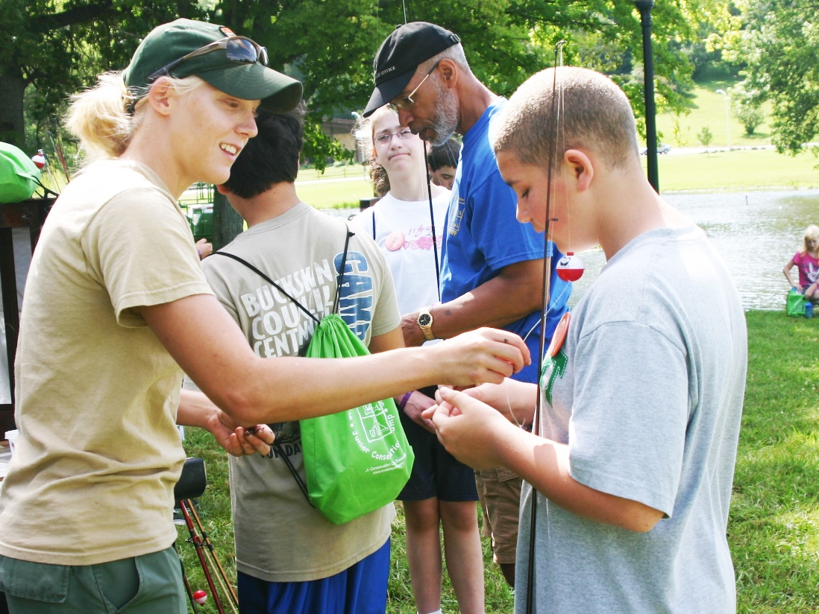
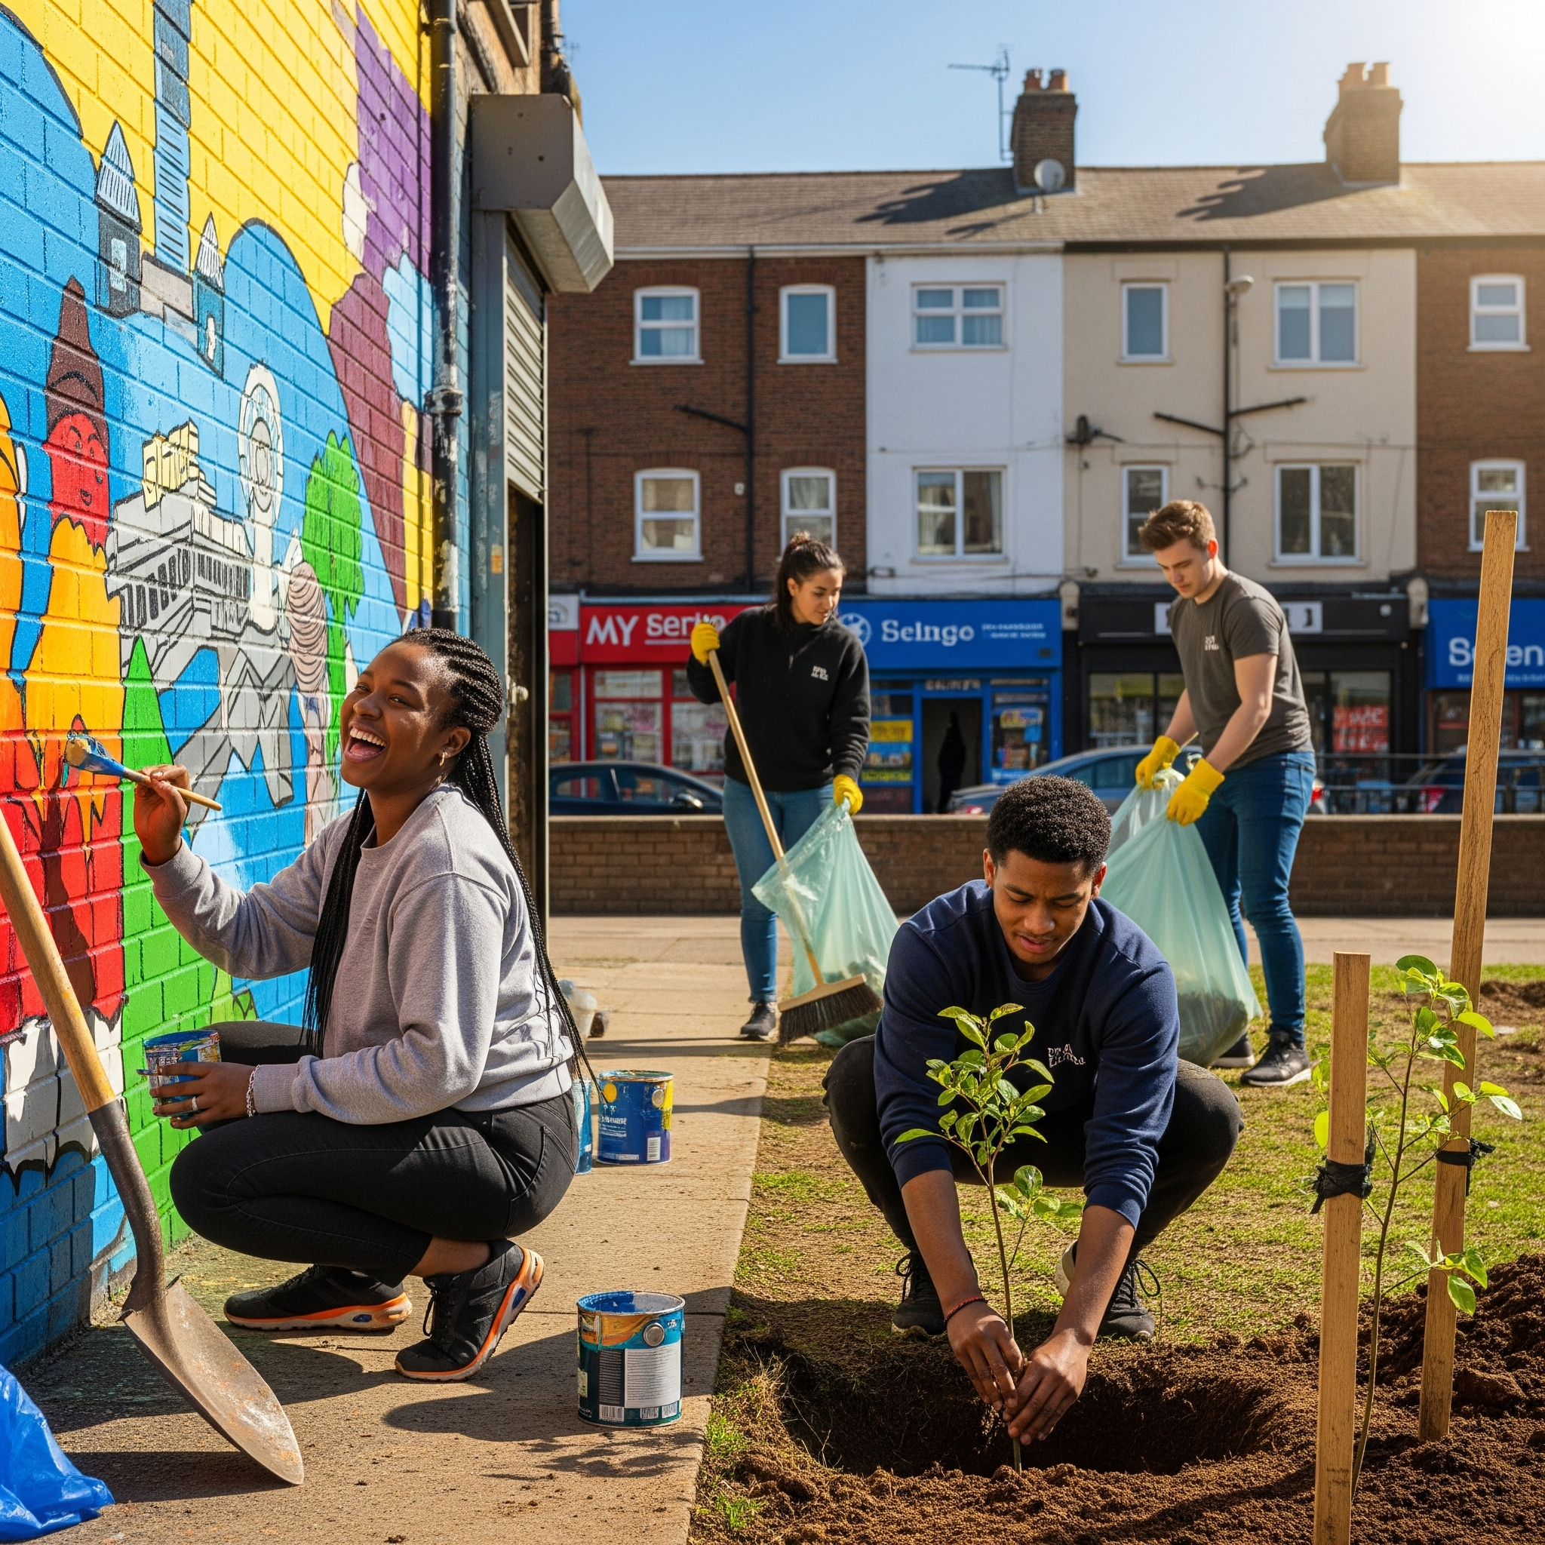
Youth Environmental Program Goals
To increase environmental awareness with young people throughout West Virginia
To encourage participation in activities and projects that will improve their communities
Notes:
The main goals of the youth program are to increase environmental awareness with young people in West Virginia and encourage them to become involved in projects that improve their communities. Some examples are hosting school recycling programs, planting trees or pollinator gardens, and learning about litter control and the water cycle, to name a few.

Slide 3
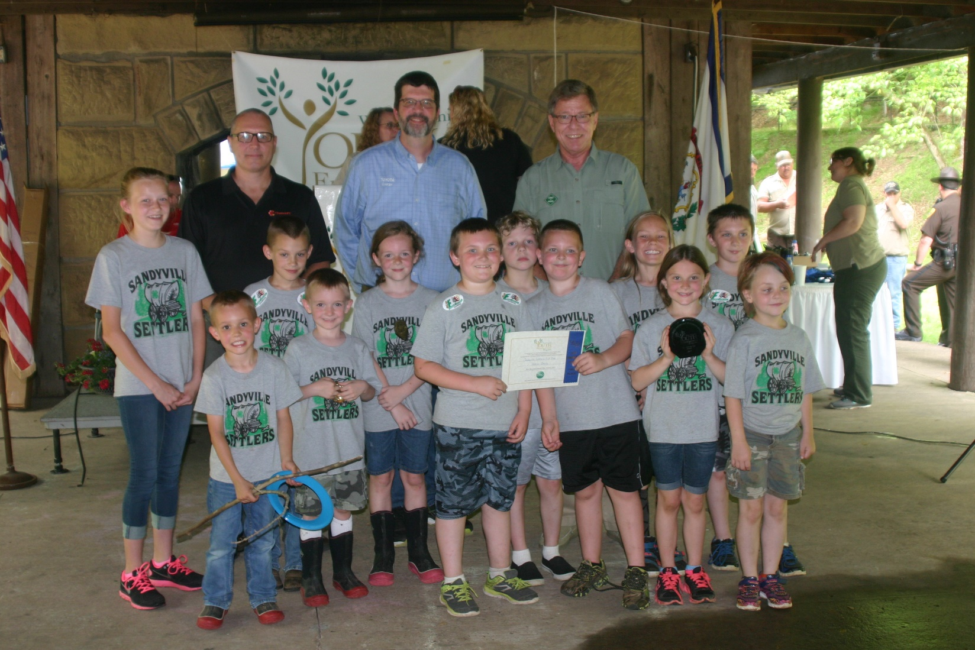
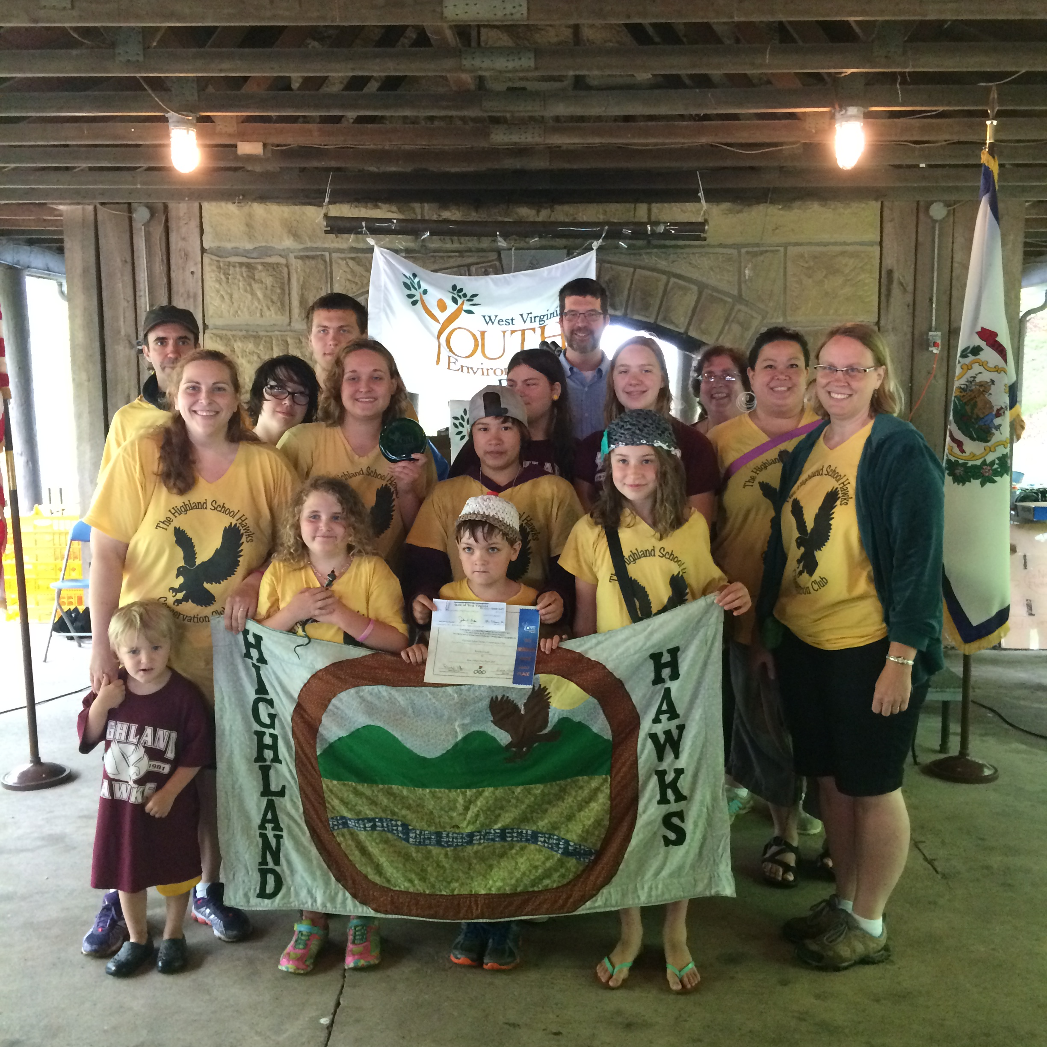
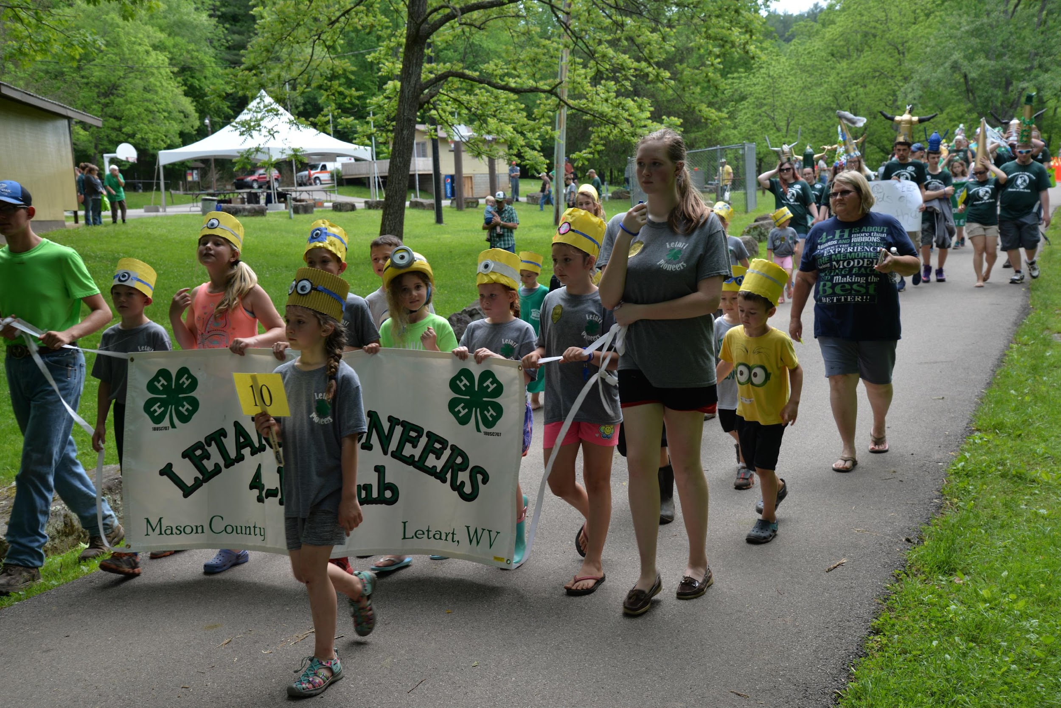
Benefits
Free enrollment for any youth group or school
More than $15,000 in cash prizes and scholarships awarded annually (deadline is March 15)
Statewide activities, including Youth Environmental Day
Notes:
This statewide program offers recognition to youth groups that are making a difference in their community. More than $15,000 in cash awards are distributed each year. Winning youth groups are presented with their cash awards at Youth Environmental Day, which takes place annually on the third Saturday in May.

Slide 4
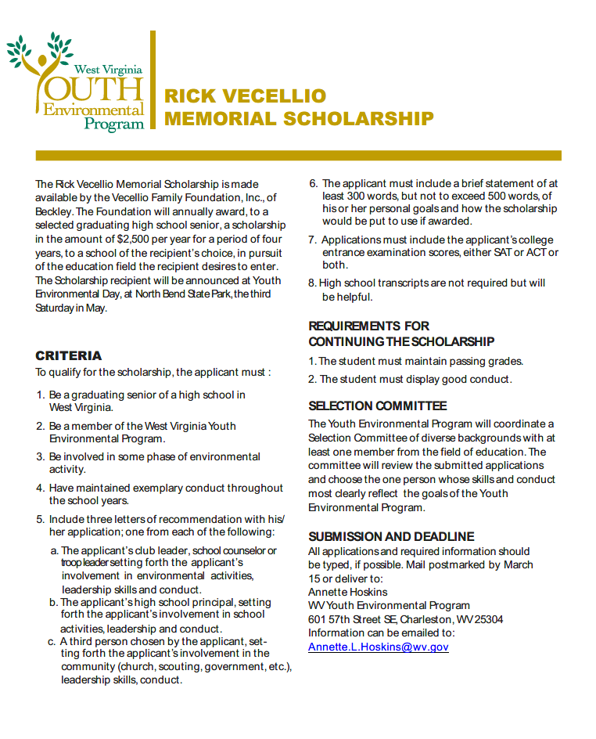
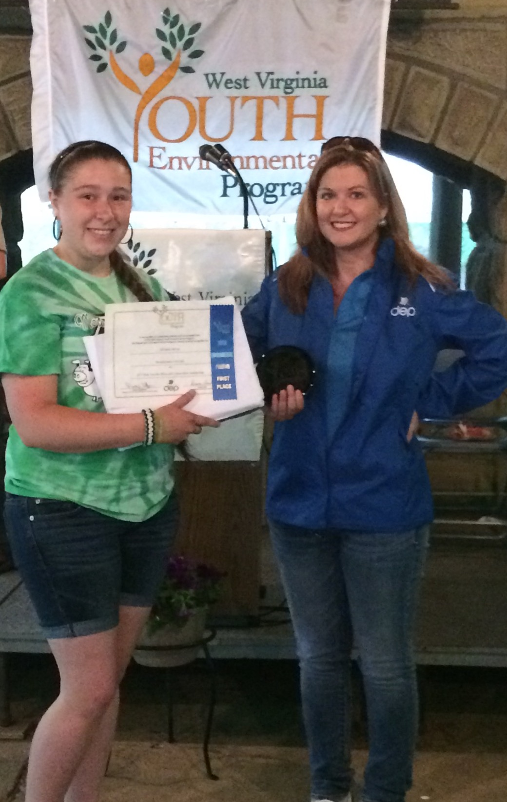
Scholarship
Given Annually to a WV graduating senior.
$10,000 - $2,500 a year for four years.
All high schools in WV are enrolled in the YEP.
Notes:
In addition to cash awards, we also award the recipient of The Rick Vecellio Memorial Scholarship which is a $10,000 scholarship presented to a West Virginia graduating senior.

Slide 5
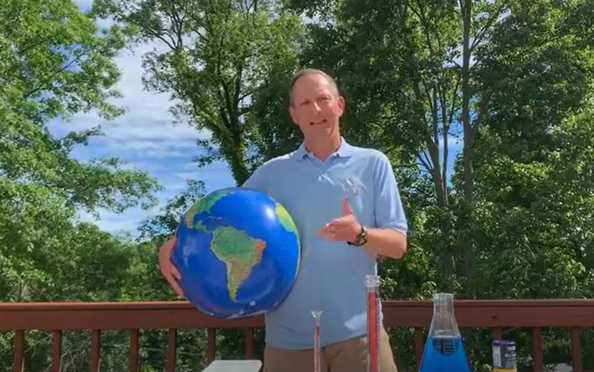
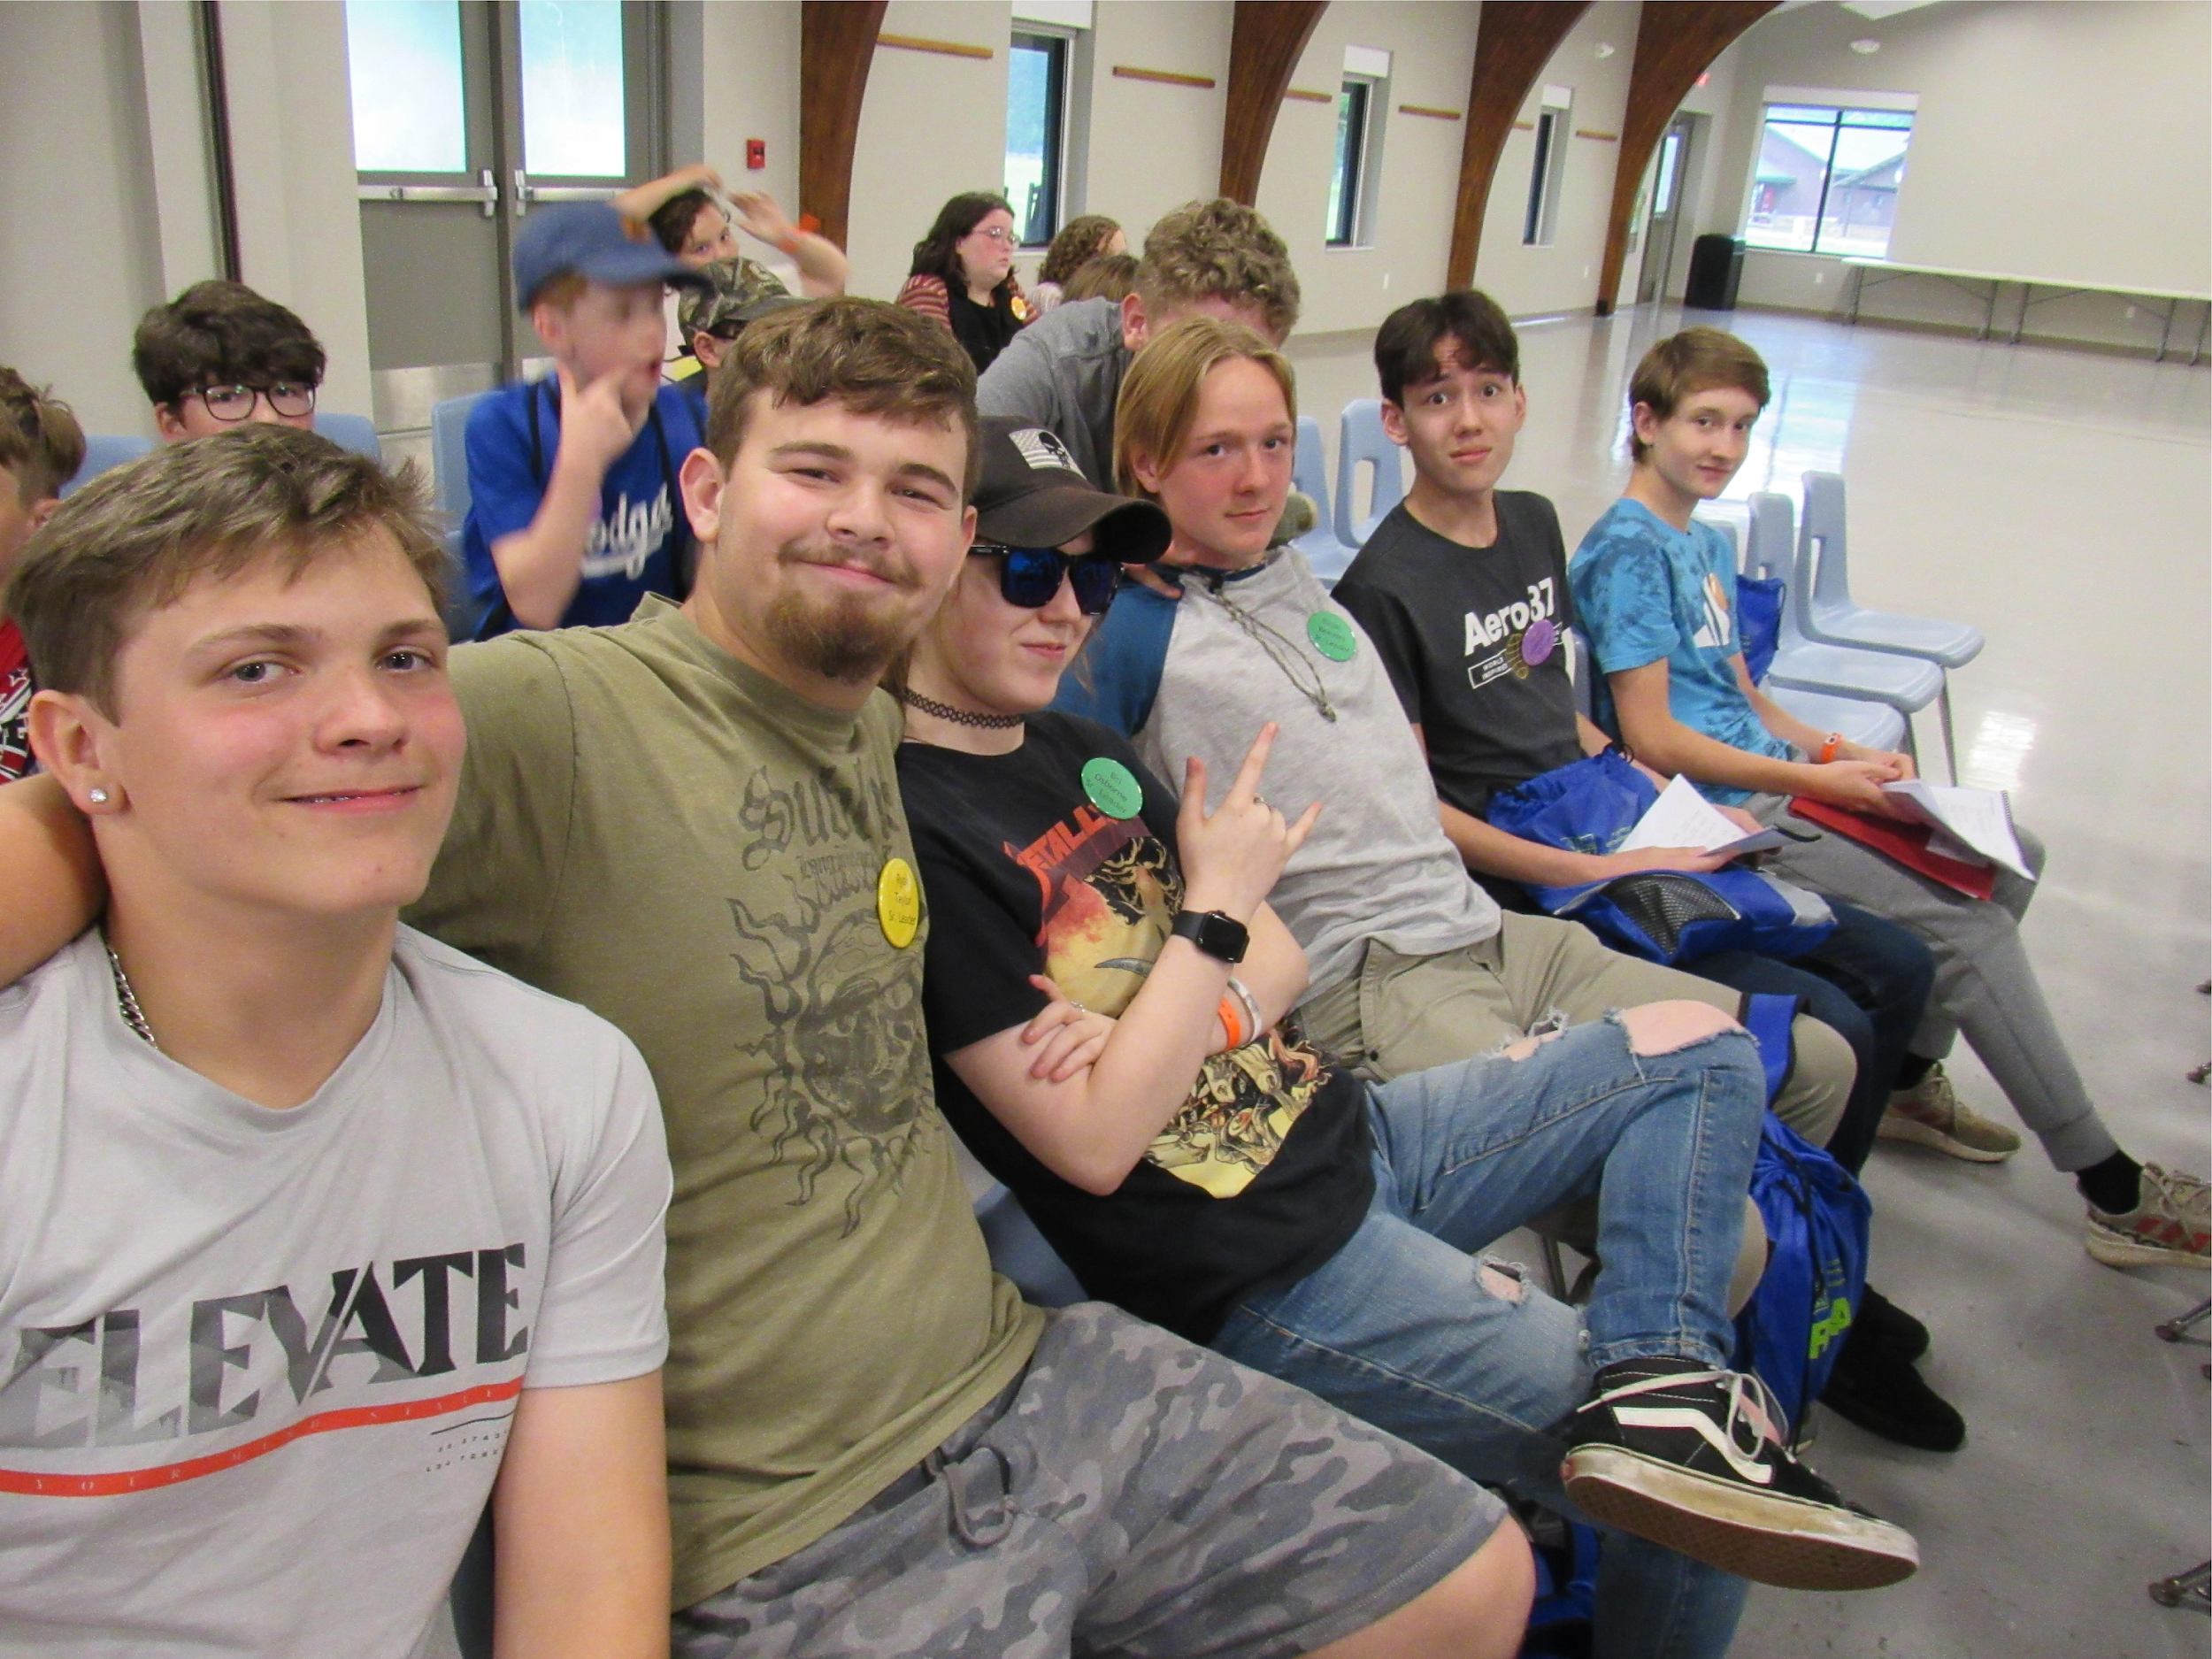
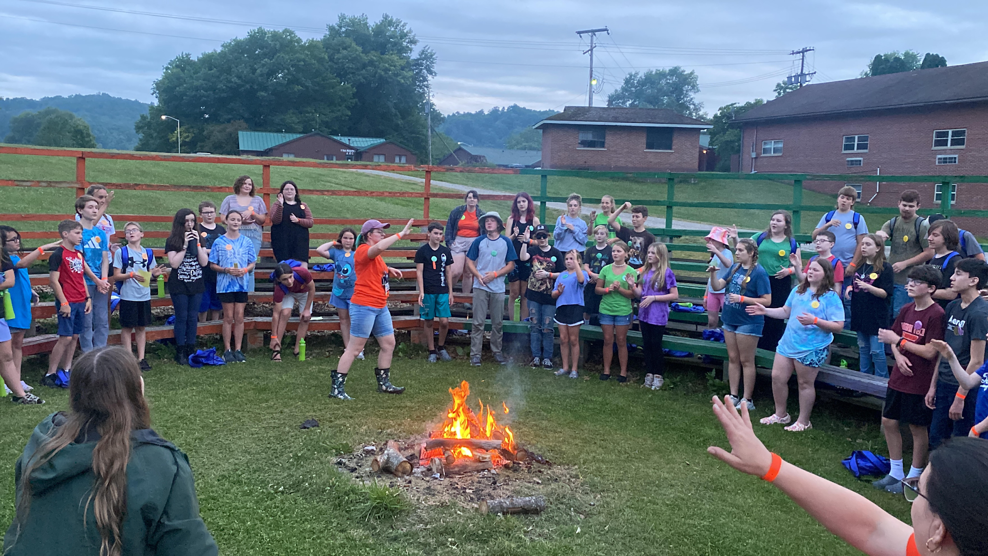
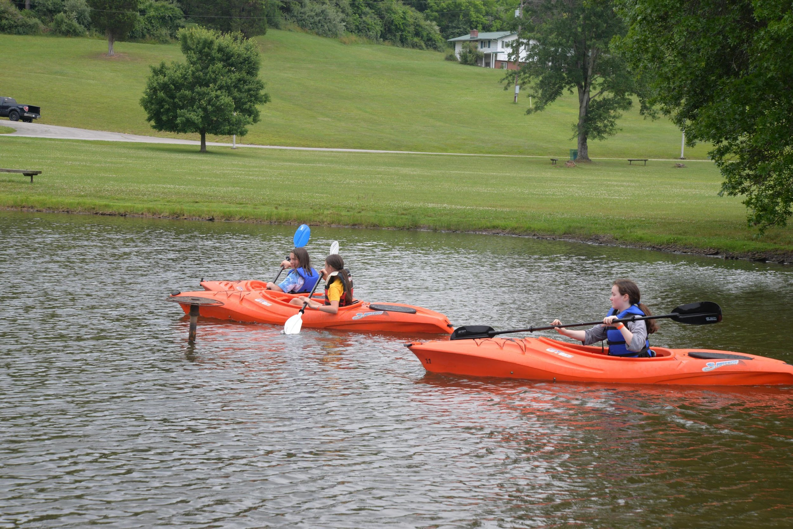

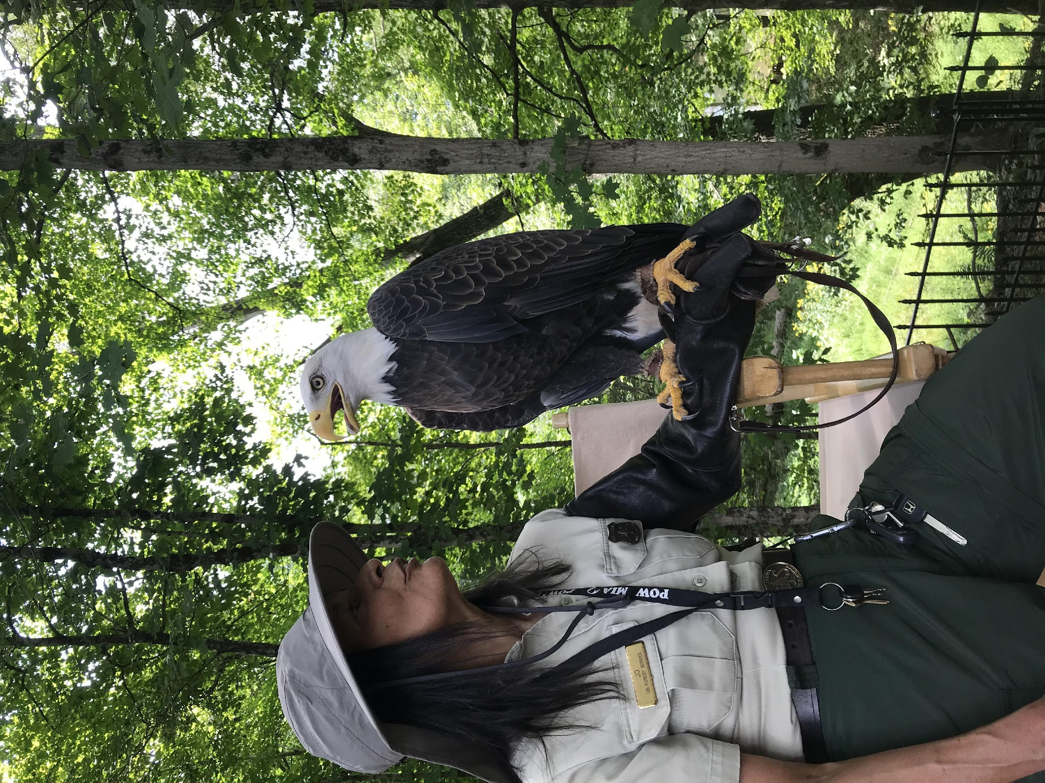
Other Events
Junior Conservation Camp 10-14yr
Cedar Lakes Ripley, WV
3rd full week of June
Scholarships available
Youth Environmental Conference 13-17yr
First Full weekend of November
This conference changes location each year
Check out our virtual camps:
YouTube page :Environment Matters
Notes:
In addition to Youth Environmental Day, the youth program hosts a weeklong Junior Conservation Camp in June in Ripley, as well as a weekend Youth Environmental Conference at different locations throughout the state each fall.

Slide 6
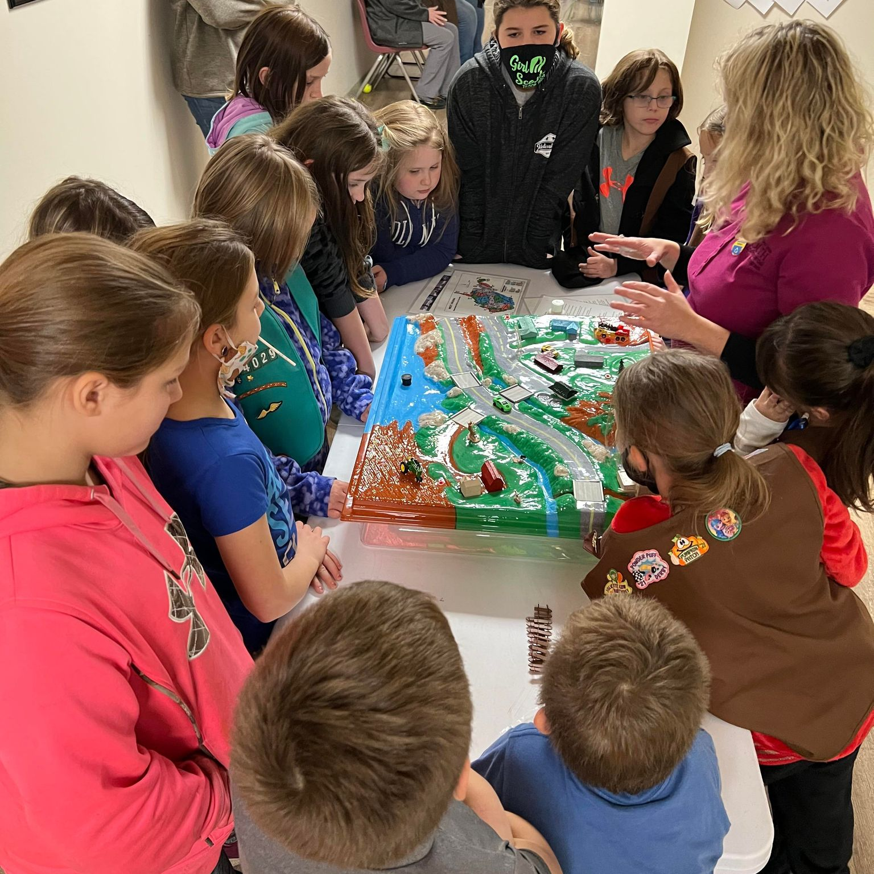
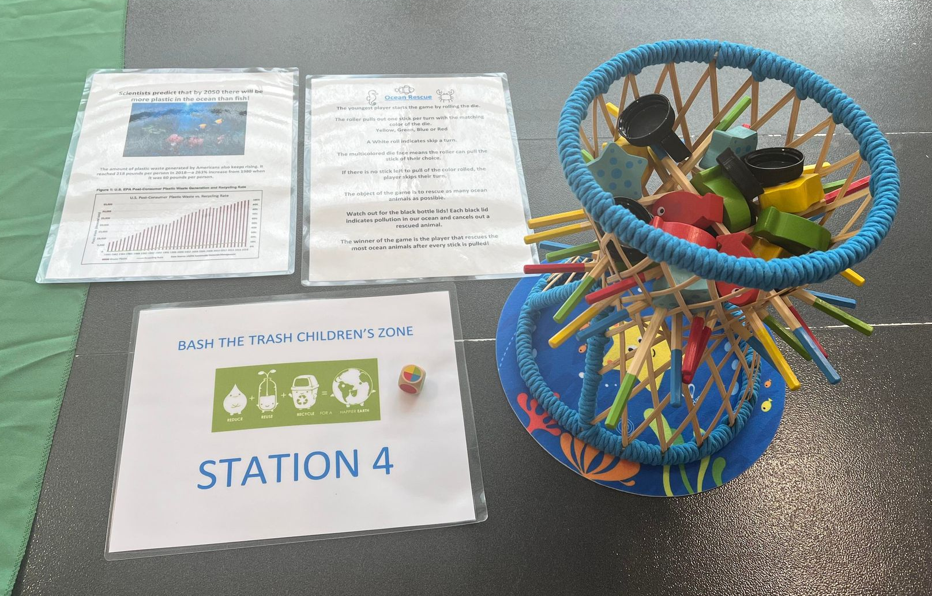
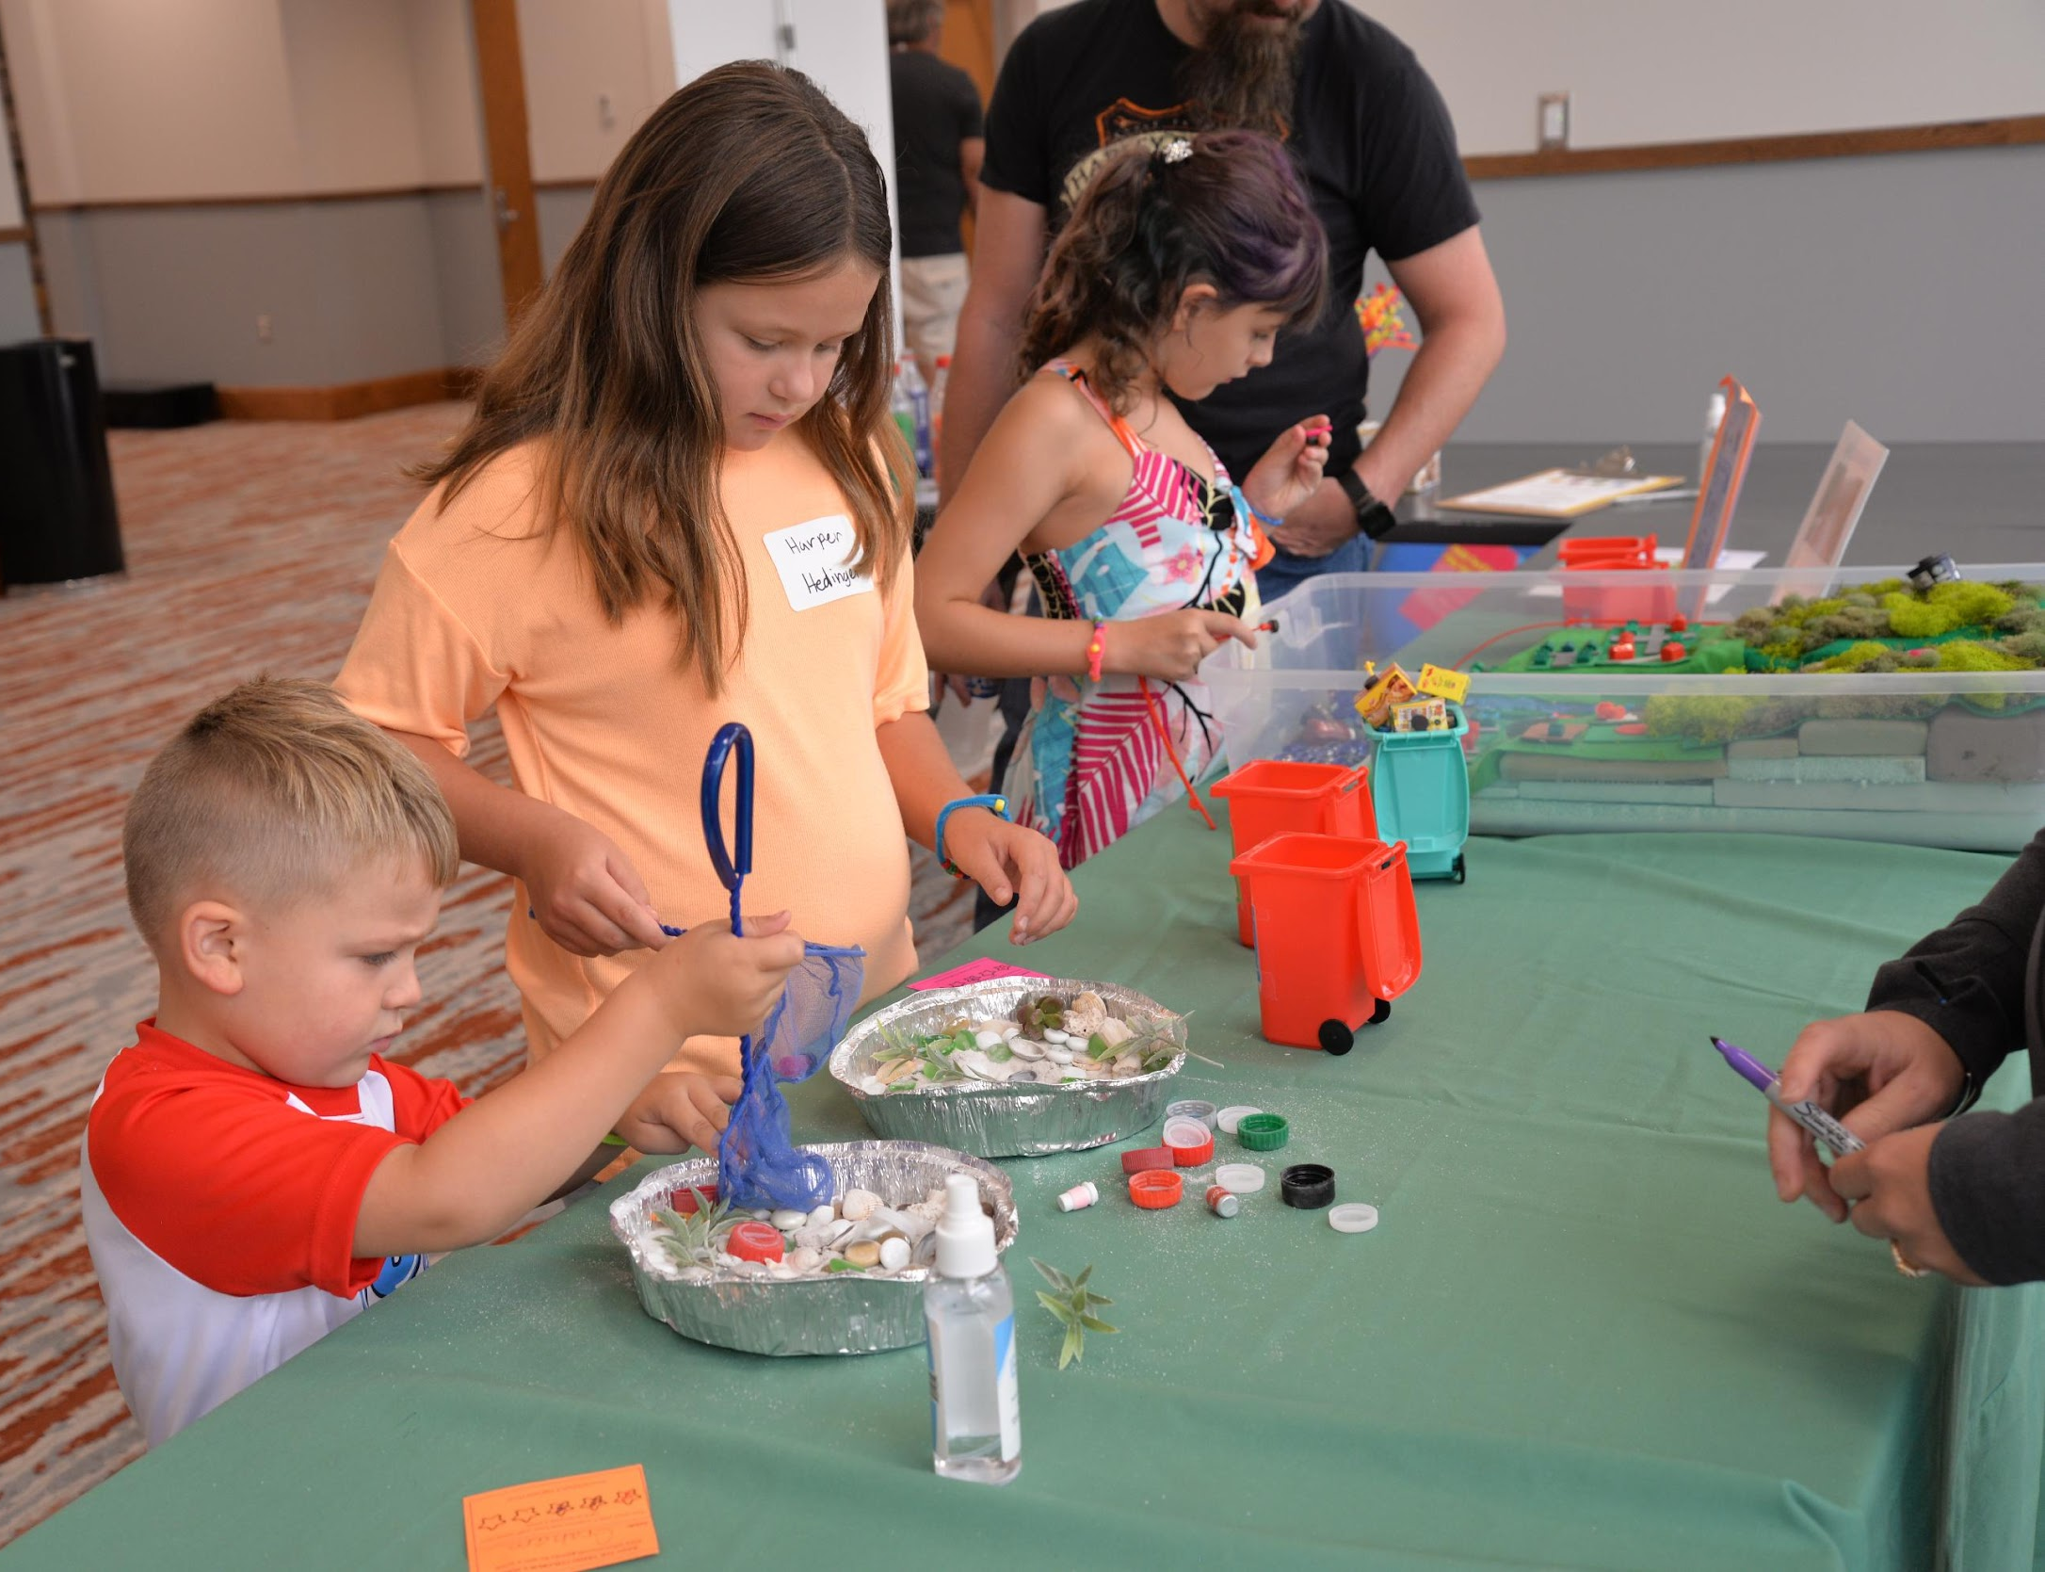
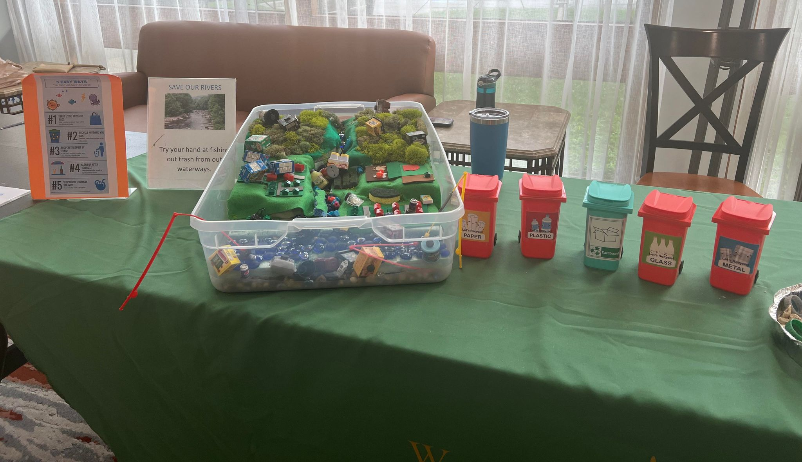
Additional Resources
Environmental Education Programs
In person, hands-on presentations
Online presentations, live or pre-recorded, are available year-round
Topics can include:
Recycling ( 3Rs)
Water conservation
Plants ( Trees, Flowers, Seeds)
Pollinators
Litter Control
Composting
Outdoor activities
Up-cycle crafts
Enviroscape
Water exploration
Notes:
District coordinators work with youth groups and schools to offer presentations for a range of environmental topics. These are made available for children in preschool through high school.

Slide 7

Environmental Teacher of the Year Award
Award recognizes K-12 teachers in West Virginia schools.
Winners are chosen in Elementary, Middle, and High School levels.
Each winner receives a $500 personal award.
A $1000 award promotes STEM programs in their school.
Applications must be submitted by the February 14th deadline.
Notes:
The Youth Environmental Program awards the Environmental Teacher of the Year award each year to recipients of elementary, middle and high school teachers. The winning teacher receives a 500 personal award and the school receives a 1000 award to promote STEM programs in its school.

Slide 8
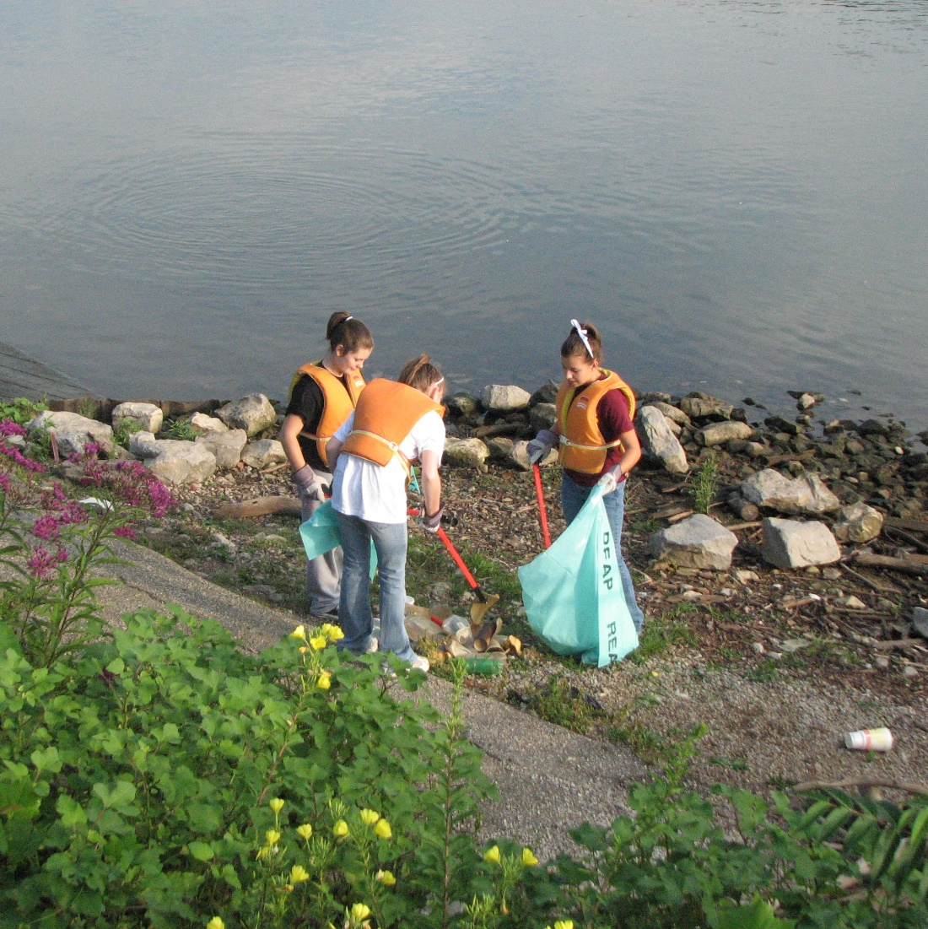
Ideas for your troop, school or family
Recycling Drive
Stream Clean-up
Trail work
Volunteer at a Recycling Center
Visit local parks and trails
Do an outdoor scavenger hunt (spiders, insects, leaves, etc.)
Build a composting station
Find a new outdoor activity to try (fishing, hiking, boating, geocaching)
Plant trees or pollinator gardens
Litter Clean-up
(AAH/Make It Shine programs)
Notes:
Groups can incorporate environmental education into their regular activities.

Slide 9

Other Programs We Promote
WV State Conservation Camp is for youth ages 14-17 and takes place at Camp Caesar in Webster County. https://wvconservationcamp.com/
West Virginia Envirothon is a great competition for students in grades 9-12 on 5 subjects: aquatics, forestry, soils, wildlife, and a current environmental topic.
https://www.wvca.us/wven/
The Recycling Coalition promotes purchasing recycled content and proper recycling techniques. It also coordinates the Re-Fashion show and provides incentives for for adults and youth.
https://www.wvrecycles.org/
Projects WET, WILD, and Learning Tree offer valuable environmental resources.

Slide 10
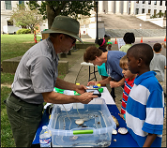
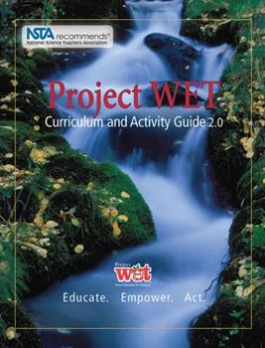
Leader Resources
Project WET
Tomi Bergstrom
Project WET Program Coordinator
tomi.m.bergstrom@wv.gov
Website: dep.wv.gov/wwe/getinvolved/wet/Pages/default.aspx
Project Learning Tree
Linda Carnell
West Virginia PLT State Coordinator
Linda.O.Carnell@wv.gov
website: www.plt.org/network/west-virginia/
Project WILD
Emily McCabe
Project WILD State Coordinator
Tel: (304) 558-2771
emily.k.mccabe@wv.gov
Website: www.fishwildlife.org/projectwild
All of these programs have free online training for leaders, teachers and parents
Notes:
Additional resources for teachers, youth group leaders and parents include Project WET, Project Learning Tree and Project Wild. These programs offer free training and activity guides.

Slide 11
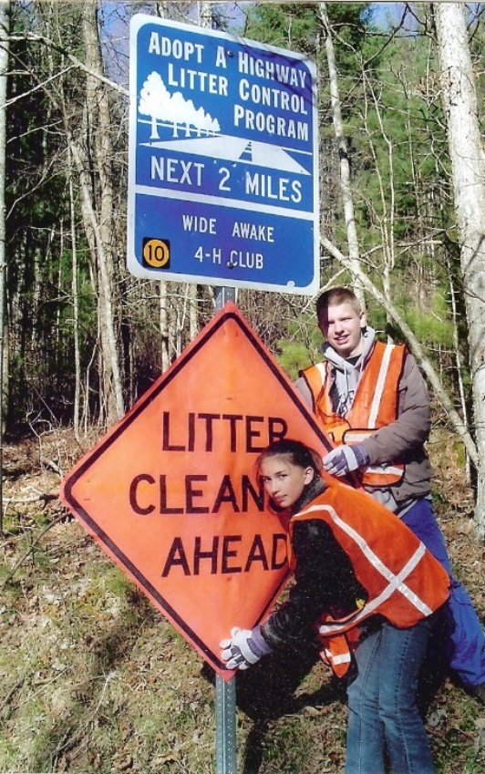

Adopt-A-Highway Program
It is co-sponsored by the Division of Highways and the Department of Environmental Protection.
Applications are available on the DEP website or by calling (800) 322-5530.
Notes:
Probably the most well-known volunteer cleanup program is Adopt-A-Highway, which is a joint effort between the DEP REAP Office and the West Virginia Division of Highways. Any public or private business, organization, civic group, family or individual can adopt a two-mile stretch of road. There is a minimum age requirement of 12 years old for Adopt-A-Highway, but any age can participate in the smaller-scale program called Adopt-A Spot.

Slide 12

Litter Cleanups
Adopt-A-Highway
2-mile minimum
12-year-old age requirement
State-maintained roads only
Two signs per adoption
Two-year contract
Two annual cleanups
Adopt-A-Spot
An extension of AAH
¼ mile or less
No age requirement
One sign per adoption
Two annual cleanups
Notes:
Applications are available on the DEP website or by calling the office. Groups sign up for two years, or they can register for a one-time cleanup. The way it works is that you register your cleanup with the DEP. You are provided safety gloves, vests, bags, and litter pickers which can be picked up at your local DOH garage. Once your cleanup is completed, you report your cleanup and location to the DOH garage, and they pick up the bags you collected. Then you send a report card to the REAP office for credit. Then you will have signs posted for your highway adoption.

Slide 13


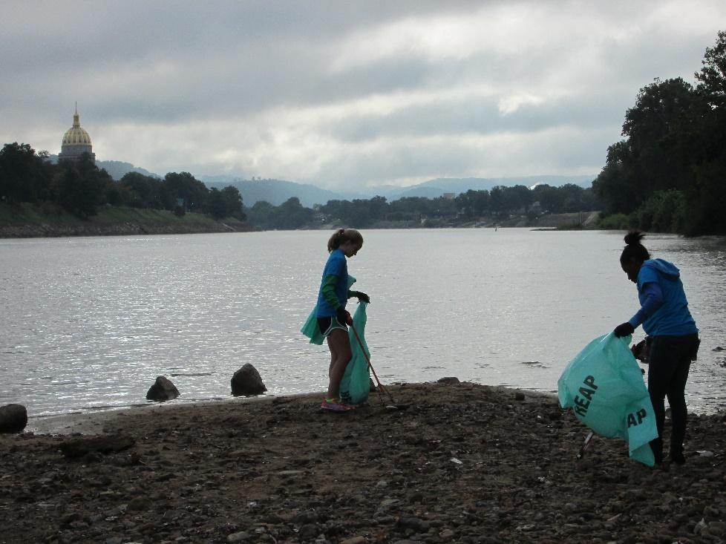
Make It Shine
Groups of volunteers, businesses, community organizations and local governments work with the WV Make It Shine Program to host several cleanup events each year.
Make It Shine Statewide Cleanup
1st two weeks in April 1-15th
Deadline March 10th
Public Land
Gloves, bags, hauling, landfill fees
Adopt A Stream
Established in 2023
Goal is to improve the quality of our environment by encouraging public involvement in the elimination of stream litter.
Objective is to save taxpayers money by increasing public awareness and to serve as an educational tool by focusing on the consequences which result when stream littering is allowed to continue unchecked.
Offers volunteers the opportunity to take charge of their environment by making a positive effort to create a cleaner, more aesthetic place in which to live.
Notes:
If you are looking for resources beyond highway cleanups, another volunteer cleanup program is the Make It Shine Program. Groups of volunteers, businesses, community organizations and local governments take part in this effort, making a difference throughout the state. The major statewide cleanup event kicks off at the beginning of April, and the deadline for registration is at the end of February. This allows time to distribute supplies and coordinate plans for hauling. River sweeps also take place throughout the state. In addition, Make It Shine presents awards to recognize communities that are striving to improve the environment.

Slide 14
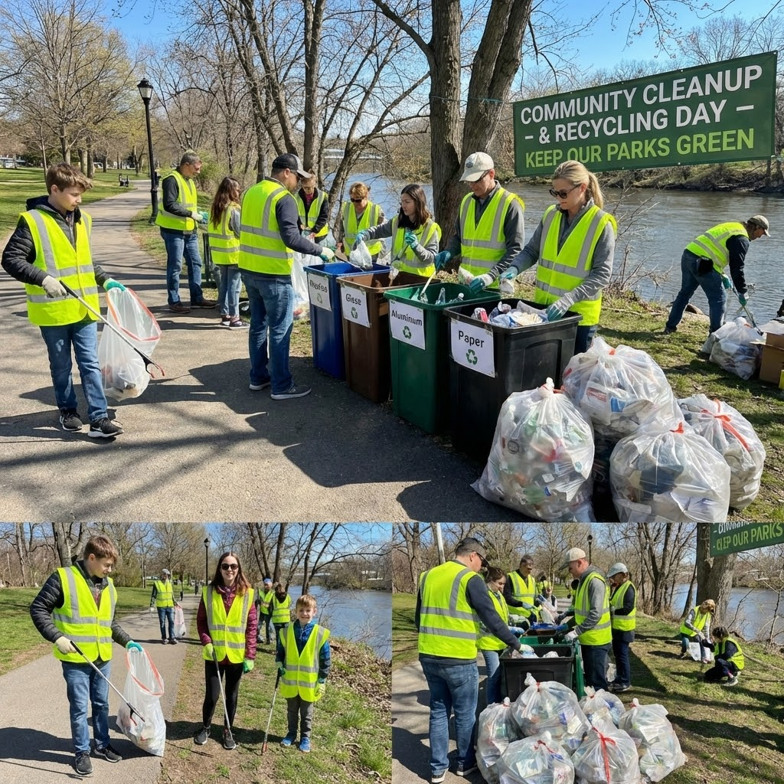
Partnering for Impact
Your support is critical in helping us increase environmental awareness and encourage hands-on, community-focused projects among young people.
We value your support; how can we, in turn, better support your efforts to promote environmental awareness and community-focused projects?
Notes:
None of this happens without support from partners like you. Your involvement helps us expand opportunities, reach more students, and strengthen community engagement. So we ask: how can we better support your goals while continuing to promote environmental awareness together?

Slide 15
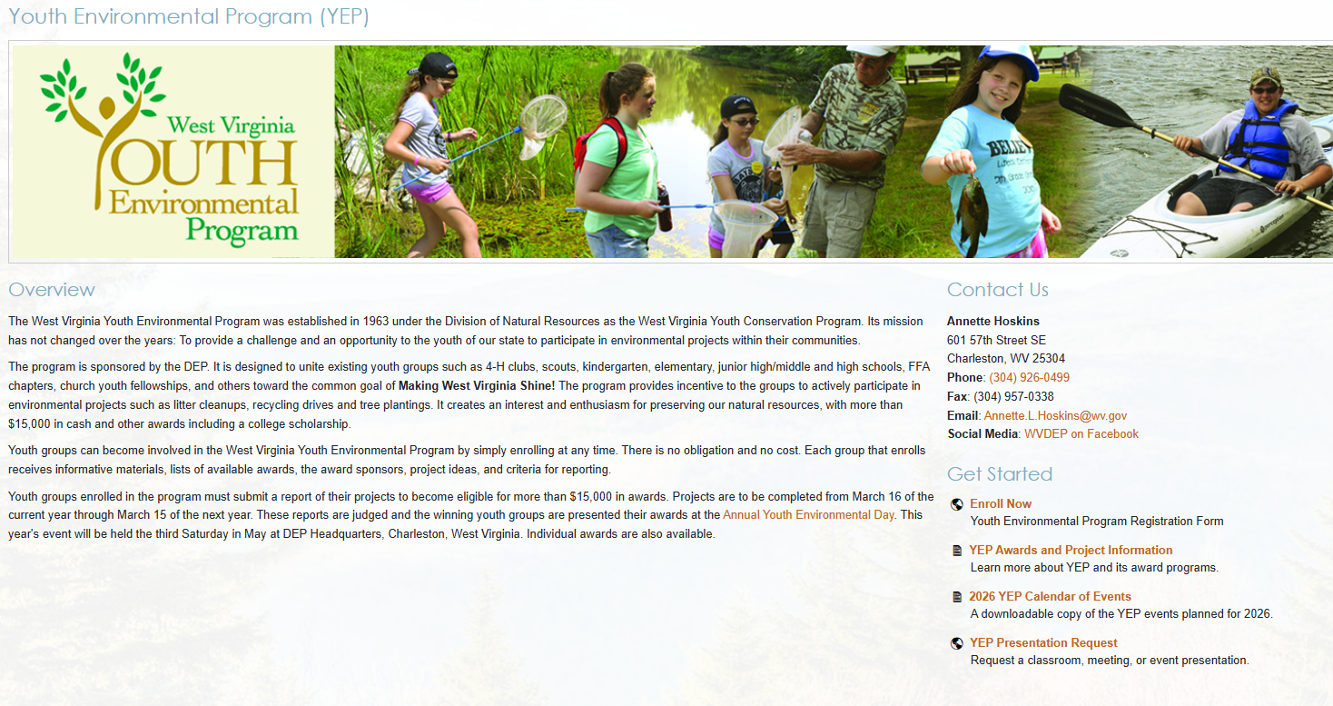
Additional Information
For information about the Youth Environmental Program, online enrollment and cash awards, go to www.dep.wv.gov
and click on the Youth Environmental Program link
Notes:
Enrollment, award categories and more details are online at www.dep.wv.gov under the Youth Environmental Program link.

Slide 16
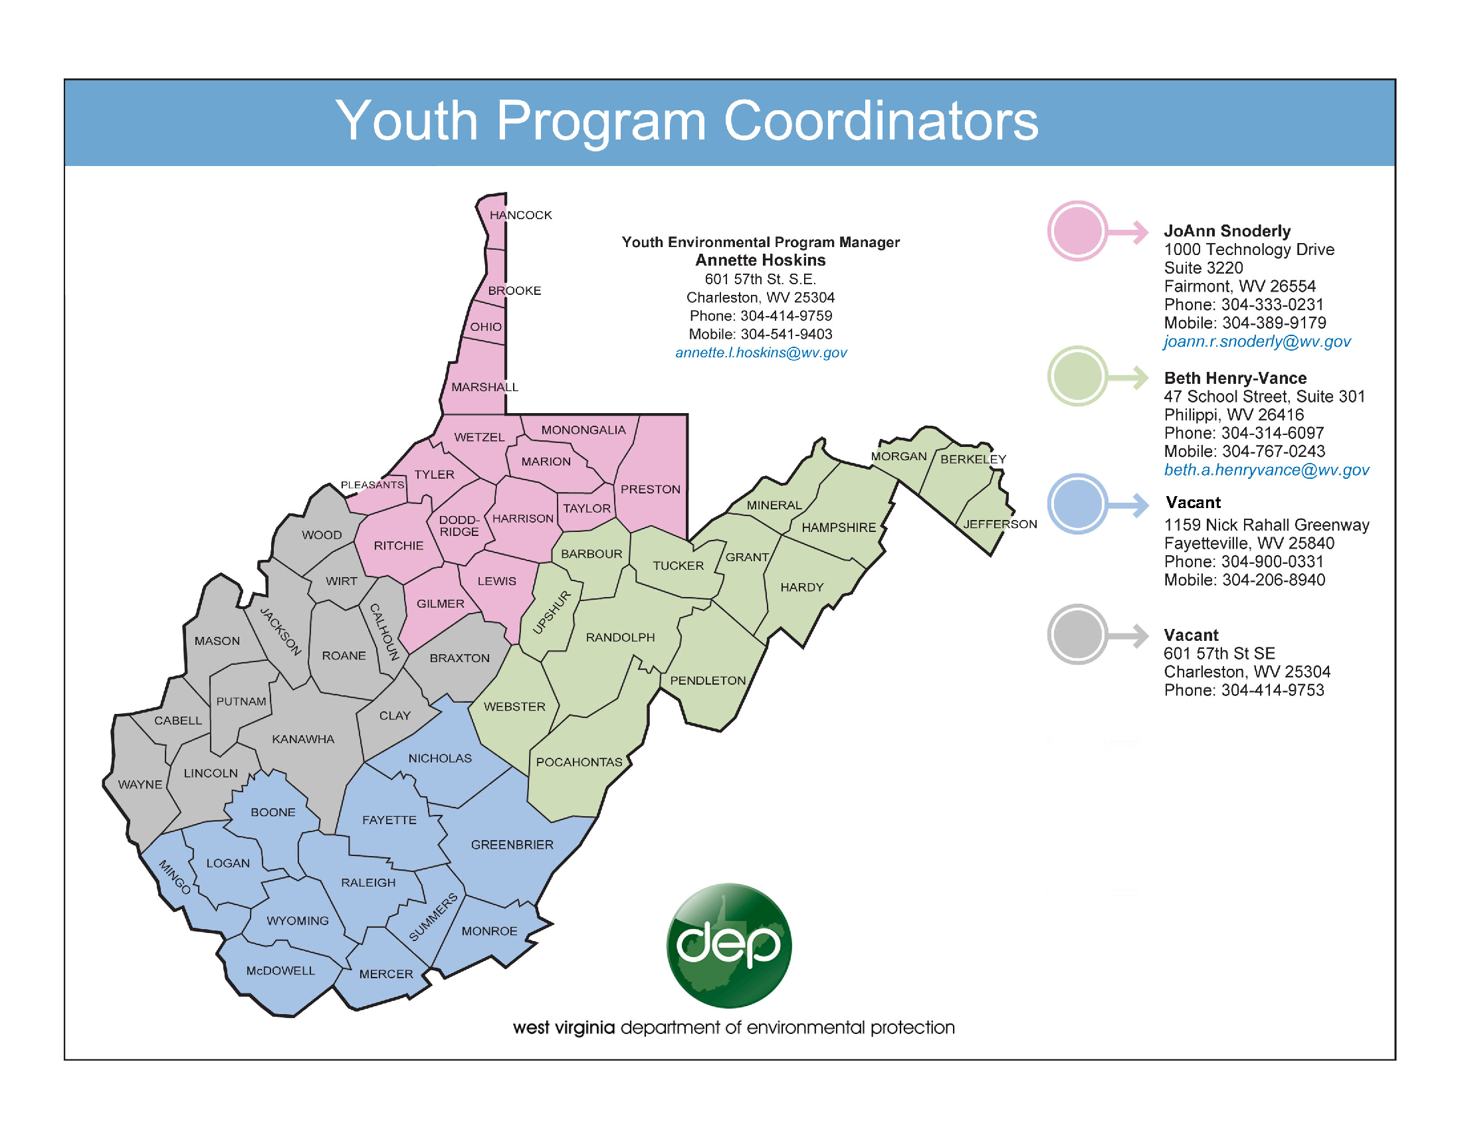
Annette Hoskins, Director
Youth Environmental Program
304-414-9759
Annette.L.Hoskins@wv.gov
Questions??

