Slide 1

Recycling coalition of west virginia, inc.
Presented by Niki Davis &
Isaiah McCoy

Slide 2

About us
Who We Are
The Recycling Coalition of West Virginia is a statewide nonprofit organization with a mission of advocating recycling and waste reduction in West Virginia.
We coordinate activities through various programs such as our annual Re-Fashion Show, Youth Contests, and Recycling Champions.

Slide 3
Our programs

Slide 4
of prize money awarded to winners of our Youth Contests and Re-Fashion Show each year, promoting recycling and sustainable practices across schools and communities in our state.
$3,600+

Slide 5
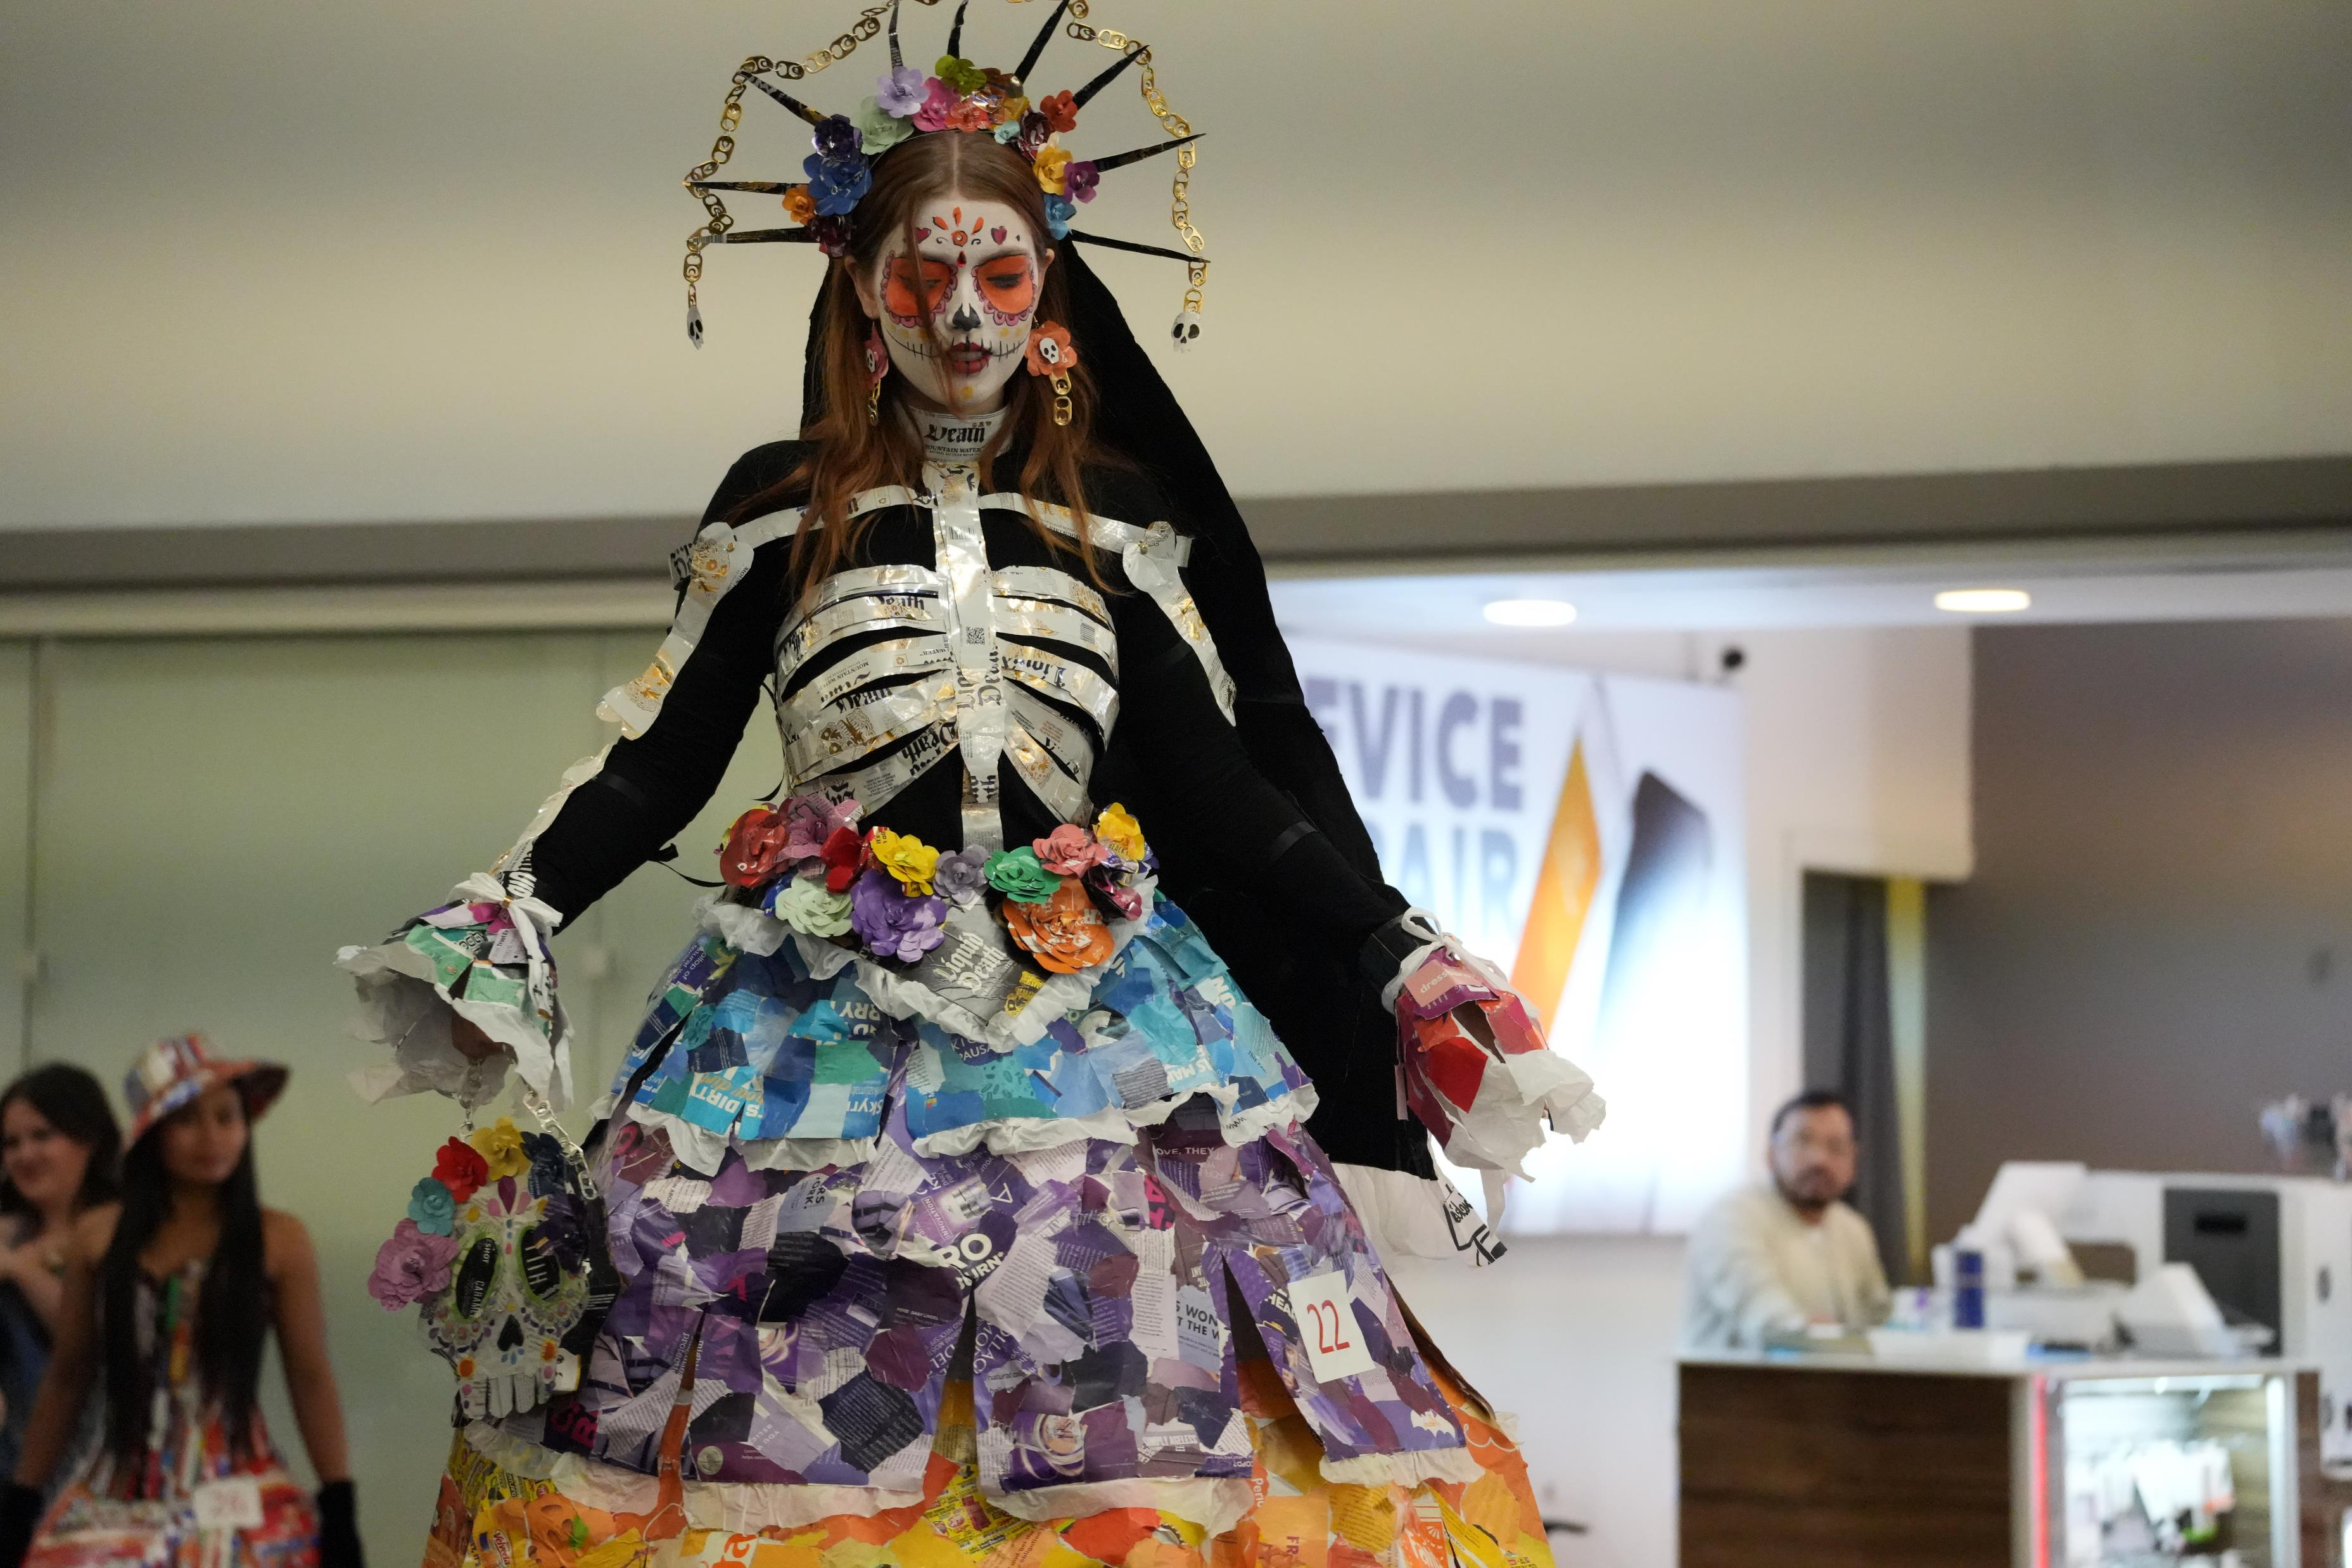
The re-fashion show
Sustainability in Style
Participants are challenged to use their creativity and imagination to create fashion pieces out of reused or recyclable materials, bringing awareness to upcycling and reuse.
Real-world impact​
By turning recycled waste into wearable art, the Re-Fashion show inspires West Virginia communities to reduce landfill waste, rethink consumer habits, and make sustainability a visible part of everyday life.
1st Place in 14 & Over, 2025 Re-Fashion Show, Anneliese Schupbach

Slide 6
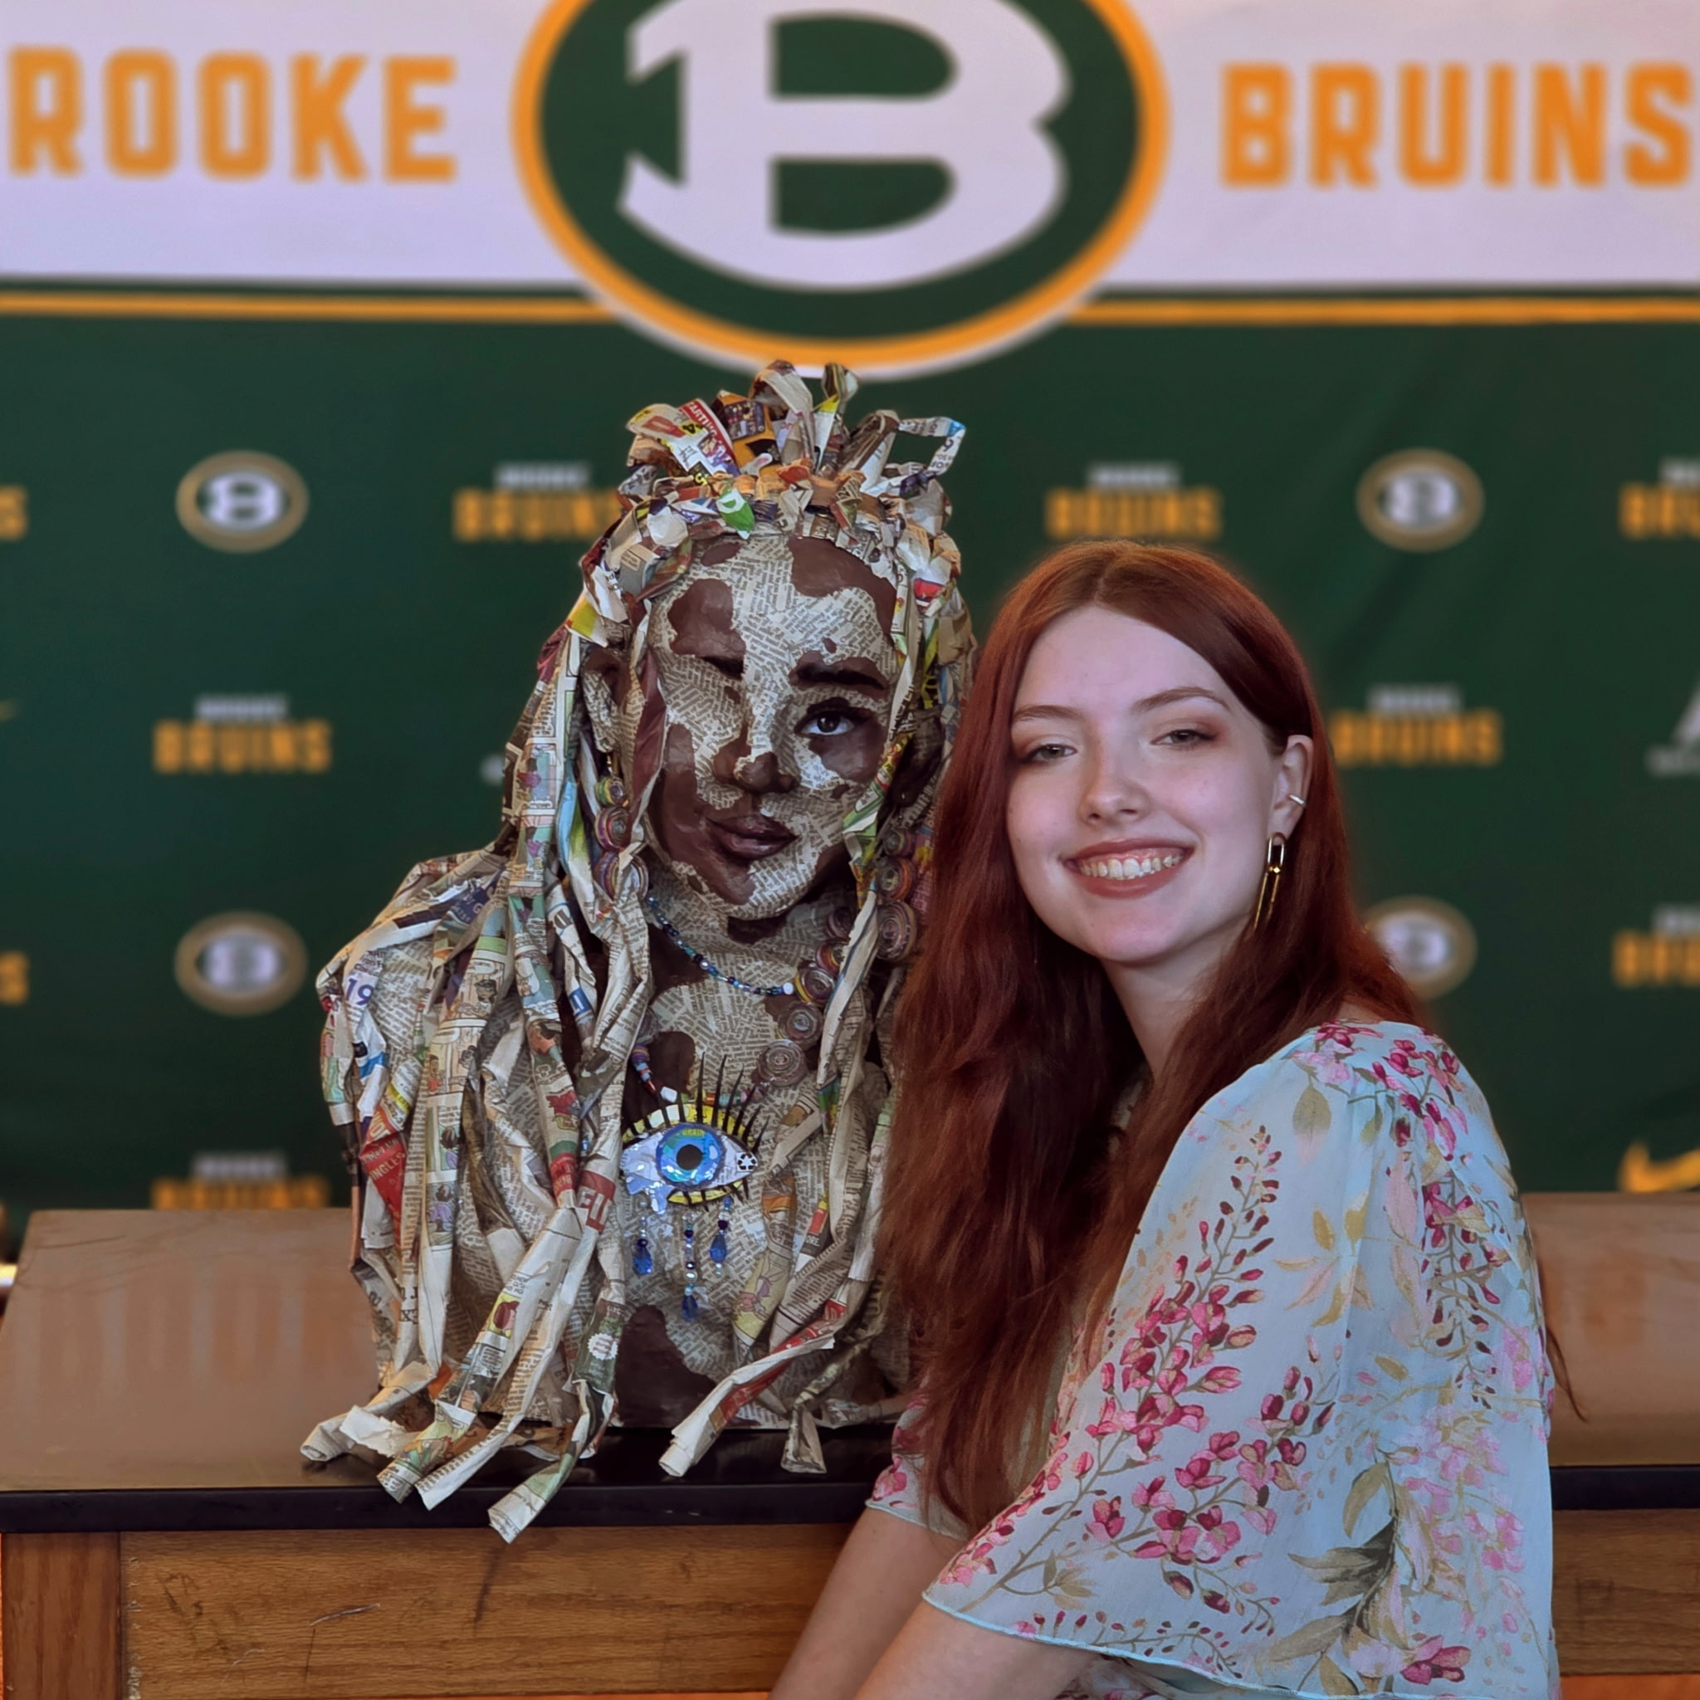
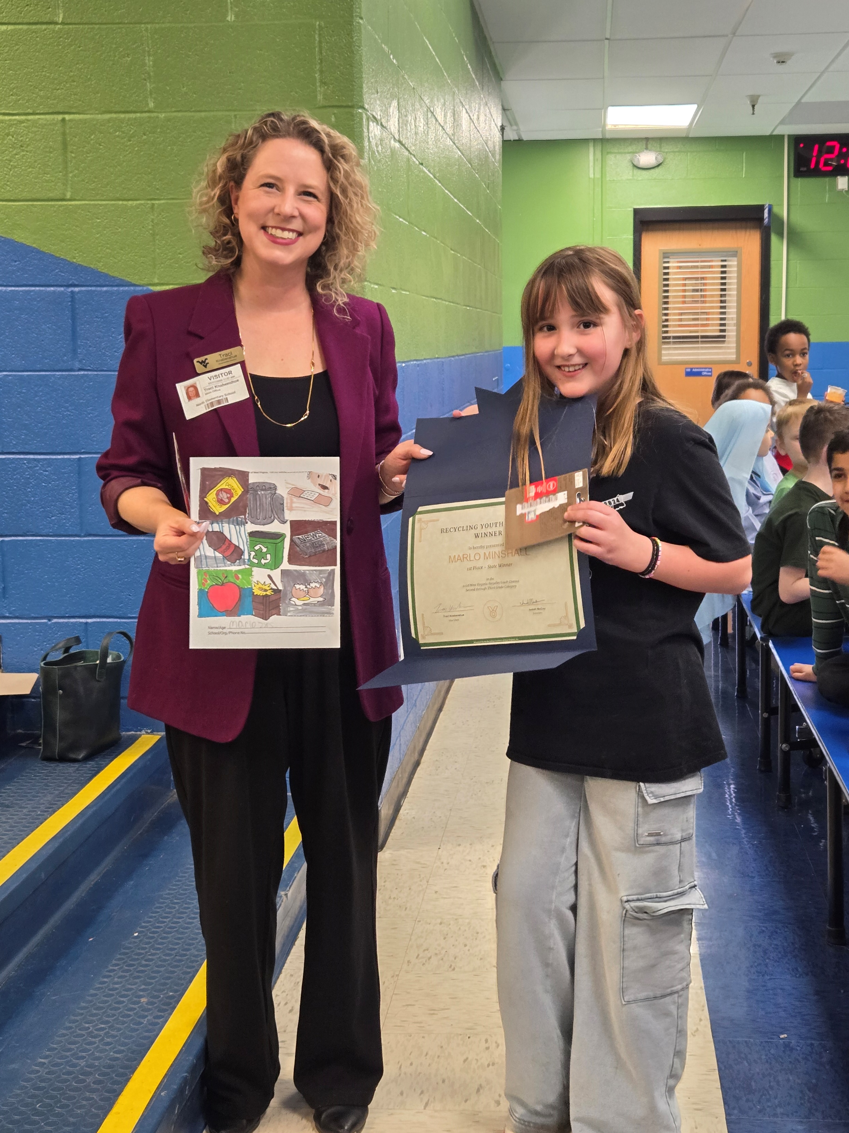

Youth contests
It all comes back to you.
Every fall, the Recycling Coalition opens entries to West Virginia schools for its Freedom & Coloring Contests.
The Coloring Contest is split into two grade categories, Pre-K-1 and 2-3. Students are provided coloring sheets and are judged at the January meeting of the Coalition, where one winner of each category is selected and awarded.
The Freedom Contest is divided into grades 4-5, 6-8, and 9-12. Students are asked to use their imagination to create a piece related to recycling that pays tribute to the theme “It all comes back to you.”

Slide 7
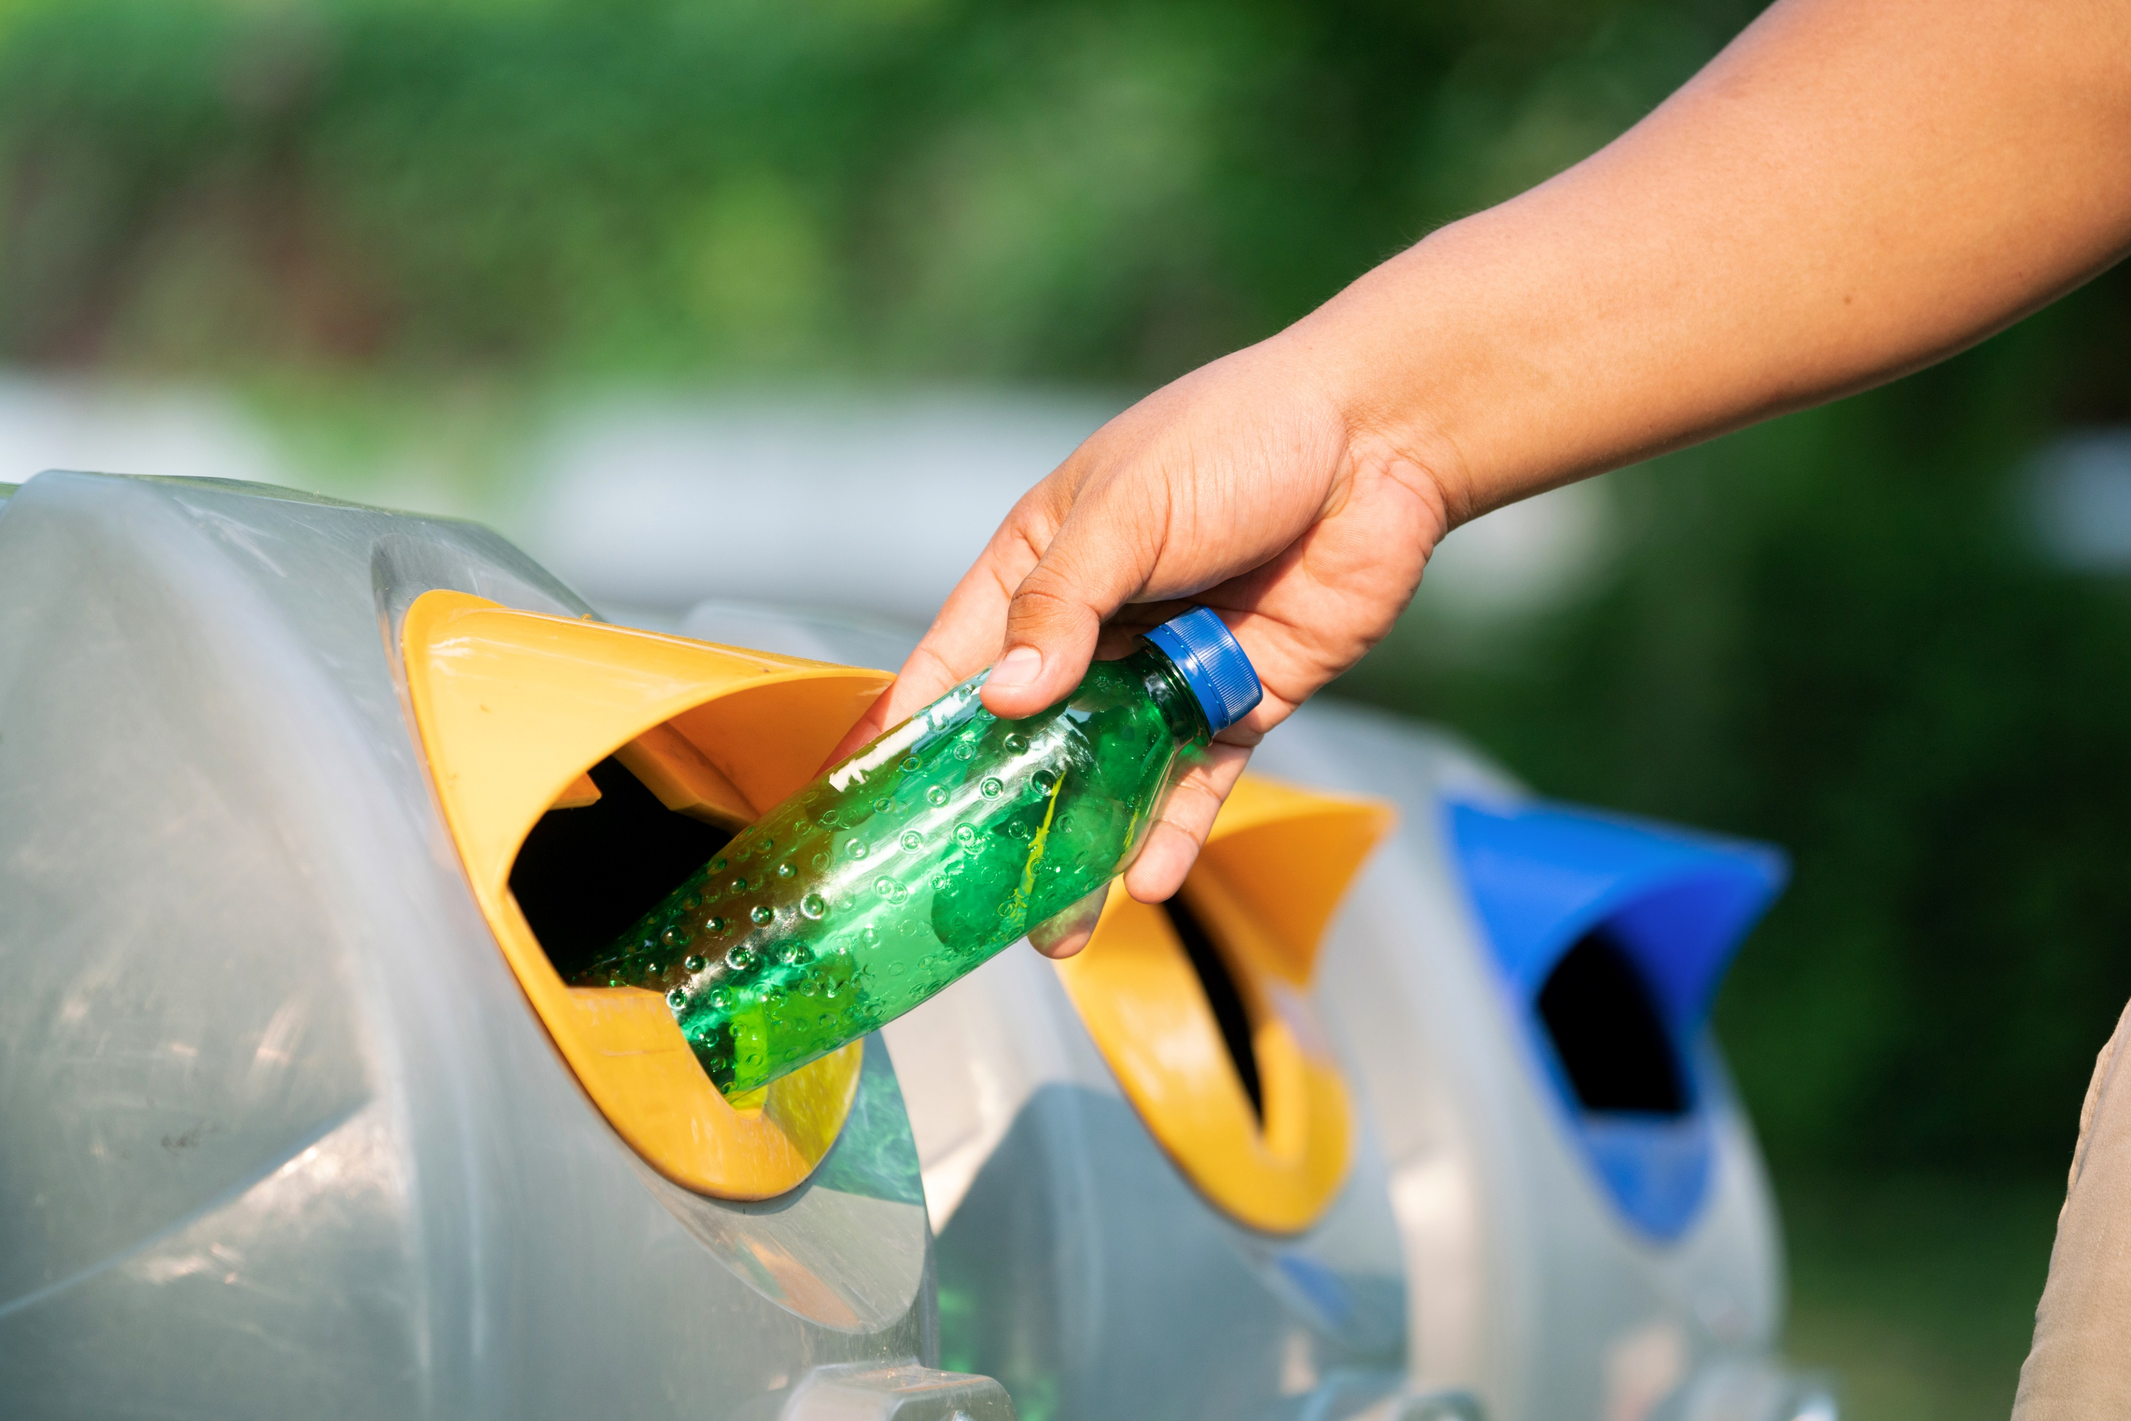
Recycling champions
The Recycling Coalition awards Recycling Champions on a nominations basis, honoring members of the community who reach beyond their normal responsibilities to contribute time and service to support the recycling industry in the Mountain State. These Recycling Champions provide leadership and significant contribution to the recycling community.
Think you know a Recycling Champion?
Head to our website at wvrecycles.org or scan the QR Code at the end of the presentation!

Slide 8
Where do we go from here?

Slide 9
What rcwv is doing right now
KEY ACCOMPLISHMENTS
Approved revised bylaws
Established a formal Board of Directors
Built an initial statewide membership base bringing together individuals, nonprofits, government, and industry
Became affiliate members of the National Recycling Coalition, giving our members dual membership and providing access to nationwide benefits and connections
Constructed a new website allowing for digital donations, memberships, event registrations, and more
This work has created organizational stability, pathways to leadership, and access to national resources and opportunities for connections and education.

Slide 10
The recycling coalition of west virginia is steered and directed by a nine-person board of directors representing state agencies, west virginia nonprofits, county solid waste authorities, higher education, the west virginia manufacturers association, and waste and recycling private industry. The board is voted on by coalition members every November. The first official board will be nominated in October, elected in November, and begin serving in January 2027.
Interim Board of Directors
Mark Holstine | Chair | West Virginia Solid Waste Management Board
Traci Knabenshue | Vice Chair | West Virginia University
Chelsea Runion | Treasurer | West Virginia Department of Environmental Protection
Rachel Eads | Board Member | West Virginia Department of Education
Erika Young | Board Member | Waste Management
Rebecca Friend | Board Member | Association of West Virginia Solid Waste Authorities
Rob Vanater | Board Member | Solid Waste Authority At Large
Jennifer Piercy | Board Member | West Virginia Manufacturers Association
Vacant | Board Member | West Virginia Nonprofit
Meet our Board

Slide 11

More about our memberships
We offer memberships to college students, individuals, government and nonprofit organizations, and private corporations.
College Students – FREE!
Individuals – $50.00
Government & Nonprofit Organizations - $150.00
Private Corporations - $300.00
Memberships reset on a calendar-year schedule opening January 1st of each year and expiring on December 31^{st.}

Slide 12
What are other states doing?
Kentucky recycling coalition | Association of ohio recyclers | Pennsylvania resource council
Statewide networking and circular economy growth | Policy education through hosting conferences and creating spaces for shared knowledge flow | Leads the state in hard-to-recycle materials
Connects local SWAs, schools, and private haulers | Important role in industry-government collaboration | High community engagement with consumer-facing events
Serves as a development hub for recycling professionals | Provides the platform for best-practice exchanges among counties and MRF partners | Shows how Coalitions can become the public voice of statewide recycling

Slide 13
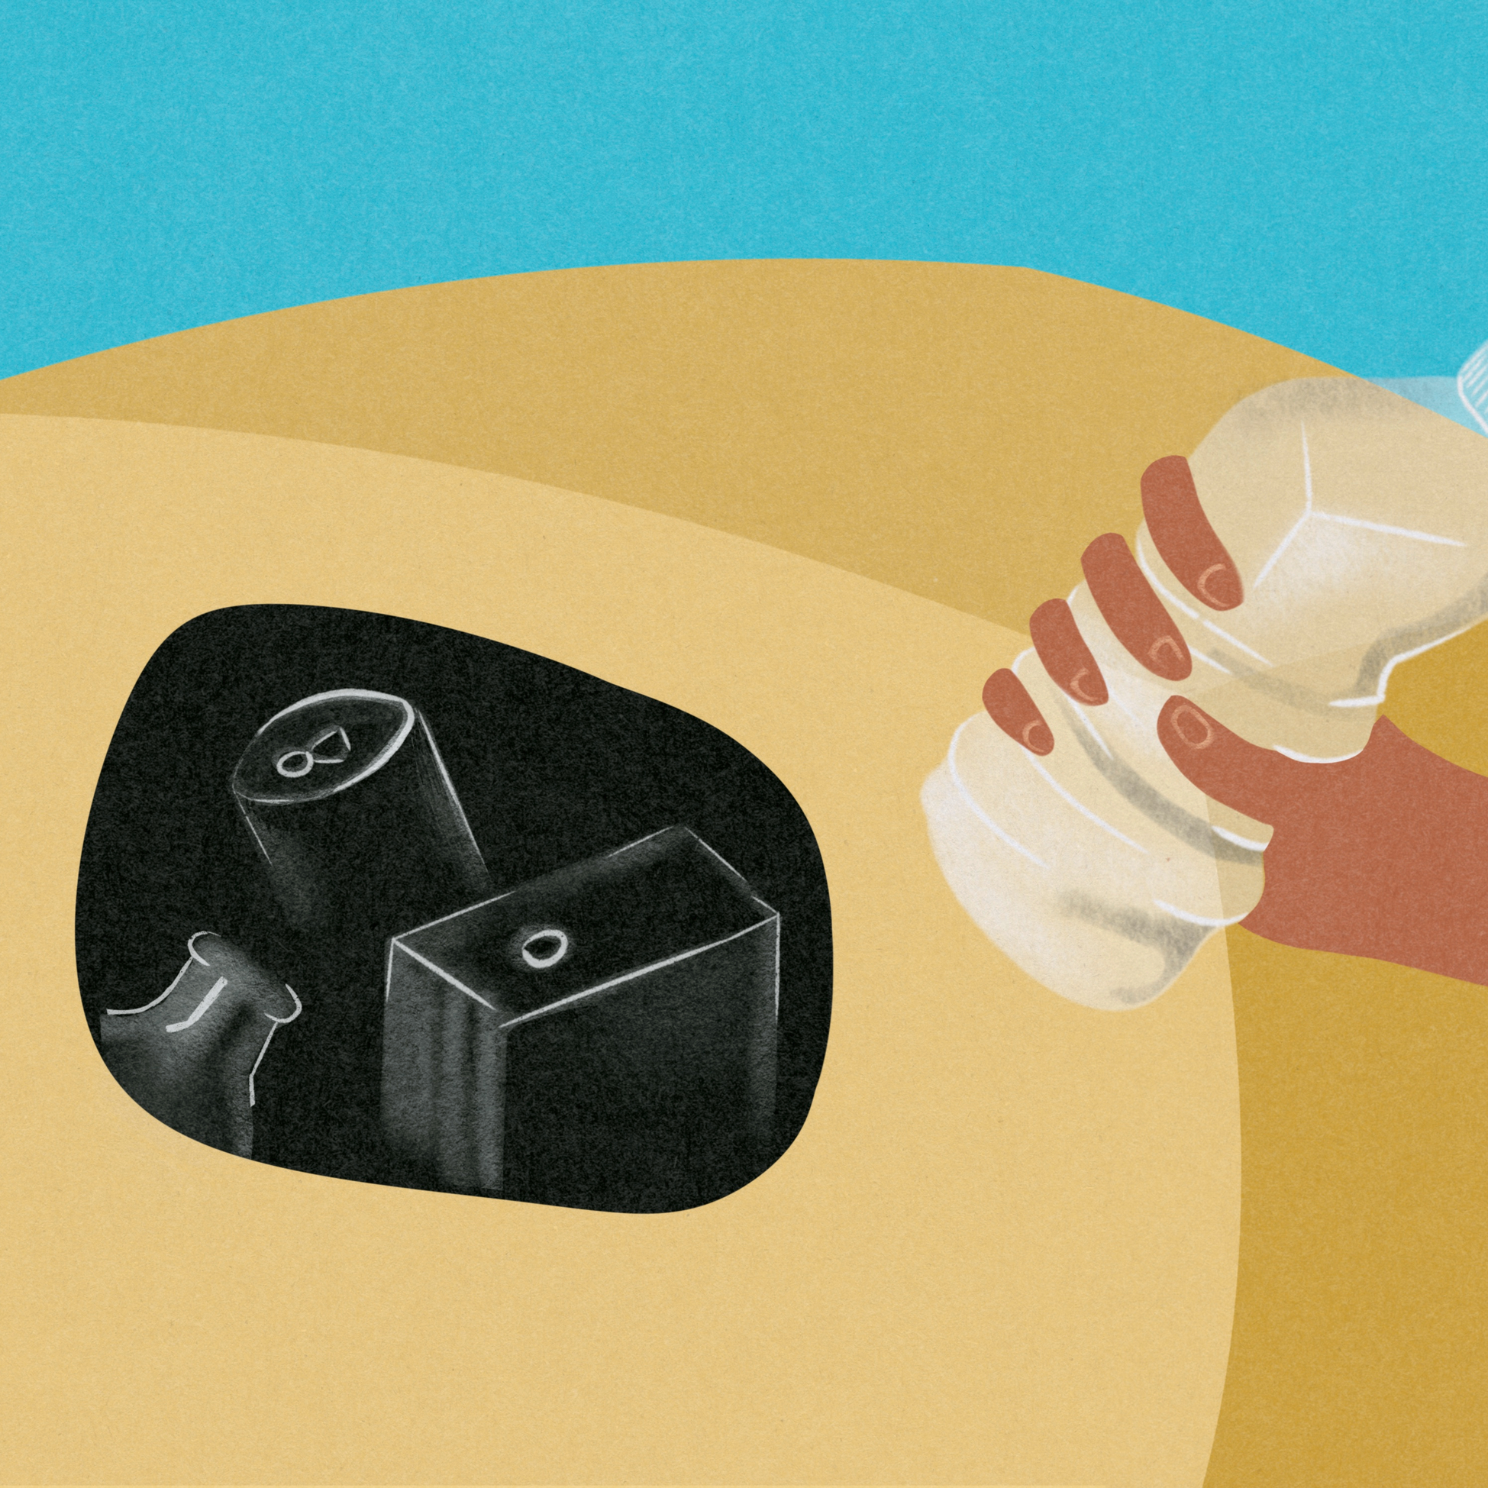
Looking to the future: where rcwv goes from here
Develop statewide policy priorities and advocacy voice
Support peer-to-peer knowledge exchange
Professional networking and development
Partnerships for a circular economy
Continued youth and community engagement
Becoming the unified voice for recycling in West Virginia – linking community action to statewide systems change

Slide 14

2nd Base
Diversify & Involve Stakeholders
We’ve successfully rounded 1st Base by establishing a solid educational foundation, and we are currently gaining momentum at 2nd as we diversify our membership and input.
Our next big play is to drive toward 3rd, where we can gather strategies, ideas, and knowledge to address pertinent issues.
By securing all these bases, we’ll be positioned to bring it all home with the legislative advocacy and support needed to win for the future of recycling in West Virginia.
3rd Base
Integrate Strategies and Ideas to Address Issues
1st Base
Education & Outreach
Home
New Projects, Initiatives & Legislative Improvements
COVERING OUR BASES

Slide 15
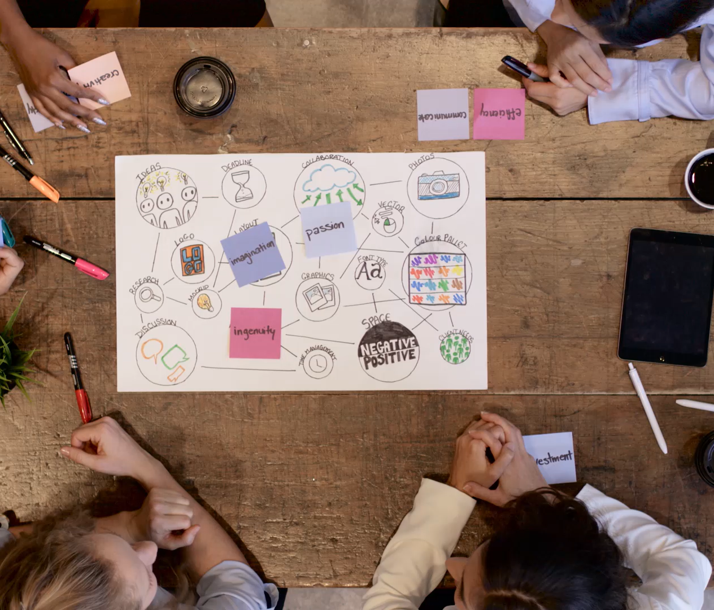
Join us!
Do you want to be a part of the conversation about the future of recycling initiatives in West Virginia?
Simply visit our new website and click Join Today! We offer membership packages for college students, individuals, organizations, and corporations.
Want to learn more about our programs, join the mailing list, or find out about meetings? Visit our website for more information.
https://wvrecycles.org

Slide 16
Recycling in west virginia
Turning a new page.

