Slide 1
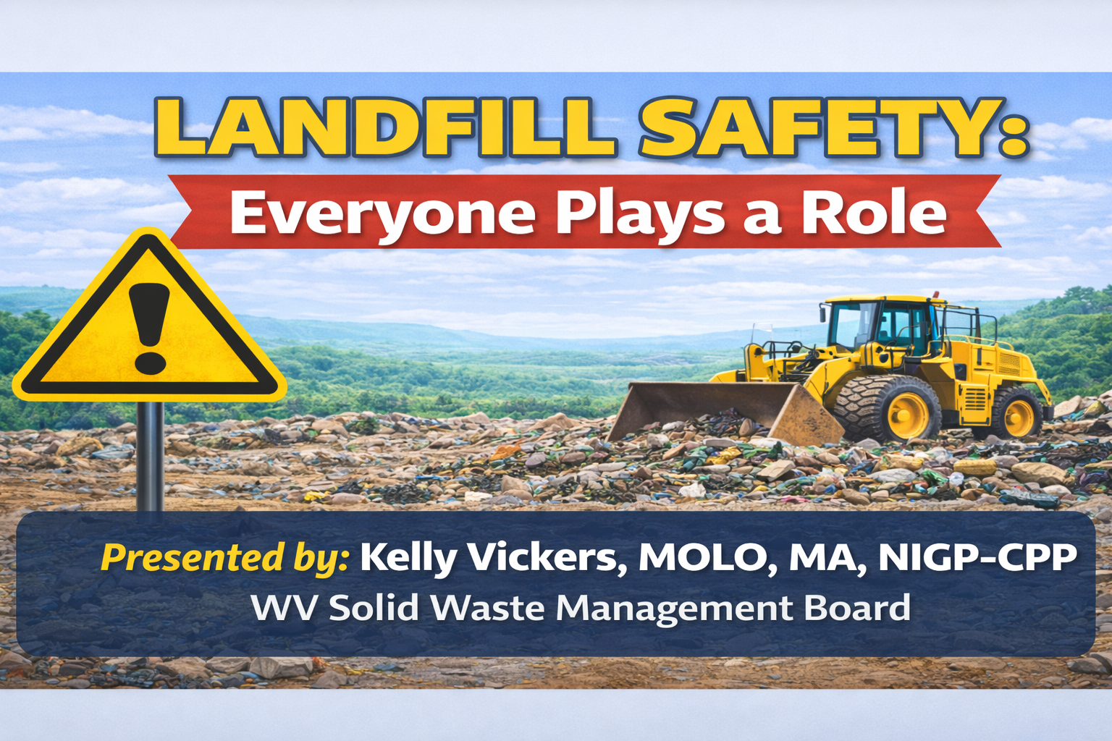
Notes:
Solid waste is one of the most dangerous public service jobs that most people never think about. When people think about risk, they think police, fire, construction… But what we do every day—handling unknown waste, operating heavy equipment, managing public traffic—it carries real risk.
And here’s the important part—this isn’t just an operator issue.
If you’re a board member, safety is part of your oversight responsibility.
If you’re management, it’s your job to set expectations and enforce them.
If you’re staff, you’re the ones exposed to it every single day.
So today, we’re going to walk through:
What the real risks are
What the expectations are
And how we build a culture where safety is just how we operate
Because at the end of the day—
👉 Safety is not one person’s job. It’s everyone’s responsibility.

Slide 2
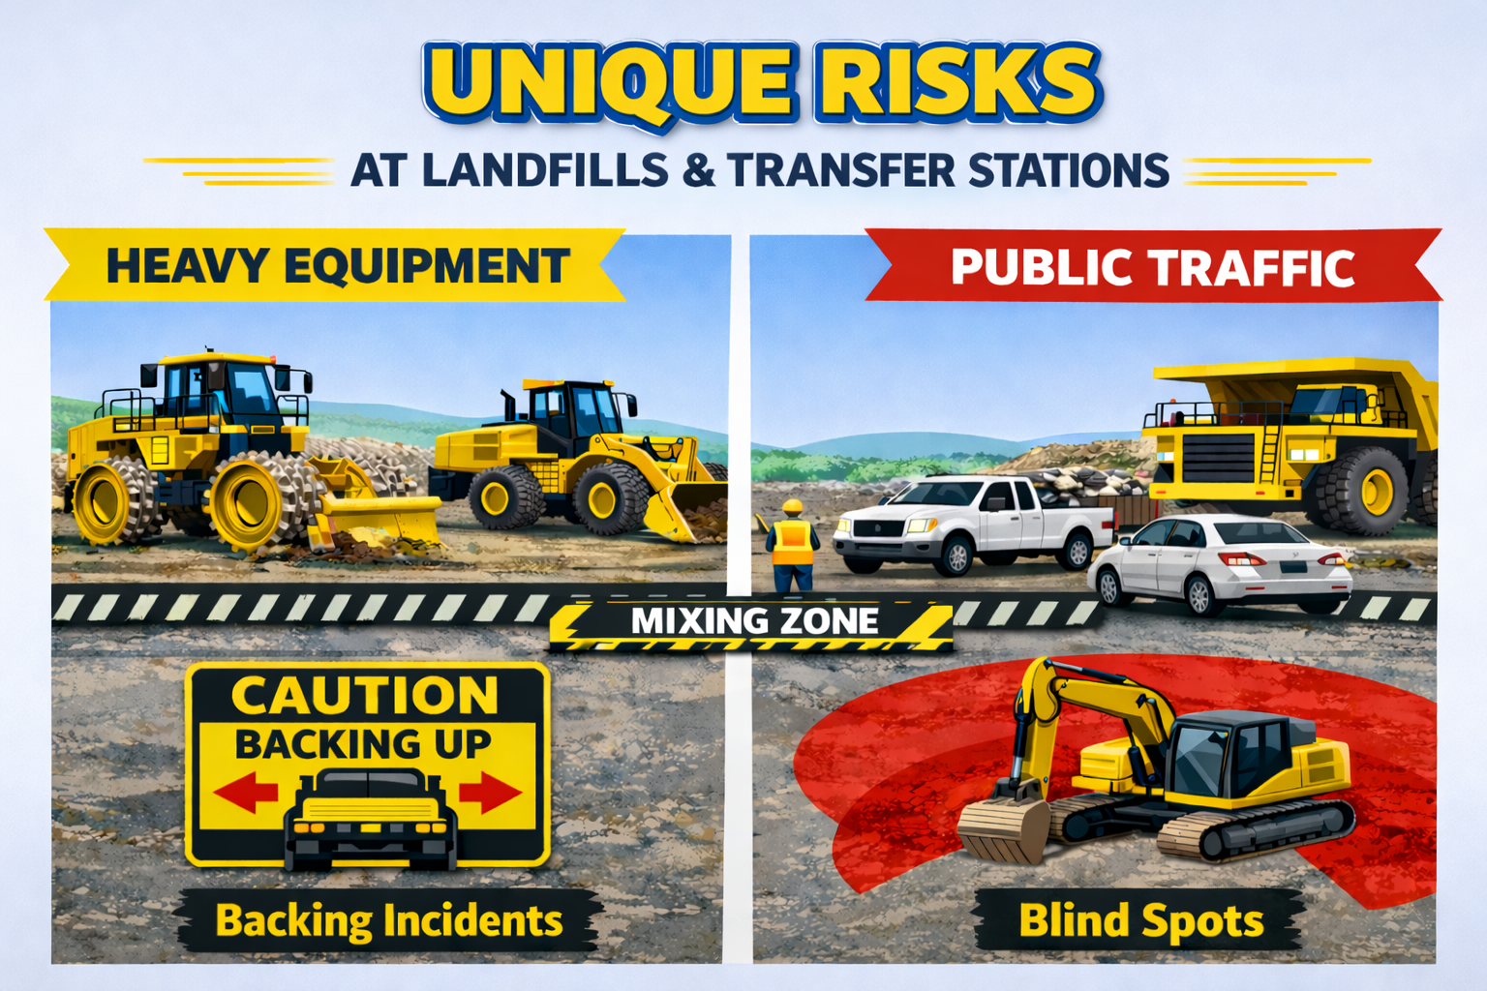
Notes:
Unique Risks at Landfills & Transfer Stations
Let’s talk about what makes our environment different.
Traffic & Heavy Equipment
“You’ve got: Compactors, Dozers, Loaders, Haul trucks
And then… the public driving through all of it
That mix alone creates one of the biggest risks we have.
Blind spots are real. Backing incidents are real.
👉 Interactive Moment:
‘Show of hands—how many of you have either seen or experienced a near miss involving equipment or traffic?’
That’s exactly why traffic control isn’t optional—it’s critical.

Slide 3
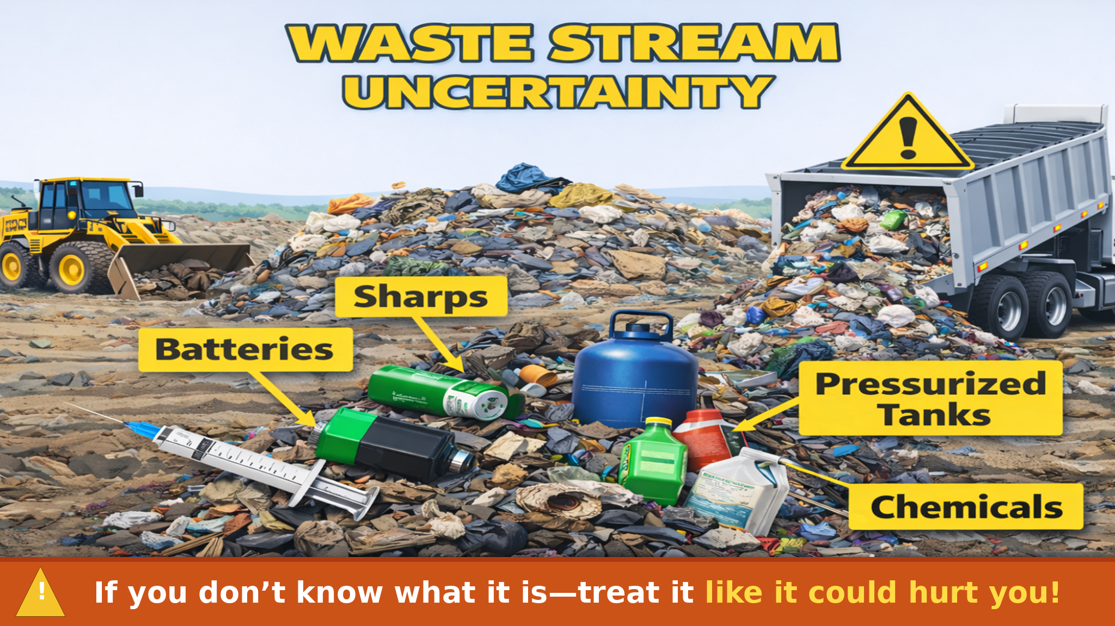
Notes:
Waste Stream Uncertainty
We also deal with something most industries don’t—
We don’t control what comes in.
Inside that load could be: Sharps, Batteries, Pressurized tanks, Chemicals
So the mindset has to be:
👉 If you don’t know what it is—treat it like it could hurt you.

Slide 4
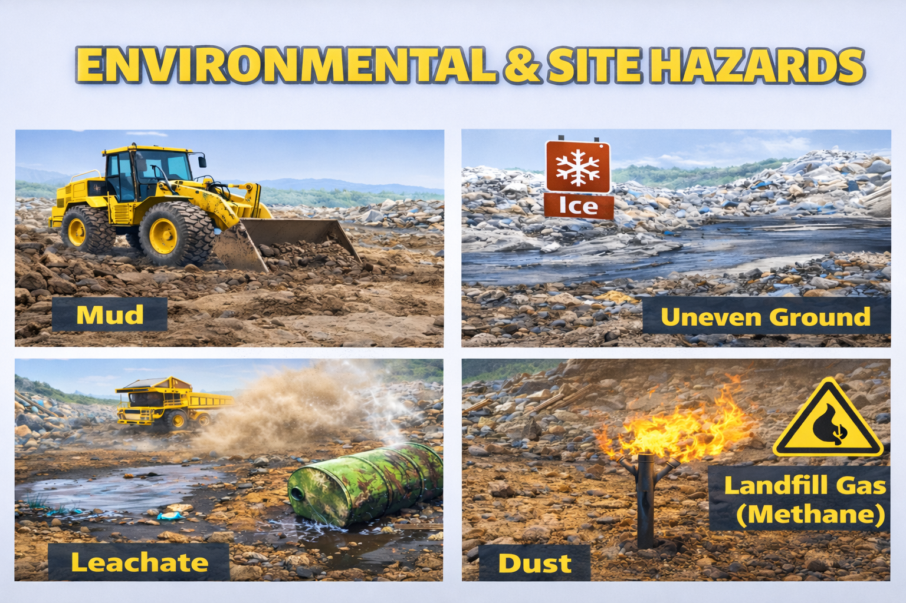
Notes:
Environmental & Site Hazards
Then layer in:
Mud
Ice
Uneven ground
Dust Leachate
Landfill gas like methane
This is not a controlled indoor environment—this is constantly changing conditions.

Slide 5
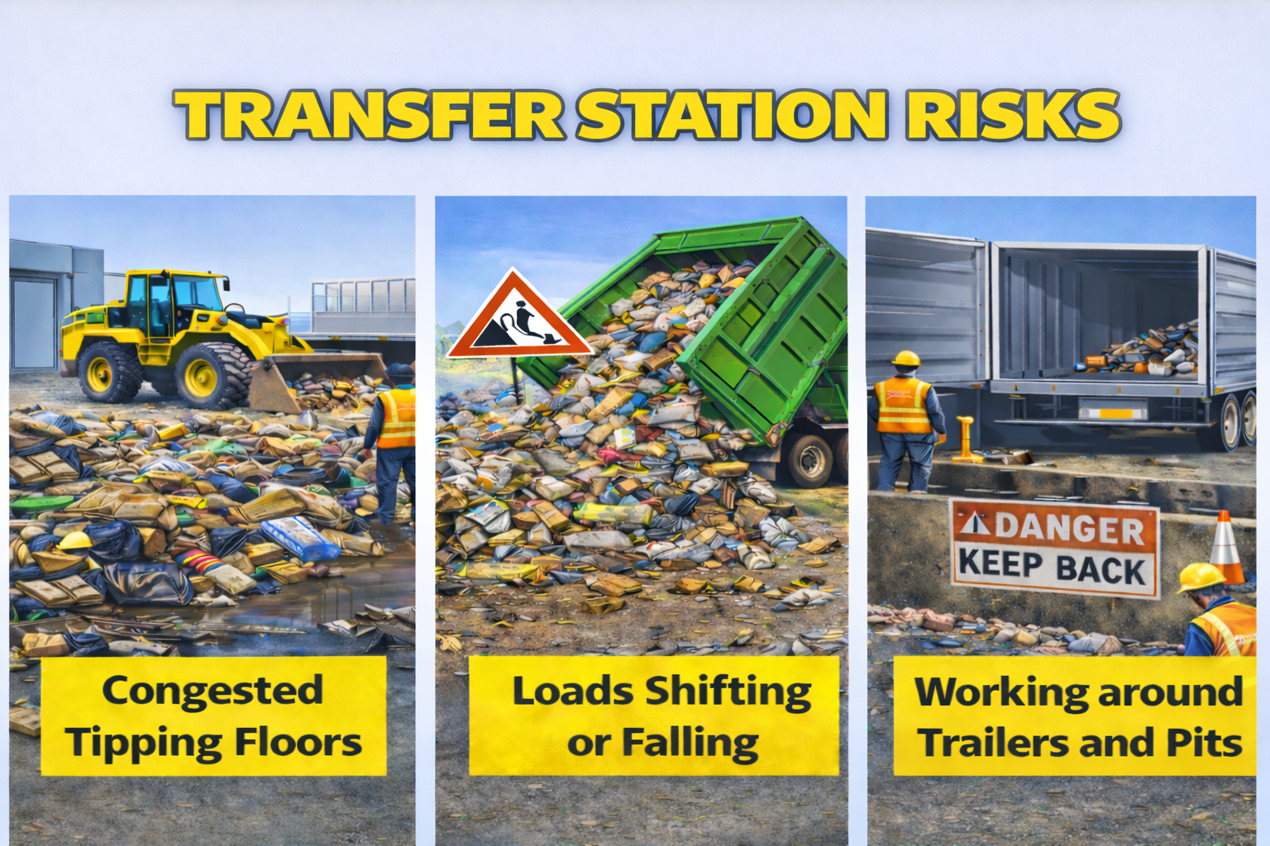
Notes:
At transfer stations, it’s a different type of risk:
Congested tipping floors
Loads shifting or falling
Working around trailers and pits
Things happen fast and when they do, you don’t always have time to react.

Slide 6
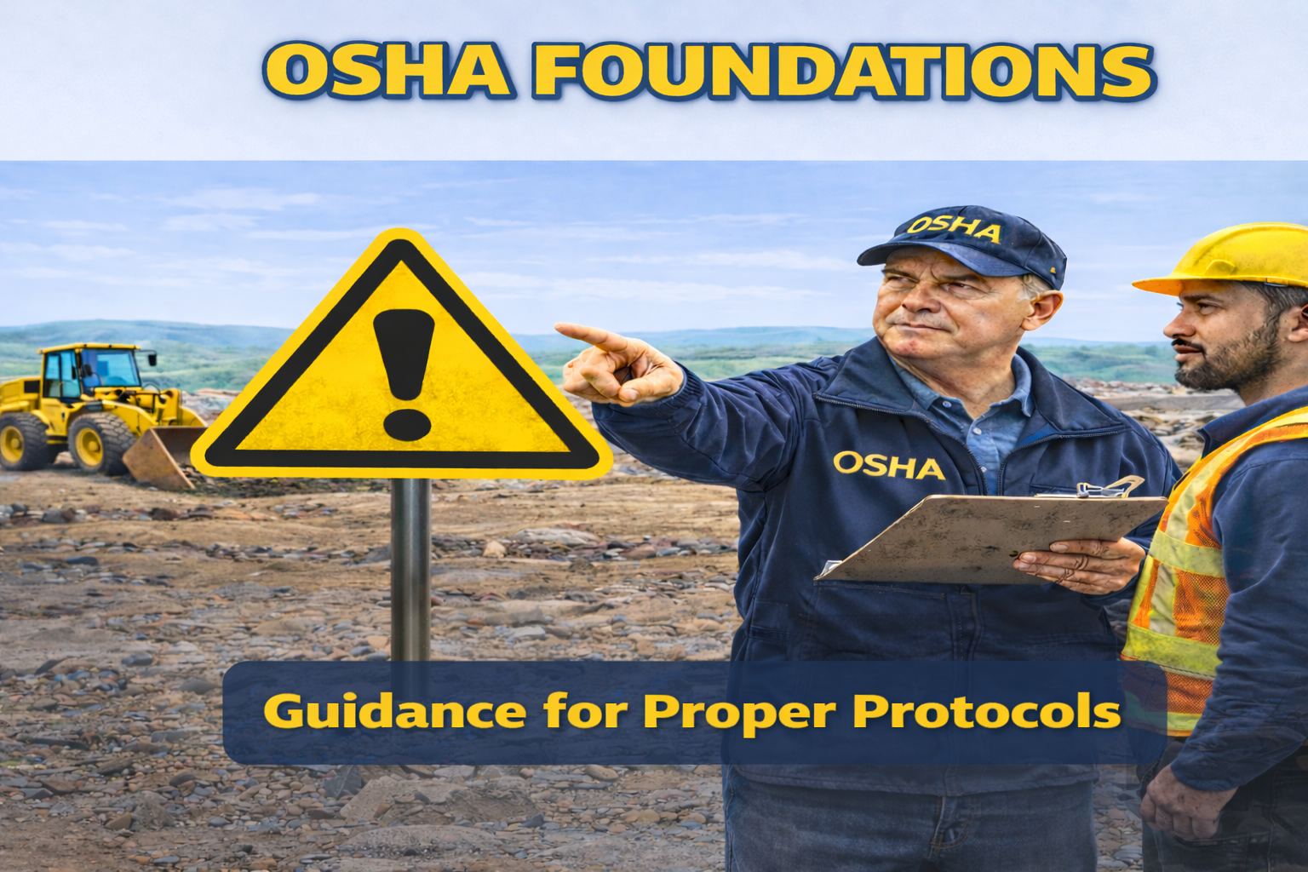
Notes:
Now let’s talk about what OSHA expects. While it is true that public entities aren’t directly regulated by OSHA in West Virginia, those standards still serve as the benchmark for safe operations, and they are fully enforceable for private employers. The SWMB uses these guidelines as metrics for our biennial performance reviews.
General Duty Clause
This is the big one—OSHA’s General Duty Clause.
It basically says: 👉 If there’s a recognized hazard—and you don’t address it—you’re responsible. Plain and simple.

Slide 7
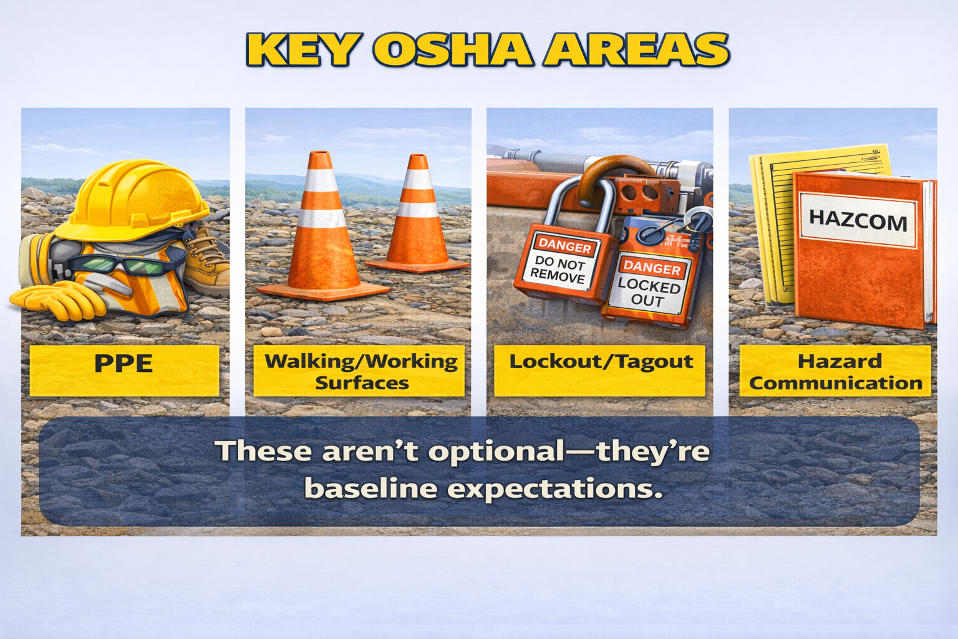
Notes:
Key OSHA Areas
For our world, that typically includes:
PPE
Walking and working surfaces
Lockout/Tagout
Hazard Communication
These aren’t optional—they’re baseline expectations

Slide 8
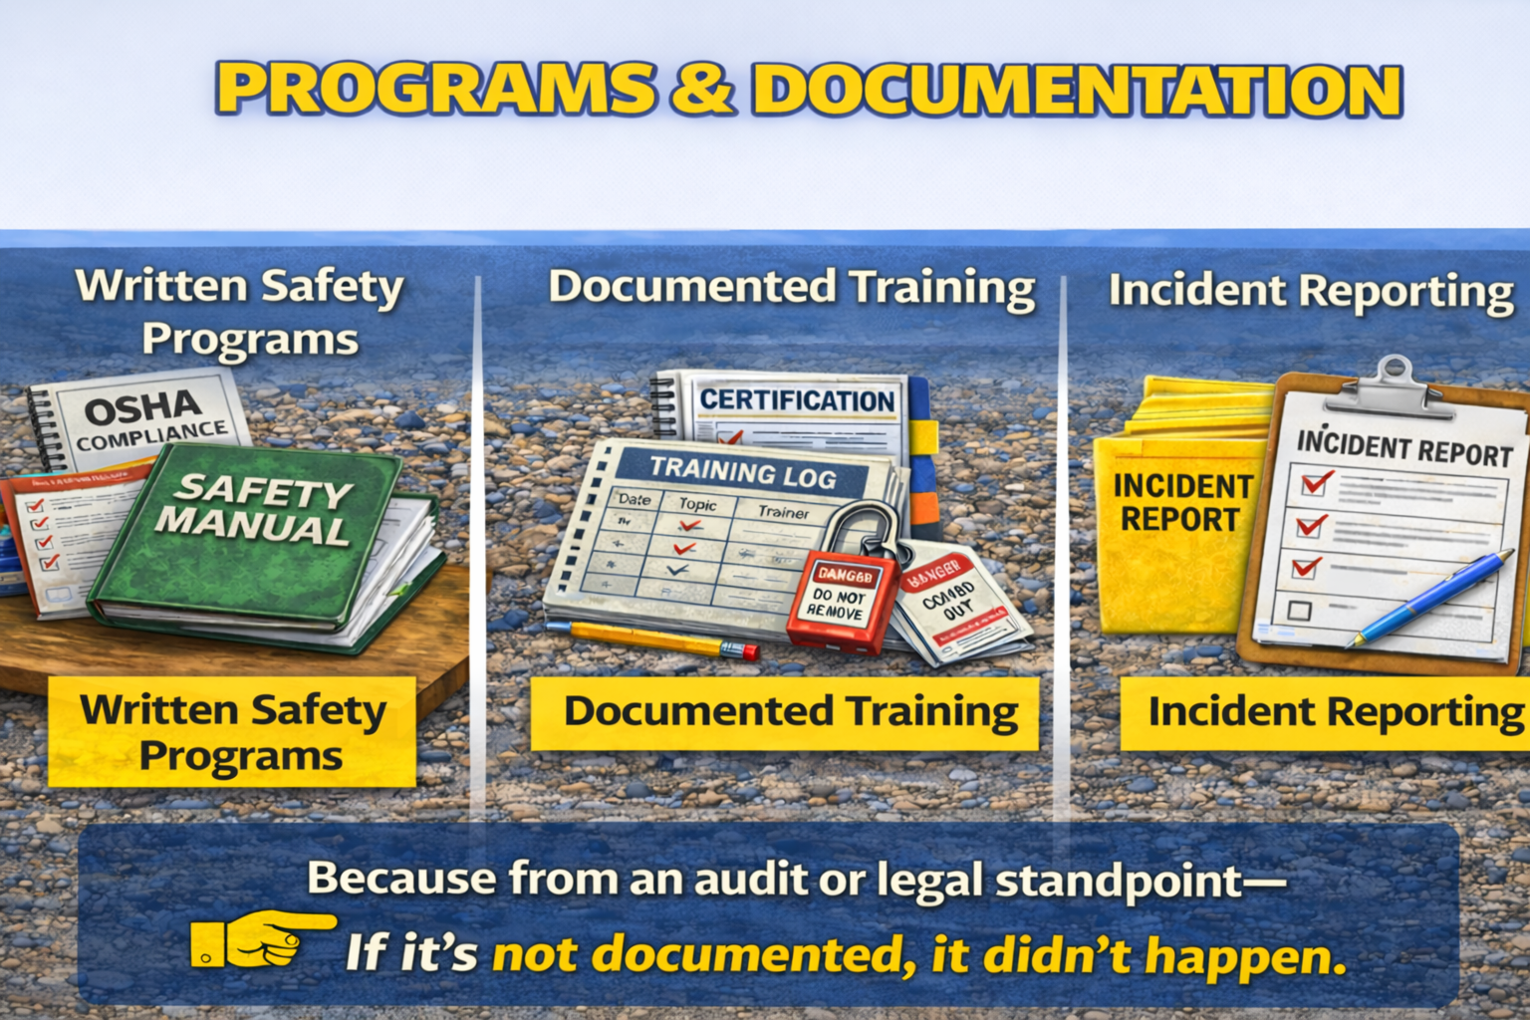
Notes:
And here’s where a lot of folks get tripped up:
You need:
Written safety programs
Documented training
Incident reporting
Because from an audit or legal standpoint—
👉 If it’s not documented, it didn’t happen.

Slide 9
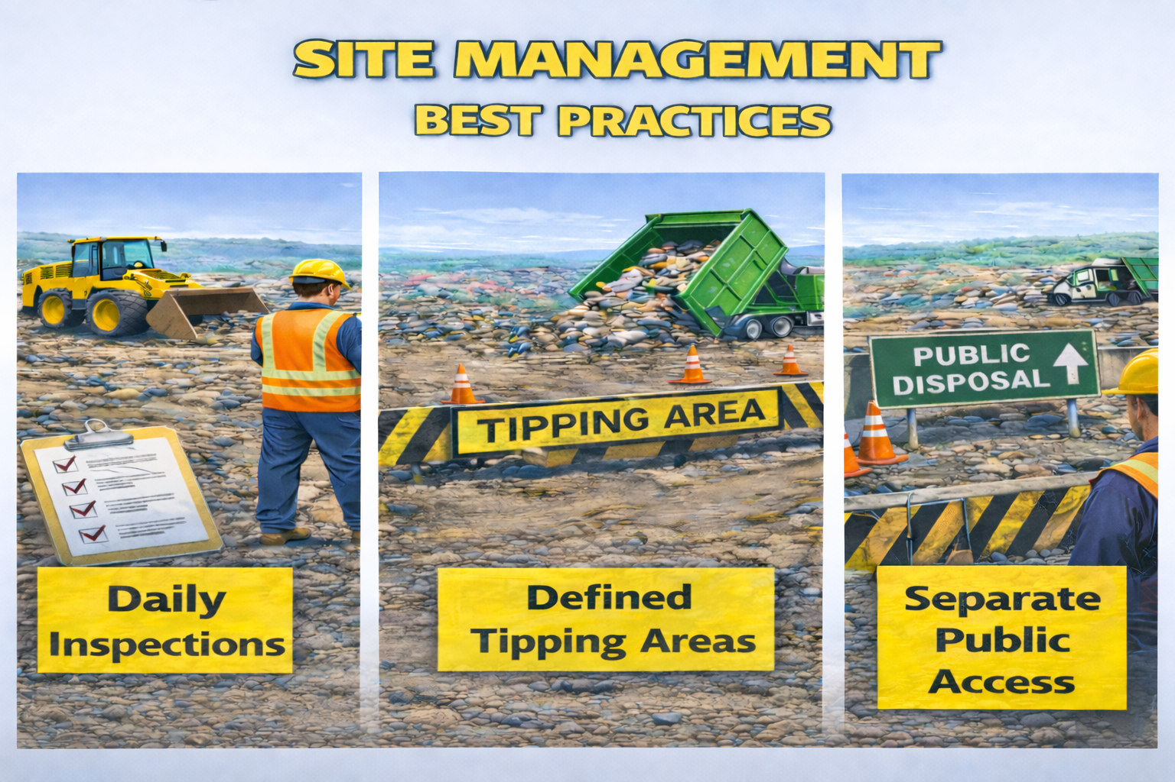
Notes:
Now let’s talk about what best practice looks like in our industry.
Daily Operations
From a MOLO standpoint:
Daily inspections
Defined tipping areas
Separation between public and equipment
That’s the foundation.

Slide 10
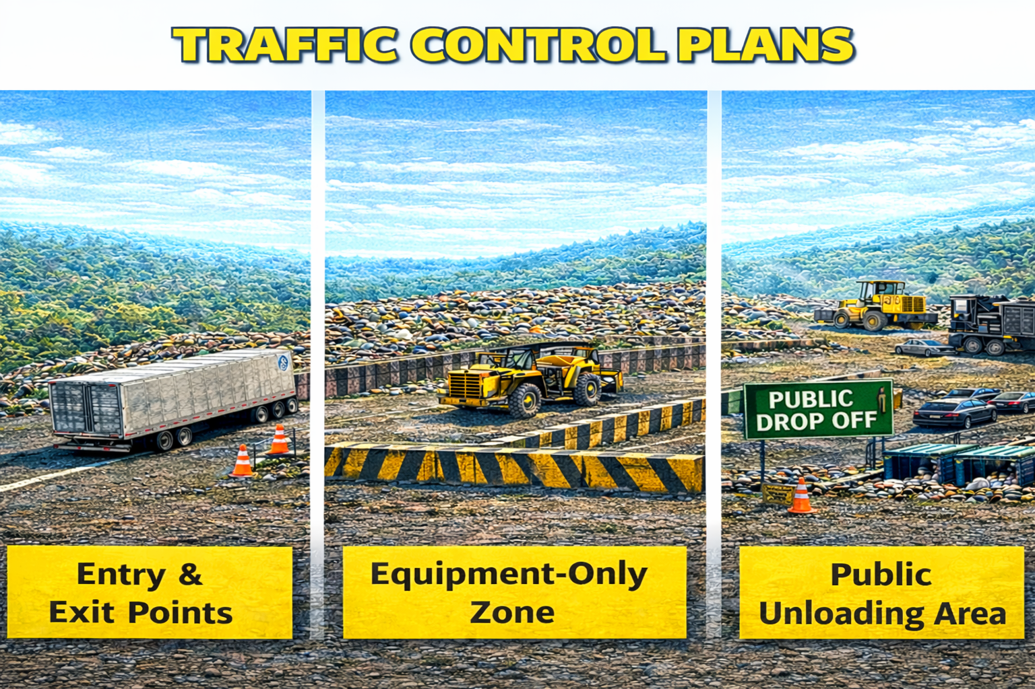
Notes:
This is one of the biggest ones.
You should clearly have:
Entry and exit points
Equipment-only zones
Public unloading areas
👉 Interactive Moment:
‘If someone pulled onto your site today for the first time—would they know exactly where to go without asking?
If the answer is no—that’s a risk.

Slide 11
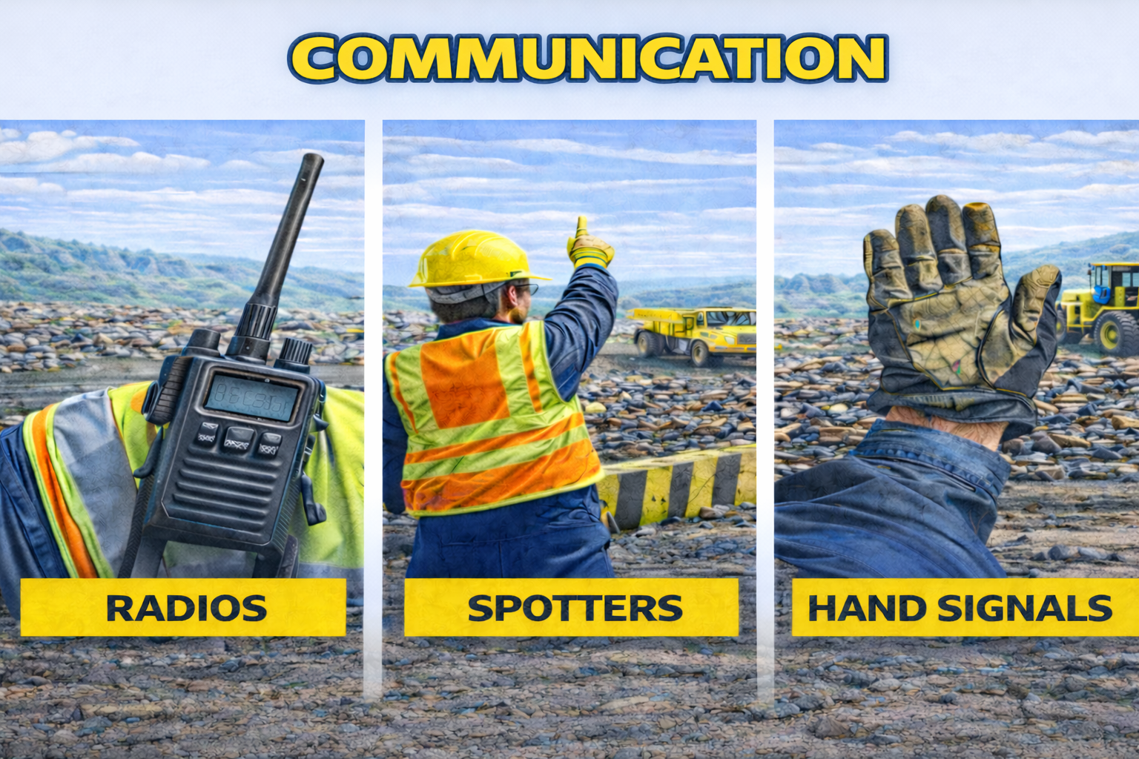
Notes:
Communication
Radios, spotters, hand signals—whatever system you use—
It has to be consistent and understood by everyone.

Slide 12
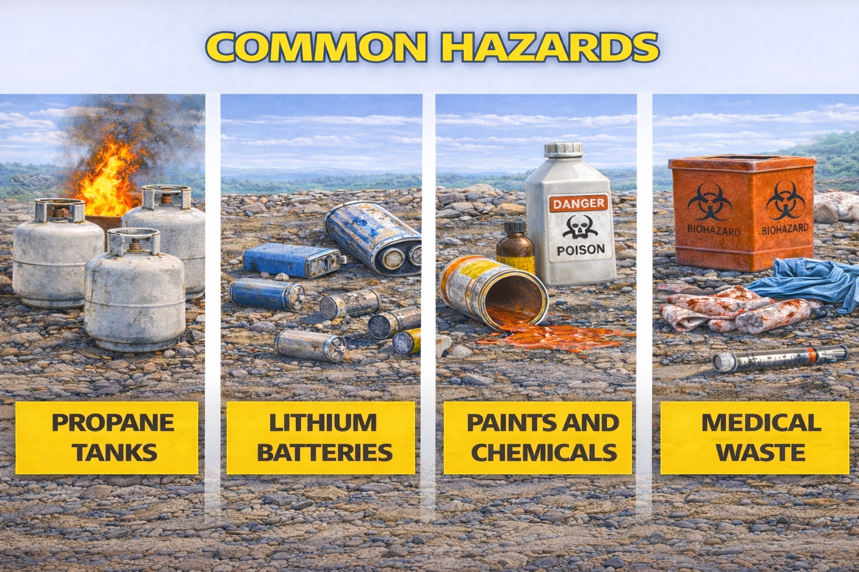
Notes:
Now let’s talk about something we see more and more—hazardous materials.”
Common Hazards
Things that show up regularly:
Propane tanks
Lithium batteries
Paints and chemicals
Medical waste
And sometimes they don’t look dangerous until they are

Slide 13
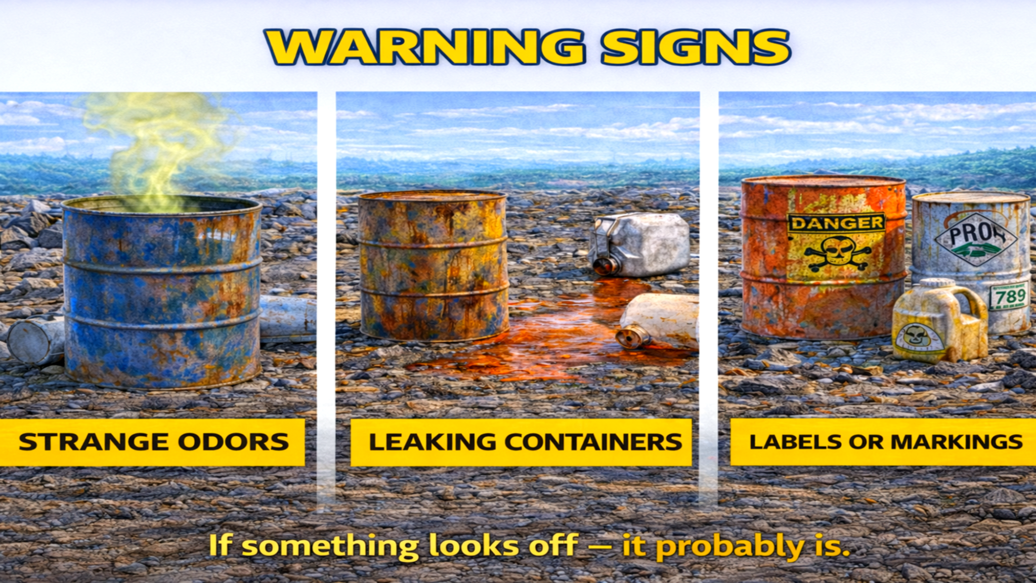
Notes:
Watch for:
Strange odors
Leaking containers
Labels or markings
If something looks off—it probably is

Slide 14
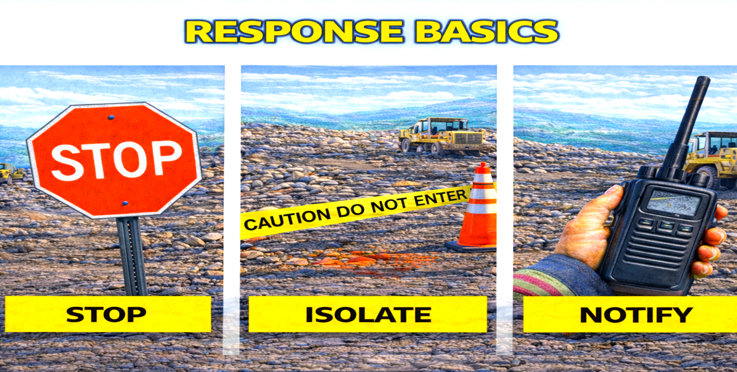
Notes:
And this is critical:
You are NOT expected to be hazmat responders.
Your job is to:
Stop
Isolate
Notify
👉 Interactive Moment:
‘What’s the worst thing you can do if you suspect hazardous material?’
Exactly—don’t touch it.”

Slide 15
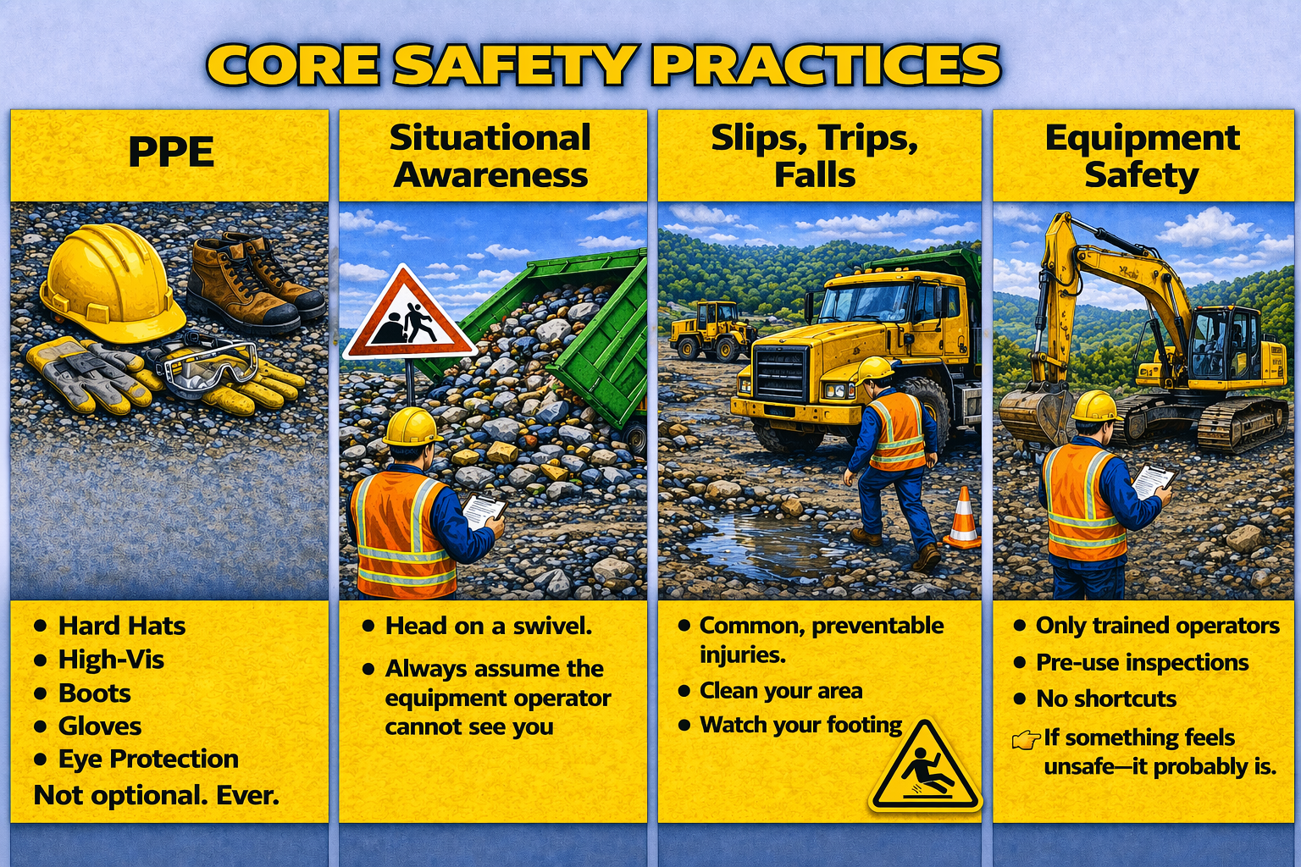
Notes:
Let’s bring it back to the basics that apply every single day.”
PPE
Hard hats, high-vis, boots, gloves, eye protection—
Not optional. Ever.
Situational Awareness
Head on a swivel.
Always assume the equipment operator cannot see you.
Because most of the time—they can’t.
Slips, Trips, Falls
One of the most common injuries—and one of the most preventable.
Clean your area. Watch your footing.
Equipment Safety
Only trained operators
Pre-use inspections - No shortcuts
👉 If something feels unsafe—it probably is.”

Slide 16
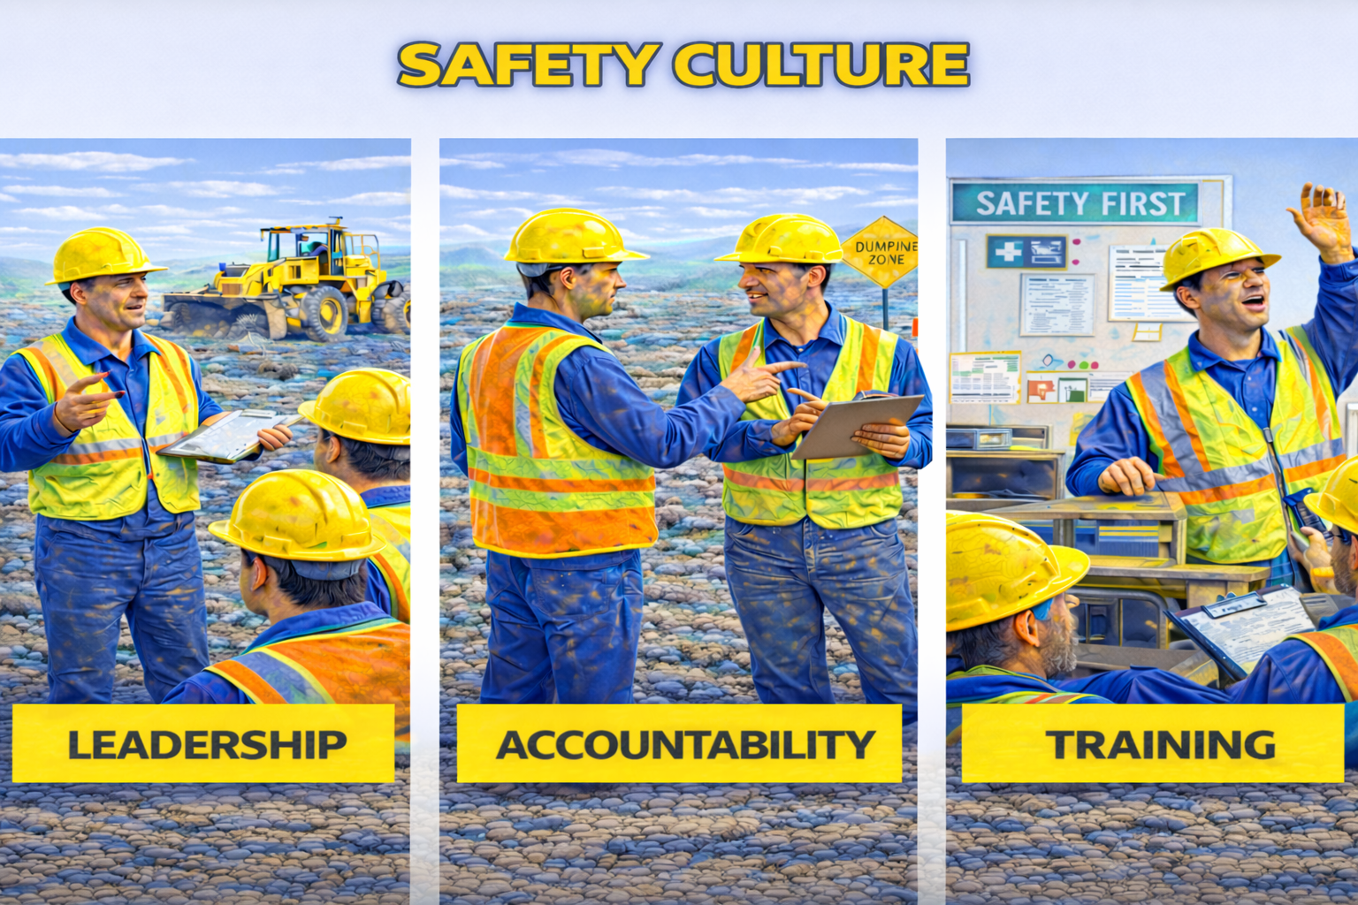
Notes:
This is where everything comes together.
Leadership Responsibility
Safety starts at the top.
If leadership doesn’t take it seriously—no one else will.
Accountability
“Clear expectations. Consistent enforcement.
You can’t ignore it one day and enforce it the next.
Training
Safety is not a one-time conversation.
It has to be reinforced over and over.”

Slide 17
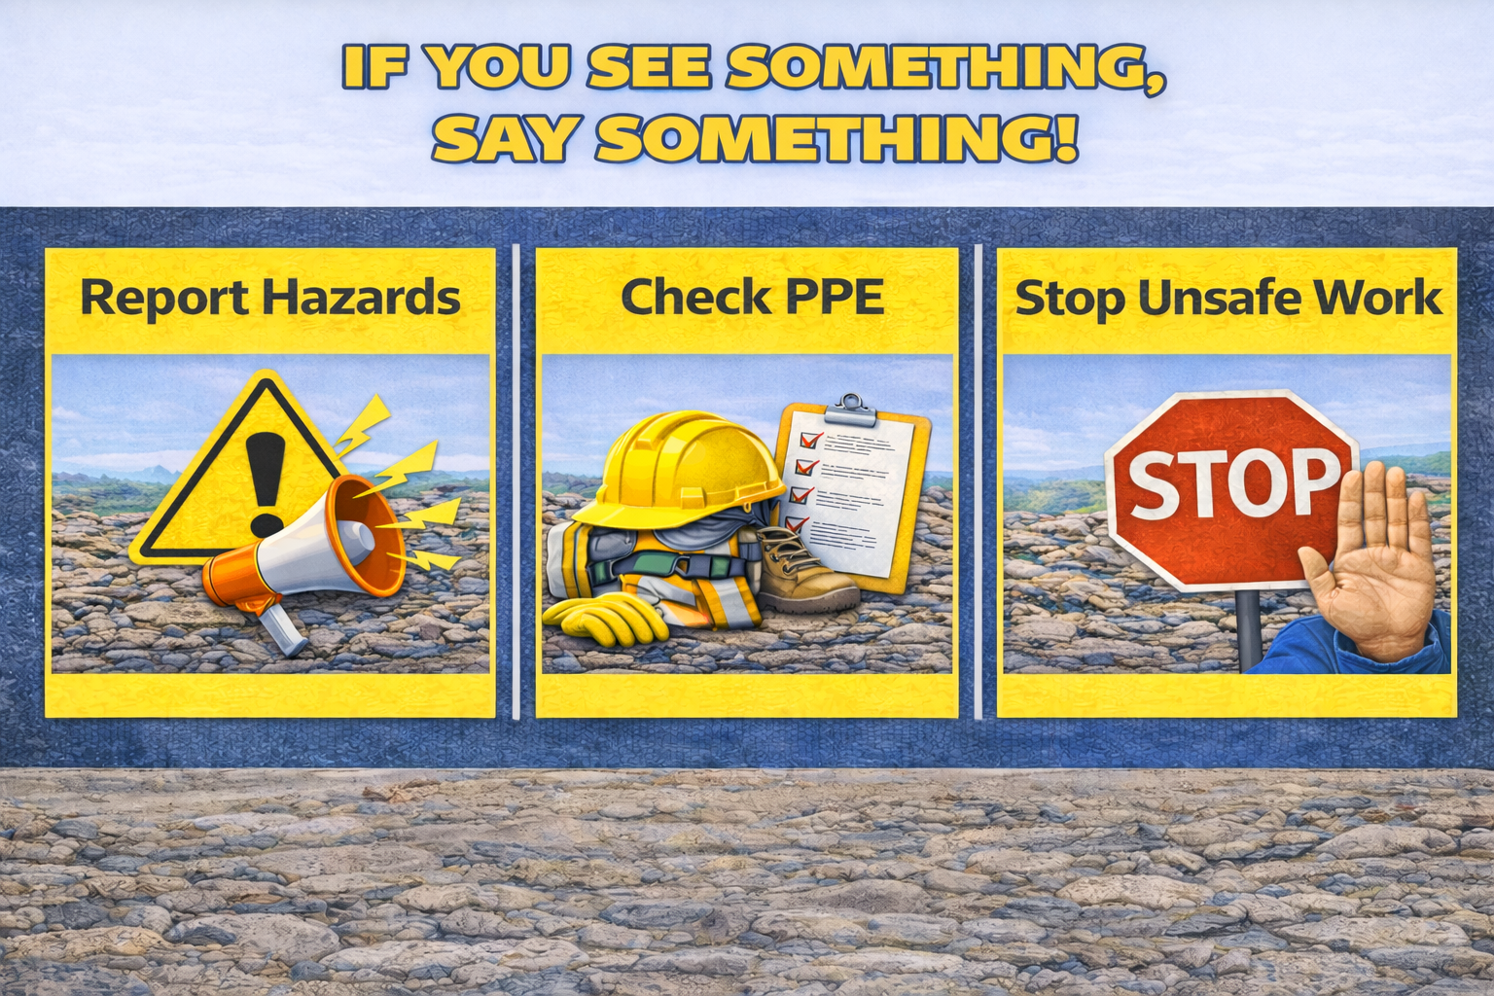
Notes:
Employees need to feel like they can:
Speak up
Report issues
Stop unsafe work
👉 Interactive Moment:
‘f someone on your team saw something unsafe—would they feel comfortable saying something?
That answer tells you a lot about your culture.

Slide 18
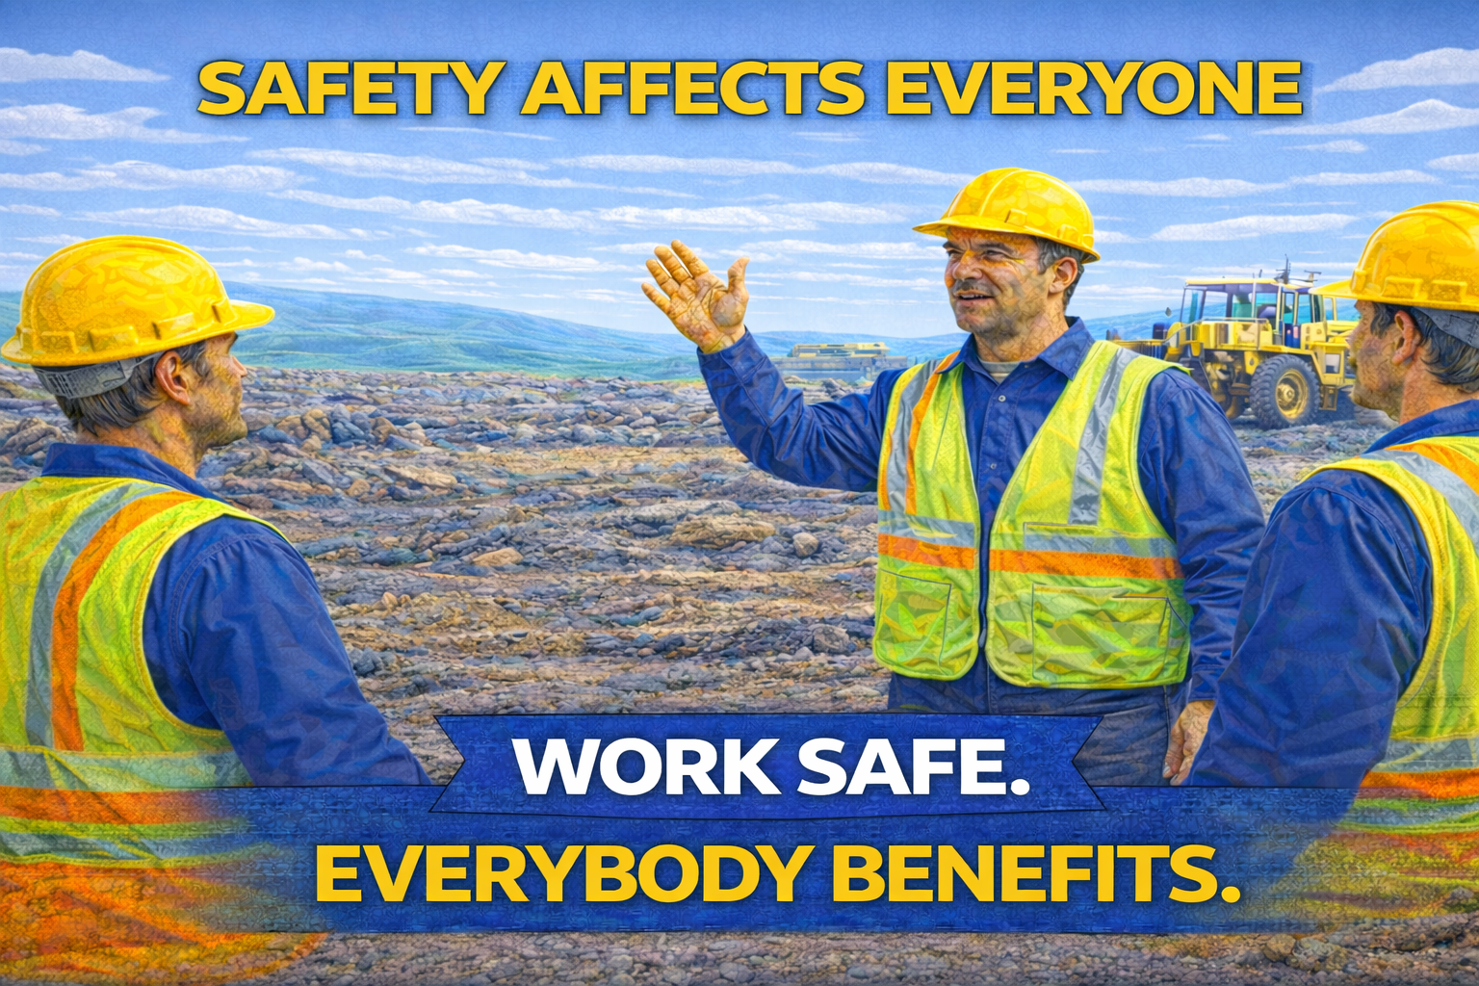
Notes:
So to wrap this up—
We talked about:
The risks
The requirements
The best practices
And the culture behind it all
And the biggest takeaway is this:
👉 Safety failures don’t stay in one department.
👉 They impact everyone.
The safest sites aren’t accident-free by chance—
They’re built that way on purpose.
And every single person in this room plays a role in that.

