Slide 1
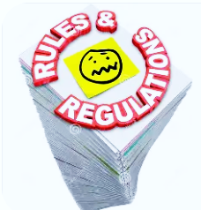
Who Regulates What?

Slide 2
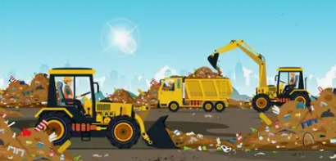


What is the West Virginia Public Service Commission’s (PSC) role in the state’s solid waste industry?
Landfills and Transfer Stations
Trash Haulers
Interactions with Other Agencies

Slide 3
Landfills and Transfer Stations
Certificate of Need
Rate Cases – How rates, fees, and service pricing are established or reviewed
Operating Tariffs
Escrow Requirements and Tracking
  Memorandum of Understanding (MOU) with the DEP
Closure, post-closure costs are built into the Rate
Assessment fees

Slide 4
Trash Haulers
Certificates of Convenience and Necessity (WV Code 24A-2-5)
Rate Cases – How rates, fees, and service pricing are established or reviewed
Operating Tariffs
Common areas of dispute between haulers, authorities, and customers
Service territories
The PSC’s role in handling complaints, enforcement, and compliance expectations
What aspects are regulated versus unregulated

Slide 5
Interactions with Other Agencies
Solid Waste Management Board
County Solid Waste Authorities
Department of Environmental Protection (DEP)

Slide 6
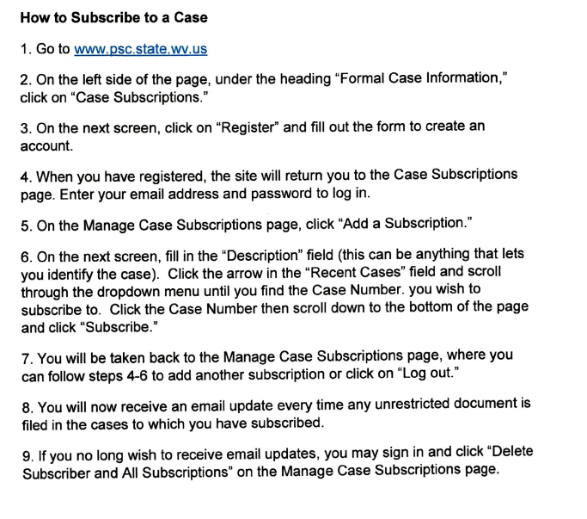
How to Subscribe to an Open Case with the WV PSC

