Slide 1
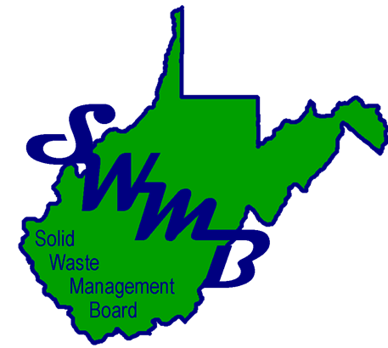
Solid Waste Authority
Board Member & Staff Training
Comprehensive and Siting Plans:
Regulatory Requirements and Sustainable Planning

Slide 2

Objectives
Understand your legislative purpose as a solid waste authority.
Understand when Comprehensive and Siting Plans are due and what must be included.
Learn the procedures for reporting updates or changes.
See how siting plans relate to permitting requirements.
Identify key elements for sustainable, forward-looking planning.

Slide 3
Purposes
WV Code §22C-4
Protect public health and welfare
  by acting promptly to secure proper and effective solid waste collection services and disposal facilities in both the public and private sectors.
  by providing for a comprehensive program of solid waste collection, processing, recycling and disposal to be implemented by state and local government in cooperation with the private sector.
  by establishing SWAs to develop and implement litter and solid waste control plans.
  based on the integrated waste management hierarchy.
Enable local citizens to resolve land-use conflicts which may be created by proposed commercial solid waste facilities through the existing forum of solid waste authorities.
  Protect compelling interests of the counties and local communities
  Most effectively resolved in local government forum where citizens can most easily participate
  Comprehensive policy which reflects the values and goals of those communities.
  Intent of the Legislature that all commercial solid waste facilities operating in this state must receive site approval at the local level through application with the SWA and processes outlined in WV Code and State Rules
Notes:
Chapter 22C Article 4 is titled County and Regional Solid Waste Authorities.
Established SWAs
Purpose of the Legislature to protect the public health and welfare as it relates to solid waste collection, processing, recycling and disposal

Slide 4

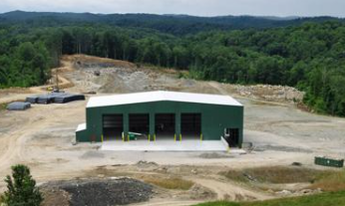
The Plans
Comprehensive Litter & Solid Waste Control Plan
W. Va. Code §22C-4-8
SWMB Rule 54CSR3
Significant plan changes
New ordinances, laws, rules
Major progress and initiatives
Update Required Every 5 Years
Projected 20-Years Covered By Plans
Amend at any time by the SWA effective upon state Board approval
Formats for each plan are specified in 54CSR3 and 54CSR4 such as table of contents, executive summary, background, methodology, public participation, maps, etc.
Minor updates should be submitted as they occur.
Commercial Solid Waste Facility Siting Plan
W. Va. Code §22C-4-24
SWMB Rule 54CSR4
Applications requesting redesignation of zones
Support or Deny Certificate of Site Approval

Slide 5
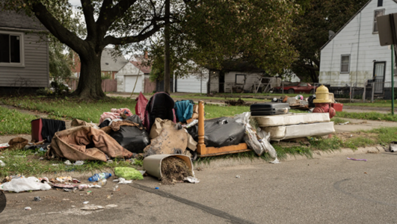
The Plans
KEY ELEMENTS THE PLANS SHOULD DEMONSTRATE:
MOST IMPORTANT! Public Health & Safety….
  Do the current solid waste collections, disposal services, and facilities adequately serve the needs of the entire county or region now and for the next 20 years?
  Compare population and tonnage projection with…
  Lifespan of the landfill(s) used by your county (even if outside the county)
  The permitted tonnage limit and the average disposal tonnage accepted
  Time remaining on landfill cell-technical and financial planning for new cells
Compounding results and efforts
  Goals set in previous plan: New plan should follow-up, actions taken, what’s next.
  Use measurable outputs and outcomes
    Educational materials: How many households reached
    Attempts resulted in increased participation at recycling center
    LCO reduced open dump occurrence

Slide 6
Comprehensive Litter & Solid Waste Control Plan
-Content of Plan-
General Information
Describe plan goals and objectives for the next twenty (20) years.
Describe status of existing solid waste management activities in the county or region, and how the plan is being implemented.
Describe how funds, including grant funding, have been used and will be used to implement the plan.
Describe actions taken by the authority to implement the hierarchy established in W. Va. Code §22C-4-1, in the following order of priority: (1) source reduction, (2) recycling, reuse, and materials recovery, and (3) landfilling.
2025
2030
2035
2040
2045

Slide 7

Comprehensive Litter & Solid Waste Control Plan
-Content of Plan-
54CSR3 Section 5
Assessment of litter and solid waste problems (open dumps, waste tire piles, litter)
Evaluation of existing solid waste collection and disposal services for all county or regional residents.
Recommendations and reasons for the siting of one or more solid waste facilities – existing or proposed – to ensure the present and future solid waste needs
Timetable for the implementation of the plan for the next twenty (20) year projection
Program for open dumps
Program to enlist voluntary assistance for cleanup
Notes:
An assessment of litter and solid waste problems in the county or region
Open and unpermitted dumps
Waste tire piles
Litter
An evaluation of existing solid waste collection and disposal services for all county or regional residents. (20 year projections, demographics,transportation methods, maps)
Maps - highways, collection, treatment, transportation, disposal, recycling, facilities, and haulers.
Demographic projections for the next 20 years
Areas of urban concentration / areas with potential for urbanization
General description of geographic features
Identify major highways, rail or river routes used in the transportation of solid waste

Slide 8

Comprehensive Litter & Solid Waste Control Plan
-Content of Plan-
54CSR3 Section 5
Coordination with Division of Highways and other state and local
Program for incarcerated/probation litter cleanup
Coordination with related solid waste collection and disposal services of municipalities and other counties, if applicable
Program to identify the disposal of out of county or out of region solid waste
Provision for the proper disposal of commercial or industrial solid waste produced within the county or region
Recycling Plan: Feasibility of source separation of 3 materials or more, characterization of waste, recycling ordinances, public education program, etc.

Slide 9
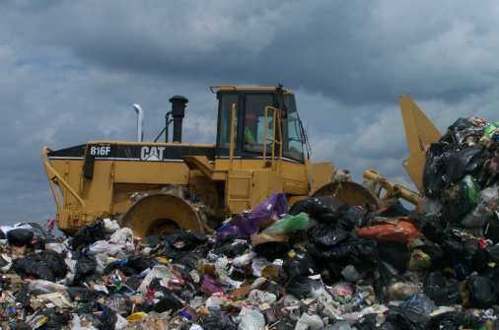
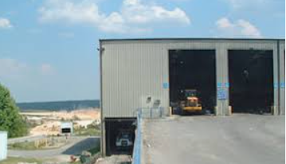
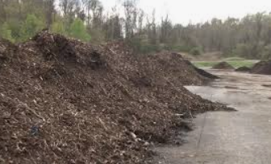
Commercial Solid Waste Facility Siting Plan
-Content of Plan-
Solid Waste Facility Zones
Class A facilities (over 10,000 tons per month)
Class B and C facilities (under 10,000 tons per month)
Class D facilities (construction/demolition only)
Solid waste transfer stations
Recycling facilities
Energy recovery facilities, and environmentally acceptable incinerators
Materials recovery facilities
Composting facilities
Description of purposes and objectives to be met by the next plan within a twenty (20) year period
The provisions of the Comprehensive plan regarding collection and disposal of solid waste and the requirements, if any, for additional facility capacity.
Definition of Solid Waste Facility Zones
Rationale for Establishing Siting Zones

Slide 10
Commercial Solid Waste Facility Siting Plan
-Content of Plan-
Siting Zones
(readily available information)
AUTHORIZE
Consideration of ALL criteria
PROHIBIT
One or more criteria
TENTATIVELY PROHIBIT
Areas not clearly established or reviewed
Rationale for Establishing Siting Zones
(10 Criteria)
Efficient collection, transfer, and disposal
Economic Development
Transportation Infrastructure
Property Values
Groundwater and surface waters
Geological and Hydrological Conditions
Aesthetic and Environmental Quality
Historical and Cultural Resources
Existing & Potential Land Uses
The Public Health, Welfare, and Convenience
  (Additional restrictions found in 54CSR4…)

Slide 11
Commercial Solid Waste Facility Siting Plan
Applications for Requesting Redesignation of Zones
Proposal of New SWFs
SWA receives copy of pre-siting notice filed with DEP
Review of current Siting Plan. Proposed site not in an “Authorized” Zone?
Application to amend the Siting Plan to redesignate a zone.
Follow Siting Plan Update Procedures in 54CSR4
  Applicant must affirmatively demonstrate the required criteria
  Public input and hearing process
  Approval by WV Solid Waste Management Board before becoming effective.
The person seeking new facility needs to have applied for and obtained approval from the PSC for a Certificate of Need before…
Application for Certificate of Site Approval from the SWA
New Class A facilities: additional process outlined in §22C-4A – County Referendum

Slide 12

Plan Update Process: Public Participation
Comprehensive Plans require a minimum of 2 public hearings, Siting Plans require minimum of 1.
Public Hearing: Solicit public ideas, opinion, and comments on development of the draft plan (Comp Plan)
  Publish notice of Public hearing (Class I Legal Ad) AT LEAST 30 days in advance. Legal ad to include: date, time, location of the meeting, and locations of where a copy of existing plan may be viewed.
  Record proceedings of hearing by mechanical means.
  Record and summarize all written comments and proceedings.
Draft update of plan: consideration of public input (Comprehensive Plan) or affirmative demonstration of zone redesignation (Siting Plan) with strikes/underlines.
Provide a copy of the draft updated plan (with strikes/underlines) to SWMBplanning@wv.gov.
Public Hearing: Solicit public ideas, opinion, and comments concerning the draft plan (in each county affected)
  Place draft plan out for public review at:
    the county clerk’s office(s),
    at all public/branch libraries
    appropriate regional planning and development council
  Publish public hearing notice (Class I Legal Ad) AT LEAST 30 days in advance and by posting the public notice at appropriate county courthouse(s). Legal ad to include: date, time, location of the meeting; locations of where a copy of draft plan may be viewed; invitation for oral and written comments; date of written comment period shall be extended 10 days after hearing date; address where comments may be mailed
  Mail public notice to persons requesting to be placed on a SWA maintained mailing list.
  Prepare written summary of public comments, responses, and considerations in the development of final plan.
Prepare final plan with considerations from public input.
Notes:
Most counties have both plans due at the same time, some on different schedules. You can do use the same public hearings to do both plans.
These are minimum public hearings required. Some go ahead and include the siting plan on both public hearings as well.
5 years is a minimum- you can update them as frequently as necessary even if you want to do one of the plans early to get it on the same schedule to share public hearings.

Slide 13
Plan Update Process
Submission of Final Plan to SWMB
Approve final plan at a subsequent SWA meeting after all hearings and procedures are complete and any changes incorporated.
Submit a complete package and clean version of plan to SWMB
  (all strike/underlines/notes) removed
  Public Participation records
    Copy of Affidavit for hearing(s)
    Copy of Class 1 Legal Ad(s)
    Copy of Minutes for hearings(s)
    Summary of public comments, responses, and statement explaining how it responded to public comments in the development of the plan.
  All maps, attachments, appendices in place
  Cover page with signature of chairperson
  Signed minutes from authority meeting approving updated plan

Slide 14
Plan Update Process
SWMB Review & Approval of Final Plans
SWMB plan review administrative and technical completeness.
(Siting plans must be complete before technical review, 30-day notice to make administratively complete.)
Within ninety (90) days of deficiency notice, the authority shall revise and resubmit corrected plan.
The SWMB shall approve the final plan in writing if it complies with the purposes and requirements of applicable state and federal law, if any, and 54CRS3 and 54CSR4.
No later than sixty (60) days after approval, the authority shall submit to the board a hard copy and an electronic copy of the final plan. The authority must also transmit one copy to each of the following:
  Appropriate regional planning and development council
  County planning commission
  Office of each county clerk - who shall file and make available for public inspection

Slide 15

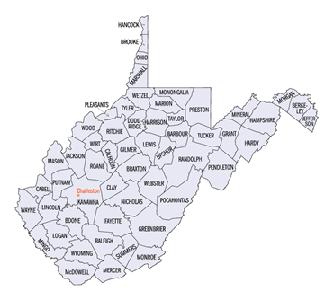
Summary
Solid waste authorities hold legislative purpose to protect public health and welfare, environment, economic growth, property values, and transportation by following the integrated waste management hierarchy.
Comprehensive and Siting Plans must be updated every five (5) years with a projected plan of twenty (20) years.
Updates and amendments require public participation and SWMB approval through the appropriate use of state and federal law and applicable rules promulgated by 54CSR3 and 54CSR4.
Siting Plans are the first step to site approval and permitting.
Sustainable and forward looking planning includes a combination of assessment, collaboration, and enforcement in order to meet disposal and waste reduction needs.

Slide 16
Thank you!
Please reach out if you have any questions!
SWMBplanning@wv.gov
Niki Davis
Niki.N.Davis@wv.gov
304-414-1124
Isaiah McCoy
Isaiah.S.McCoy@wv.gov
304-414-1121

