Slide 1
Bionic Tire Recycling: Innovative Solutions for Sustainable Waste Management
Advancing eco-friendly methods to manage tire waste
Notes:
---
This presentation explores the cutting-edge field of bionic tire recycling, focusing on innovative solutions to address the growing challenge of tire waste and promote sustainable waste management practices.

Slide 2
Meeting Program
Understanding the Challenge of Tire Waste
Introduction to Bionic Tire Recycling Technology
Process and Mechanisms of Bionic Tire Recycling
Environmental and Economic Benefits
Future Prospects and Industry Adoption
Notes:
We will begin by examining the global tire waste problem and the environmental impacts of traditional disposal methods. Next, we will introduce the concept of bionic tire recycling technology, followed by an overview of the process and mechanisms involved. Then, we will discuss the environmental and economic benefits, and conclude with future prospects and industry adoption challenges.

Slide 3
Understanding the Challenge of Tire Waste
Notes:
Tire waste is a significant environmental concern worldwide, requiring innovative approaches for effective management. This section outlines the scope of the problem, environmental consequences, and the urgent need for advanced recycling methods.

Slide 4
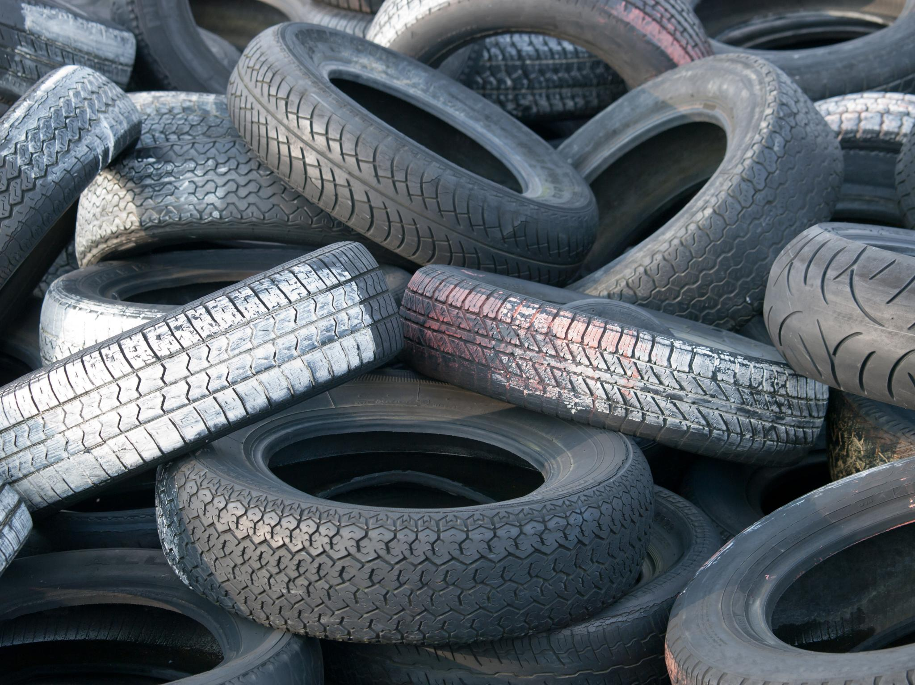
Overview of Global Tire Waste Problem
Tire Waste Volume
  Millions of tires are discarded globally every year, contributing to significant waste accumulation.
Disposal Challenges
  Tires are highly durable, making disposal and recycling difficult and persistent worldwide.
Environmental Impact
  Accumulating tire waste causes environmental hazards in landfills and illegal dumping sites.
Notes:
---
Millions of tires are discarded annually around the world, leading to mounting waste in landfills and illegal dumps. The durability of tires makes their disposal complex and persistent, posing a growing global challenge.
Image source: Microsoft 365 content library

Slide 5
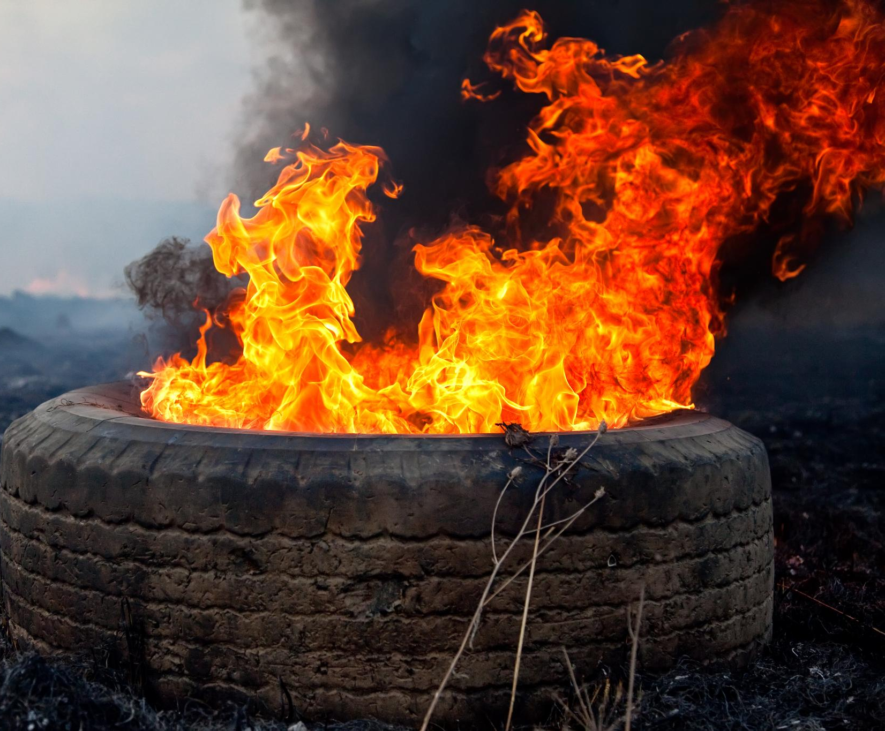
Environmental Impacts of Traditional Disposal
Soil and Water Pollution
  Landfilling tires leads to toxic substances leaching into soil and water, harming ecosystems and human health.
Air Pollution from Burning
  Burning tires releases harmful chemicals and particulate matter, contributing to air pollution and respiratory problems.
Environmental and Health Risks
  Traditional disposal methods increase environmental degradation and pose significant public health risks globally.
Notes:
---
Traditional tire disposal methods, such as landfilling and burning, contribute to soil and water pollution, release toxic chemicals, and increase air pollution. These practices exacerbate environmental degradation and public health risks.
Image source: Microsoft 365 content library

Slide 6
Need for Advanced Tire Recycling Methods
Limitations of Conventional Disposal
Traditional tire disposal methods cause significant environmental harm and waste valuable materials.
Innovative Recycling Technologies
New recycling techniques enable efficient material recovery and reduce ecological impact.
Supporting Circular Economy
Advanced tire recycling promotes sustainability by reintegrating materials into production cycles.
Notes:
---
Given the limitations of conventional disposal, there is a critical need for innovative recycling technologies that efficiently recover materials, reduce environmental harm, and support circular economy principles.
Image source: Microsoft 365 content library

Slide 7
Introduction to Bionic Tire Recycling Technology
Notes:
Bionic tire recycling leverages biological processes and advanced engineering to transform tire waste sustainably. This section introduces the concept, compares it with traditional methods, and highlights key technological innovations.

Slide 8
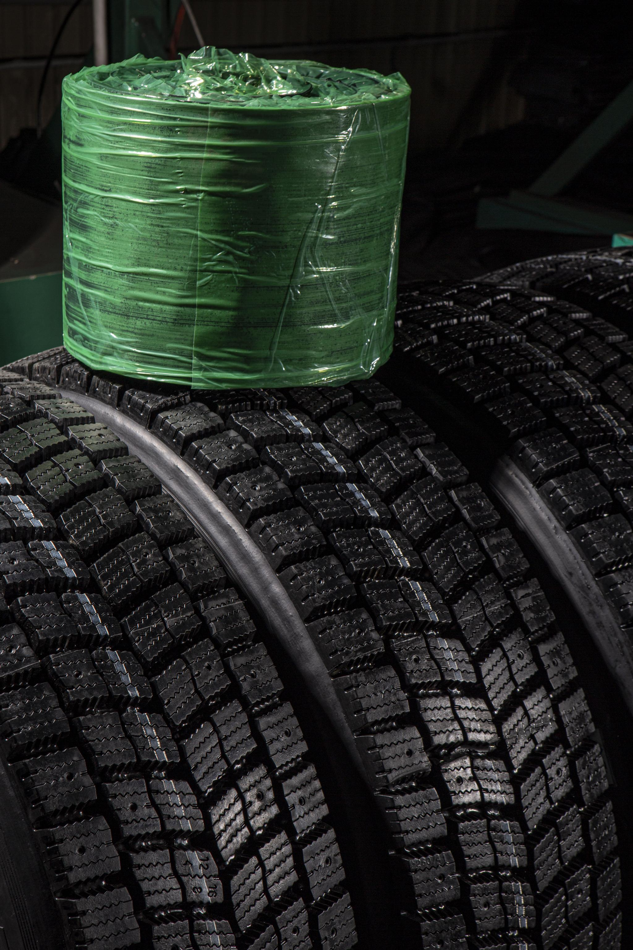
Definition and Concept of Bionic Recycling
Bionic Recycling Overview
  Bionic recycling combines mechanics and technology to enhance tire waste breakdown methods efficiently and sustainably.
  Grinding tires, removing steel, and recycling other components that are not rubber material enhance our ability to keep materials out of the waste stream.
  Mechanical processes and groundbreaking procedures being developed and patented here at Bionic make us the global leader in recycling efficiency and innovation.
Notes:
---
Bionic recycling integrates biological agents or biomimetic processes with mechanical and chemical techniques to break down tire components more effectively and environmentally friendly.
Image source: Microsoft 365 content library

Slide 9
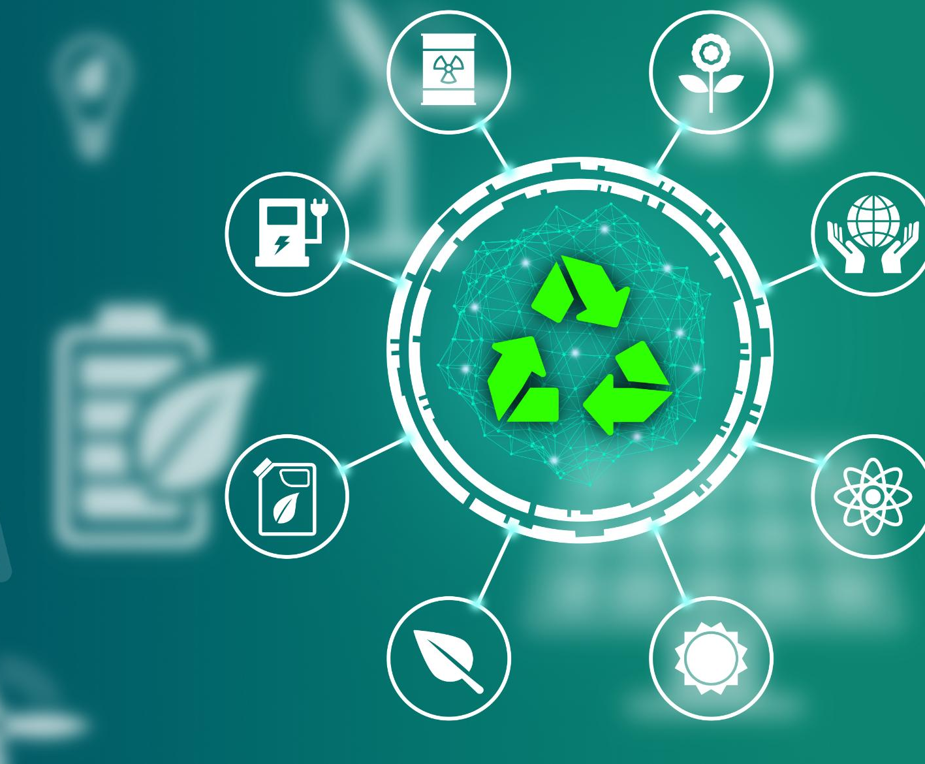
Comparison with Conventional Recycling Methods
Efficiency Advantages
  Bionic recycling significantly improves efficiency compared to conventional pyrolysis and mechanical shredding methods.
Lower Environmental Emissions
  Bionic recycling reduces harmful emissions, offering a cleaner alternative to traditional tire recycling techniques.
Enhanced Material Recovery
  This method achieves greater material recovery, maximizing resource reuse from tire waste.
Notes:
---
Unlike conventional methods such as pyrolysis or mechanical shredding, bionic recycling offers improved efficiency, lower emissions, and greater material recovery, making it a promising advancement in tire waste management.
Image source: Microsoft 365 content library

Slide 10
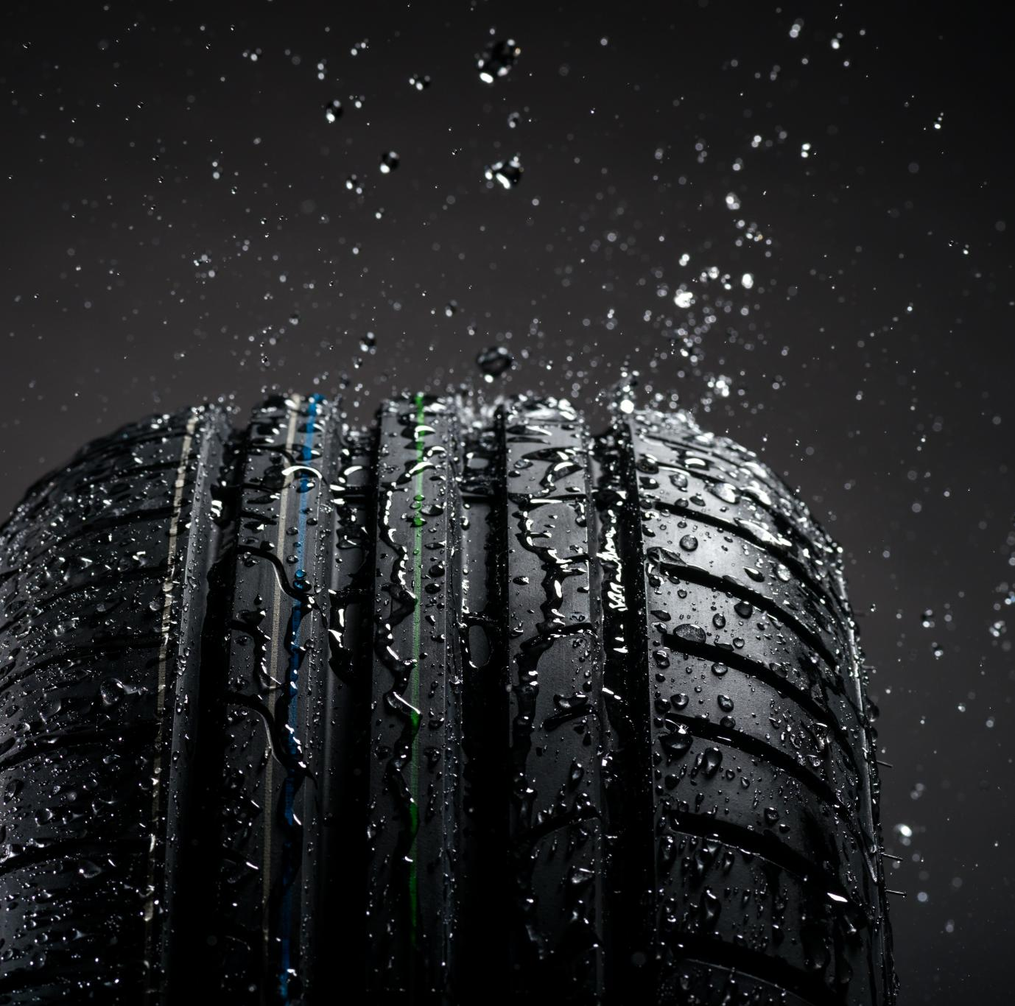
Key Technological Advancements
Engineered Microbial Degradation
  Use of engineered microbes accelerates the natural breakdown of tire materials efficiently and sustainably.
Enzymatic Treatments
  Enzymes specifically target tire polymers to speed degradation while reducing harmful environmental effects.
Biomimetic Catalysts
  Catalysts inspired by natural processes enhance tire material degradation with minimal ecological disruption.
Notes:
---
Innovations include engineered microbial degradation, enzymatic treatments, and biomimetic catalysts that accelerate tire material breakdown while minimizing environmental impact.
Image source: Microsoft 365 content library

Slide 11
Process and Mechanisms of Bionic Tire Recycling
Notes:
This section covers the materials involved, detailed recycling steps, and the valuable end-products generated through bionic tire recycling processes.

Slide 12

Materials and Components Involved
Tire Material Composition
  Tires are made from a combination of rubber polymers, steel reinforcements, and textile fibers for strength and durability.
Bionic Recycling Process
  Bionic recycling selectively targets tire components to separate and convert them into reusable materials efficiently.
Notes:
---
Tires comprise rubber polymers, steel, and textile fibers. Bionic recycling targets these components selectively to enable efficient separation and conversion into reusable materials.
Image source: Microsoft 365 content library

Slide 13

Breakdown of Recycling Steps
Pre-Treatment Stage
  Initial processing prepares materials for effective recycling by removing contaminants and sorting components.
Component Separation
  Separated components allow for targeted recycling and improved material recovery efficiency.
Purification and Recovery
  Purification processes ensure recovered materials meet quality standards with minimal waste production.
Notes:
---
The process typically involves pre-treatment, biological or biomimetic degradation, separation of components, and purification, resulting in material recovery with minimal waste.
Image source: Microsoft 365 content library

Slide 14
End-Products and Their Applications
Reclaimed Rubber Usage
Reclaimed rubber is recycled to produce new tires and other durable products, reducing waste and conserving resources.
Steel Repurposing
Recovered steel is reused in construction and industrial products, promoting sustainability and resource efficiency.
Fiber Recycling Applications
Recycled fibers are utilized in manufacturing various products, supporting circular economy principles and reducing environmental impact.
Notes:
---
Recovered materials such as reclaimed rubber, steel, and fibers can be repurposed in manufacturing new tires, construction materials, and industrial products, supporting a circular economy.
Image source: Microsoft 365 content library

Slide 15
Environmental and Economic Benefits
Notes:
Bionic tire recycling offers significant advantages in reducing pollution, conserving energy, and creating economic value, contributing to sustainable waste management strategies.

Slide 16
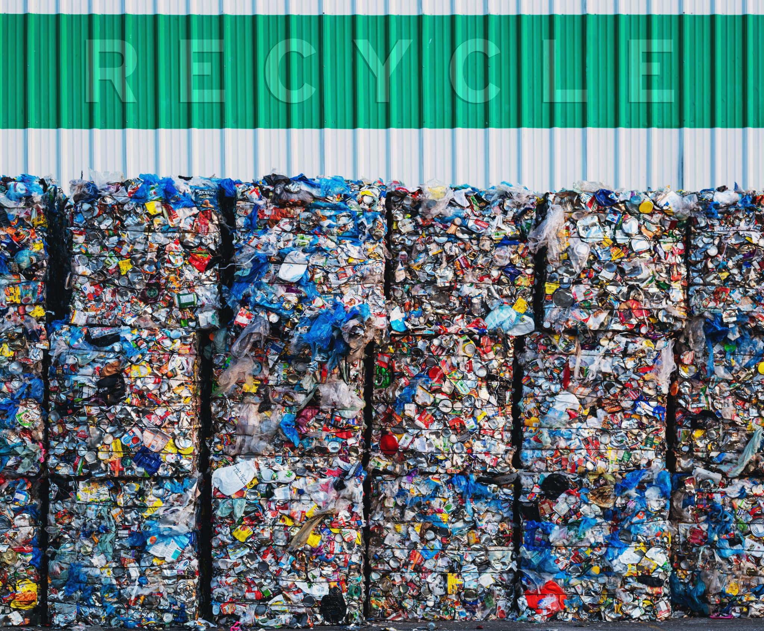
Reduction in Landfill and Pollution
Tire Waste Diversion
  Bionic recycling diverts tires from landfills, reducing the volume of waste and environmental contamination.
Toxic Emission Reduction
  The process reduces toxic emissions, minimizing pollution and protecting ecosystems from harmful pollutants. We do not participate in waste to energy lanes. We do participate in singular waste to manufacturing.
Ecosystem Protection
  By mitigating environmental hazards, Bionic Tire Recycling helps preserve natural habitats and supports biodiversity.
Notes:
---
By diverting tires from landfills and reducing toxic emissions, bionic recycling mitigates environmental hazards and protects ecosystems.
Image source: Microsoft 365 content library

Slide 17
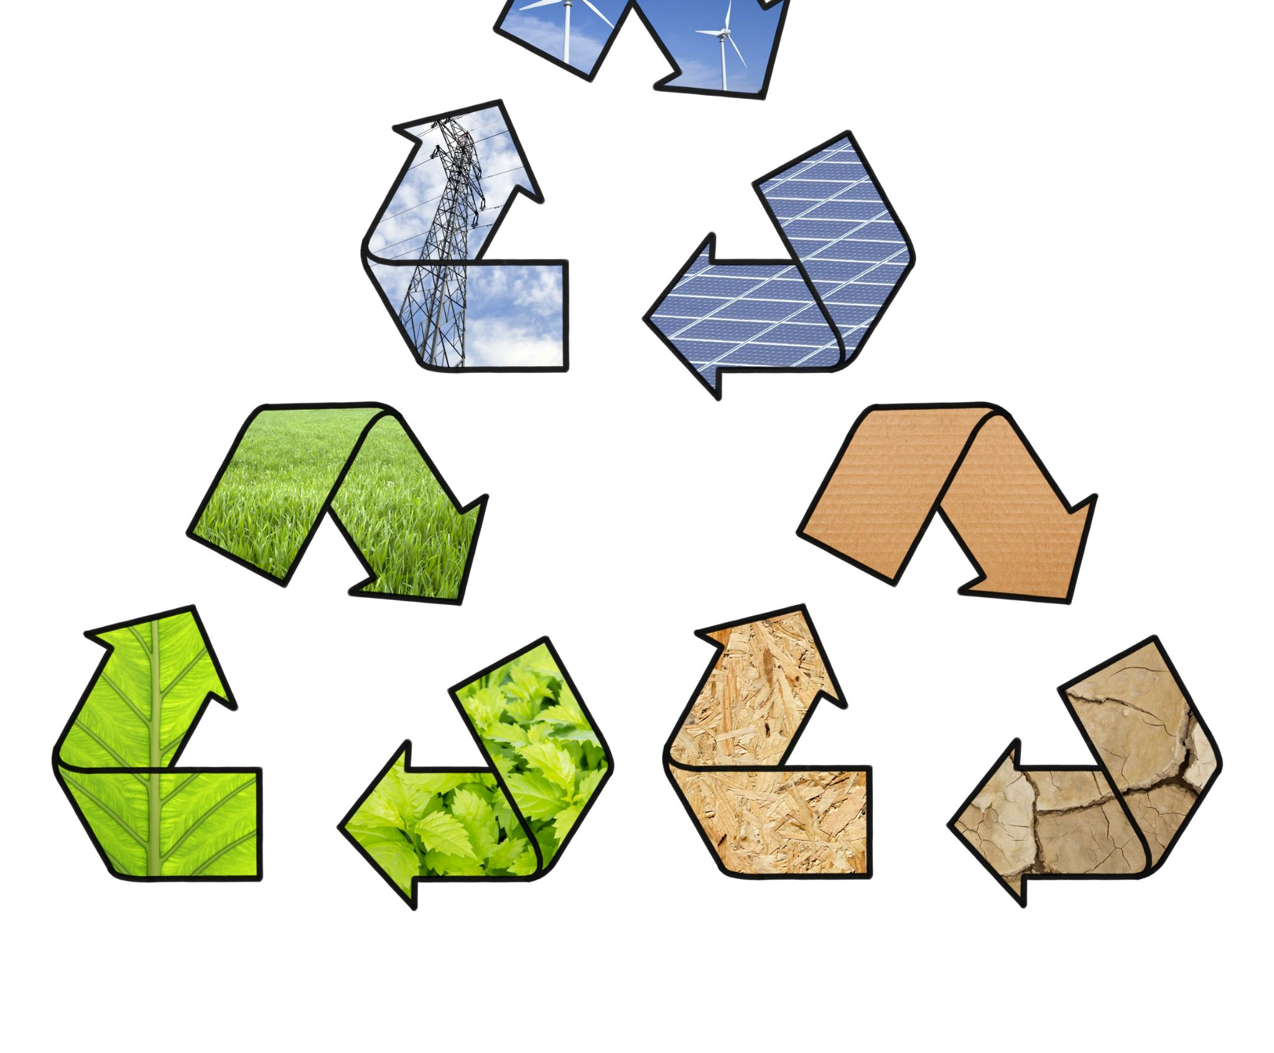
Energy Efficiency and Resource Conservation
Lower Energy Consumption
  This method uses significantly less energy than traditional recycling processes, promoting sustainability.
Resource Recovery
  Valuable materials are recovered efficiently, reducing reliance on extracting new raw materials.
Reduced Virgin Material Use
  By recycling effectively, the need for virgin materials is minimized, protecting natural reserves.
Notes:
---
This method consumes less energy compared to conventional recycling and recovers valuable resources, minimizing the need for virgin materials.
Image source: Microsoft 365 content library

Slide 18

Market Potential and Economic Impact
Sustainable Market Demand
  Increasing demand for sustainable materials drives expansion in recycling markets worldwide.
Regulatory Support
  Government policies and regulations encourage growth and adoption of recycling initiatives.
Economic Growth and Jobs
  The recycling sector fosters job creation and contributes significantly to economic development.
Notes:
---
The growing demand for sustainable materials and regulatory support creates promising market opportunities, fostering job creation and economic growth in the recycling sector.
Image source: Microsoft 365 content library

Slide 19
Future Prospects and Industry Adoption
Notes:
Looking forward, bionic tire recycling holds considerable promise for scalability and innovation, despite challenges in widespread implementation. This section explores the outlook and emerging trends.

Slide 20

Expansion Opportunities and Scalability
Biotechnology Advancements
  Innovations in biotechnology enable efficient breakdown and recycling of tire waste using biological processes.
Process Engineering Improvements
  Process engineering developments support scaling of recycling from lab to industrial scale for global impact.
Global Tire Waste Management
  Scaling Bionic Tire Recycling improves global tire waste management, reducing environmental pollution significantly.
Notes:
---
Advancements in biotechnology and process engineering pave the way for scaling up bionic recycling to industrial levels, enhancing global tire waste management.
Image source: Microsoft 365 content library

Slide 21
Challenges in Large-Scale Implementation
Technological Complexity
Complex technology presents challenges in deployment and integration at large scales.
Initial Investment Costs
High upfront costs create financial barriers for large-scale implementation.
Regulatory Frameworks and Awareness
Effective regulations and public awareness are essential to support adoption.
Notes:
---
Barriers include technological complexity, initial investment costs, and the need for regulatory frameworks and public awareness to support adoption.
Image source: Microsoft 365 content library

Slide 22

Emerging Trends and Research Directions
Microbial Strain Optimization
  Research aims to enhance microbial strains to boost productivity and efficiency in biotechnological applications.
AI Integration in Process Control
  Artificial intelligence is integrated to improve precision and automation in process control systems.
Hybrid Method Development
  Hybrid approaches combine multiple technologies to enhance efficiency and reduce costs in production.
Notes:
---
Ongoing research focuses on optimizing microbial strains, integrating AI for process control, and developing hybrid methods to improve efficiency and cost-effectiveness.
Image source: Microsoft 365 content library

Slide 23
Conclusion
Innovative Recycling Approach
Bionic Tire Recycling offers a sustainable and innovative solution to tire waste management.
Environmental Benefits
This method reduces environmental pollution and conserves natural resources effectively.
Importance of Collaboration
Ongoing research and industry partnerships are essential to maximize recycling benefits.
Notes:
Bionic Tire Recycling represents an innovative and sustainable approach to managing tire waste, offering environmental and economic benefits. Continued research and industry collaboration are key to realizing its full potential in global waste management.

