Slide 1

Leading the Way
Presentation by:
Carolyn Muller
SWANA
Vice President, Industry Relations
SWWB Conference
April 2026

Slide 2
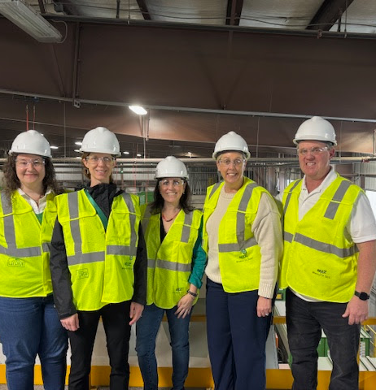
SWANA's Members
Represent
Landfills
Transfer Station
Recycling
Waste to Energy
Landfill Gas
Resource Recovery
Energy Recovery
Collections
Disaster and Debris Management
Hazardous Waste
Organics

Slide 3





2026 Corporate Partners

Slide 4


Forward,
Together:
Prioritizing
Safety.
Promoting
professional
development
opportunities.
Championing
progress on
sustainability.
Key
Strategic
Pillars
Delivering
exceptional
value to
members.

Slide 5
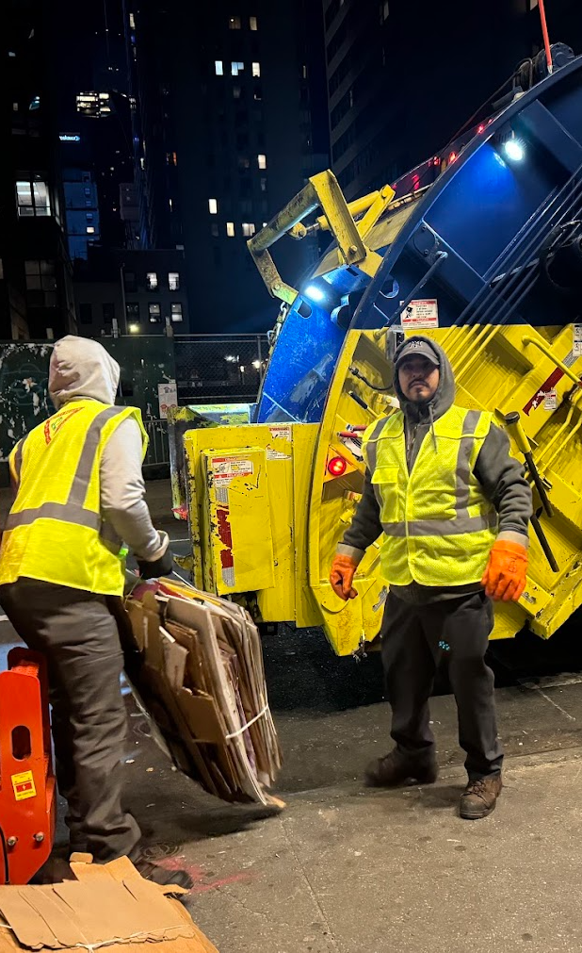
Priority Issue: Safety
Legislation and Regulations
  State-level advocacy in coordination with
  SWANA chapters. Maryland, Nebraska, and Iowa
  battery EPR.
  Occupational Safety and Health
  Administration (OSHA) Heat Injury and Illness
  Prevention in Outdoor and Indoor Work Settings.
  OSHA Emergency Response Standards.

Slide 6
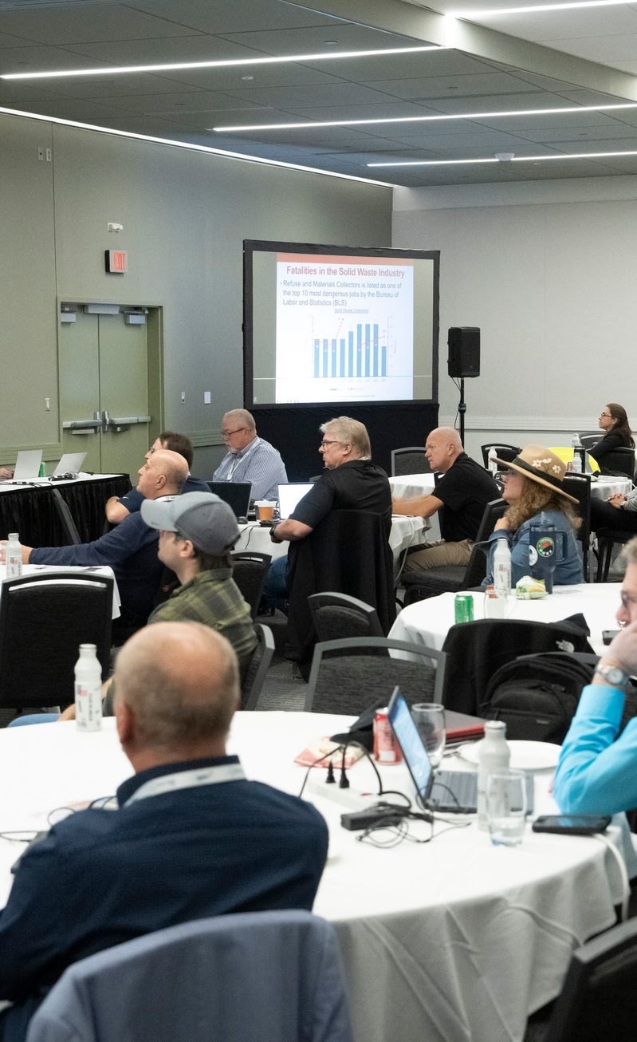
Priority Issue: Safety Committee
Safety Committee
  Reinvigorated SWANA Safety Committee with
  broader geographic and role representation.
  Conduct regular meetings to advance safety
  initiatives.
  Joint meetings with National Waste and Recycling
  Association.

Slide 7
Future Initiatives: Safety
Incorporate safety best practices
into trainings.
Create a new SWANA training on
heat safety.
Provide resources for leadership.
Develop a safety program that
can be implemented at Regional
Events.
Research safety best practices in
different sectors of the industry.
Identify sponsorships to support
safety efforts.
Partner with like-minded
organizations.
Resources to promote volunteer-
driven safety initiatives on the
chapter and regional level.
Update Technical Policies with a
focus on batteries and safety.

Slide 8

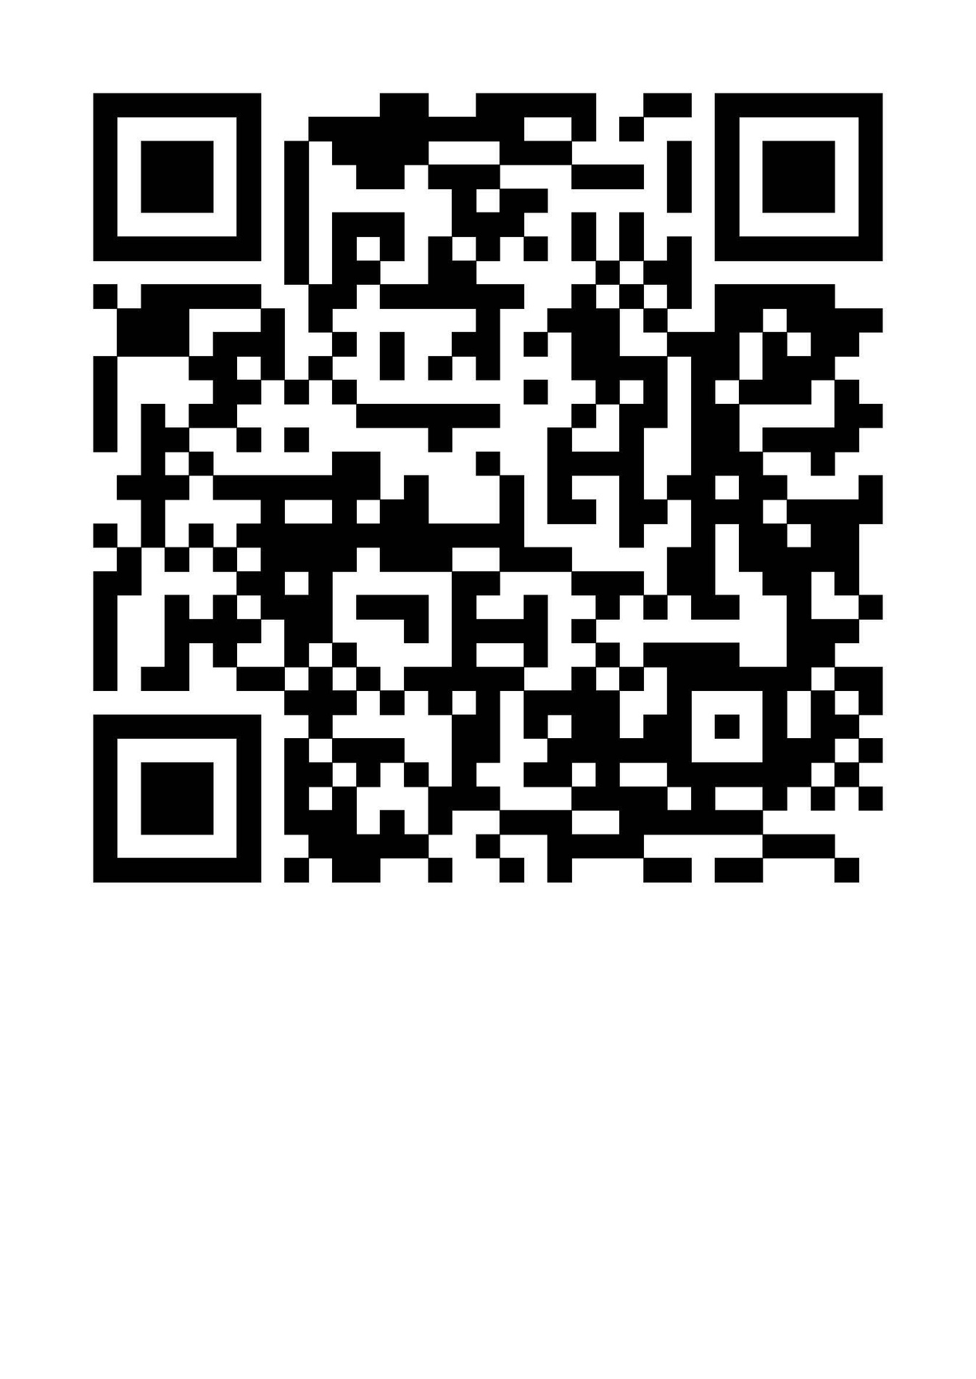
New Safety Publication
Complimentary for SWANA members

Slide 9


Slide 10
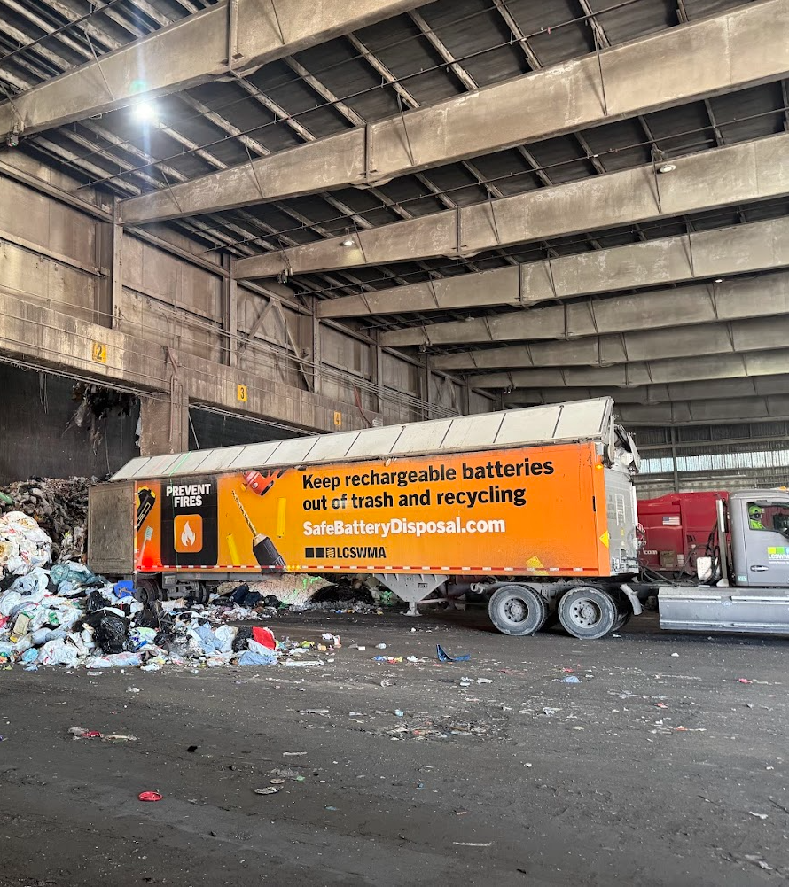
Battery Safety and
Our Members
SWANA Lithium-Ion Battery
Workgroup
3 Sub-Workgroups
Advocacy and Public Policy
Vehicle and Facility Safety
Communications and
Outreach

Slide 11
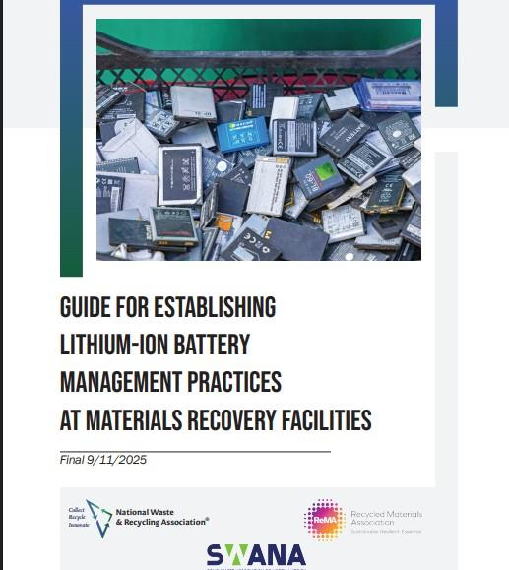
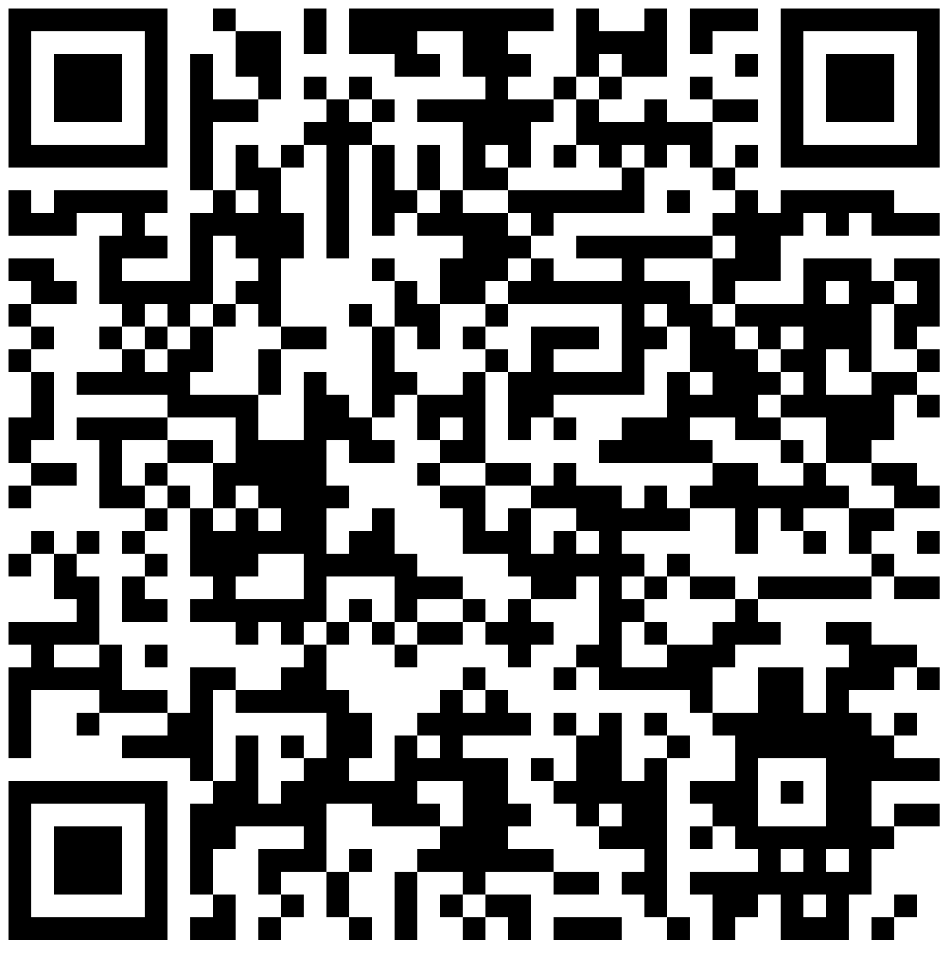
SWANA Safety Resources
Guide to Developing Lithium
Battery Management
Practices at MRFs developed
with SWANA, NWRA and
ReMA

Slide 12
Product Safety: Product Safety Statement
The SWANA SMM Technical Division Advocacy Committee recommended that
SWANA create a statement to address the issue of items that explode and catch
fire, including batteries, compressed gas cylinders, marine flares, fireworks, and
more.
SWANA issued a statement calling for Coordination on Product Safety and
Responsible End of Life Management for dangerous products.
"SWANA calls on producers and policy makers to join us and prioritize safety and
responsible end-of-life (EOL) management in the design, labeling, and marketing
of hazardous products to protect the safety of our workers and the long-term
viability of our waste and recycling infrastructure."

Slide 13

14 Organizations Signed the Product Safety Op-Ed

Slide 14

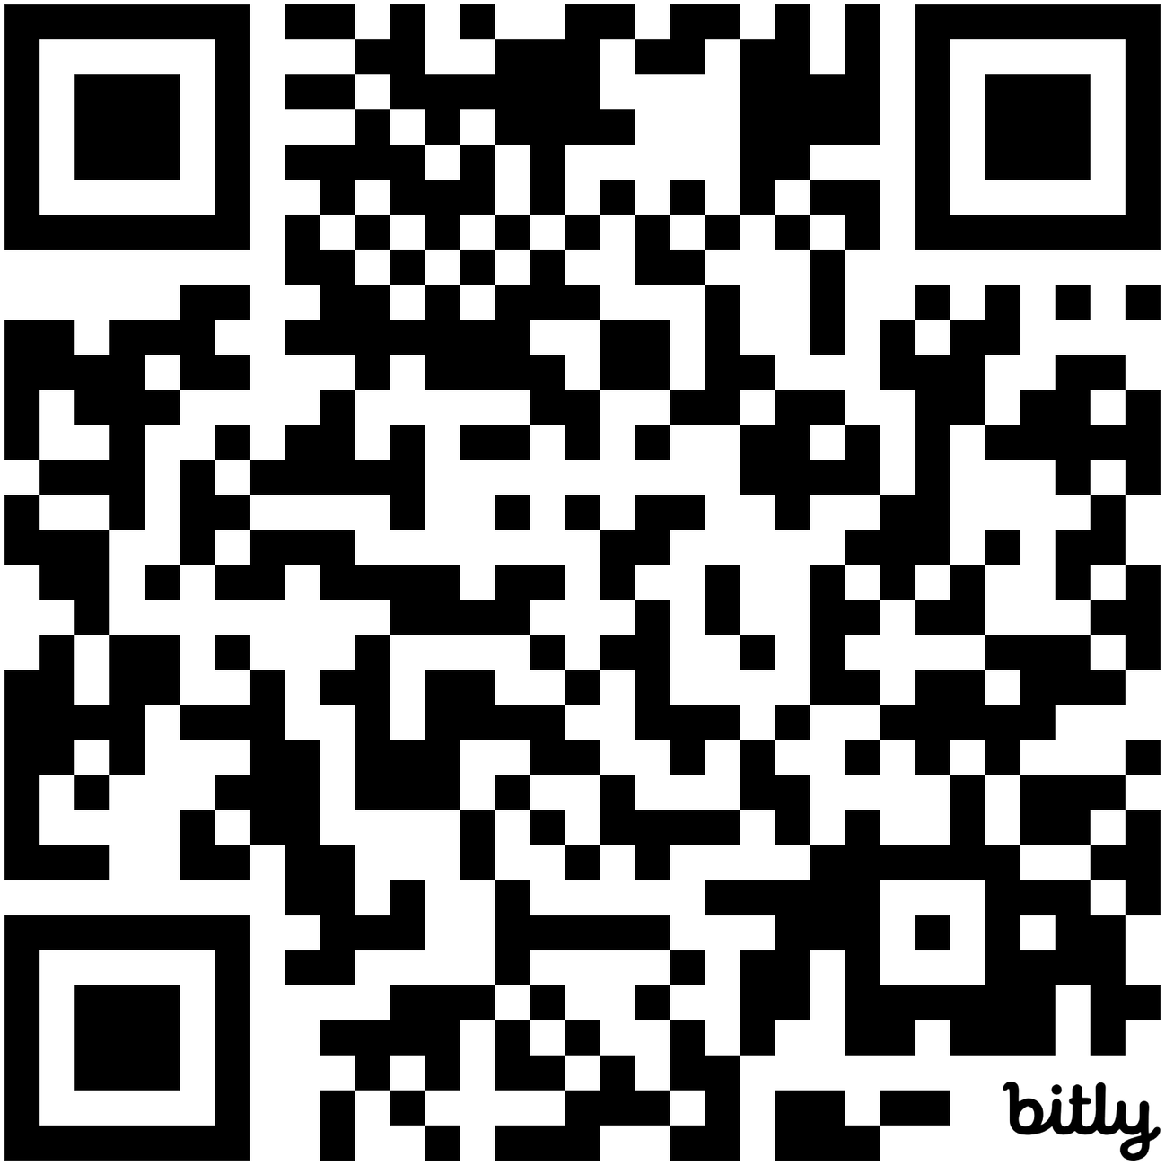

Fire Safety Webpage
Fire Safety Resources, Anonymous Fire Reporting, Battery Dropoff Locations

Slide 15
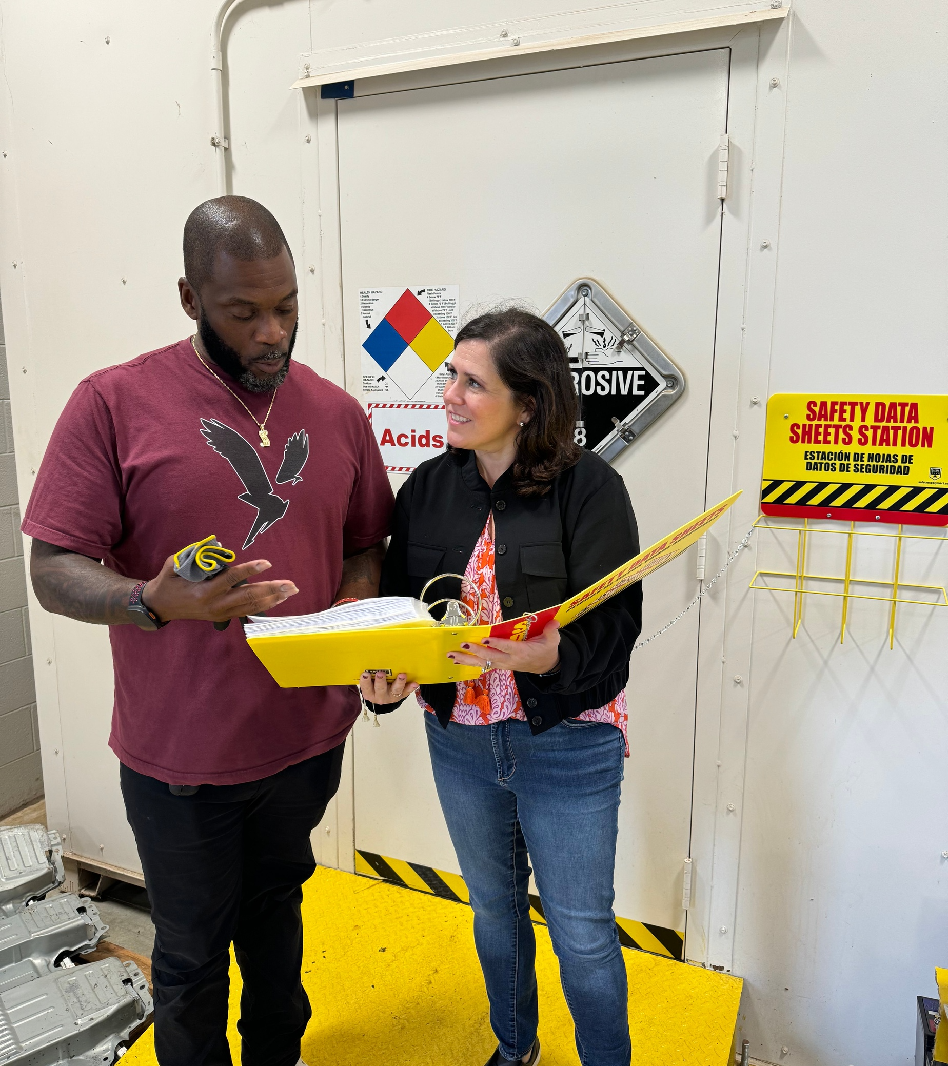
SWANA Supports
Members to Lead
on Worker Safety
Essential training and best
practices.
Championing “Move Over” laws.
Setting the highest standard.
Holding ourselves accountable.
Leveraging technology to
advance.

Slide 16
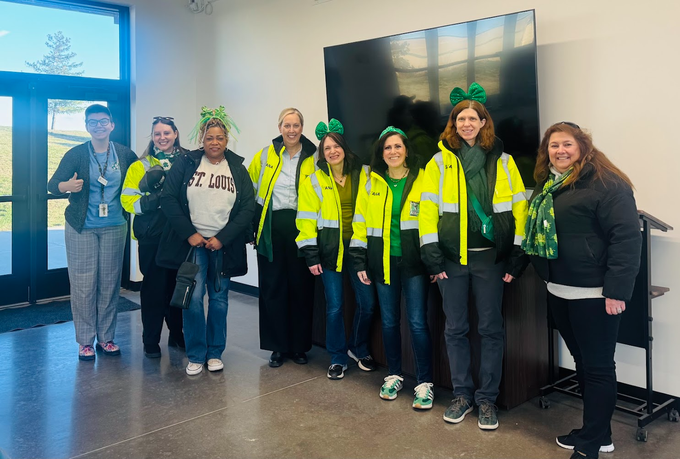

47
10K
CHAPTERS
MEMBERS
Members in
28
COUNTRIES

Slide 17
Your Member Experience
Focus on the mission of
advancing waste to resource
management.
New The Resource newsletter
distributed weekly.
Greater Customer Service.
Revamp Technical Division
benefits and offerings.
Continually refresh RCon.
Increase partnerships, leading
to collaboration opportunities
for SWANA members.
Launch SWANA volunteer
opportunity website and
ramped up volunteer
recruitment efforts.
Revamp SWANA website.
Increase communications
with chapter leaders.

Slide 18
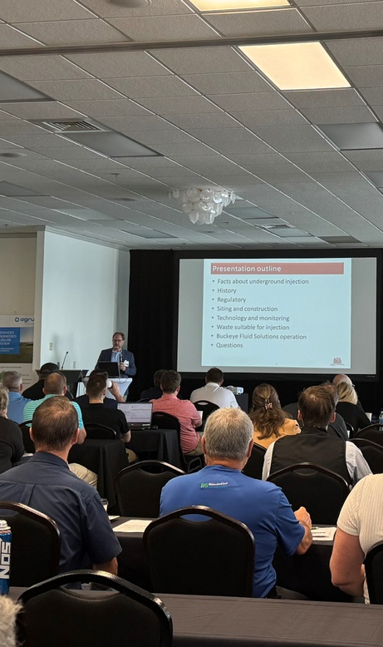
Collection Systems
HHW & CESQG Collection
Operations
Composting Programs
Integrated Solid Waste
Management Systems
Landfill Operations
Recycling Systems
Transfer Station Systems
Zero Waste Principles &
Practices
Training and
Certification

Slide 19
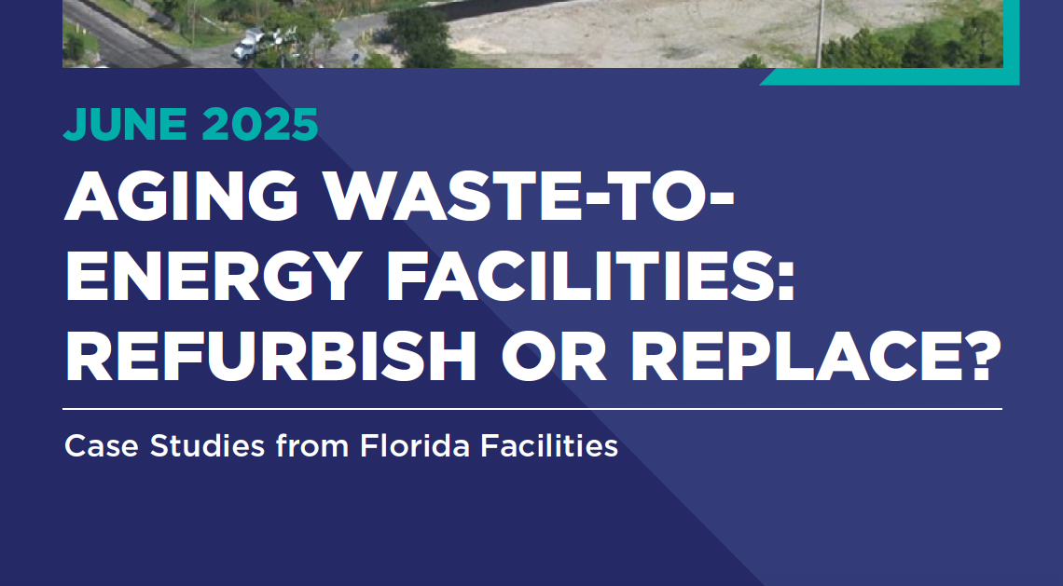

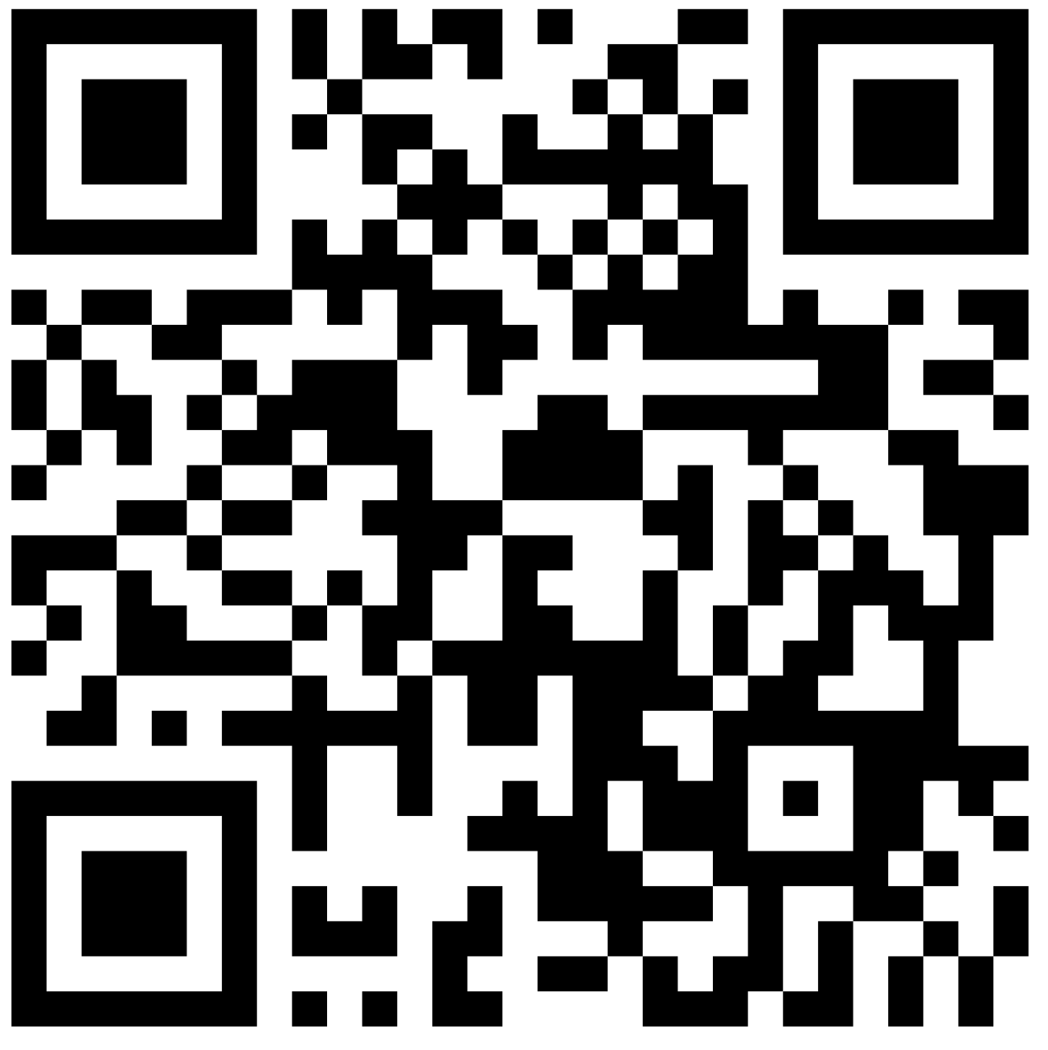

67 reports
complimentary for
SWANA Members
Members of the Applied
Research Foundation select
the topic, contribute to the
review, and receive exclusive
access report's findings.

Slide 20
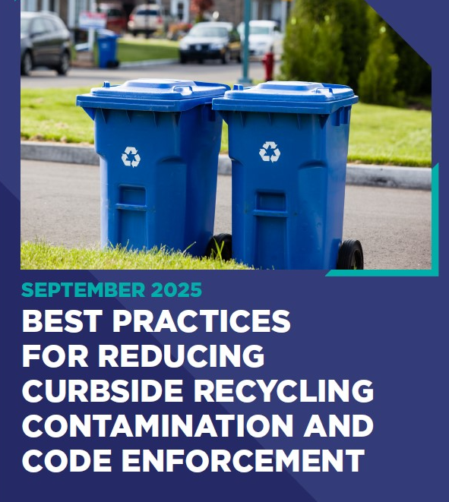
Applied Research
Foundation Report
September 2025
Complimentary for SWANA Members
Upcoming Reports Include:
Horizontal Landfill Gas Collection
System Installations: Best Practices
Molecular Recycling Options for
Plastics and Wood Waste

Slide 21
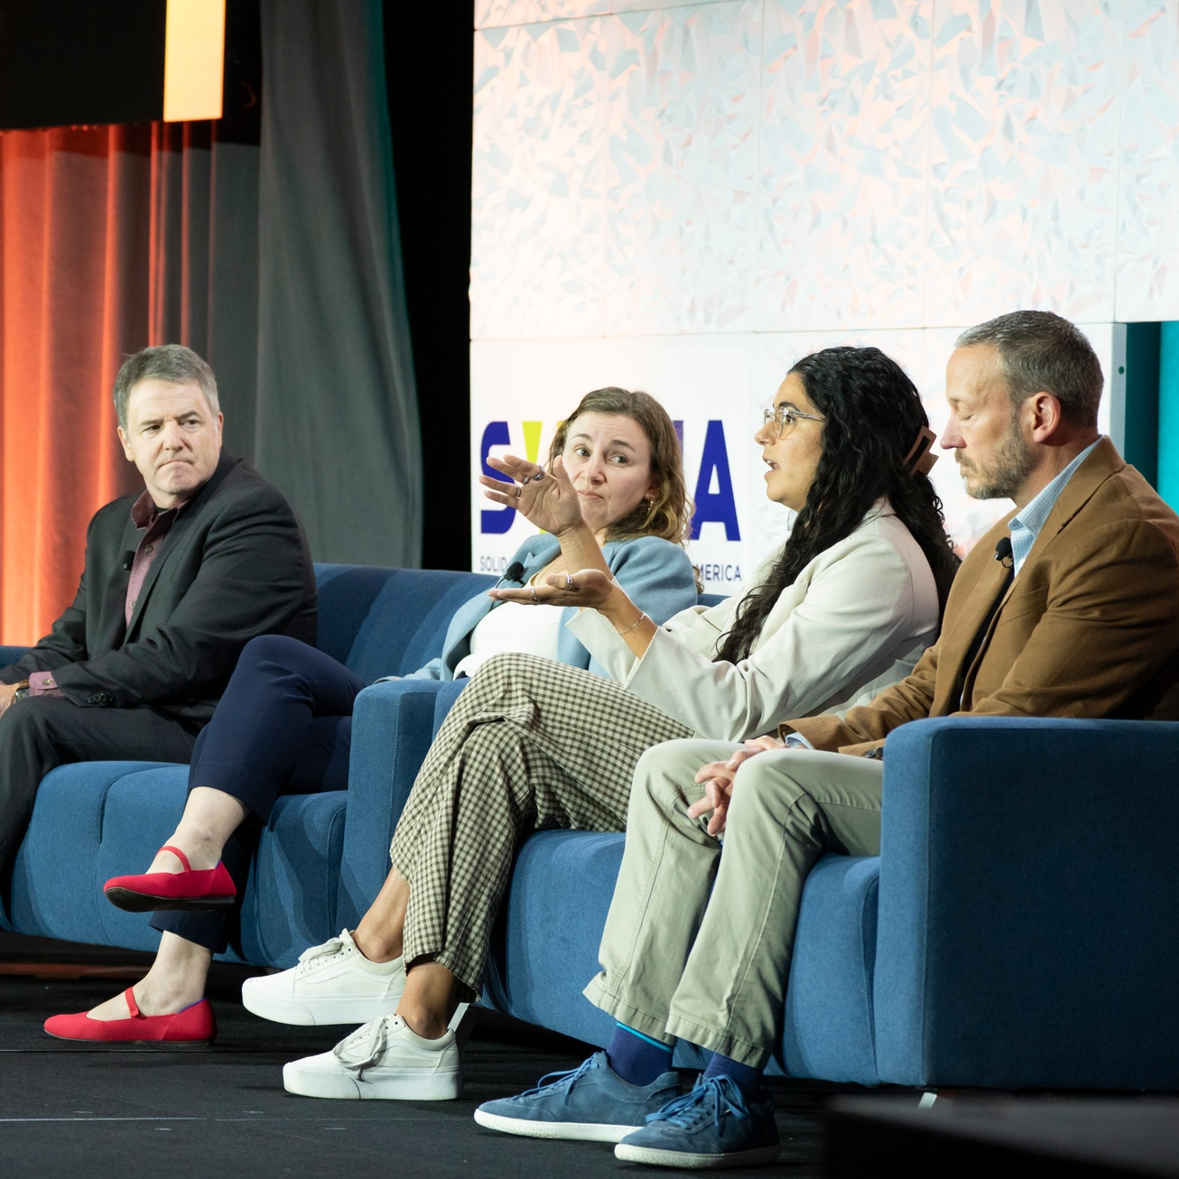
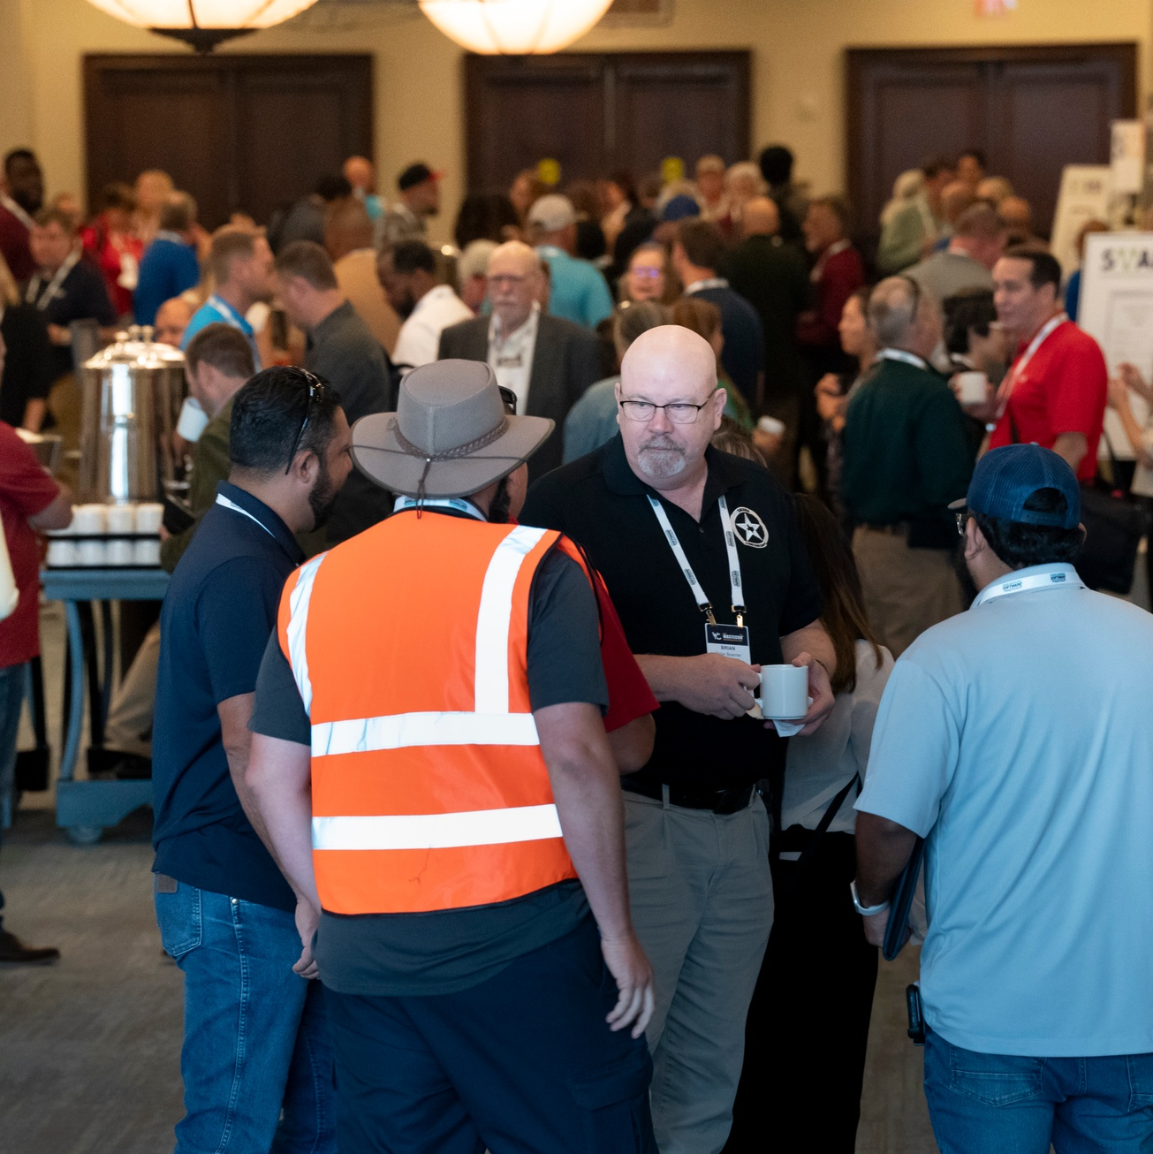
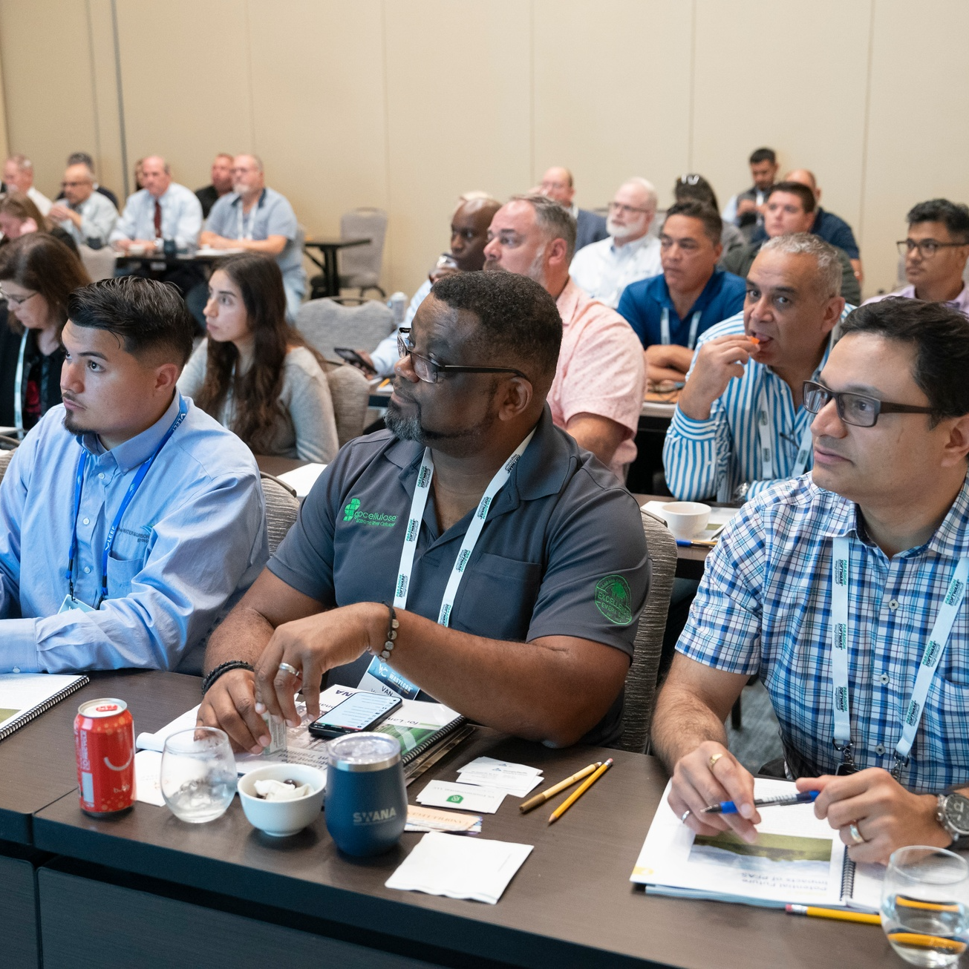
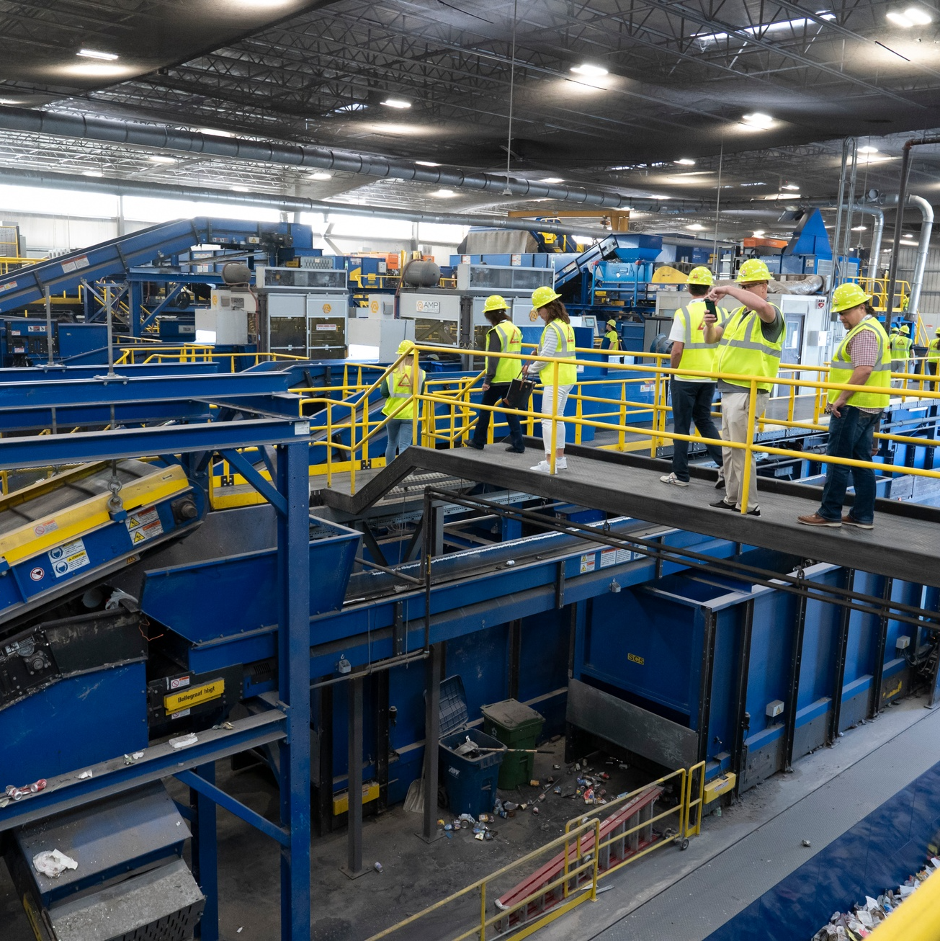
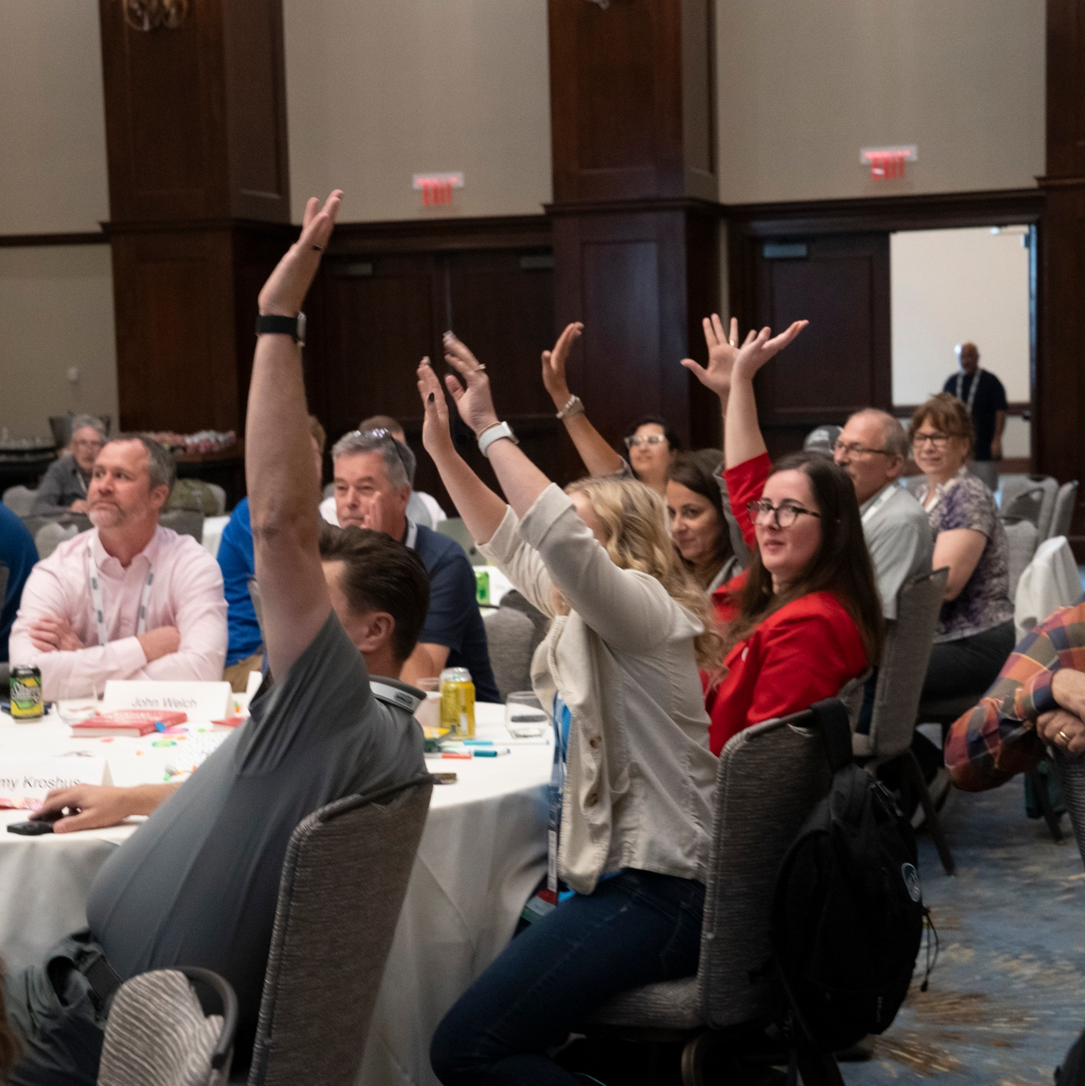
Build Your Own RCon Adventure in St. Louis
Achieve your professional goals by selecting relevant sessions and tours.
Educational Opportunities
200+ Exhibitors
PDH hours for RCon sessions
More PDHs with Trainings and/or Tours
Experiential Learning Tours
1,500+ Waste & Resource
Management Professionals

Slide 22

Recent and Upcoming Webinars
April 14, 2026 - YP Webinar Series: Young, Capable, and
Ready Fireplace Chat
May 14, 2026 - Highlights of RCon 2025: Landfill Gas
101
May 20, 2026 - Highlights of RCon 2025: WTE in
Anchorage
May 27, 2026 - Highlights of RCon 2025: Take Charge:
Watt to Do with Batteries
June 9, 2026 - YP Webinar Series: Drones and Airspace
Analysis in the Solid Waste Industry
September 9, 2026 - YP Webinar Series: From Tension to
Trust: Facilitation Tips and Conflict Resolution Tools

Slide 23

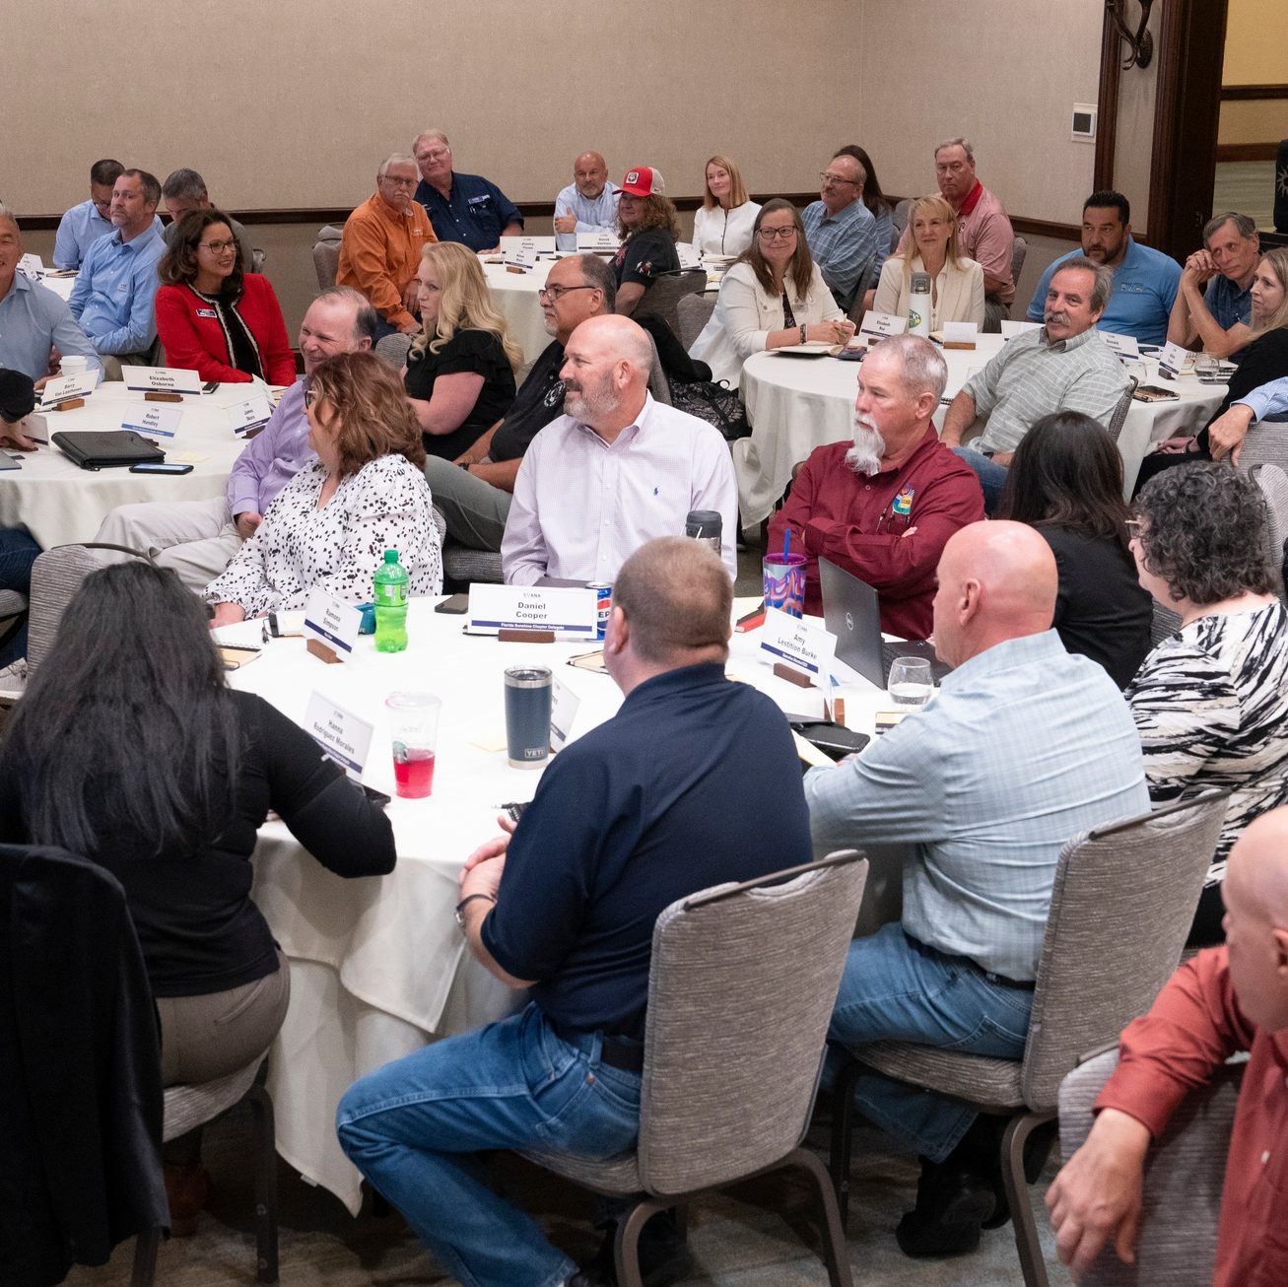
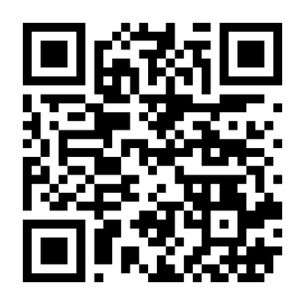
SWANA Chapter Events
Check out the SWANA Chapter Events page to
know what's coming up
Contact us if you have a Chapter event you
would like to add to the calendar

Slide 24
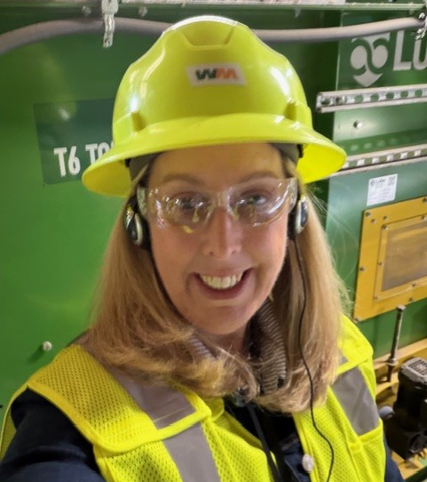
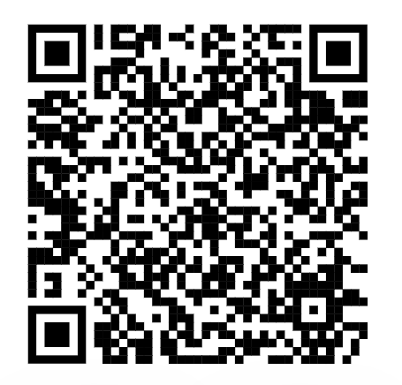
Can't wait to
hear from you.
Carolyn Muller
Vice President, Industey Engagement
SWANA
cmuller@swana.org
240-494-2244
www.swana.org
https://www.linkedin.com/in/carolynfmuller/

